Slide 1
Mental Capacity and Deprivation of Liberty: the Law Commission report and the draft Mental Capacity (Amendment) Bill 2017
March 2017
Alex Ruck Keene
Barrister, 39 Essex Chambers
Honorary Research Lecturer at the University of Manchester
Wellcome Trust Research Fellow, King’s College London
alex.ruckkeene@39essex.com

Slide 2
Caveat
These slides and commentary thereupon represent my personal view, not that of the Law Commission to which I am a consultant on the MCD project

Slide 3
Background
Originated from a proposal from Mind for a review of the relationship between the DoLS and the Mental Health Act; ultimately reference from DH to consider DoLS in its entirety
Summer 2014 – July 2015 pre-consultation and drafting of consultation paper
Public consultation on provisional proposals July-November 2015 – consultation events and 583 written responses: one of highest response rates
Interim report out – unusually – May 2016
Final report and draft Bill published March 2017

Slide 4
The solution: the Mental Capacity (Amendment) Bill : overview
“Mental Capacity Act 1.5”
Reforms to section 4
Limitations to the section 5 defence
A revised approach to section 4B
Regulation-making power for supported decision-making schemes
The Liberty Protection Safeguards
Setting neutral
From age 16
Authorisation by responsible body – NHS for CCG/hospitals, LA for all other cases (including self-funders)
Additional scrutiny by AMCP in ‘objection’ cases

Slide 5
MCA 1.5: Section 4
Section 4 amendments:
Change from passive duty to consider wishes and feelings where ascertainable to active duty to ascertain wishes, feelings, beliefs and values
Duty to give particular weight to any wishes or feelings ascertained in making determination of best interests
Applies to all actions/decisions falling within the scope of s.1(5) MCA

Slide 6
MCA 1.5: Limitations to Section 5
Sections 6A-C: limit scope of section 5 defence in relation to serious interferences with autonomy of individual:
a public body moving the person to long-term accommodation;
restricting the person’s contact with others;
the provision of serious medical treatment;
the administration of “covert” treatment; and
the administration of treatment against the person’s wishes.
Section 5 defence only available to those acting in paid capacity or for remuneration where written record of such matters as steps taken to support person to make their own decision and that any duty to provide advocate has been complied with

Slide 7
MCA 1.5: Supported decision-making schemes
Regulation making power (section 63A) to enable supported decision-making schemes to be established
Towards CRPD compliance

Slide 8
Deprivation of liberty: the concept
No statutory definition of DoL, so remains that set down in Article 5 ECHR (s.64(5))
Advance consent: statutory provision (new section 26A) for 16 plus
Express provision (section 29A) that attorney / deputy cannot consent to arrangements giving rise to deprivation of the person’s liberty

Slide 9
Deprivation of liberty: emergency and interim authority
Section 4B to be amended so as to give authority to deprive of liberty:
Pending resolution by court of question of authorisation (as at present)
Pending authorisation under LPS
In emergency
In all cases, contingent on
Reasonable belief in lack of capacity to consent (new)
Necessary to deliver life-sustaining treatment/carry out vital act
No time limit - no more ‘urgent’ authorisation

Slide 10
Liberty Protection Safeguards: the centrality of ‘arrangements’ (para 1)
“Arrangements” – the LPS keyed to arrangements for enabling care and treatment of 16+ giving rise to a deprivation of liberty
Can be in any setting, or multiple settings
Can include arrangements for transport
Can include arrangements to ensure return of individual to particular placement(s)
Not arrangements for assessing/treating mental disorder (exception in relation to LD falling within LD exception in the MHA 1983)

Slide 11
Responsible body (para 7)
If carried out primarily in a hospital: the hospital manager (in most cases the trust that manages the hospital in England or the local health board in Wales)
If carried out primarily through the provision of NHS continuing health care: the relevant clinical commissioning group in England or local health board in Wales
Otherwise: the responsible local authority, identified (in most cases) on basis of OR

Slide 12
Conditions for authorisation (paras 14-21)
Capacity assessment: lack of capacity to consent to arrangements – and provision for fluctuating capacity
Medical assessment: person is of unsound mind
Necessary and proportionate assessment: likelihood of harm to self or others (additional conditions re likelihood of harm to others)
Three assessments, minimum of two assessors, who must be independent of each other
Ability to rely upon previous/other assessments where reasonable to do so

Slide 13
Arrangements which cannot be authorised
Arrangements cannot be mental health arrangements (para 1)
Arrangements cannot conflict with decisions made by MHA decision-makers under ‘community’ provisions of MHA (e.g. s.17 leave/CTOs) (para 1)
Arrangements cannot conflict with decision of attorney/deputy as to where the person is to live (para 15)

Slide 14
Independent review
Independent reviewer – not involved in day to day care and treatment of person
Upon review, will determine whether:
conditions for authorisation are met; or
requires approval of AMCP
Identity of independent reviewer deliberately not set in legislation

Slide 15
AMCP approval
Duty to refer in ‘objection’ cases and where N&P requirement met wholly or mainly on the basis of risk of harm to others
Power to refer in other cases, subject to acceptance by AMCP
AMCP to be provided by LA, determined on same basis as responsible body
Cannot be involved in day to day care/treatment of individual
Task to review information to determine whether conditions are met
Must meet individual unless not practicable or appropriate, and may consult and take any other steps necessary

Slide 16
Authorisation
Where conditions met (including approval of AMCP if required) RB may authorise
Then creation of authorisation record which can travel with individual and be amended if RB changes, so long as specific arrangements are authorised
Effect of authorisation – defence to liability to acts done pursuant to authorisation (not acts of care and treatment themselves) (new section 4AA)

Slide 17
Duration, cessation and renewal
Can be renewed, on first occasion for up to 12 months, and on second and subsequent occasions for up to 3 years
Unlike DoLS, no formal termination provisions – automatic cessation where RB determines it should or where knows/reasonably suspects that three core conditions no longer met
Protection for those acting on basis of authorisation if no reason to believe that has come to an end
Suspension for short term mental health admission

Slide 18
Safeguards
Reviews
Advocacy
For the person, unless appropriate person, and from start of assessment process
For the appropriate person, on an opt-out basis
Right of access to court/tribunal
Section 21A replacement as ‘holding’ position but recommendation that Government review which is the appropriate judicial body – focus on promoting the accessibility of the judicial body, the participation in the proceedings of the person concerned, the speedy and efficient determination of cases and the desirability of including medical expertise within the panel deciding the case.

Slide 19
MHA interface
Fusion not on the table, but recommendation that Government consider this
Simplified interface inside and outside hospital
Repeal of s.16A (addressing the Dr A conundrum)

Slide 20
Giving ‘teeth’ to deprivation of liberty
Introduction of new tort of unlawful deprivation of liberty (section 4C) actionable against private care providers, i.e.
Manager of nursing/care home
Hospital manager of independent hospital
Further person/body prescribed in regulations in due course

Slide 21
Coroners and Justice Act 2009
Intention that deaths under LPS authorisations (and court orders) not to be considered deaths in state detention but additional safeguards required to ensure that deaths attributable to lack of care do not go unnoticed.

Slide 22
Other matters
Recommendation for updated – and consolidated – Code of Practice
Tidying-up of advocacy provisions
Impact assessment accompanying the report
Report and draft Bill available at http://www.lawcom.gov.uk/project/mental-capacity-and-deprivation-of-liberty/

Slide 23
Where next?
Up to Government
Potential for pre-legislative scrutiny
Making the MCA matter in the meantime

Slide 24
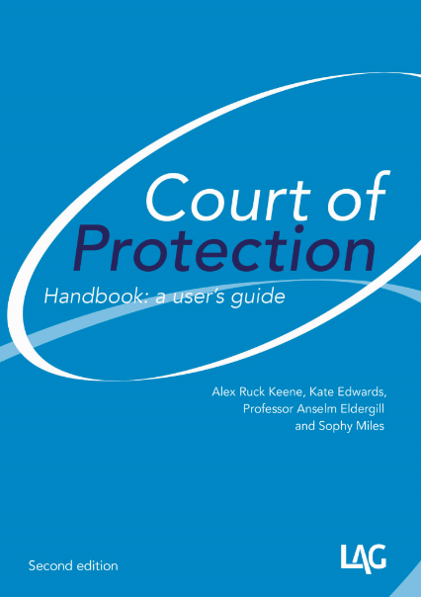
Keeping yourself up-to-date
http://www.39essex.com/resources-and-training/mental-capacity-law/
http://www.scie.org.uk/mca-directory/
www.mclap.org.uk
www.mentalhealthlaw.co.uk
www.courtofprotectionhandbook.com

