Slide 1
Housing and dementia:
Are we nearly there yet?
A decade as the Housing LIN Dementia Lead
March 2017
Sue Garwood
Housing LIN Dementia Lead
Notes:
Grannies and eggs

Slide 2
Notes:
You get the picture. Two hours in from a six hour journey, a voice pipes up from the back seat, “Are we nearly there yet?”, and so starts a lusty rendition of She’s coming around the mountain or 0 green bottles. Well, I’m not going to burst into song, but it does feel to me as though for the last ten years as the Housing LIN’s dementia lead, I have been uttering the same constant refrain along with many other people....”don’t forget about housing”... i,.e trying to put housing on the map. So, what progress has been made in this time, where are we now and where do we need to get to? Really difficult to have a comprehensive overview or to cover that here in 20 minutes, so a selection which gives us some idea. I’m going to share my own perspective on these things, taking you briefly through the journey and some of the milestones along the way, and consider the answer to the question “Are we nearly there yet?”. Apologies to those of you to whom all this is old hat...difficult to know where to pitch presentation.

Slide 3
But firstly, what do I mean by “housing”?
People’s homes - their physical environment – enables or disables
Dementia friendly or at least age-friendly design or adaptability
Supply of suitable and varied housing - tenure, size, design, mainstream and specialist, models
A workforce – e.g. housing officers, support workers, HIA advisers, maintenance staff, architects
A range of housing-related services – e.g. repairs, adaptations, housing-related support and home from hospital schemes
The sector can make an important contribution to the wellbeing of people with dementia but to do so
it needs to be understood and included by health and social care &
we need to skill our workforce in dementia & local systems
Notes:
In the charter, this is expressed differently as Place, people and process which also makes sense. Either way, it is more than physical environment
* LSN Beyond the Front Door: What home means to people with dementia and their carers

Slide 4
Backdrop
85,000 people are living with dementia in the UK
Increases with age – affects 1 in 6 over 80s
72% have another medical condition or disability
Two-thirds live in their own homes, mostly in ordinary housing
One-third of people with dementia live alone in the community
85% of people would choose to remain in their own homes for as long as possible if diagnosed with dementia
An estimated 40% of hospital beds are occupied by people with dementia
60% of people with dementia go into hospital from their own homes while only 36% return home
Notes:
Some of these figures may not be up-to-date but illustrate the trend

Slide 5
National Dementia Strategy 2009
Member of an external reference group
Objective 10:
“Considering the potential for housing support, housing-related services and telecare to support people with dementia and their carers” To be delivered by:
Monitoring the development of models including ECH
Skilling the housing workforce
Watching brief over evidence base for assistive technology and telecare
Notes:
So what was there when I started as Housing LIN Dementia Lead. Not untypical was a rather superficial conference espousing ECH as a universal panacea for PWD without addressing any key issues .Despite its rather lacking in conviction, just getting housing included felt like a major achievement back then.

Slide 6
Prime Minister’s Challenge: 2012-15 & 2020 challenge
Driving improvements in health and care in all settings - including increased diagnosis rates
Awareness-raising campaign to improve understanding and reduce risk
Creating dementia-friendly communities including dementia-friendly businesses – and development of industry charters
Better research - including extra funding & requirement that people with dementia participate
Post diagnostic support & enabling people to live longer at home
Provided massive impetus, raising the profile of dementia, and has contributed to some really positive developments.............................
Notes:
People living with dementia should be supported to live independently in their own homes for as long as they are comfortable and safe to do so. 5.76 of 2020 Implementation Plan under Housing

Slide 7
Dementia Action Alliance
Launched with Dementia Declaration – 7 co-produced “I statements”
The alliance for organisations across England to connect, share best practice and take action on dementia.
Wide membership including people with dementia and carers
Organisations commit to and report on actions quarterly
Quarterly meetings – excellent content & networking
Various campaigns
Carers call to action
Dementia words matter campaign
Post-diagnostic support campaign
309 local DAAs
If you’re not already members do join - www.dementiaaction.org.uk/
Notes:
5439individual members and over 140 organisations who are national members
I have personal choice and control or influence over decisions about me
I know that services are designed around me and my needs
I have support that helps me live my life
I have the knowledge and know-how to get what I need
I live in an enabling and supportive environment where I feel valued and understood
I have a sense of belonging and being a valued part of family, community and civic life
I know there is research going on which delivers a better life for me now, and hope for the future

Slide 8
More positive national developments
Dementia Friendly (DF) communities initiative – 205 communities working to become DF in 2016
Dementia Friends campaign –1.7 million people in 2016
Public Health campaign – A little help from my friends
Improving inclusion
DEEP (Dementia Engagement and Empowerment Project) – see guides
TIDE (Together in Dementia Everyday) for carers
SURPs (Service User Review Panels) – AS
2020 Implementation plan – wide consultation
Champion & task and finish groups driving implementation
Some really useful publications – see last 3 slides

Slide 9
So where is housing in all this?
Joint Housing LIN/DAA “Housing Call to action”
Dementia and Housing Working group
Dementia – Finding Housing Solutions
Making a start: Dementia – Skilling the General Needs Housing Workforce
Housing and Dementia Research Consortium (HDRC)
Dementia-friendly housing charter
Inclusion in the 2020 Implementation plan
Housing and dementia events e.g. Feeling at Home

Slide 10
The Housing LIN contribution
Network of over 40,000 housing, health and social care professionals
Member of dementia-related groups & forums
Comprehensive website on housing and dementia
National and regional events and regular news updates include dementia topics
Actively contribute to key consultations e.g. MCA & deprivation of liberty; housing & dementia charter; Welsh dementia strategy
Resources such as briefings, case studies, reports
Notes:
The Housing LIN is a sophisticated peer-to-peer network bringing together over 40,000 housing, health and social care professionals in England and Wales to exemplify innovative housing solutions for an ageing population.
Recognised by government and industry as a leading ‘knowledge hub’ on specialist housing, our online and regional networked activities
HDRC, DHWG, Dementia Workforce advisory group, not National mental capacity forum...not for want of trying

Slide 11
And on the ground.......
Spurt of new specialist housing targeting people with dementia built to dementia-friendly design principles e.g. Llys jasmine(86); Hare Hill (124); Flowers House (83); Beeches Manor (96); Belong Villages
Housing providers including DF principles in cyclical maintenance e.g. Waltham Forest Housing Association; Guinness Partnership
Home adaptations and technology prolonging independence e.g. Care and repair Wyre and Fylde; BRE house
Housing organisations becoming dementia friendly and skilling their workforce – e.g. Guinness Partnership; Abbeyfield; Extra Care Charitable Trust ‘s (ECCT) Enriched Opportunities Programme (EOP); Accord
Some training programmes being developed for housing professionals
People with dementia and carers contributed to housing charter
Green dementia care initiatives – e.g. Abbeyfield’s Breath of Fresh Air
Notes:
Many more specialist housing developments. Have just included those because there are case studies of them on the Housing LIN website
Each of those above represents a different model
Llys Jasmine, Mold – separate wing of 15 flats. Partnership between Wales& West Housing and Flinshire CC. DF design – e.g. Visibility of loo from bed. Consulted with older people who helped shape design e.g. No: of parking places
Hare Hill, Rochdale – damian Utton Integrated model. 43 flats. Design shaped by Planning, Highways, police (secure by design), Littleborough civic society & client working group. HAPPI principles and dementia design – memory boxes and kitchen windows, colour themes circular route in garden. Serves wider community – communal facilities open to public; broadband and wireless networks
Flowers house, Milton Keynes and Beeches Manor H&C 21 Quattro - specialist; Green House model emphasising person and relationship-centred care & support. Two clusters of nine properties with kitchens designed to enable staff and residents to prepare food together. Two clusters enable degree of matching
Belong villages hybrid – assisted living apartments, communal facilities and dementia households registered as care home
But not enough to incorporate DF design principles in new specialist housing.

Slide 12
Effective joint working
Housing organisations joining local DAAs and contributing to the local community becoming dementia-friendly – e.g. WFHA set up theirs
Dementia resources based in extra care housing or sheltered schemes, e.g. Brookside in Ormskirk; dementia cafe at ECCT’s Lark Hill in Nottingham
Hampshire Dementia Advisor Service
Hull City Out of Hours telecare team
Selwood Housing dementia pilot
ECCT’s outreach enriched opportunities programme
Notes:
Alzheimer’s Society Dementia Café running at Lark Hill Village in Nottingham; Also an Alzheimer’s Society ‘Singing for the Brain’ group starting at Pannel Croft Village in Birmingham in April.
H&C 21 and MHF peer support groups
Accord Housing Pathways for Life
Building up examples which will be published in some form in due course

Slide 13
But we’re not there yet......
Difficult to know exactly what happening on the ground – fragmented but:
Lived experience for people with dementia and carers is often poor
Still stigma, ageism and exclusion, especially in some minority ethnic groups
Access to information and advice – people not knowing where to start
And specifically on housing
Integrated working still more aspiration than reality
Insufficient age-friendly homes & barriers to use of technology
Dementia design: new specialist housing only; frequently perceived as unnecessary & expensive; and interpretation of principles confused
Dementia-friendly housing organisations not yet the norm
Tailored training of the housing workforce still limited & superficial
Housing & dementia still Cinderella of dementia research
Notes:
Housing remains an add-on if included at all both at strategic/service development level and in individual care and support planning
Little hard evidence of effectiveness of housing interventions
Overall, housing organisations have yet to recognise the relevance of dementia to their work and are, probably understandably, prioritising other things, e.g. Welfare reform over dementia...relatively few DAA members are housing organisations
I could go on if there was space and time....So, some progress has been made since I embarked on this journey but I think we still have some way to go, and this is where I think we need to get to......

Slide 14
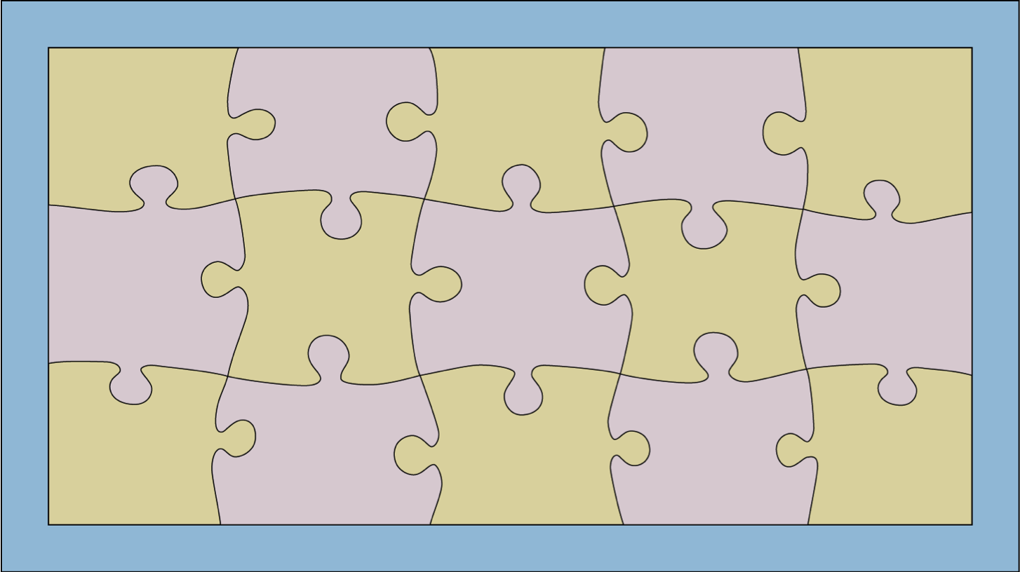
PERSON-CENTRED COMMUNITY SUPPORT
Mental Capacity Act
Legislative and Regulatory Framework
Equalities Legislation
Housing-related support services e.g. home-from-hospital &
floating support
Practical help e.g. Gardening and maintenance
Workforce - attitudes, knowledge and skills
Social care and health services
Aids, adaptations and technology
Funding
Inclusion....
Dementia-friendly community, organisations & businesses
Family, friends, relationships – informal support
A person living with dementia
Home – the physical environment, design & supply
Evidence and research to inform provision
Societal
attitudes
Citizenship,
involvement, co-production & peer support e.g. DEEP, TIDE
Voluntary sector services e.g. befriending & dementia cafes
Information, advice and advocacy
Partnerships, collaboration and teamwork
Meaningful activity
CQC Guidance
Dementia Strategy
2020 Challenge
Benefit & housing Regulations
Care Act 2014
THE DESTINATION – AN INCLUSIVE COMMUNITY
Notes:
In order to support people with dementia to remain living in their own homes well and cost-effectively, we all have to work together and do our bit. The mix will look different in different areas, and others may choose different jigsaw pieces, but the principle remains – the different aspects need to dovetail with one another to meet the needs and aspirations of individuals and their family carers living with dementia. So just have a look at some of the components that I consider key......jigsaw pieces may not contain all the relevant factors but it places the person with dementia and their family at the centre and everything around them – their home, formal services, informal services, the community all dovetail together to help the person to live well at home safely and comfortably for as long as possible

Slide 15
So, at the risk of sounding like a stuck record...back to where I began
Housing can make a considerable contribution to enabling people with dementia to live well at home
For us to do so we need a skilled and knowledgeable workforce & tailored training
But we can’t do it on our own and we can’t do it all
Inclusion of housing by the health and social care sectors at individual and wider service commissioning levels is fundamental
We still have some way to go...............................
Notes:
So, at thr isk of sounding like a stuck record...

Slide 16
Thank you!
A small selection of links to websites and resources in next three slides
C/o EAC
3rd Floor, 89 Albert Embankment
London
SE1 7TP
email: info@housinglin.org.uk
tel: 020 7820 8077
website: www.housinglin.org.uk
Twitter: @HousingLIN

Slide 17
Links
Housing LIN Dementia website
www.housinglin.org.uk/dementia
DEEP including to DEEP guides
http://dementiavoices.org.uk
Dementia Action Alliance
www.dementiaaction.org.uk
Dementia and Housing Working Group
http://www.housinglin.org.uk/AboutHousingLIN/DHWG
Housing and Dementia Research Consortium
http://housingdementiaresearch.wordpress.com

Slide 18
References & resources – a selection
2020 challenge
http://www.housinglin.org.uk/pagefinder.cfm?cid=9924
NHF and partners (2013) Dementia: Finding Housing Solutions
http://www.housinglin.org.uk/pagefinder.cfm?cid=8832
NHF & HACT (2016) Transforming care pathways for people with dementia - Linking housing, health and social care
http://www.housinglin.org.uk/pagefinder.cfm?cid=9822
DHWG (2014) Making a Start – Dementia: Skilling the General Needs Housing Workforce
http://www.housinglin.org.uk/pagefinder.cfm?cid=9203
Alzheimer’s Society (2017) Dementia-Friendly Housing Charter
http://www.housinglin.org.uk/pagefinder.cfm?cid=17731
Housing LIN (2016) Dementia and Housing: An assessment tool for local commissioning
http://www.housinglin.org.uk/pagefinder.cfm?cid=10146
Yates K (2014) Putting Dementia into the Heart of Extra Care Housing in Wales: A case study from Mold
http://www.housinglin.org.uk/pagefinder.cfm?cid=9204
Twyford K (2017) Individuals with dementia living in extra care housing: an initial exploration of the practicalities and possibilities
http://www.housinglin.org.uk/pagefinder.cfm?cid=10322
Graham Stokes (2008) – And Still the Music Plays

Slide 19
References & resources – a selection
Life Story Network (2016) Beyond the Front Door: What ‘home’ means to people with dementia and their carers
http://www.housinglin.org.uk/pagefinder.cfm?cid=10450
Halsall B & MacDonald R (2015) Design for Dementia Vols 1 & 2
http://www.hlpdesign.com/our-publications/design-for-dementia
Alzheimer’s Society Supporting LGBT people with dementia
https://www.alzheimers.org.uk/info/20046/help_with_dementia_care/38/supporting_gay_lesbian_and_bisexual_people_with_dementia
King’s Fund (2014) Is Your Housing Dementia-friendly
http://www.housinglin.org.uk/pagefinder.cfm?cid=9379
Innovations in Dementia (2016) How to Make buildings easier for People with Dementia
http://www.housinglin.org.uk/pagefinder.cfm?cid=9628
DEEP (2016)Tips for employers who want to be more dementia friendly
http://www.housinglin.org.uk/pagefinder.cfm?cid=10086
DEEP (2016) Our dementia, Our Rights
http://www.housinglin.org.uk/pagefinder.cfm?cid=10346
Keith Oliver and Forget-me-Nots: Welcome to Our World and Walk the Walk, Talk the Talk
Jutla K (2013) Making Services More Culturally competent
http://www.dementiaaction.org.uk/news_and_events/events_archive/4746_quarterly_meeting_-_september_2013

