Slide 1
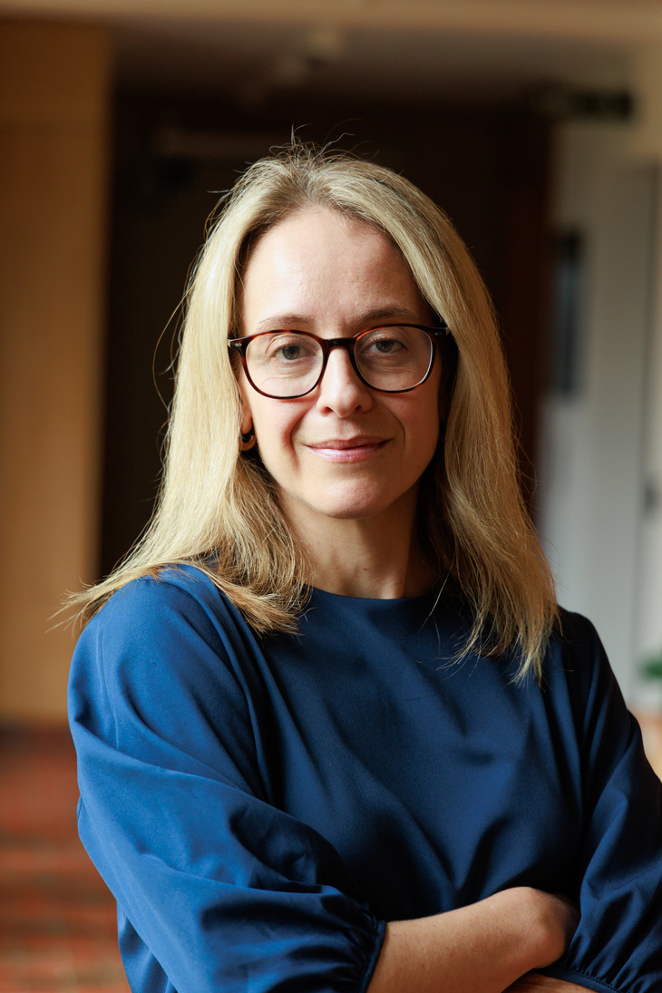



Appleby Blue: One Year On Key Findings and Recommendations
Working together to create an urban life where people will thrive
Alison Benzimra
Head of Research and Influence
Lizzie Lynch
Communications and Influence Lead
www.ustsc.org.uk | info@ustsc.org.uk | Registered Charity in England & Wales (No: 1103731)
Notes:
Lizzie to outline presentation

Slide 2
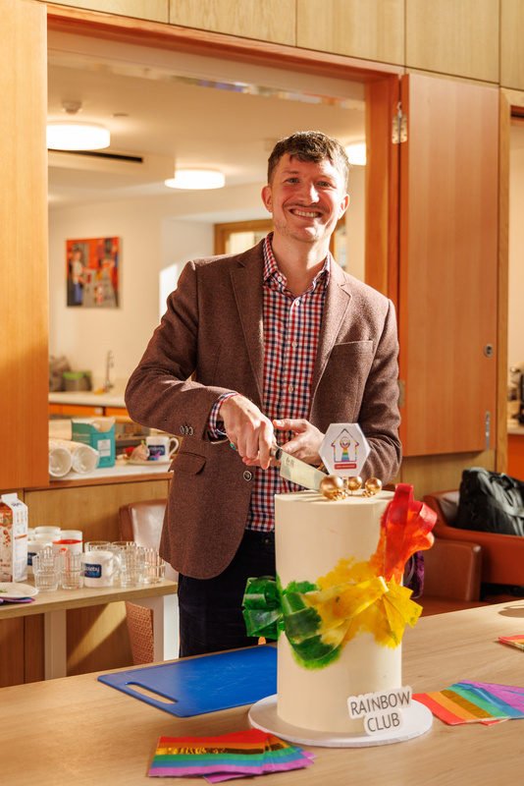
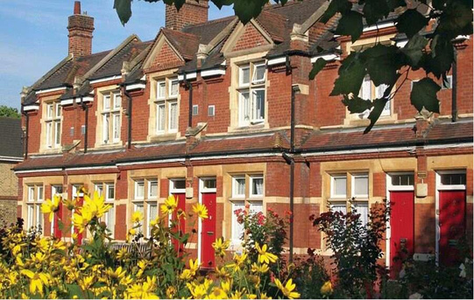
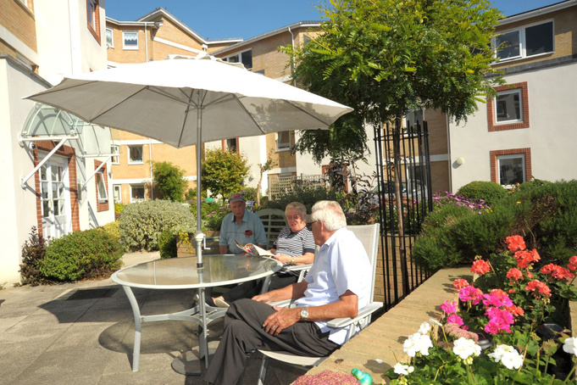
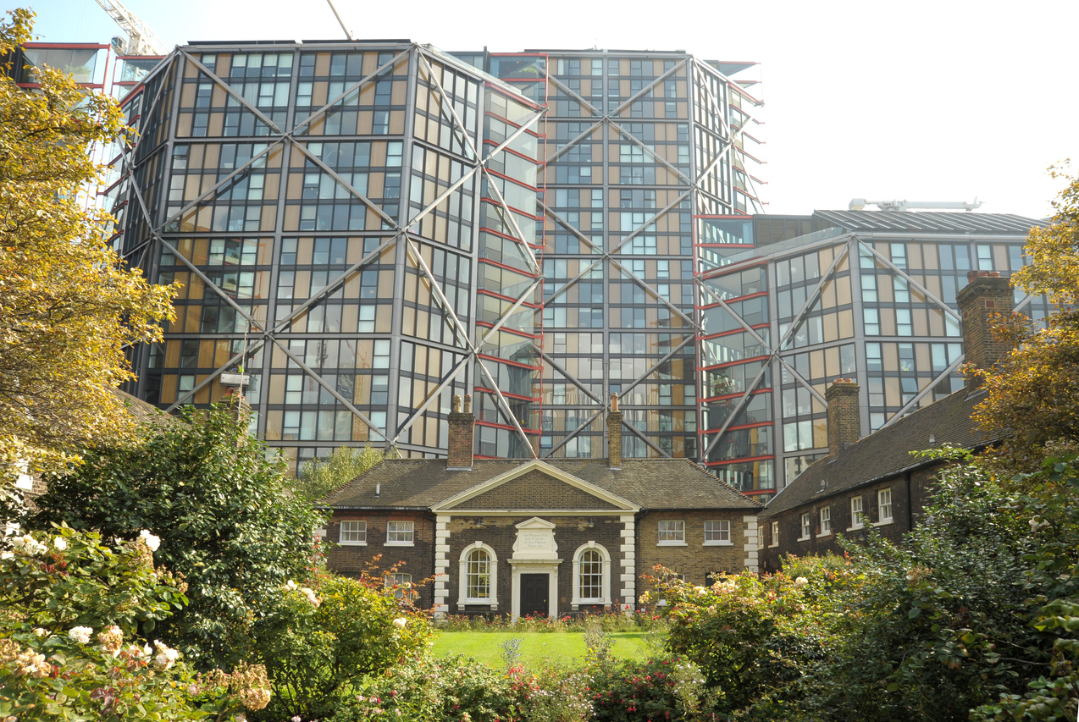
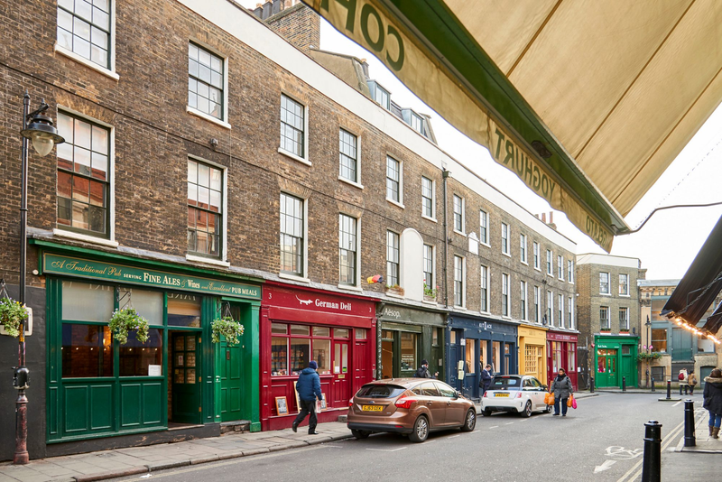
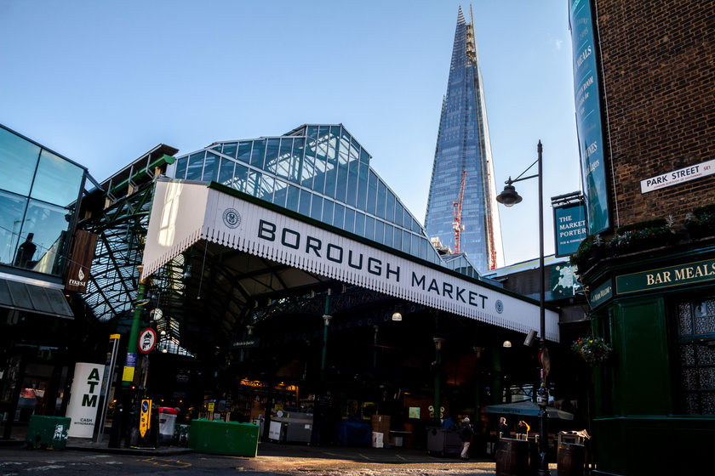

Who we are

Slide 3
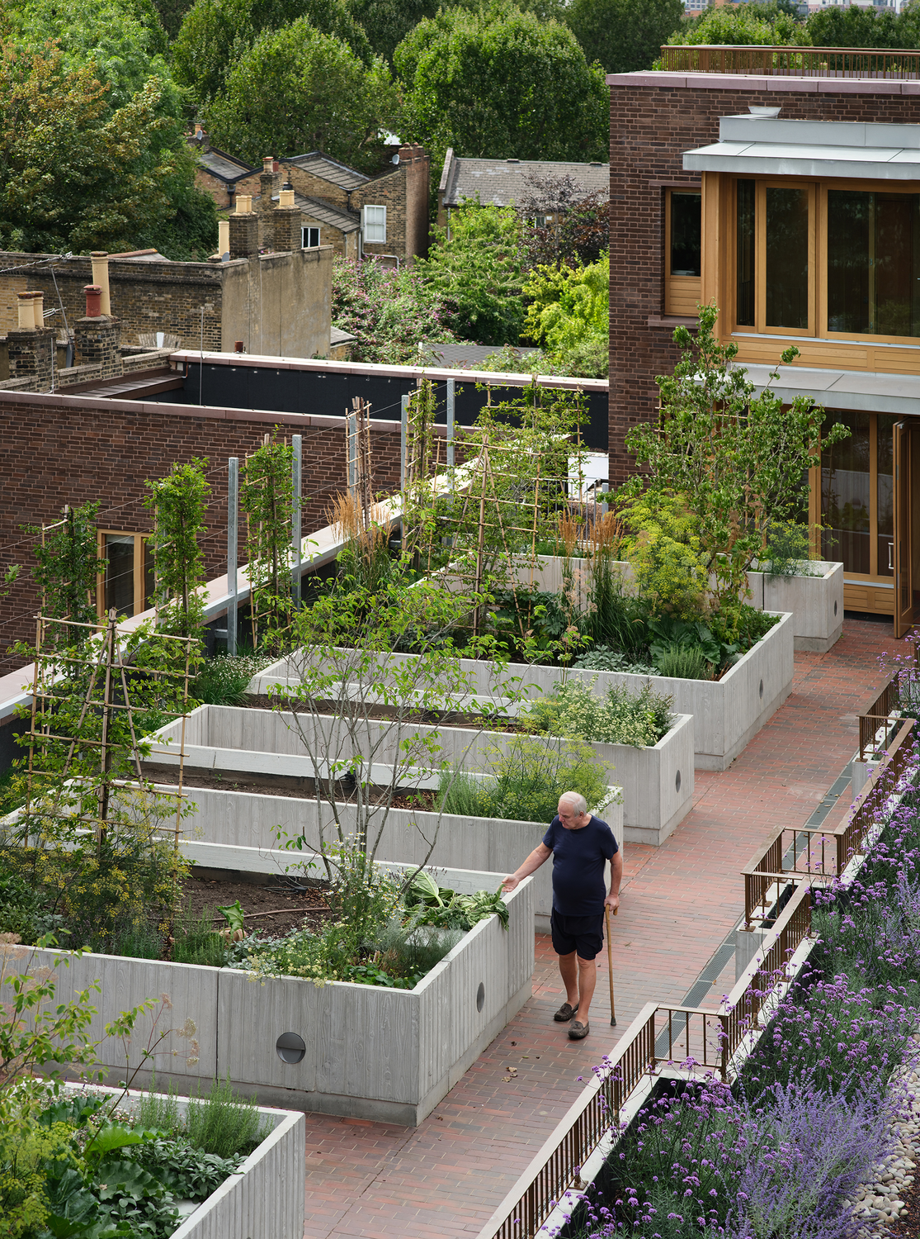
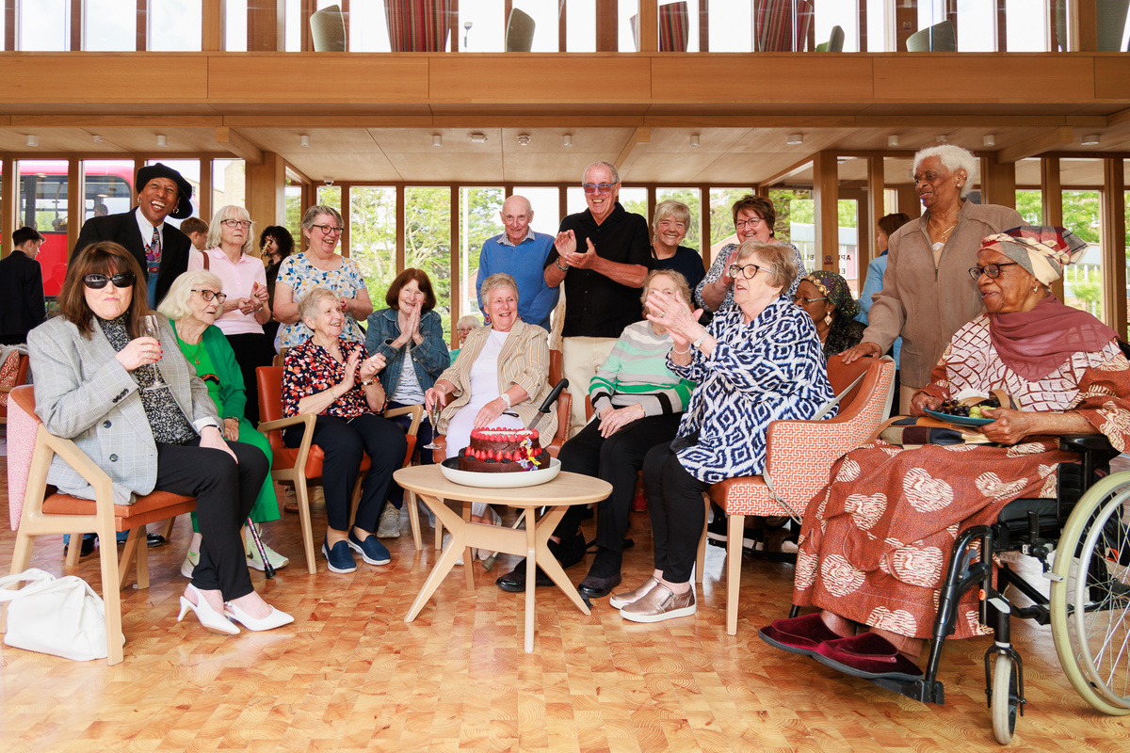
Welcome to Appleby Blue
3
Notes:
​Section 106

Slide 4





Appleby Blue Model
co-produce
Resident Support Model
Design Quality
Appleby Blue Model
improve outcomes
learn and share
Community
Integration
4
Notes:
​

Slide 5
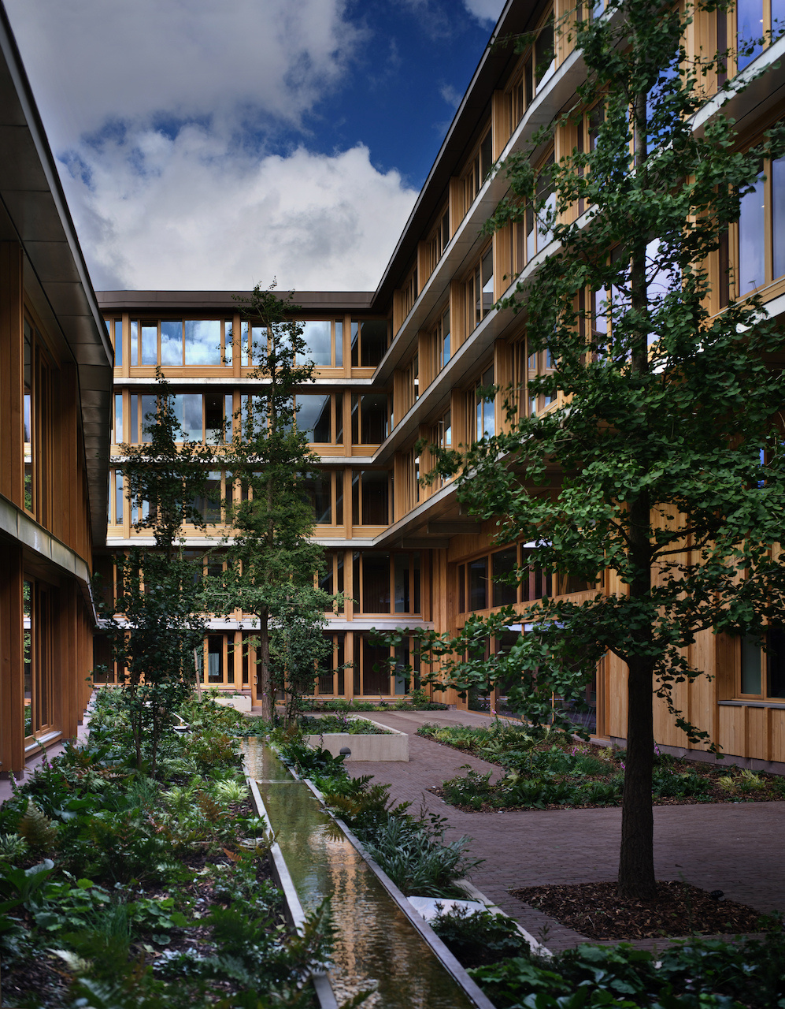

Appleby Blue:
One Year On
Read our Appleby Blue One Year On Report:
What we’ve learned after one year at Appleby Blue
8 practical recommendations from our first year at Appleby Blue shared in our new report.

Slide 6
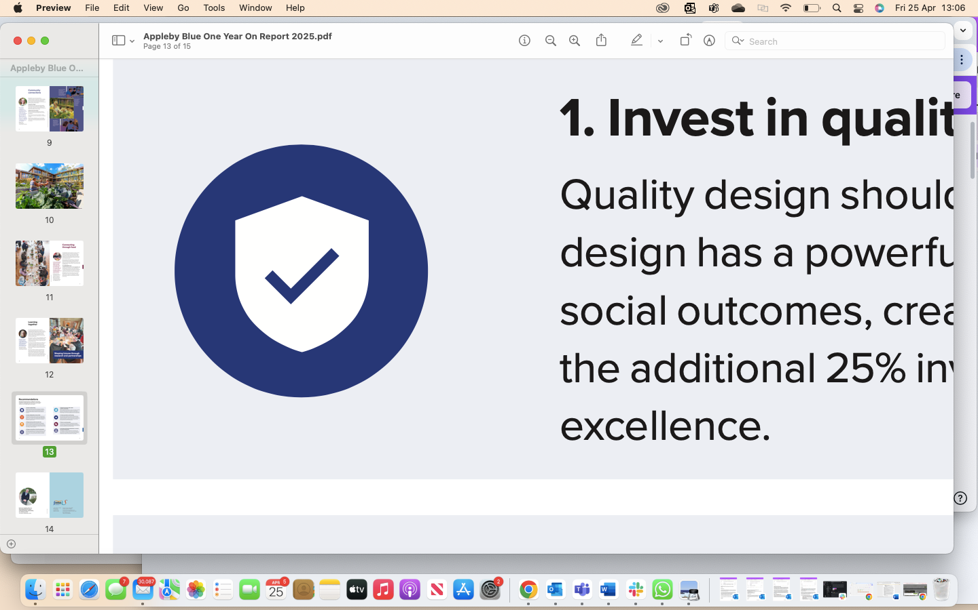

Invest in Quality Design
Quality design should be accessible to everyone. Thoughtful design has a powerful impact on mental wellbeing and broader social outcomes, creating societal benefits that far outweigh the additional 25% investment needed to achieve quality and excellence.

Slide 7
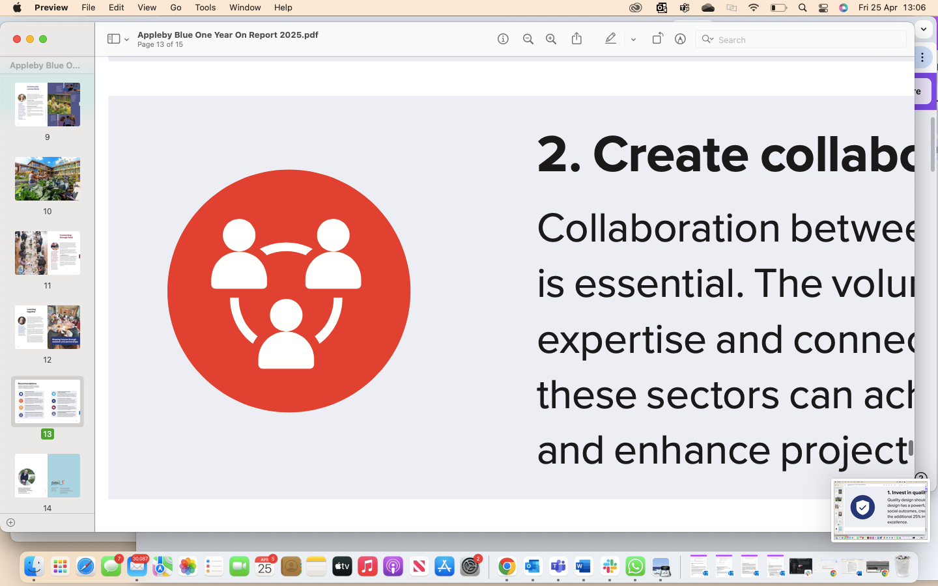
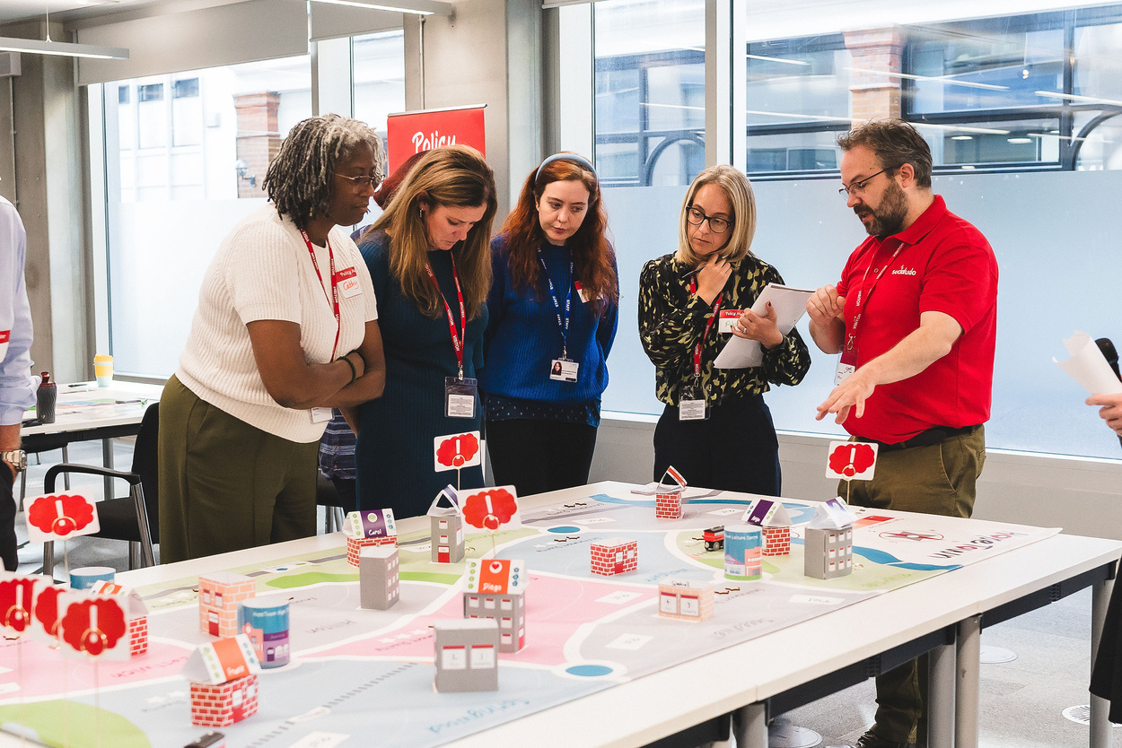

Create collaboration across sectors
Collaboration between the public, private, and voluntary sectors is essential. The voluntary and community sectors bring unique expertise and connections often overlooked. By working together, these sectors can achieve outcomes that benefit communities and enhance project success.

Slide 8
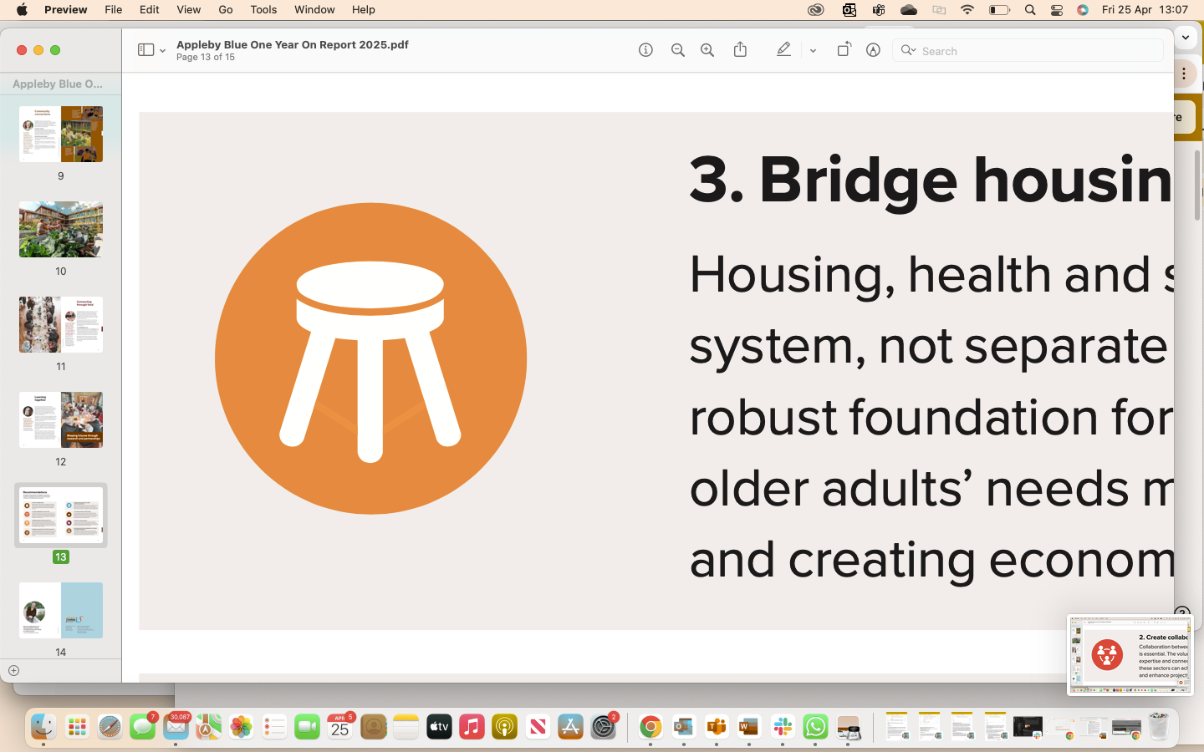


Bridge housing, health and social care
Housing, health and social care should work as an integrated system, not separate silos. Addressing them together creates a robust foundation for wellbeing. This cohesive approach supports older adults’ needs more effectively, benefiting society as a whole and creating economic savings too.
Notes:
financial wellbeing
close working relationship with social services as residents cognitive and physical abilities change
Advocates for residents

Slide 9
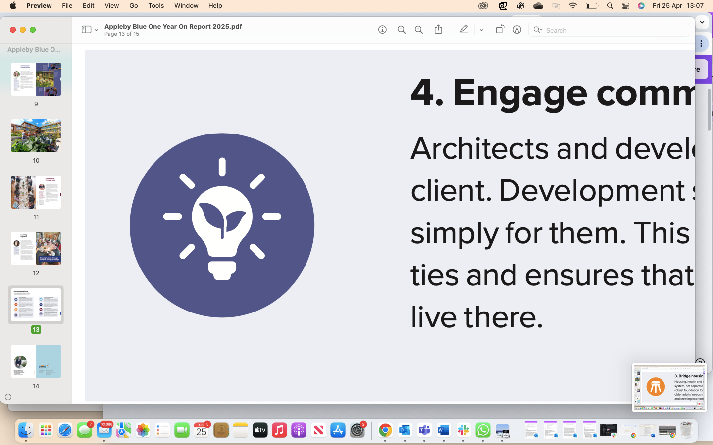
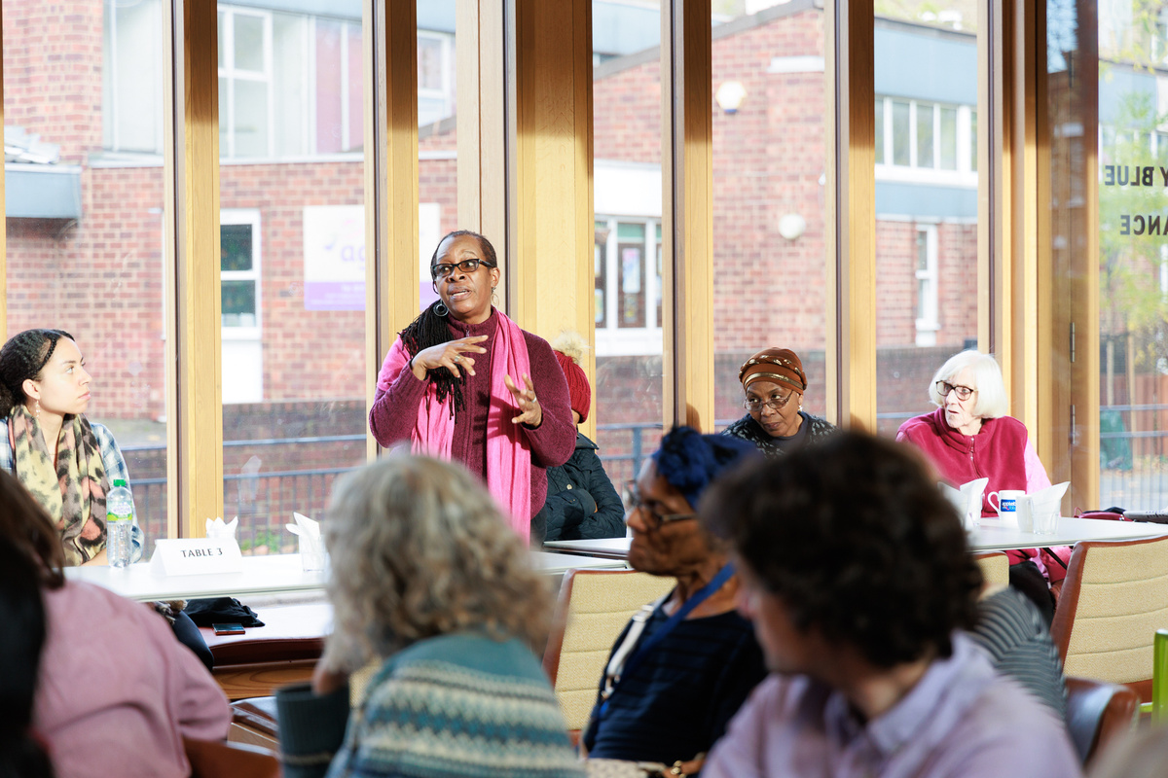

Engage communities in the built environment
Architects and developers should view the community as a central client. Development should be co-created with communities, not simply for them. This community-centred approach strengthens ties and ensures that spaces meet the real needs of those who live there.
Notes:
learning inform future development

Slide 10
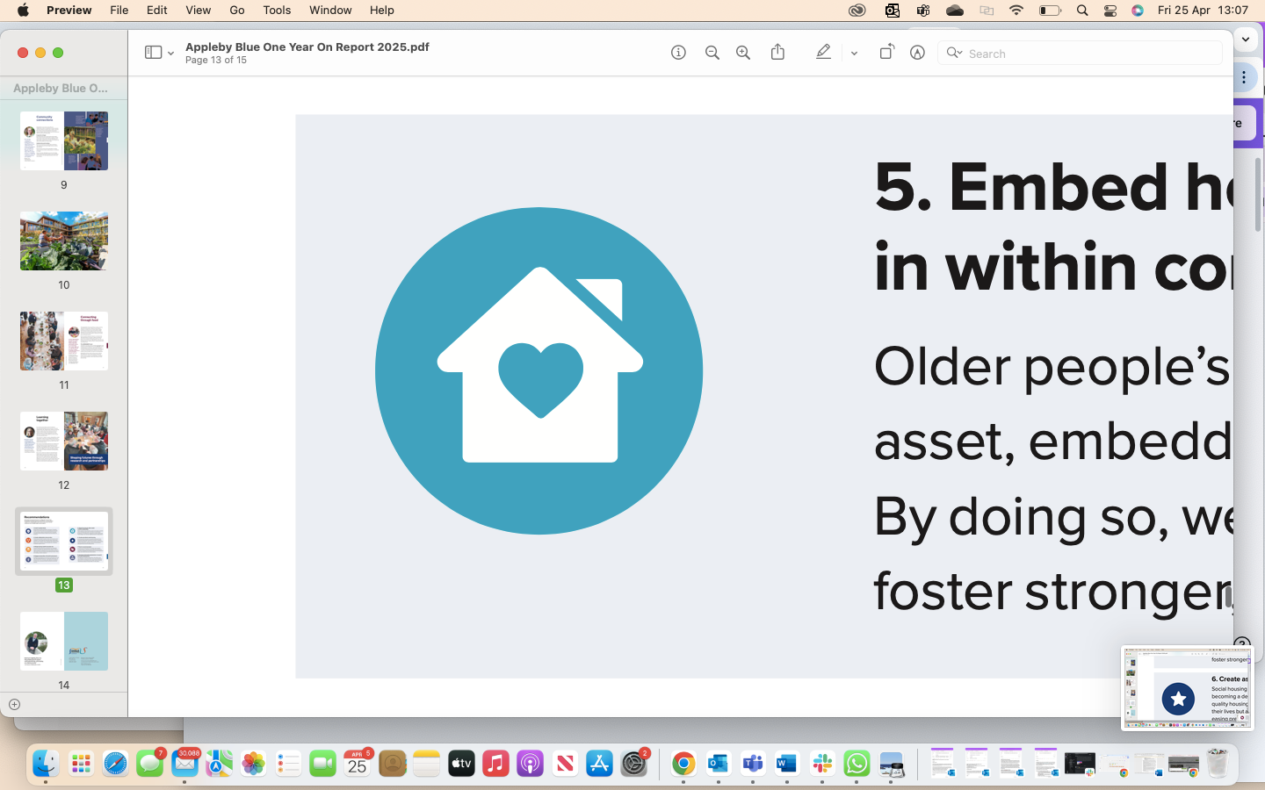
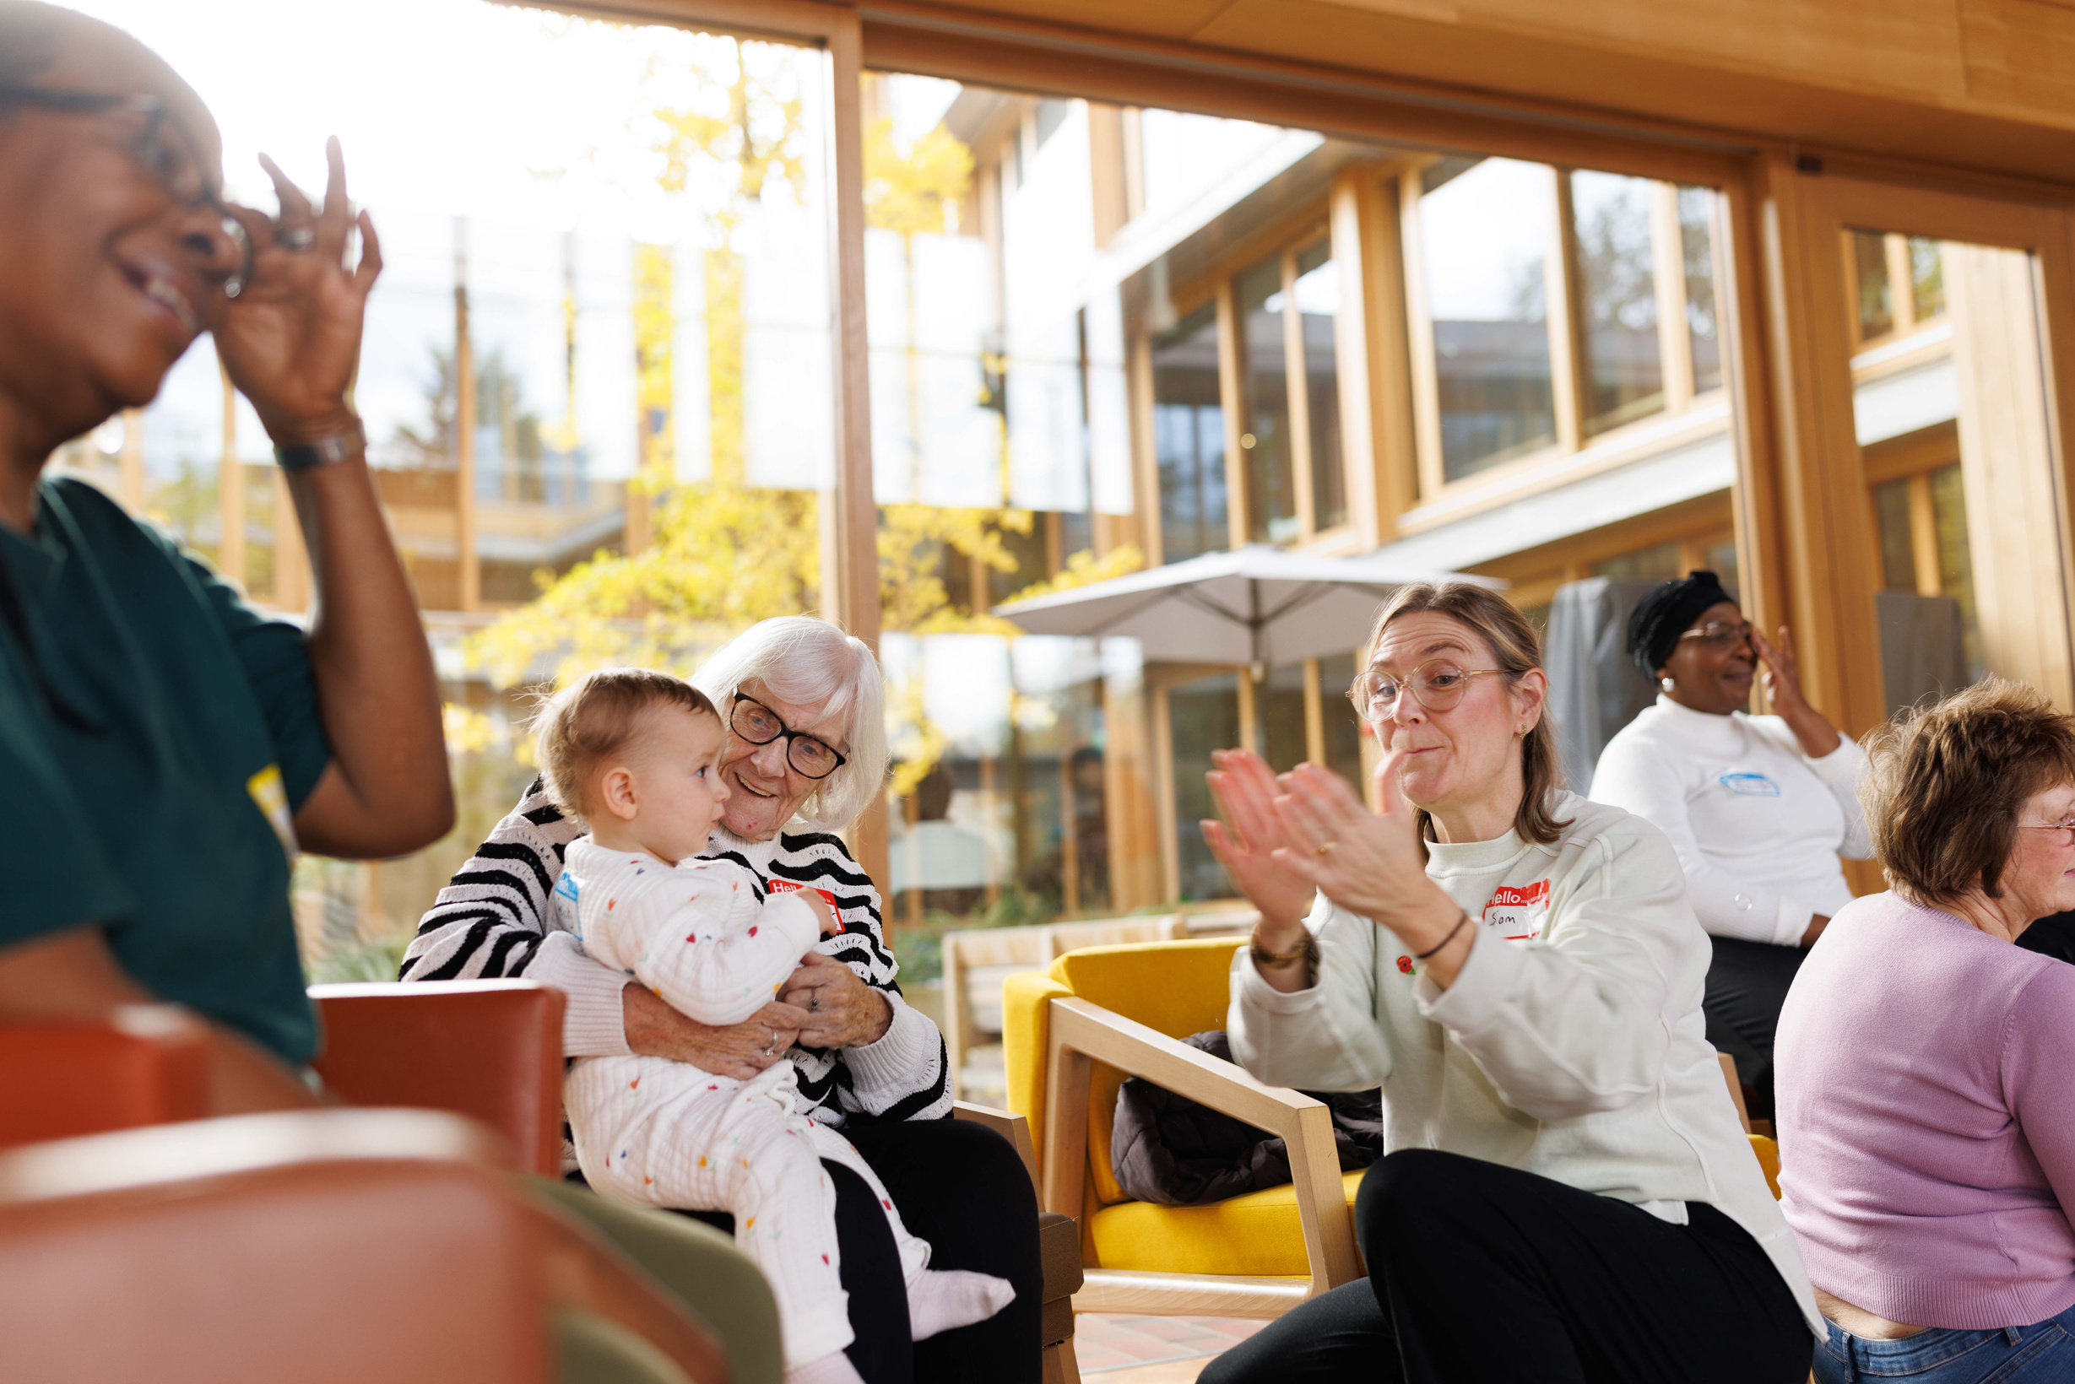

Embed housing for older people within communities
Older people’s housing should be viewed as an integral community asset, embedding older adults in the heart of community life.
By doing so, we celebrate the contributions of older residents and foster stronger, more inclusive neighbourhoods for all generations.

Slide 11
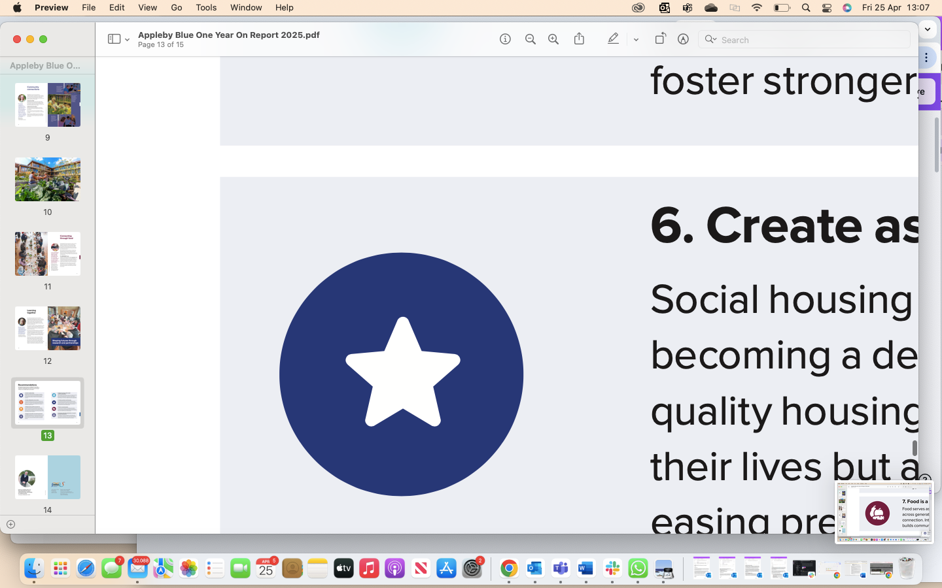
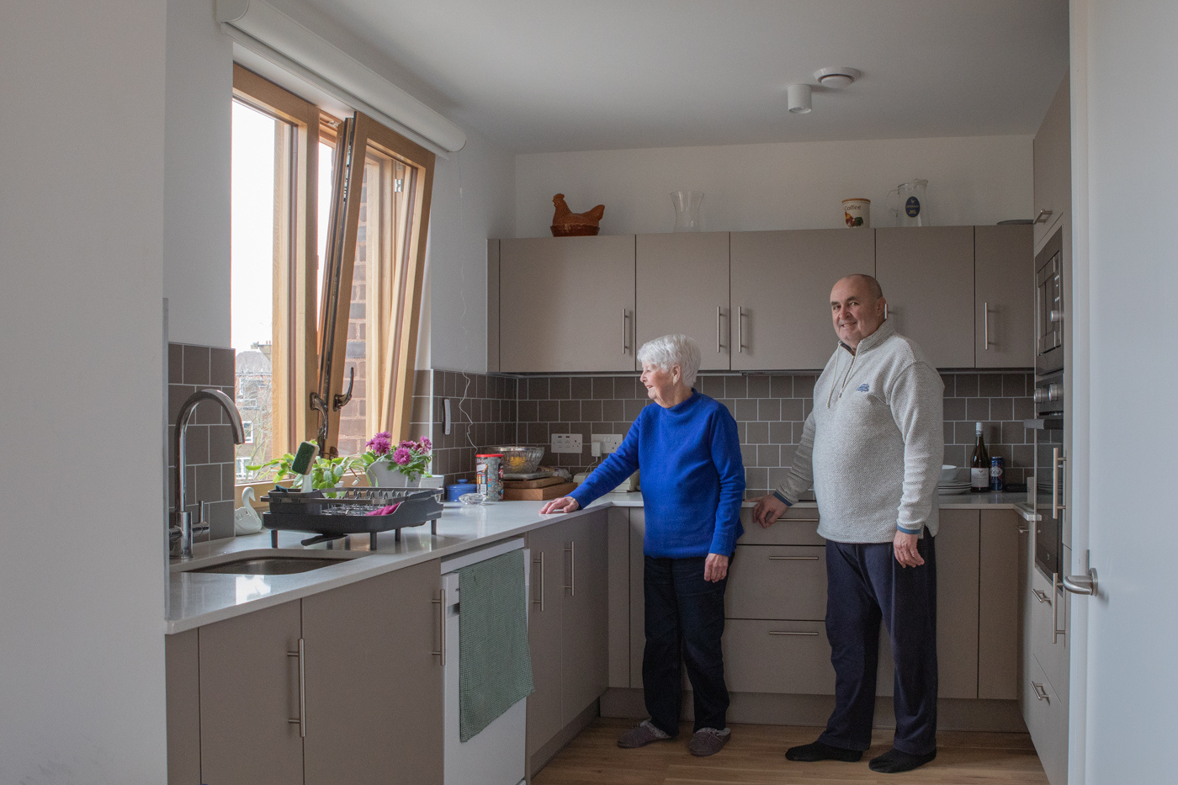

Create aspirational social housing
Social housing for older adults should offer dignity and choice, becoming a desired option rather than a last resort. Increasing quality housing options in cities for older people not only enhances their lives but also frees up larger homes for younger families, easing pressures across the housing chain.

Slide 12
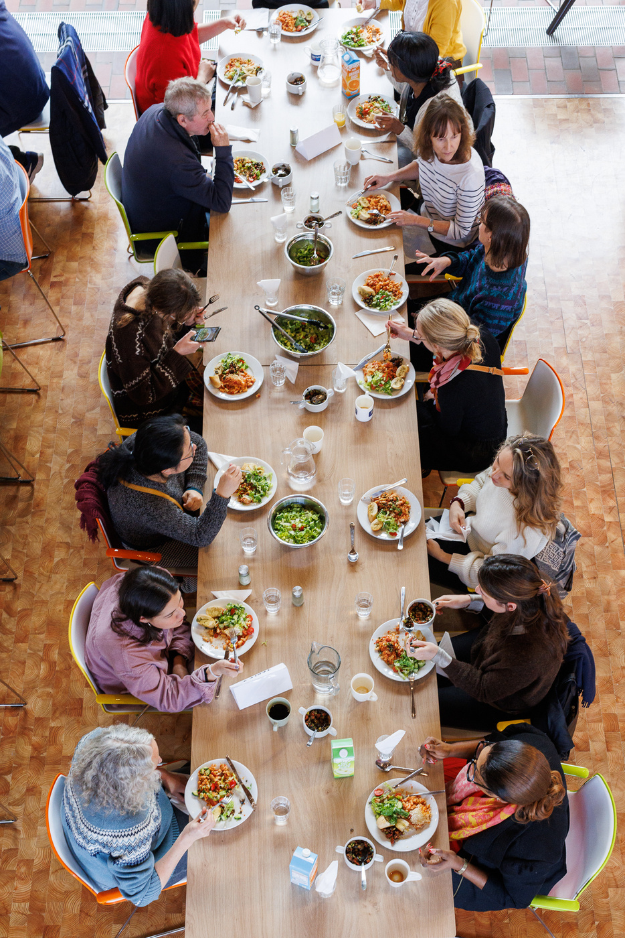
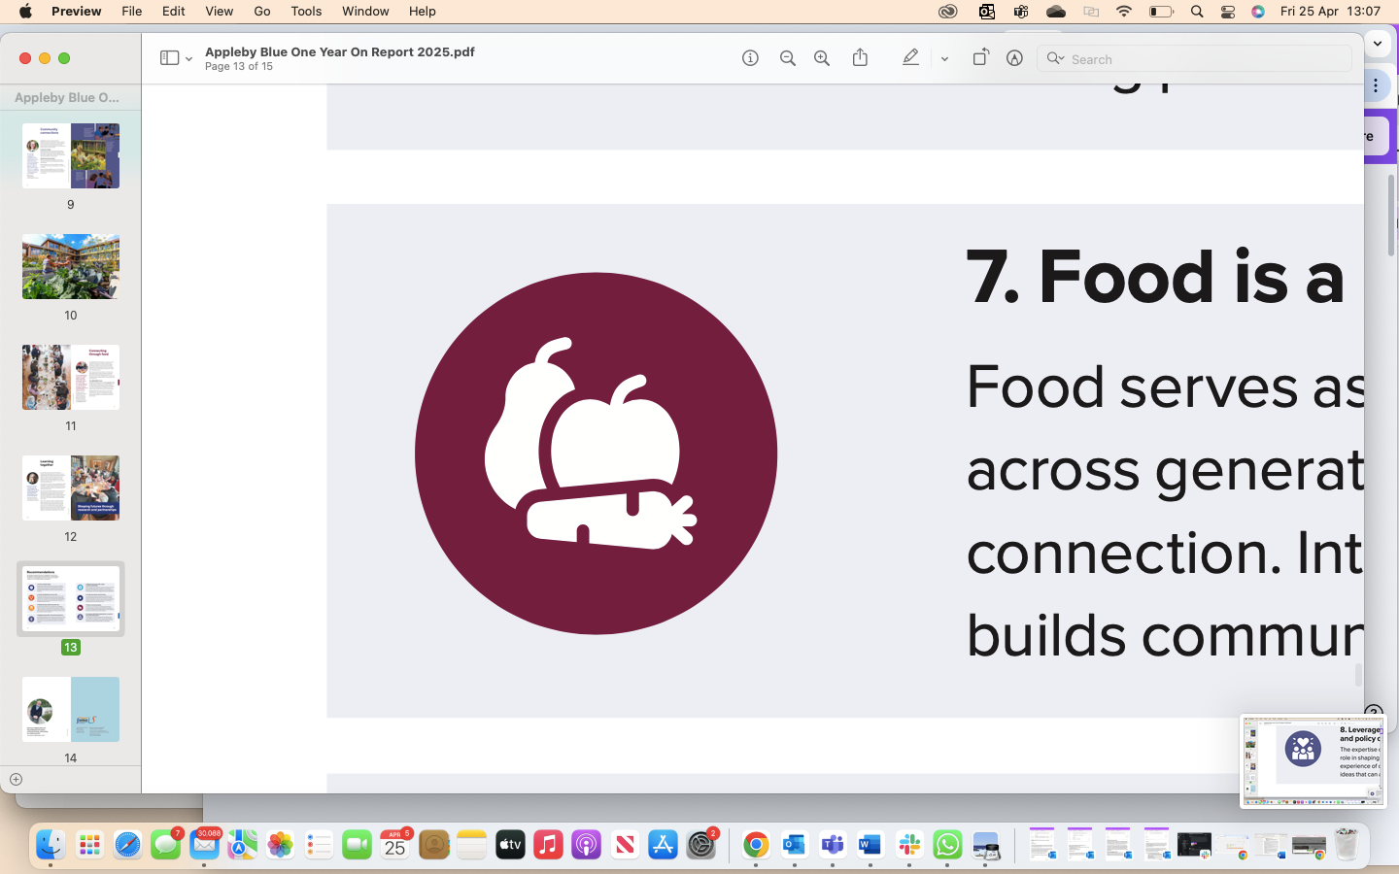
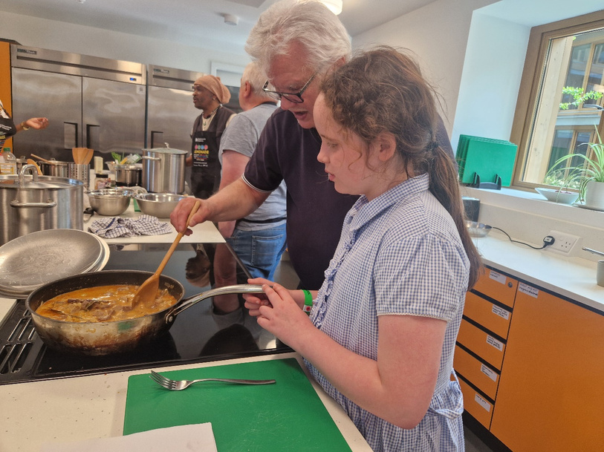

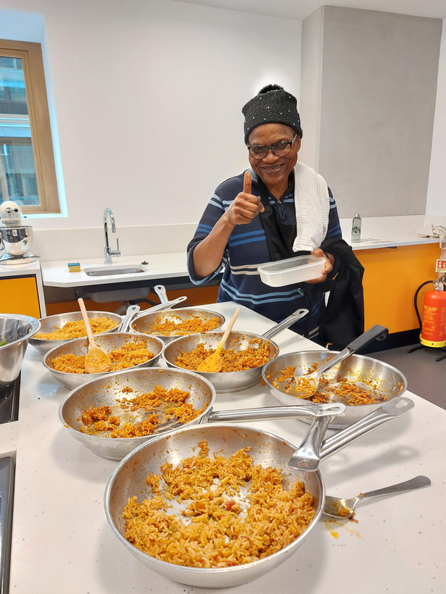
Food is a social connector
Food serves as a powerful tool for bringing people together across generations, celebrating cultural diversity, and fostering connection. Integrating food-related activities into housing projects builds community bonds and enriches daily life.
Notes:
https://www.bournemouth.ac.uk/research/projects/lemonade

Slide 13
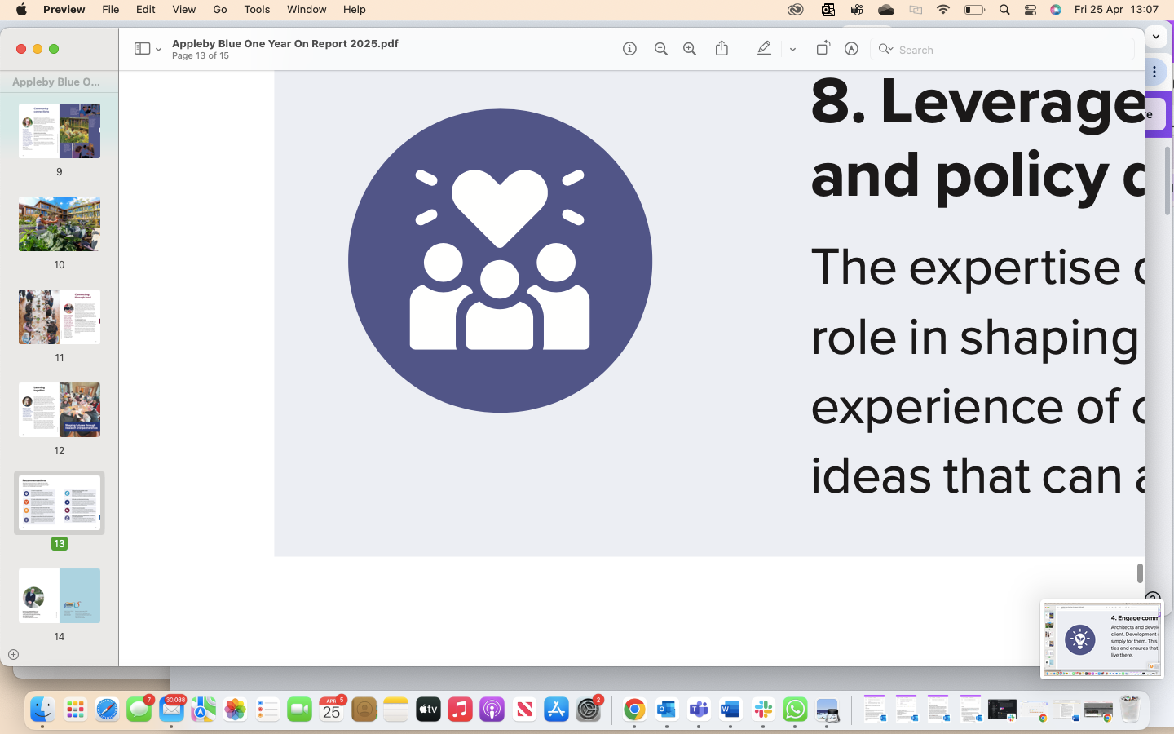
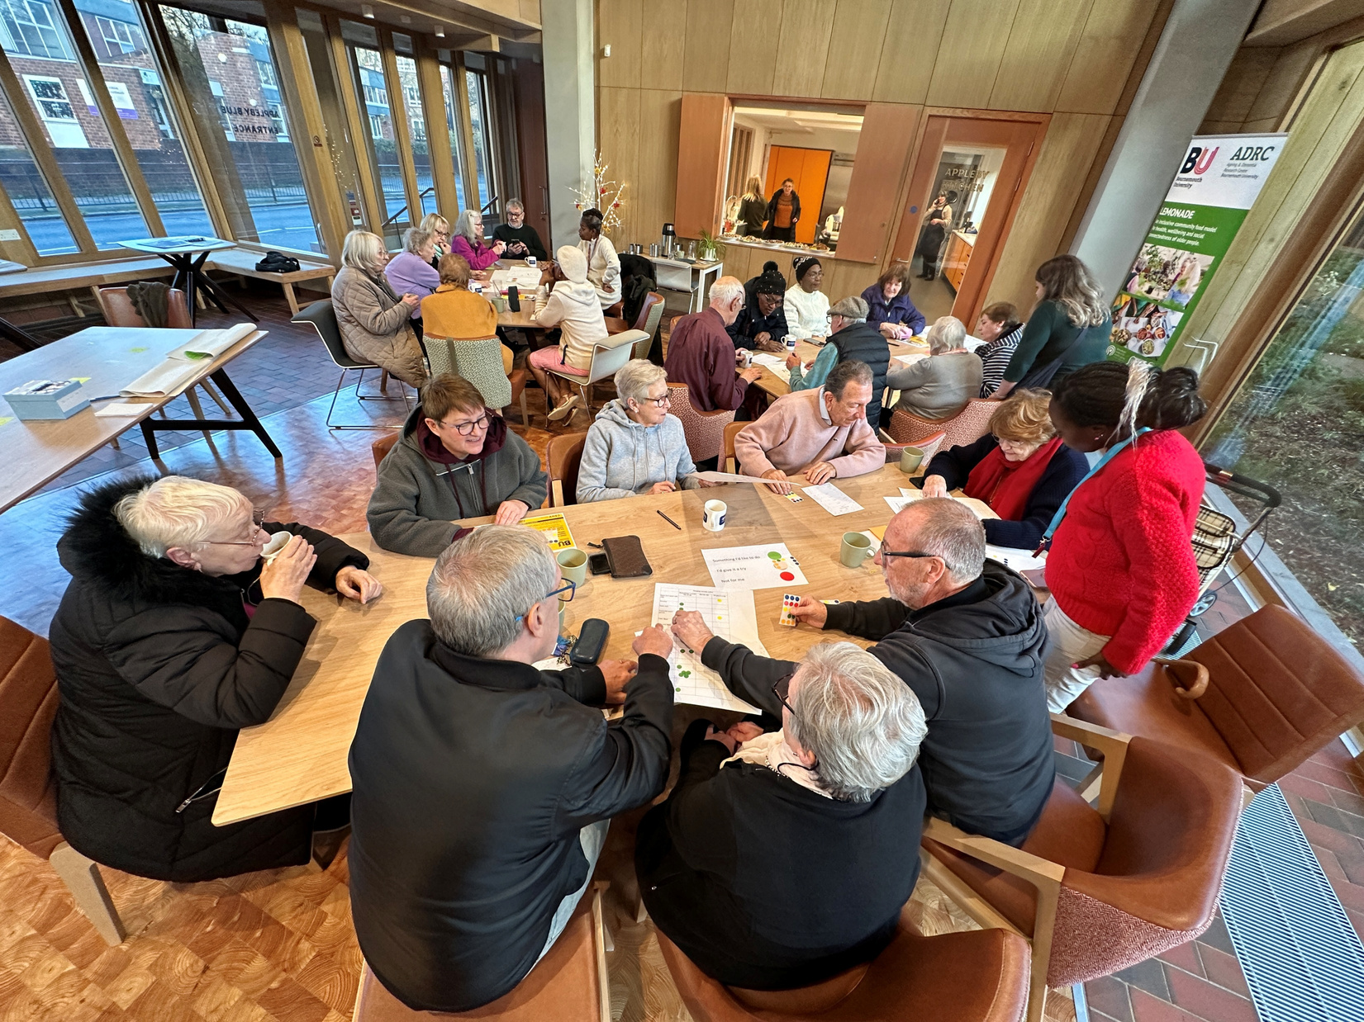

Leverage community organisations in research & policy development
The expertise of community organisations should play a vital role in shaping housing policy. Their on-the-ground insights and experience of co-producing research bring innovative, practical ideas that can advance housing models for older people.

Slide 14
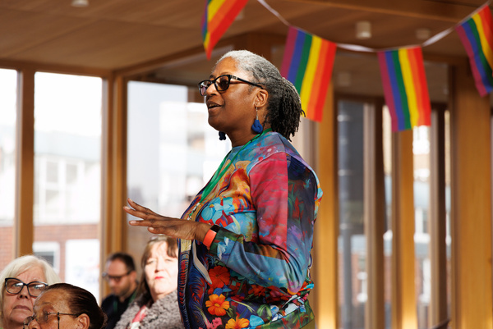
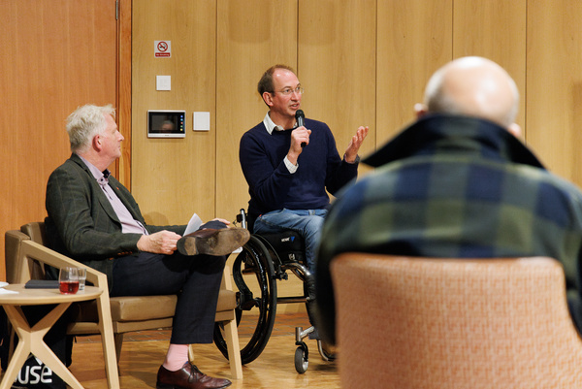
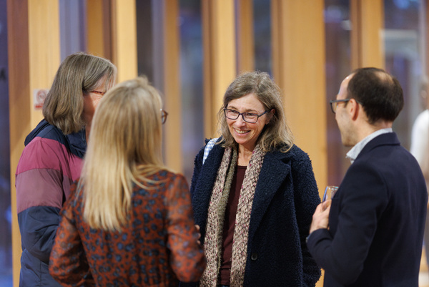
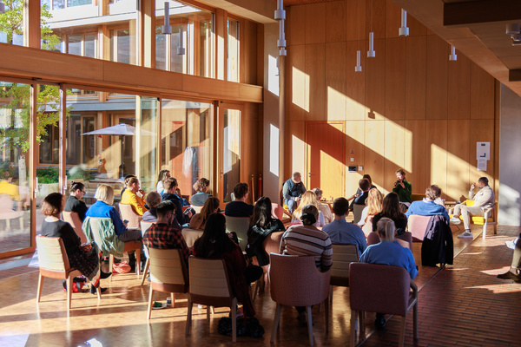
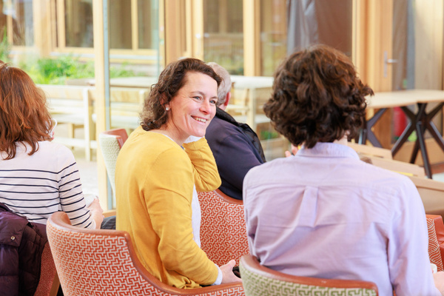
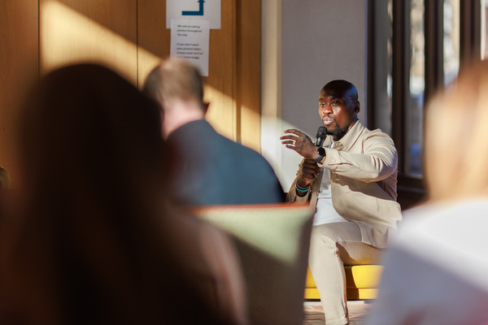



United Thinking: Appleby Blue Autumn Sessions
How to Influence: Relationships and Partnership Working
How partnership working fosters progress with funding, premises & relationships
Date: Tuesday 28th October 2025
Time: 1:30pm - 3:30pm
Venue: Appleby Blue Almshouse
14
Notes:
more impactful where we build lasting relationships

Slide 15
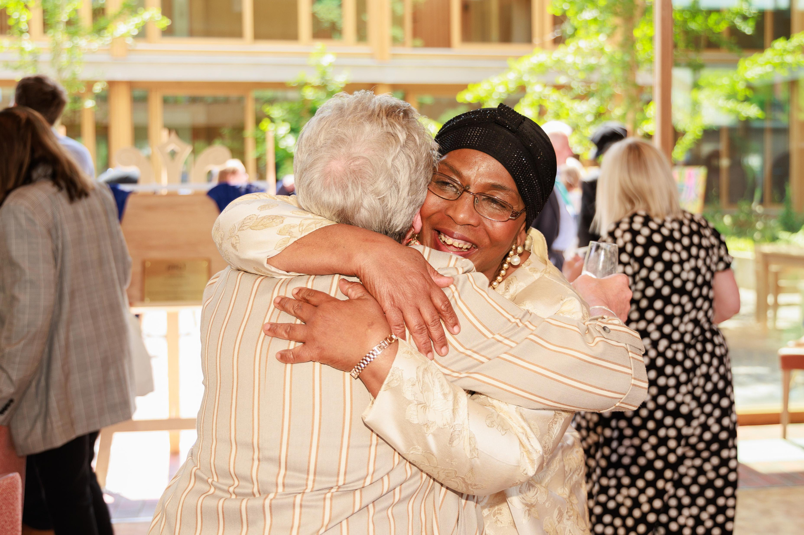
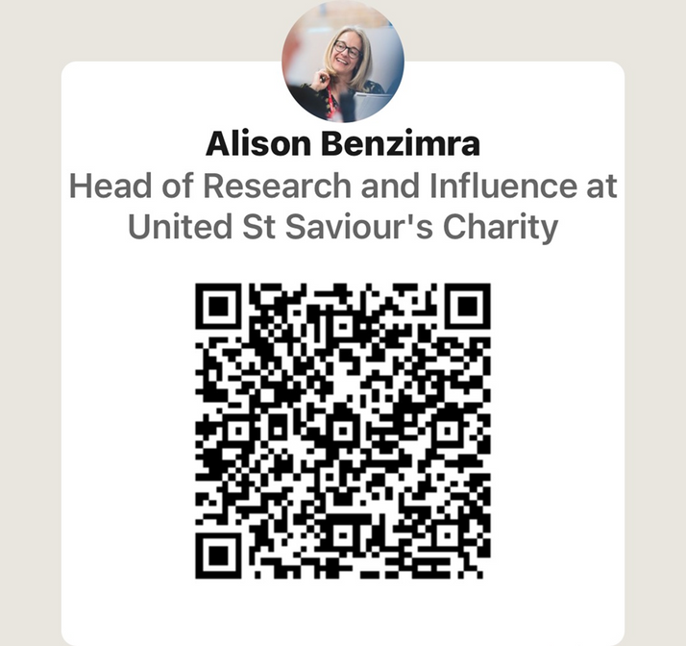
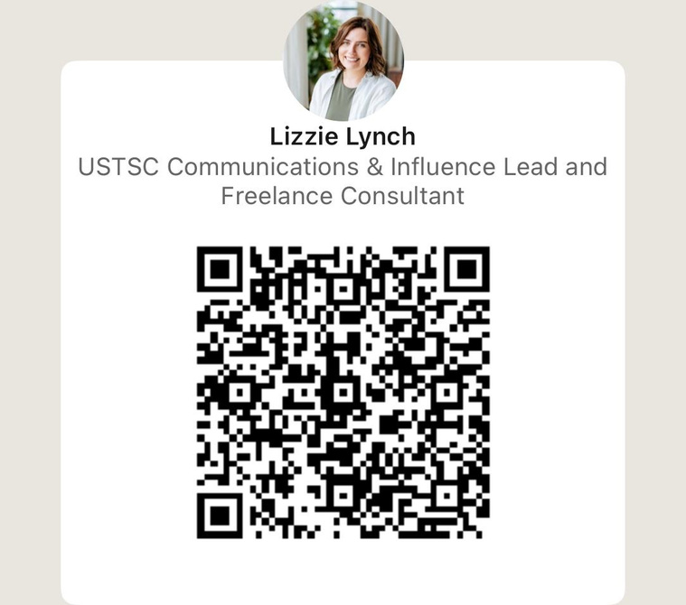

Interested in a knowledge exchange?
Get in touch to arrange a day at Appleby Blue to share innovations!
We work together to create an urban life where people will thrive.
15

