Slide 1
Extra Care Housing: The Opportunity and Challenge Friday 10th November 2023 Ian Copeman Business Director, Housing LIN

Slide 2
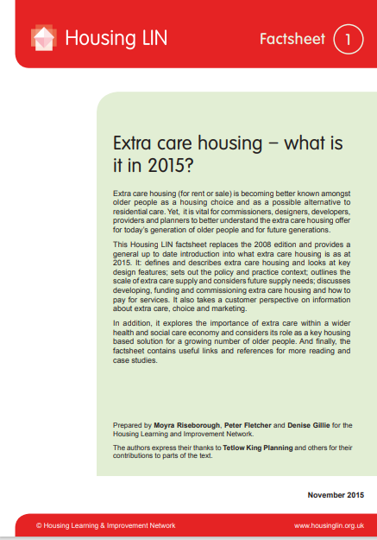
Extra care housing: it’s popular…
3,218 extra care housing related resources
14,314 ECH topic webpages views / 23,945 ECH resources views
Extra Care Housing What is it? (published in 2015 - 2,068 downloads this year
Design Principles for Extra Care Housing (3rd edition published in 2020 - 566 downloads this year
Extra Care Housing What is it? & Design Principles for Extra Care Housing are no. 3 and 5 of our most popular downloads
Extra care housing topic page is the 3rd most popular page (our homepage is the 1st ; HAPPI topic page the 2nd)

Slide 3
Context: a case study
West of England extra care housing improvement project
Bristol, Bath & North East Somerset; North Somerset; South Gloucestershire
Overall population 1.2m and growing
Increasing older population: to 2042 65+ pop +25%; 75+ pop +38%
42 schemes/2,500 extra care housing dwellings (2x national average)
Mix of operators
Wanting to better understand the opportunities and challenges of next ‘phase’ of extra care housing development

Slide 4
The opportunities
Increasing older population, many with equity (but not all)
Extra care housing offer for homeowners to buy or rent relatively under-developed, particularly ‘lower/middle market’
High demand for affordable rented housing – potential for ‘rightsizing’
Drawing on a mixed economy of housing providers/operators
Nuanced understanding of future demand
Local authorities’ pressure to manage care spending
Potential for technology to complement staff presence
Appetite for local authority collaboration across boundaries

Slide 5
The challenges
What’s ‘old’? Evidence of people leaving it later in life to move to ECH
Translating ‘need’ into people actually moving
Securing and retaining a care workforce
Balance of needs in ECH has been shifting over time
Increasing mix of higher support and care needs
Maintaining ECH as a vibrant and attractive place to live
Affordability: real and perceived
What’s in a name
Notes:
Evidence of slow/slowing ‘fill rates’

Slide 6
Implications: in praise of paradox
Managing an increasingly diverse and complex mix of needs/requirements
Delivering a positive image and experience of ageing that is consistent with living independently
Retaining/attracting a mixed economy of operators and cross-sector collaboration
Facilitating a viable operating environment for care providers
Potential for co-locating ECH with other types of age-friendly housing
ECH being inclusive of people with diverse needs and circumstances
Support and training for staff in high support needs
Change the name?

Slide 7
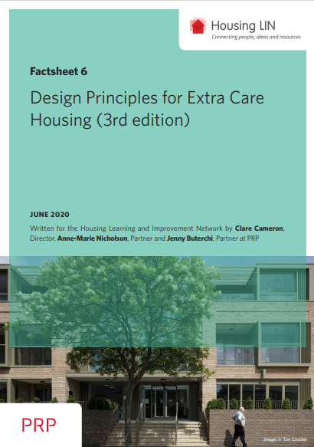
Resources
ECH design guidance (thank you, PRP) www.housinglin.org.uk/Topics/type/Design-Principles-for-Extra-Care-Housing/
ECH commissioning www.housinglin.org.uk/Topics/browse/HousingExtraCare/Commissioning/
Events and HAPPI hour webinars www.housinglin.org.uk/Events/
Commissioner network - forthcoming
What is extra care housing? Videos www.housinglin.org.uk/Topics/type/Spotlight-on-Extra-Care-A-video-series-from-the-Housing-LIN/

Slide 8
The last word…

