Slide 1
Bolton at Home ‘Quit & Get Fit’ Smoking Cessation Pilot 2021
Paula Rowson
Community Investment Manager
Shauna Morton
Head Community Investment

Slide 2
Background
Making Smoking History programme - Greater Manchester Health and Social Care Partnership
Local partnership – Bolton at Home / NHS Bolton /CCG /BMBC Public Health/ BWCT / Bolton CVS
Community Action Plan – 6 month Pilot agreed on Bolton at Home estate - The project commenced 11th February 2021.
Peer Navigators – Newly recruited /Health focus (CCG Funded) live in the neighbourhood.

Slide 3
Project Overview
A pilot project to encourage customers to stop cigarette smoking by taking up Vaping and or using NRT.
The project is incentivised as participants receive a free starter vape on weekly visits and have the oils paid for the life of the project.
If they attend all sessions and make positive progress they will receive an upgraded Vape at the end of the project.
WhatsApp group for peer support and instant access to advice about the technical sides of the vapes as well as share positive stories about how they were doing.

Slide 4
Aims
E-cigarettes have been advocated as an effective smoking cessation intervention, with evidence indicating that they are substantially less harmful than conventional cigarettes. A pilot to encourage 25 people to swap from conventional cigarettes to e-cigarettes was piloted on the Washacre estate (a socially disadvantaged estate in Bolton).
Prior to the project commencing, we identified that one of the barriers to people stopping cigarette smoking is the perception that the person will gain weight as a result. Therefore to address this we wanted to incorporate some physical activity sessions in to the project.

Slide 5
Objectives
Peer Navigators to own a new ‘Health Focused’ project to help them engage with community
To enable customers to give up smoking with peer support via weekly catch up /WhatsApp group
To enable customers to be more physically active following pandemic.
To enable customers to improve their mental health following pandemic.
To engage with new customers /get people back out on estates using community facilities (covid compliant)

Slide 6
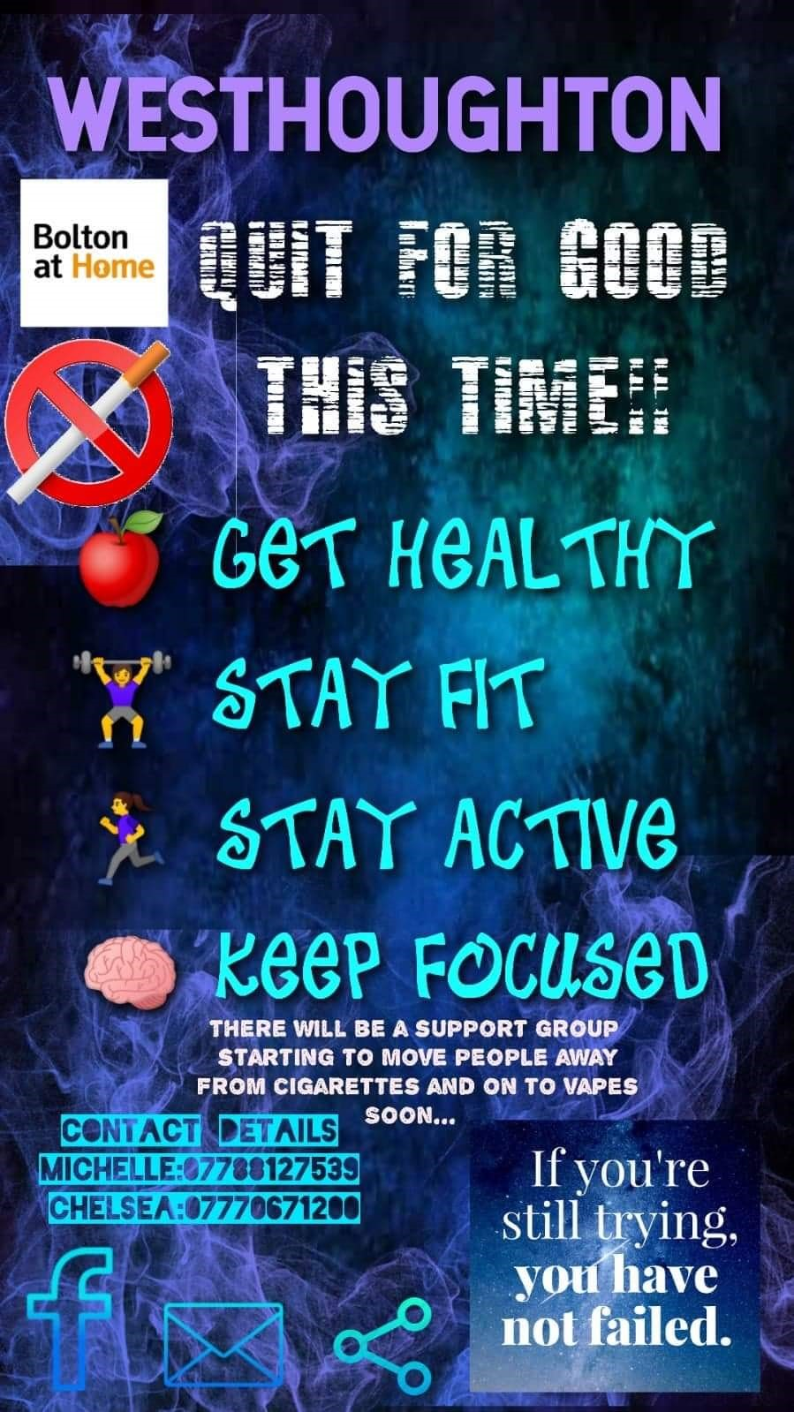
Recruitment of participants/ Promotion
Publicised through social media and door knocks.
Creation of a Facebook page that people could message to be signed up.
Peer Navigators – local people employed to work in their own community.
It should also be noted that we had a few people join the project part way through as a result of positive word of mouth feedback about how well participants were doing.

Slide 7
Training
All officers involved did appropriate training.
This gave them the confidence to talk to the participants around the issues surrounding giving up smoking such as cravings, stressors, triggers as well as detailed information about the different types of NRT (Nicotine Replacement Therapy).
It also meant they were trained/able to carry out Carbon Monoxide level checks on participants at weekly sessions.

Slide 8
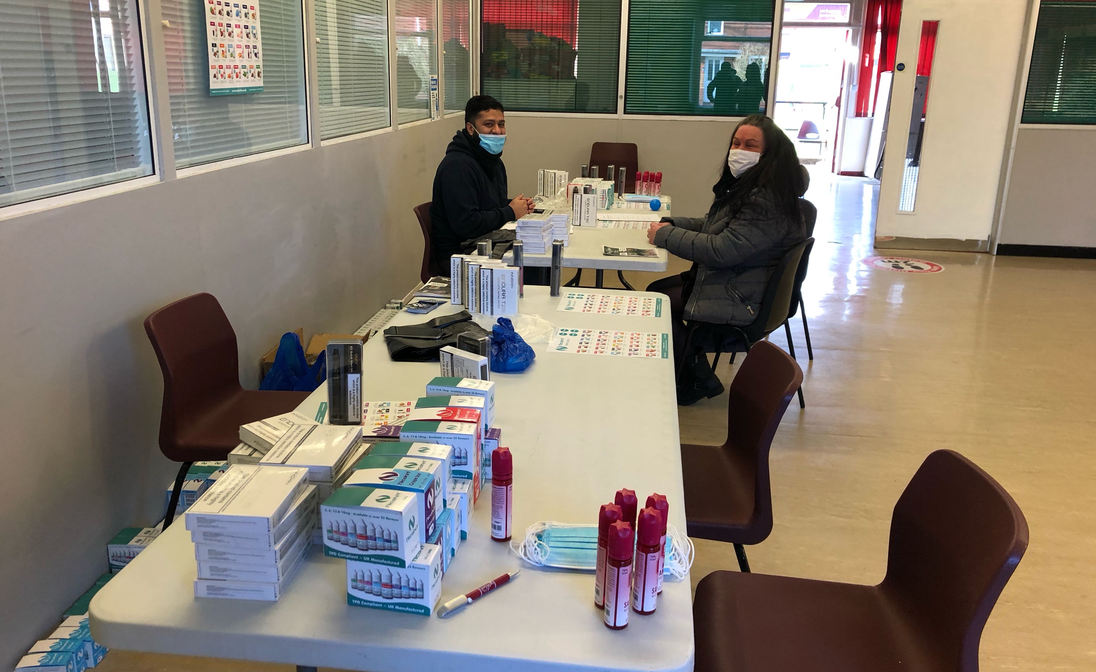
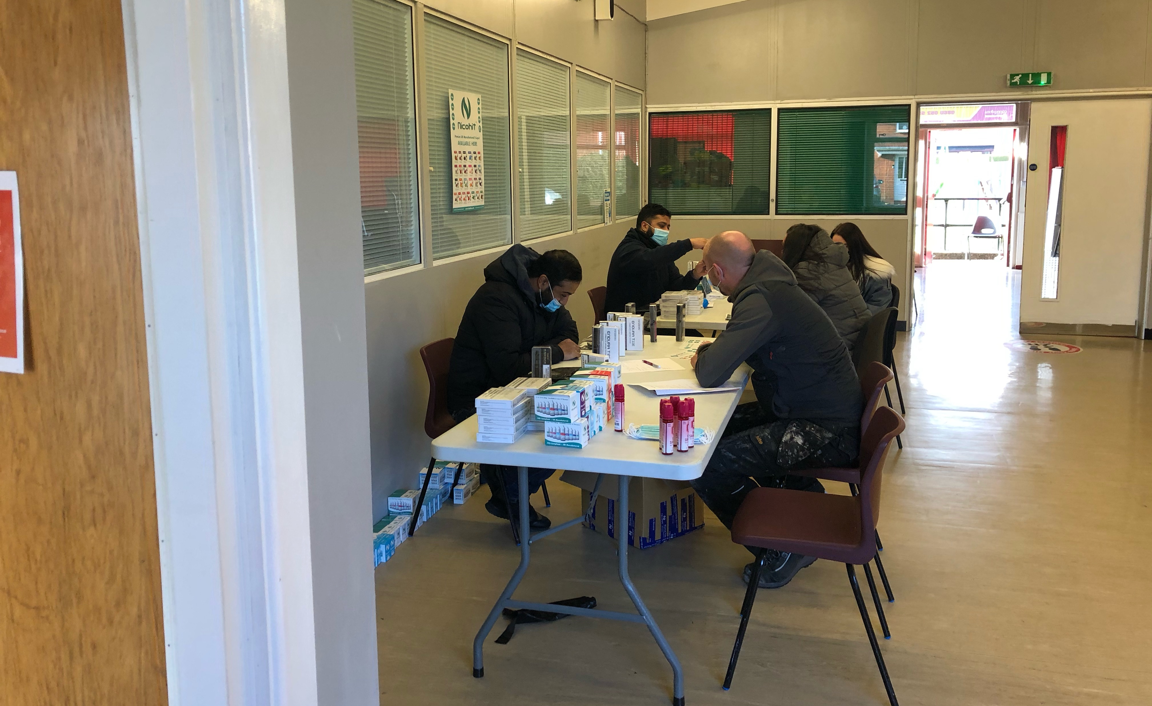
Initial Session
Vape Experts present at initial session.
Feedback from this session was positive and some participants explained that they had tried vaping in the past but were unsuccessful as they had not had any advice to go alongside it.

Slide 9
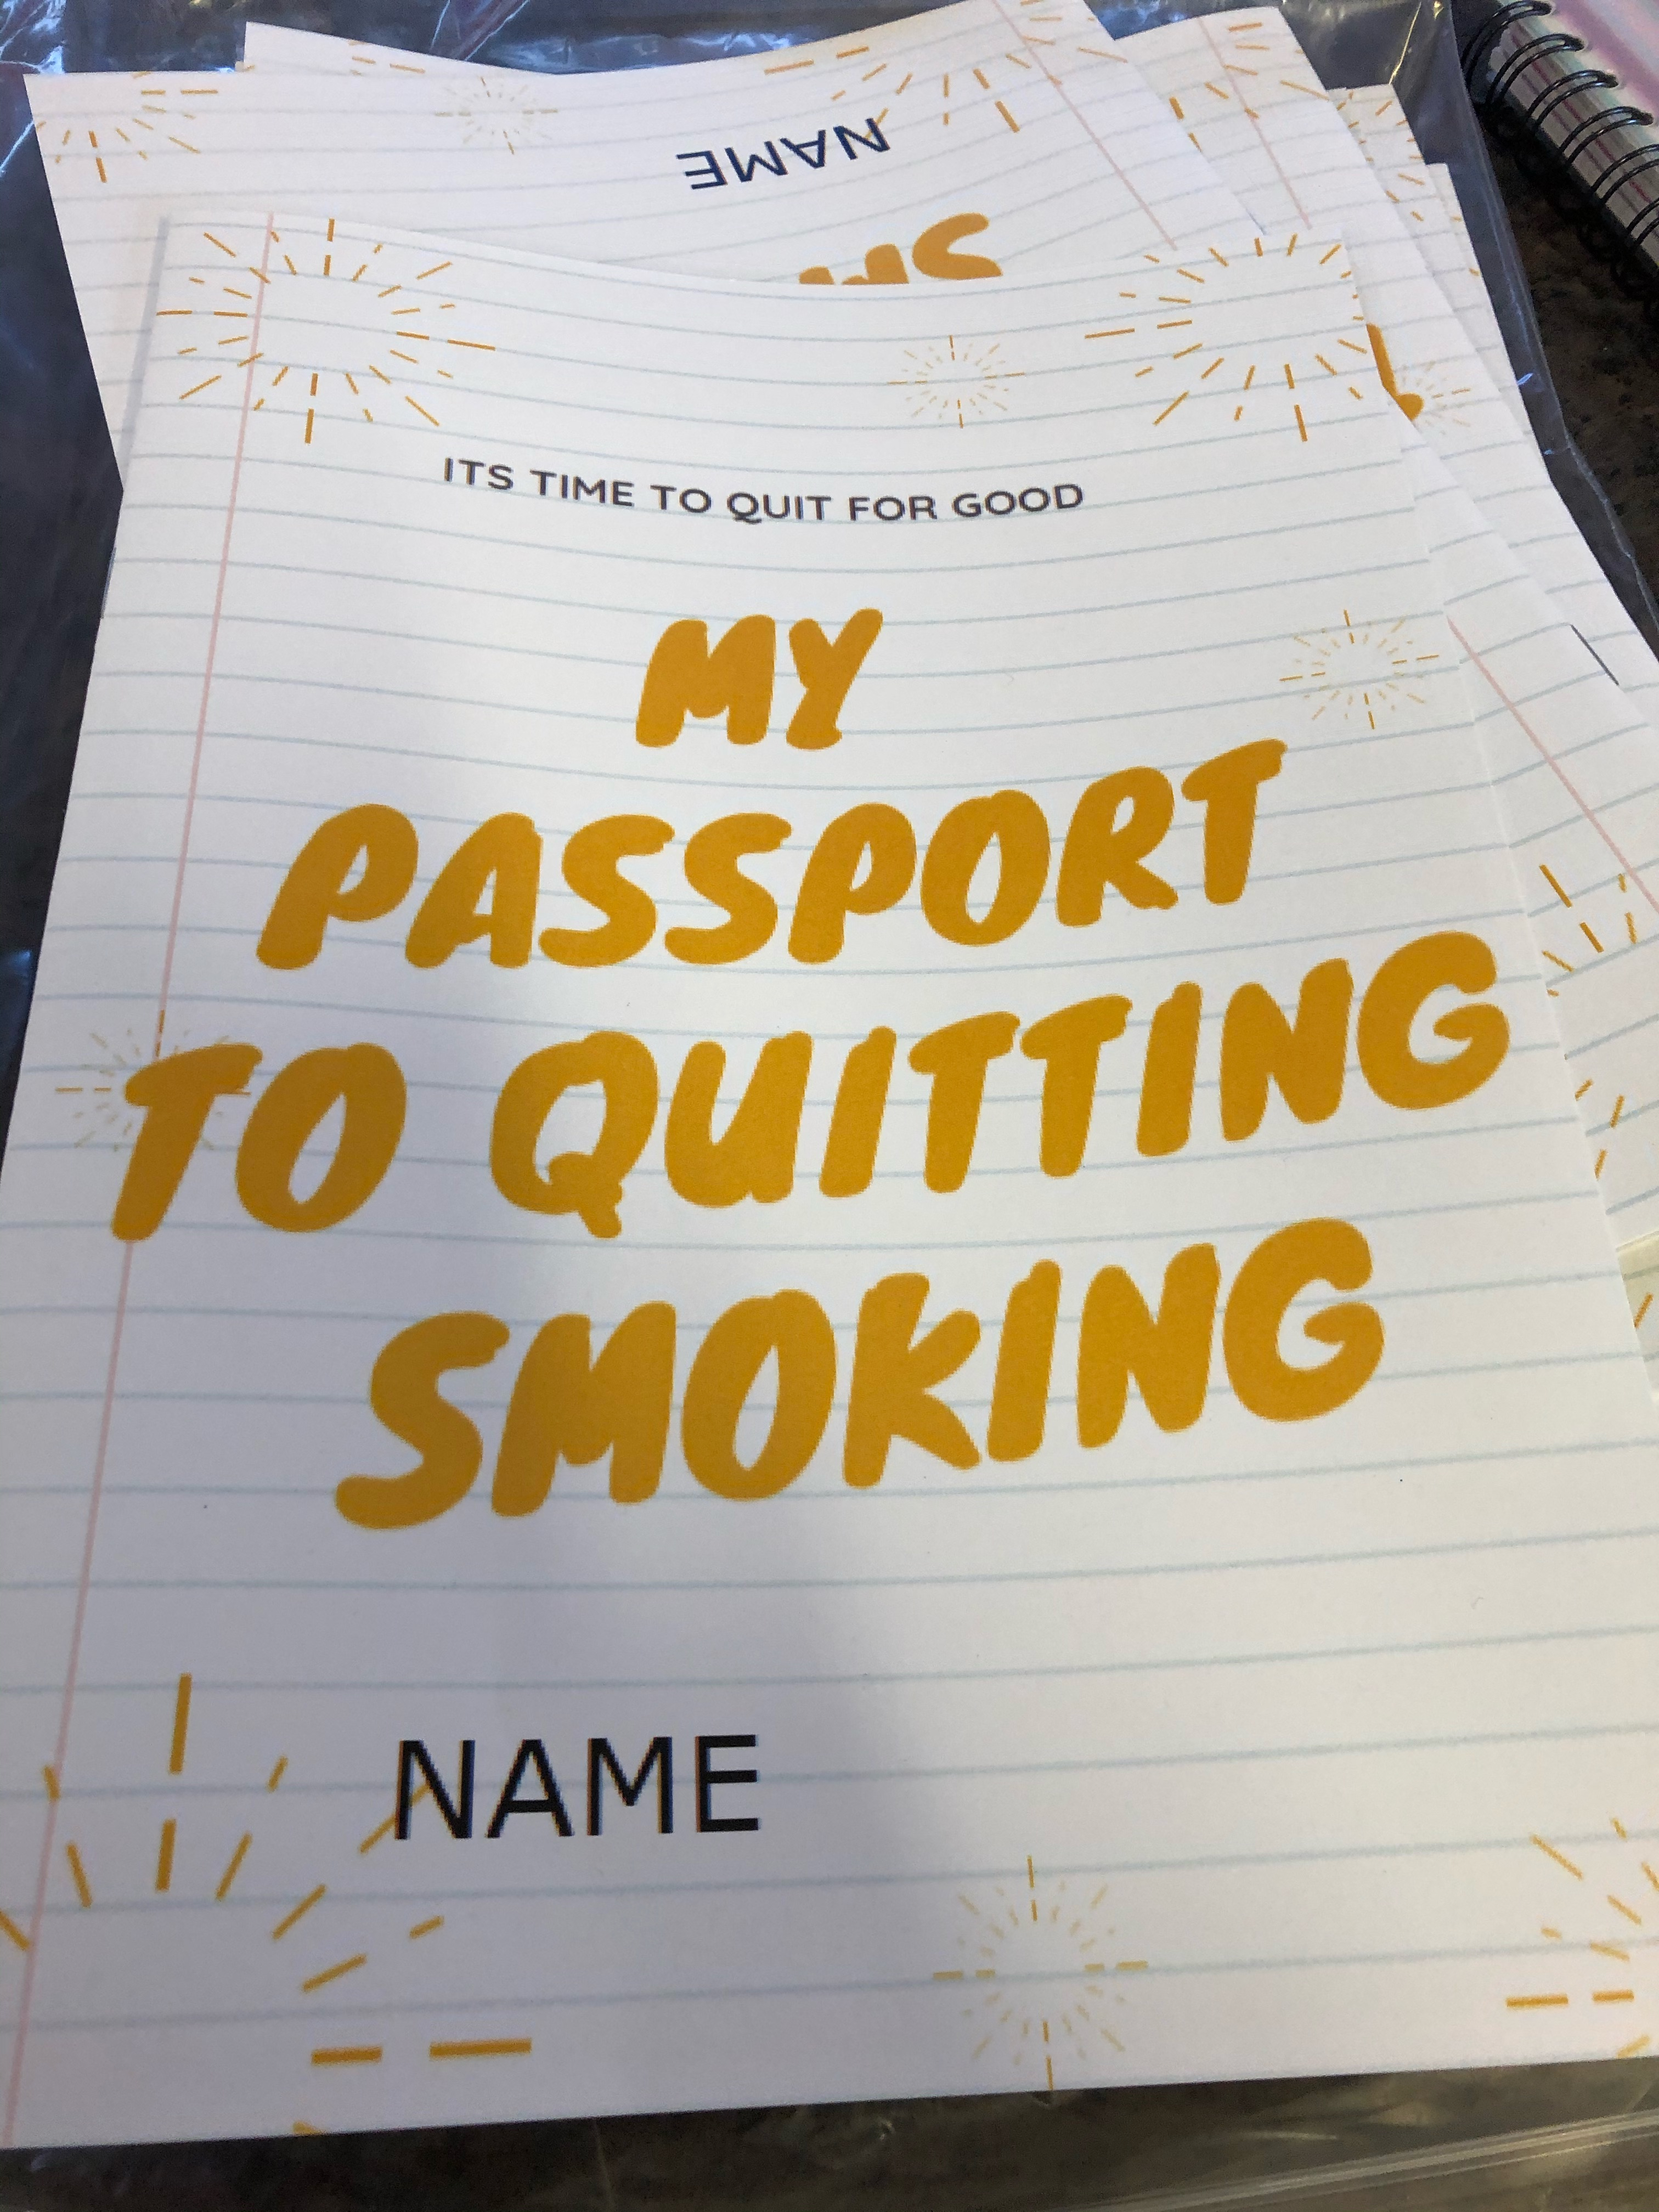
Initial Session (cont…)
Each participant was given a 'Passport to Quitting' Booklet which gave information about what to expect from the sessions, useful numbers and websites and a weekly diary where they could record any cravings or stresses they had.

Slide 10
Ongoing Sessions:
Weekly sessions (one in the afternoon and one in the early evening to accommodate those working).
Participants attended a 5-10 minute slot, where they had their Carbon Monoxide levels monitored alongside a general discussion on how they were doing and if they had managed to go the whole week without a cigarette.
We also asked participants – what fitness sessions they would be interested in and their availability. Sessions would be delivered on the MUGA (Multi use games area) and local fitness groups were approached to deliver.

Slide 11
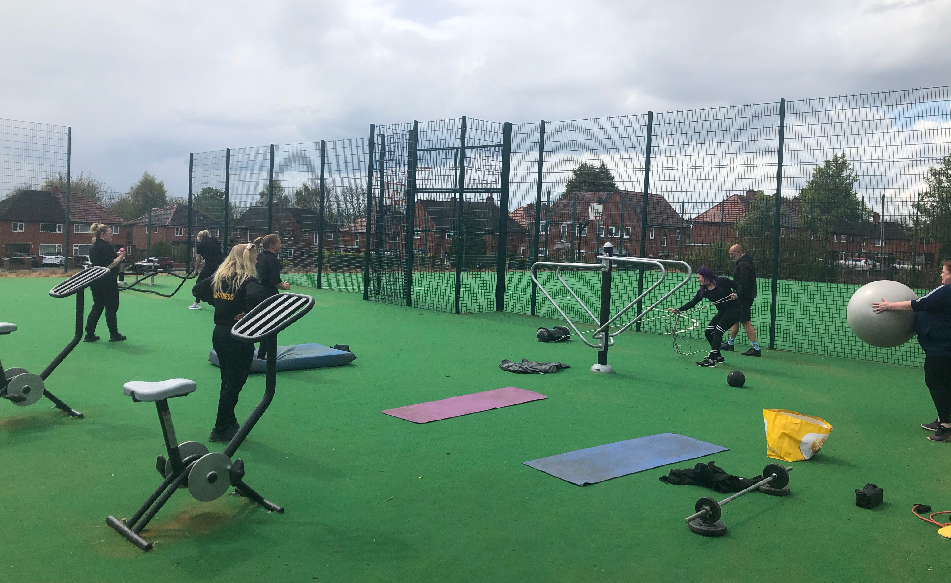
Fitness Sessions:
After two months, the format of the weekly sessions changed from just the CO check and consultation to a group fitness session.
Choice of circuit training or Yoga

Slide 12
Costings
Cost for 20 participants £5,720
Individual participant is £286
These costings are for the project as it was run. They do not include venue hire and cost of fitness sessions as they will vary according to location. ( for example if we ran it out of a UCAN or one of our outdoor sites rather than at a community centre venue hire would not be a cost).

Slide 13
Things to change/improve/ consider
Need to offer weekly sessions, we had to cancel a few due to Covid and found numbers attending weekly meetings dropped to about half when we reinstated them.
Maybe don’t start in the middle of a pandemic!!
Costs are high, would not be able to roll out at this cost, currently looking at less expensive ways of running the project in other estates.
Not everyone has taken up the offer of fitness sessions, would need to look at alternate activities (the Arts etc) and be led by the group.
6 month duration is a big commitment, need to look at community champion approach or redirect onto another project to continue the toping smoking aspect.

Slide 14
Outcomes / Successes so far…
A good initial uptake with around 20 participants signing up
Very strong retention with only a couple dropping out of the programme and a couple more whose attendance has been sporadic.
The CO monitoring has proved a really effective tool to motivate participants.
The majority of people have either quit entirely or cut down to around 1 a day (and looking to cut that out 2)
Feedback from the weekly sessions has been positive and both peer navigators have built up a good working relationship with participants
Participants have also been signposted to other services and community groups such as Money Advice Team and the local growing site to volunteer.
The WhatsApp group has proven a tremendous tool to engage and motivate participants.
Initial feedback from fitness sessions is positive
Increase in Community Cohesion – working with new customers
Reduction in social isolation – some members only reason for leaving home.
Increase in physical activity

Slide 15
Suzanne
“Since quitting smoking with group I feel I am able to keep it up! Especially now that I have started the fitness programme.
I have now tried yoga for the first time and I absolutely love it! Adele is a very professional, engaging coach and the sessions are so much fun, not only has it helped me to keep fit physically, but mentally I feel great, being able to get out of the house and do something for me that doesn’t cost anything. I would have never enrolled into a fitness class due to funds so I am truly grateful for this amazing opportunity.”
Notes:
Lisa

Slide 16
Questions ????
paula.rowson@boltonathome.org.uk
shauna.morton@boltonathome.org.uk

