Slide 1
Bolton at Home Health And Housing Informed by Residents
Paula Rowson and Lisa Bradley
Community Investment Team Managers

Slide 2
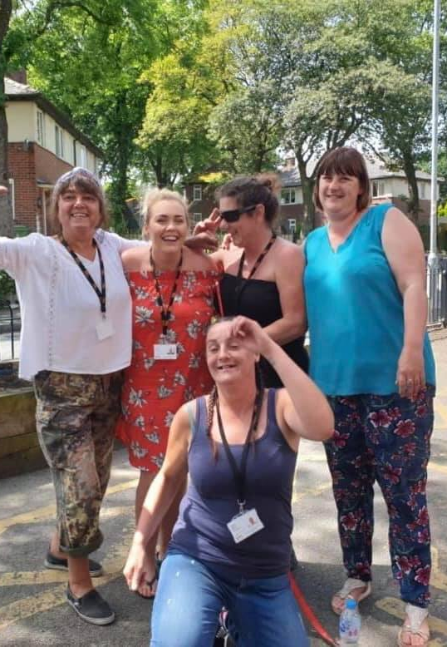
The Peer Navigator Approach
Initial Pilot: Employed 4 Peer Navigators on one of our Estates – After a successful pilot, project has grown and now employ 13 Peer Navigators. Each Peer Navigator is employed for 18 months and given training and support.
Local partnership – Scheme is in partnership with Bolton CVS. Further Peer Navigators have been funded by Bolton Council Controlling Migration Fund, Bolton CCG, Bolton's Community Champions programme and other Housing Associations partners.

Slide 3
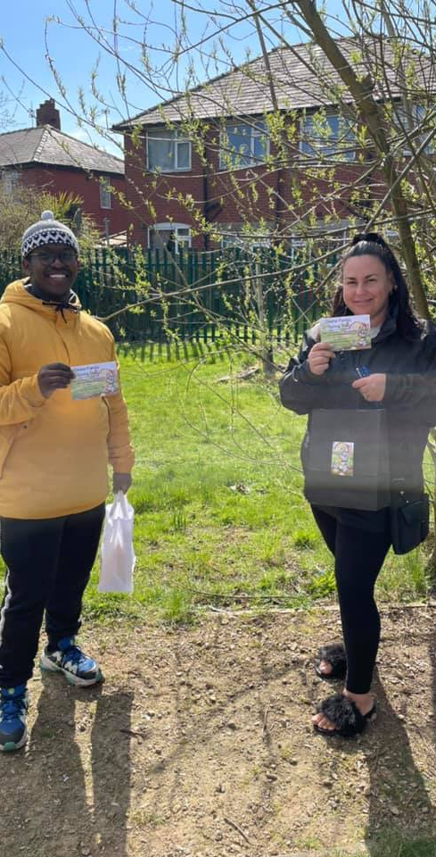
Training and Career Progression
Core: All Peer Navigators complete online training as part of their induction
Variety: Throughout the 18 months of employment they have a range of training opportunities including from external agencies such as DAV (Fort Alice), Community Asset Navigation (Forever Manchester and ABC community cohesion/ having difficult conversations (CVS)
Bespoke: Peer Navigators are encouraged to seek out other training opportunities based on their particular interests/career ambitions which are often funded by BH.
Progression: Past Peer Navigators have gone on to find employment in roles such as Health and Wellbeing apprentice, Dementia Care Navigator, CVS community role, office based positions in BH and other organisations.

Slide 4
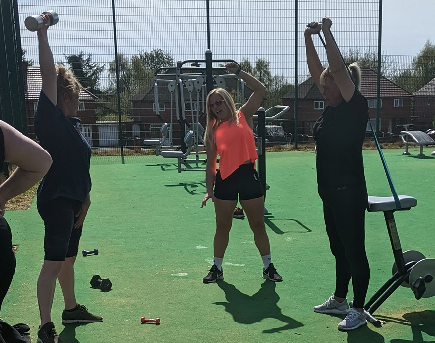
Health and Wellbeing Focus
Responsive: Peer Navigators, as members of their community are uniquely placed to be responsive to the needs of the local area.
Proactive: During the first lockdown, Peer Navigators were able to quickly identify individuals and families who needed support with food parcels, welfare calls and other support.
Navigations: Peer Navigators are aware of referral pathways and regularly refer into services (such as HIPs, social prescribers, Money Advice , Working Wardrobe, Achieve (drug and alcohol misuse service) Endeavour and Fort Alice (DAV services)
Digital: Each area has a Peer Navigator Facebook page which gives important information to local residents. These pages have a greater reach within the neighbourhood than our traditional social media.
Initiatives: Peer Navigators have initiated projects such as a school uniform donation, Period Poverty, local growing projects, arts and crafts at home, walking projects etc.
Notes:
PN Work is responsive / reflective to the local needs of the area they live/work
For example – at start of the pandemic…our work was proactive – thanks to the PNs being able to identify those that most need support i.e. food parcels / welfare calls
As mentioned PNs trained up in many services – so they are able to signpost customers direct into
Digital – All PN’s have set up local social media accounts and get greater followers/reach within their neighbourhood. Quicker routes for getting info out to customers, for example current Covid advice and guidance
Local initiatives have been set up by PN’s – for example last year parents on one estate were struggling with the outlay of school uniforms…so one PN did call out/organised with local school them to be cleaned & distributed over 250 uniforms.

Slide 5
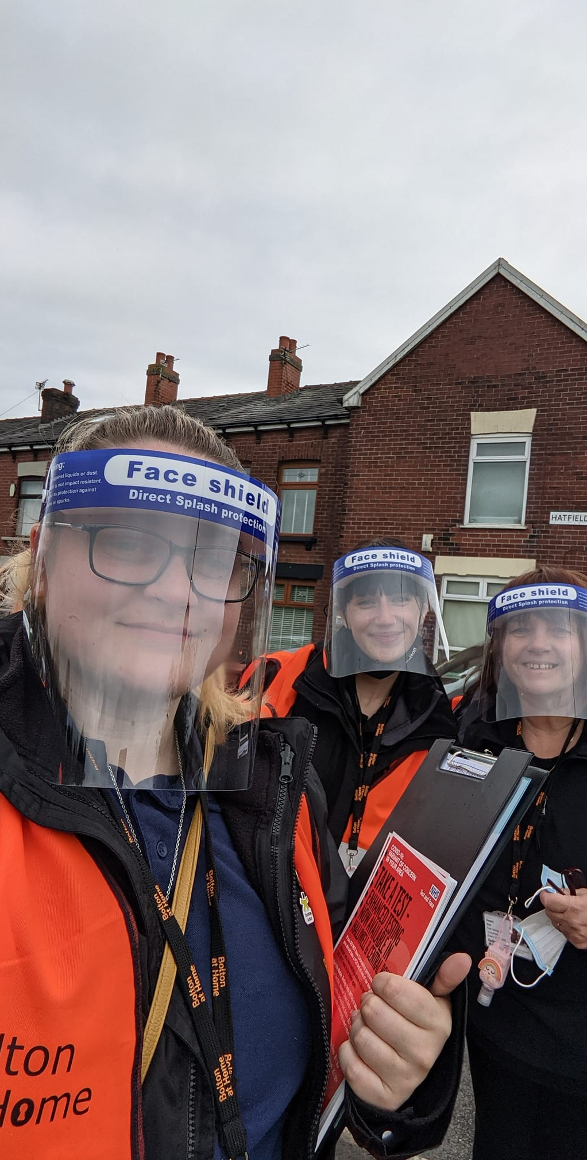
Covid Control Outbreak Engagement
Partnerships: Bolton at Home has worked closely with Bolton Council, Public health and Bolton CCG to help to stop the spread of Covid. The Peer Navigators have been a key part of the strategy adopted
Targeted Door knocks: Initially surveyed residents on vaccine hesitancy and barriers to getting vaccinated. Information gathered was shared with partners to inform next steps
Surge Testing mop up: Delivered testing kits to identified areas, engaged people in their own community about the impact of C19
Community Champions: All Peer Navigators have had training to deliver clear messages on Covid and will continue to support the recovery in Bolton.
Notes:
Unlike many places Bolton has suffered high rates of Covid – and many local lockdowns
As Lisa mentioned - Peer Navs have had the community champions training – so they are clued up in local guidance and can signpost to current offer of testing/vaccines.
They have supported targeted door knocks – to identify barriers for people having vaccine
Helped with recent surge testing – handing out and collecting test kits & also helped promote the Covid vaccine bus in a variety of locations

Slide 6
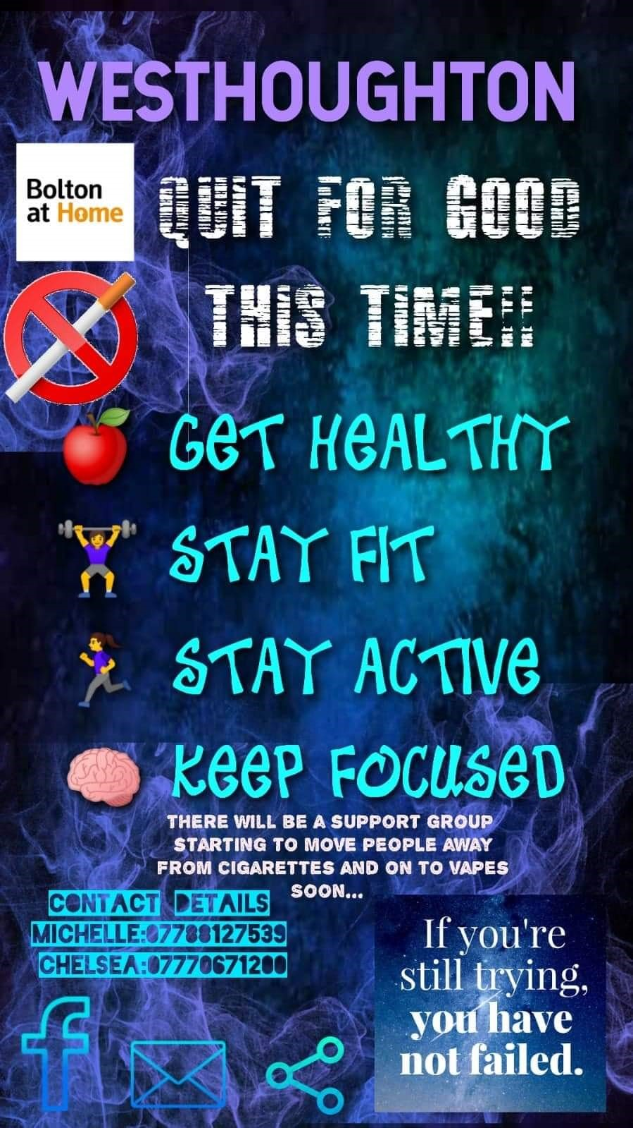
Case Study: Quit and Get Fit
Pilot Project: Peer Navigator run pilot project on one of our estates to encourage people to switch to vaping rather than cigarette smoking. Peer Navigators given appropriate training as well as support from a CDO.
Incentivised: Participants given free vapes and a regular supply of oils in return for weekly attendance for Carbon Monoxide Testing.
Peer Support: The Peer Navigators set up a WhatsApp group for participants which was used to send useful info and encouraging messages between participants.
Fitness Sessions: Participants offered weekly fitness sessions run by a local group of personal trainers. Peer Navigators took part in the sessions as well
Success: virtually no drop out from the project and nearly all the original participants have engaged in the activities and continued to stop smoking.
Notes:
One initiative we have worked on during pandemic – as a means to meeting local need and engaging with tenants was the Quit and Get Fit project
Pilot smoking cessation project – encouraging customers to replace cigerrettes with vapes.
PN’s were trained on this – so they could do the Carbon monoxide testing weekly (in a covid compliant way)
Peer Navs were key in recruiting local people and over 25 customers signed up – a whatsapp group was set up to offer peer support
6 weeks into the project, fitness sessions were introduced – as PN’s identified customers felt they were putting weight on and
Evaluation is being carried out shortly – but the project has had very little drop out – again down to the fact that it is led locally by peer navs.

Slide 7
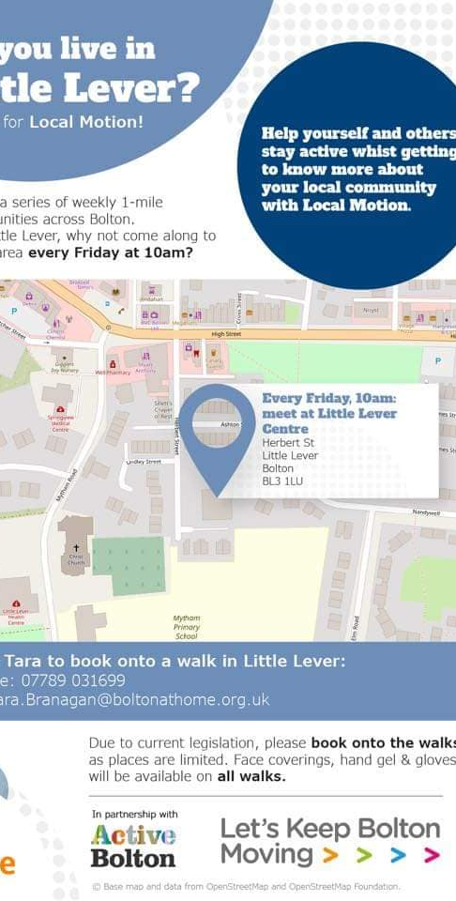
Future Focus
Social Isolation: Pilot project where current Peer Navigators will focus on social isolation and work with residents to address the impact of SI.
Local Motion Walks: Peer Navigators to train to be walk leaders so that this successful project can continue:
Health: Covid Recovery work will continue.
Summer activity programme
Continued testing over the summer holidays as part of activities.
Ongoing local engagement in neighbourhoods
Flexible to develop projects to reflect local concerns/needs.

