Slide 1
Housing an Ageing Population
Research & Analysis Team
November 2020

Slide 2





Context
The UK population is ageing.
The current UK housing stock is ill-suited for an ageing population.
These trends have significant implications for the housing market as well as for public finances more widely.
A wide body of research shows that the adequate provision of housing, both in terms of volumes and options, can simultaneously tackle the issues of housing supply, older people’s wellness, and social care spending.

Slide 3
Demographic and spatial overview

Slide 4
Demographic overview
‘Waves’ of population booms shift the country’s demographic profile as each cohort ages
In the coming years, there are projected to be many more people at older ages, while the number of people aged 64 and under is expected to remain stable. This partly reflects the 1960s baby boomers being aged around 80 years, but also general increases in life expectancy.
Post WW2 “Baby Boom”
1960s “Baby Boom” shifting over time
Source: ONS, Homes England analysis

Slide 5
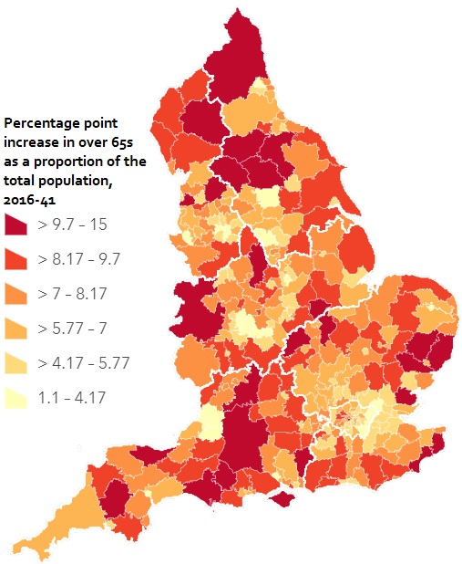
Spatial overview
Rural and coastal areas area ageing at the fastest rate
Newcastle
Population is projected to be aging at the fastest rate in rural and coastal areas, which already have a high proportion of people aged over 65.
A higher number of older residents (in absolute terms) will live in cities, but their growth will be outnumbered by that of people in working age. Thus, in relative terms, the increase in over 65s will be slowest in urban areas.
These trends are particularly relevant for local authorities’ finances, whose reliance on an ‘active’ population will increase as the Revenue Support Grant (historically, local authorities’ primary source of funding from central government in relation to non-school revenue expenditure) is phased out.
Leeds
Manchester
Sheffield
Liverpool
Birmingham
Bristol
London
Source: ONS, Homes England analysis

Slide 6
Owner occupation trends
Older people tend to be homeowners
1960s “Baby Boom” cohort over time
Homeownership is most prevalent among older people. While this may seem intuitive now, it has not been the case in historic terms.
Two main trends are visible in the chart that have implications for the housing market:
  Almost 80% of the 1960s “Baby Boom” cohort are homeowners. Analysis should focus on whether their homes are adequate for older people and whether there is a dormant demand for downsizing that is currently not met by the market.
  A lower proportion of working age generations in 2017/18 are homeowners, highlighting the decrease in affordability in the past 15 years, but also the opportunity for more people to get on the housing ladder in adequate homes (e.g. ‘lifetime homes’).
Source: English Housing Survey, Homes England analysis

Slide 7
Older people housing

Slide 8
Planning Use Classes for older people housing
General Housing
Dwelling houses
Dwelling houses / residential institutions
Residential Institutions
Care Homes
C3
C2
C3
C2
Mainstream/General Housing
The standard housing stock suitable for any member of the public to buy or rent.
Accessible/Lifetime Homes
Housing that is not age-specific, but it follows design criteria that ensure accessibility and inclusivity to promote better living across all ages.
Specialist Housing
A catch all term used in this briefing for any non-general needs housing for older people aside from care homes.
Retirement Housing
A group of flats or bungalows to rent or buy where all residents are older people.
(Enhanced) Sheltered Housing
Another term for retirement housing, offering a range of shared facilities and management.
Extra-Care Homes
Retirement housing that also provides care in a style that can flexibly respond to increasing need without jeopardising one’s role as a community member.
Nursing/Care Homes
A residential setting where a number of people, usually living in single rooms, have access to on-site care.
Applicable planning use classes
C3
Dwelling houses
C2
C3
Dwelling houses / Residential Institutions
C2
Residential Institutions
Sources: HAPPI reports 1 to 5, Lifetime Homes’ website, Lichfields’ Guide to Use Class Order in England.

Slide 9
Willingness to downsize
INTERNAL ONLY
Attitude towards downsizing is most positive among people aged 55-64
Are you planning to downsize?
(Respondents aged 55+)
Around four in ten people aged 55 to 74 do not expect to downsize, rising to over five in ten among those aged 75 and over.
Around half of people aged over 55 is considering, or expects to consider, downsizing in order to improve their standard of living.
While responses suggest that those who have downsized have already done so by the time they are over 65, around one in five respondents aged over 65 states that they will consider downsizing in the future.
Importantly, these results account for willingness to downsize, which may be affected by the perception of availability of suitable housing solutions. As such, there could be ‘dormant demand’ from respondents that would consider downsizing should the option become available.
Source: International Longevity Centre, McCarthy & Stone

Slide 10
Older people’s housing demand
INTERNAL ONLY
Almost two thirds of people over 55 does not rule out moving
Are you planning to move?
(Respondents aged 55+)
Only 36% of people aged over 55 are not planning to move. 35% of people do not know if they will move again, while 29% plan to move eventually.
  Of those planning to move, the large majority considers doing so in 5 or more years’ time.
With only around one third of respondents ruling out moving in present market conditions, there appears to be scope for the market to offer older people adequate options.
These results, especially considered alongside the responses outlined earlier on older people’s willingness to downsize, counter the impression that people are generally unwilling to leave their family home in old age and prompt us to answer the question: why aren’t they?
64%
Not ruling out moving
Source: Knight Frank, Markit Economics, from HAPPI 3 (2016)

Slide 11
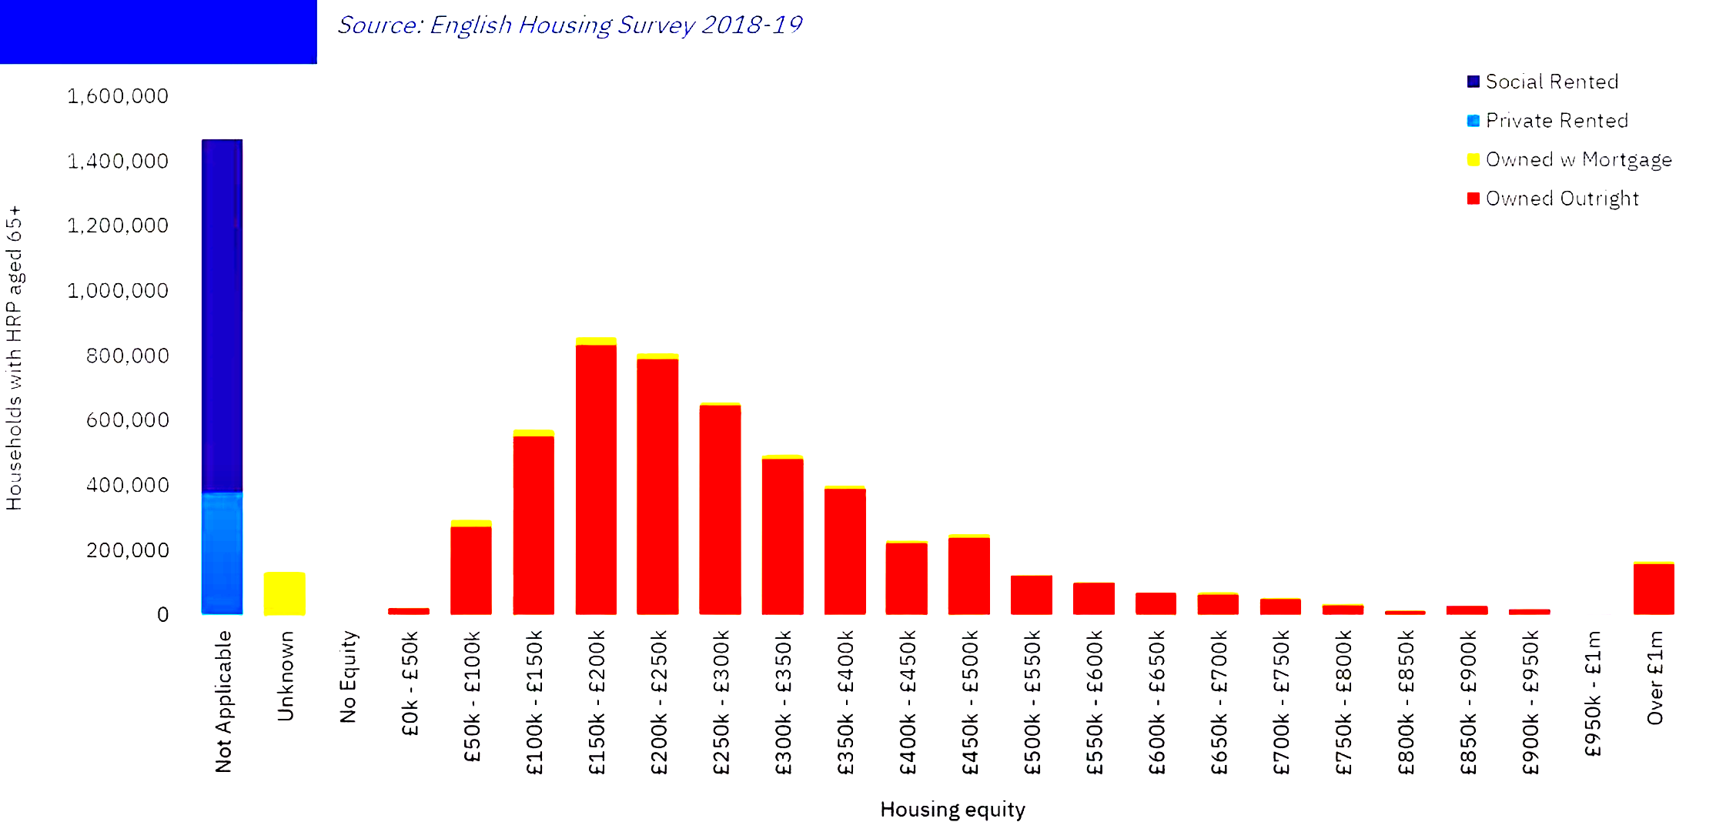
Older people’s housing equity
Older people housing equity is often too low to downsize and unlock equity at the same time
Older people have a level of housing equity comparable to the average house price in England.
While the majority of older people owns their home outright, the value of these properties does not significantly differ from the rest of the housing stock (average house price in England as of August 2020: £256,000)
As such, financial constraints are a major barrier to older people that aim to simultaneously downsize and release equity.
Housing equity of people aged 65 and over
Source: English Housing Survey 2018-2019, BuiltPlace

Slide 12
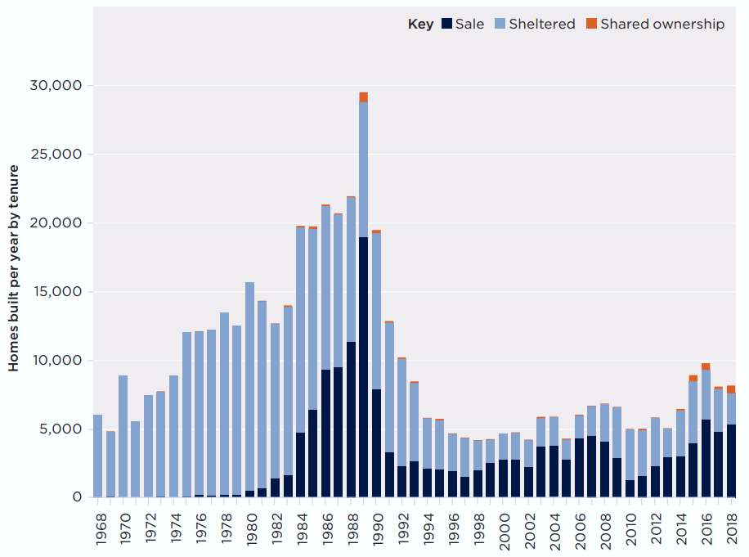
Supply of older people specialist housing
Supply is picking up, but it is still short of rate needed to meet current and dormant demand
At present, there are around 726,000 specialist homes for older people, according to data from the EAC.
More than half of the stock (52%) was built or last refurbished more than 30 years ago.
With supply having peaked in the 70s and 80s, sheltered homes make up around three-quarters of retirement homes in the UK.
While supply is at its highest levels in almost 30 years, it is still well below the rate needed to meet current and dormant need for older people housing.
There are around 12 million people aged over 65 in the UK, around 8 million households. According to Savills’ research, international benchmarks suggest that specialist housing should be provided for 15% of these households. This suggest that the current shortfall of specialist housing is over 400.000 homes.
Source: Elderly Accommodation Counsel via Savills

Slide 13
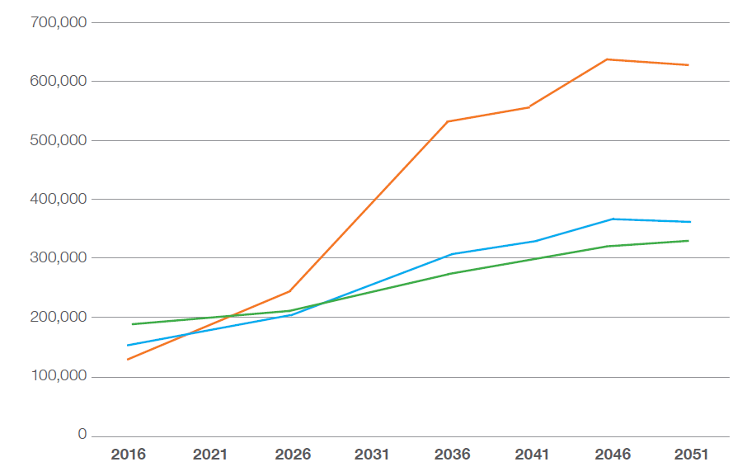
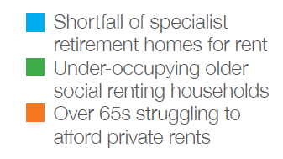
Rental homes need for people aged over 55
INTERNAL ONLY
As for the mainstream housing market, older people rental market plays an important role
The number of private renters aged over 55 has more than doubled between 2003-04 and 2017-18 (from 366,000 to 743,000), data from the English Housing Survey shows.
The Social Market Foundation, a think-tank, has provided estimates suggesting that, over the next 30 years:
There will be a need for an additional 360,000 specialist rented units (12,000 units per year) to meet the needs of older private and social renters that are/will be living in unsuitable housing
This need is likely to be compounded by the rise of older people living in the private rented sector, whose rent may become unaffordable as their income decreases. This cohort would require up to 21,000 units per year.
Part of this need may be met by local authorities by providing adequate options for under-occupying, older households to downsize. The SMF estimates that 11,000 homes per year would be needed to offer every under-occupying, older person a “rightsizer” home.
Source: Social Market Foundation, from HAPPI 5 (2019)

Slide 14
Wider benefits of older people housing provision

Slide 15
Wider health benefits of adequate housing
Access to adequate housing solutions has wide-reaching, positive effects
93%
Research on living in appropriate housing showed encouraging results on residents’ wellbeing:
A longitudinal study looking at the effects of moving into a supported and physically and socially accessible ‘extra-care’ living environment found a reduction in unplanned hospital stays (from 8-14 days down to 1-2.) It also saw a 15% reduction in depressive symptoms and a 64% reduction in ‘clinical level’ depression over an 18 month period¹.
New residents also showed improvement in depression, perceived health, aspects of cognitive function, while the control group (33 older adults who had stayed in their original homes) showed worsening functional limitations².
Evidence from a different study on ‘extra-care’ living also shows that it is not straightforward for residents to negotiate new relationships and maintain friendships outside the community³.
of homes in England in 2014 (amounting to 21.8 million units) lacked at least one of four accessibility features that provide visitability:
level access to the entrance;
a flush threshold;
sufficiently wide doorsets and circulation space; and
a toilet at entrance level.
Of which:
72%
of not-fully accessible homes (15.7 million units) could be adapted to provide all four features.
Source: English Housing Survey
Note: Extra-Care housing is “retirement housing that also provides care in a style that can flexibly respond to increasing need without jeopardising one’s role as a community member” (HAPPI 2)
Holland, C. et al. (2015) Collaborative Research between Aston Research Centre for Healthy Ageing (ARCHA) and the ExtraCare Charitable Trust: Final Report, Aston University, April 2015.
Holland, C. et al. (2017) Transition from community dwelling to retirement village in older adults: cognitive functioning and psychological health outcomes. Ageing & Society, 37(7), pp. 1499-1526.
Shaw, R. L. et al. (2016) Living well to the end: A phenomenological analysis of life in extra care housing, International Journal of Qualitative Studies on Health and Well-being, 11(1).

Slide 16
Wider financial benefits of adequate housing
Providing adequate housing solutions brings a strong dividend for public finances
Because of the health and adult social care costs growing with older age, adequate housing for older people is expected to provide significant savings to the NHS and public spending more generally.
A study by the Building Research Establishment estimates that ‘poor housing’ costs the NHS £1.4bn annually in England¹.
A separate research showed that residents in Extra Care Charitable Trust cost the NHS £1,115 less per person, per year compared to costs incurred by comparable residents in the surrounding area. This represented an NHS spend reduction of 38%, which is significant in light of the proportion that Adult Social Care and Health spending represent of the State’s total (as visible in the chat of public receipts and spending presented)².
Age
Source: OBR, Homes England analysis
Research into the savings of retirement housing
Source | Annual cost savings | Assumptions
Strategic Society Culture (2016) | £928 per person | Applied discount to means-test cost savings as some households may not qualify
Demos (2017) | £1,000 per person | Excluded savings from home sales pushing households over means-testing threshold
Holland et al (2015) | £1,115 per person
Nicol, S. et al (2015) The cost of poor housing to the NHS, BRE briefing paper.
Holland, C. et al. (2015) Collaborative Research between Aston Research Centre for Healthy Ageing (ARCHA) and the ExtraCare Charitable Trust: Final Report, Aston University, April 2015.
Source: Savills research

Slide 17
Reasons for intervention and conclusion

Slide 18
Reasons for intervention
Different types of market failure could support the case for intervention
According the HM Treasury’s Green Book, the rationale for intervention can be based on strategic objectives, improvements to existing policy, market failure or distributional objectives that the government wishes to meet.
Notwithstanding specific distributional objectives that the government may wish to meet, the case for Home England’s intervention housing market to account for an ageing population may lie in market failure. A market failure is where the market mechanism alone cannot achieve economic efficiency, examples that are relevant to older people housing are listed below.
Examples of market failures | Relevance to housing an ageing population
Market Power results from insufficient actual or potential competition to ensure that a market operates efficiently. | Due to the planning designation of older people housing being a mix of Use Classes C2 and C3 and with the two carrying different planning obligations, the incentive for the market to provide an adequate provision of accessible mainstream housing and retirement housing solutions is not always sufficient to ensure viability.
Imperfect information or ‘asymmetry of information’ could lead to moral hazard or adverse selection, since information is needed for markets to operate efficiently. | With over 90% of the housing stock lacking in at least one measure of visitability, it is apparent that the importance of these metrics is poorly understood by either housing sector actors (not providing the necessary improvements to the stock) or the public (not demanding them).
Externalities occur when an activity produces benefits or costs for others. | Several studies have shown that the provision of adequate housing to older people reduces the costs for the public.
Source: Homes England analysis

Slide 19
Conclusion
The UK population is ageing, in some areas more than in others, and the current UK housing stock is ill-suited for an ageing population.
18% of the population is 65 or over – that’s over 12 million people.
93% of current housing stock fails accessibility standards.
At present, there is no legal requirement for new homes being built to meet accessibility standards and ensure they remain accessible over time.
Older people tend to be homeowners and are less likely to move.
These trends have significant implications for the housing market as well as for public finances more widely.
People over 55 would be willing to move if options were available. However, house prices need to be affordable as older people seek to release equity.
By 2043, there will be 360 older people for every 1000 of working age, up from 295 in 2018, for a total of over 17 million people aged 65 or over. This puts increasing pressure on local authorities’ finances.
A wide body of research shows that the adequate provision of housing, both in terms of volumes and options, can simultaneously tackle the issues of housing supply, older people’s wellness, and social care spending.

Slide 20
Contact Information
Andrew McWilliam
Andrew.McWilliam@homesengland.gov.uk

