Slide 1



Becky Walker

Slide 2
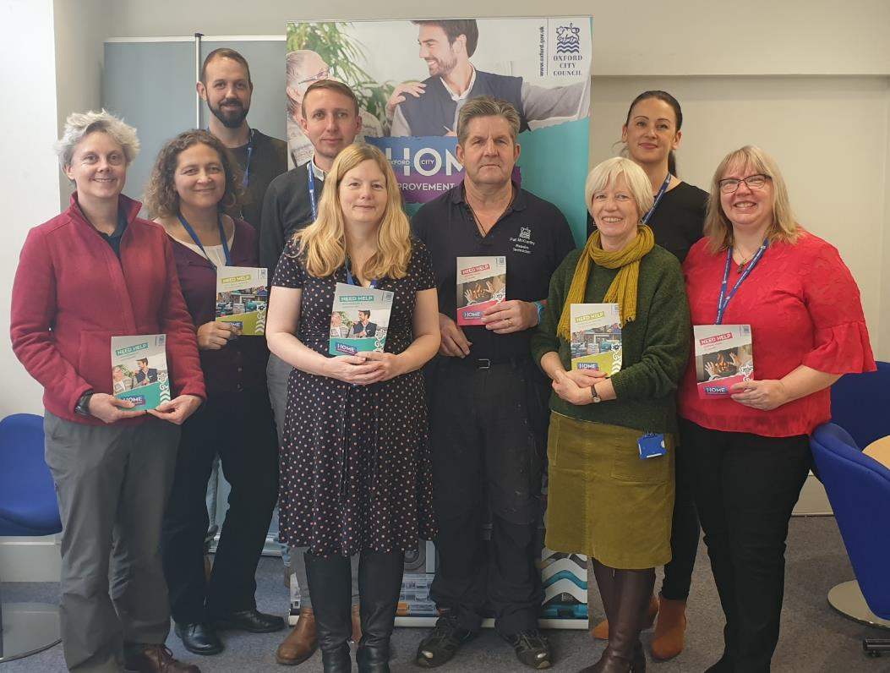
Home Improvement Agency

Slide 3






What do we do…
Disabled Facility Grants
Children’s Disabled Facility Grants
Heating
Repairs & Assistance
Small Repairs Handyperson Service

Slide 4


Covid-19
On 27th March, the head of NHS in England, Sir Simon Stevens, said: "We have reconfigured hospital services so that 33,000 hospital beds are available to treat further coronavirus patients.“
There is now a drive to get as many patients as possible who do not need to be there, discharged from hospital.
From 15 April, all routine operations, such as hip and knee replacements, are being cancelled for three months.

Slide 5

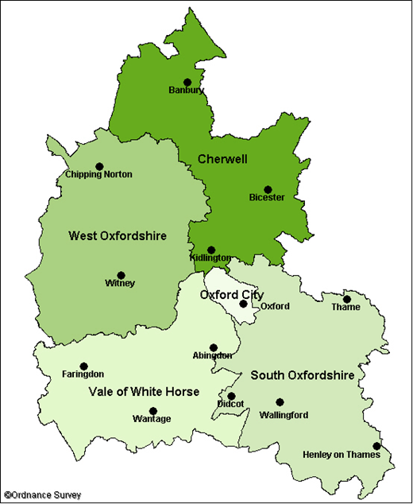

We’ve recognised that many patients cross district borders, so we coordinated with our partner HIA’s in Oxfordshire to support Hospital Discharge in their areas regardless of policy differences.
This meant that hospitals across Oxfordshire had one consolidated contact route to access the support HIA’s can offer

Slide 6
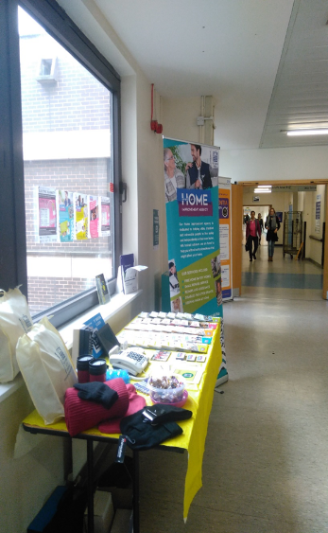
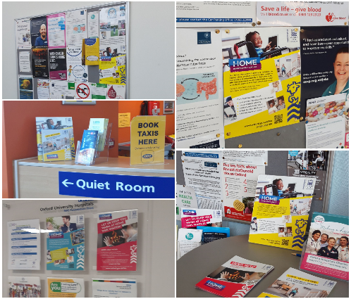
Marketing
We marketed the Safe & Secure grant to all hospitals in Oxfordshire and contacted Adult Social Services, GP surgeries and practicing health professionals.

Slide 7
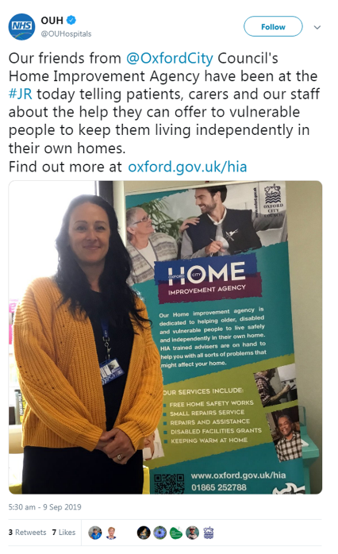
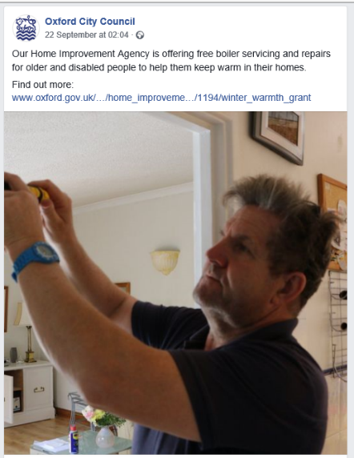
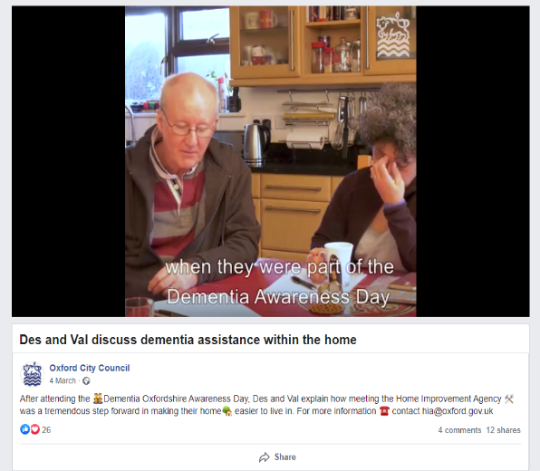
Social Media

Slide 8
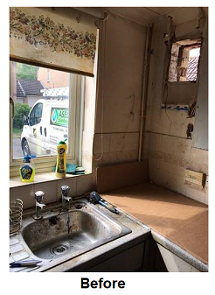
Case study
We received an urgent request from the Social Services team at the John Radcliffe (JR) Hospital. Their client had no hot water or central heating and the team need to arrange a deep clean of the home beforehand to enable hospital discharge.
We arranged for our Gas Safe engineer to visit the property with social services to evaluate and quote. Unfortunately the boiler had already been condemned and capped off with a DO NOT USE sticker on the boiler.

Slide 9
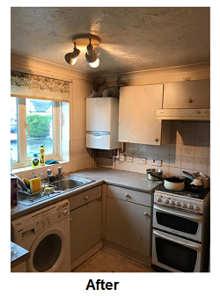
The Care Coordinator at the JR explained “It was all sorted quickly and we as a team are very grateful to your team for helping to get someone out of hospital and reduce the delay in discharge, also reducing the risk of patient catching Covid or another infection whilst waiting in hospital. So thank you very much.”

Slide 10
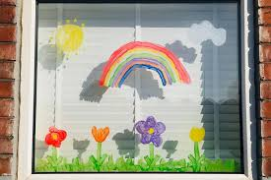
Since Covid we have undertaken roughly 130 Safe & Secure grants at a total cost of £49K. The average cost of each job was only £376.
We made over 765 welfare checks with existing clients referring many to the specialised Oxford City Council HUBS to deliver food parcels and collect prescriptions.

Slide 11
Feedback
“I work in the hospital social services team. Myself and my colleagues heavily rely on the HIA to support us with timely discharges. This could be urgently fitting key safes to free up a hospital bed or providing grants to fix heating and hot water. Without them and their service we would struggle to get people out of hospital as fast as we do, resulting in further delays and holding up beds which are in critical demand. When we contact them, they are prompt and efficient and get things done quickly.”
“We rely on their knowledge and expertise to quickly decide whether they can support with this hospital discharge and how they can go about it. “ Social & Community Services - John Radcliffe Hospital
“First of all I just wanted to say a big thank you for all your help over the past few weeks. Your installation of key safes has been very helpful in getting our most vulnerable patients home from hospital and allowing their carers to access their property.” OT Department, Nuffield Orthopaedic Centre Neurosciences
“Response was very prompt, staff were very helpful and efficient. It was all sorted quickly and we as a team are very grateful to your team for helping to get someone out of hospital and reduce the delay in discharge, also reducing the risk of the patient catching Covid or another infection whilst waiting in hospital. So thank you very much.” - Care Coordinator - John Radcliffe Hospital
“Just to thank you hugely for organising the service to fix my WC. Now the fixing you organised, has already saved me from bothering my GP so often and perhaps from needing hospital care-especially at this critical time of covid19.” – Client feedback

Slide 12


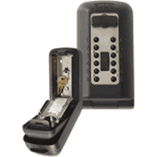
Last year we installed 452 Keysafes, this saved the NHS 3,164 bed days.
A keysafe is estimated to save the NHS approximately seven bed days this was a saving of over £1.145m

Slide 13
Major Repairs
Flexible home improvement loans, backed by the council, provided to home owners aged 60 and over needing major repairs or adaptations.
Essential Repair Grant Provided to low income home owners with major structural repairs.

Slide 14
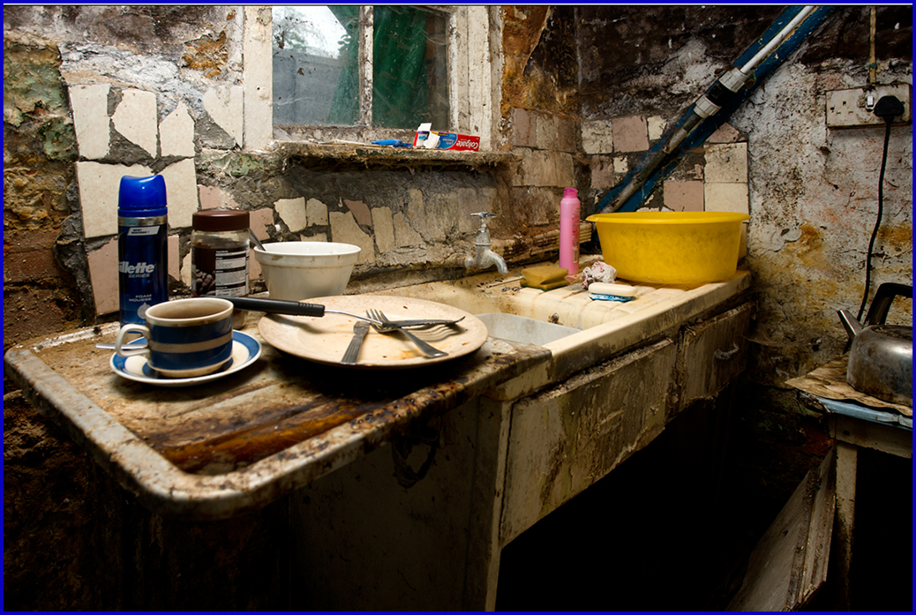
Before

Slide 15
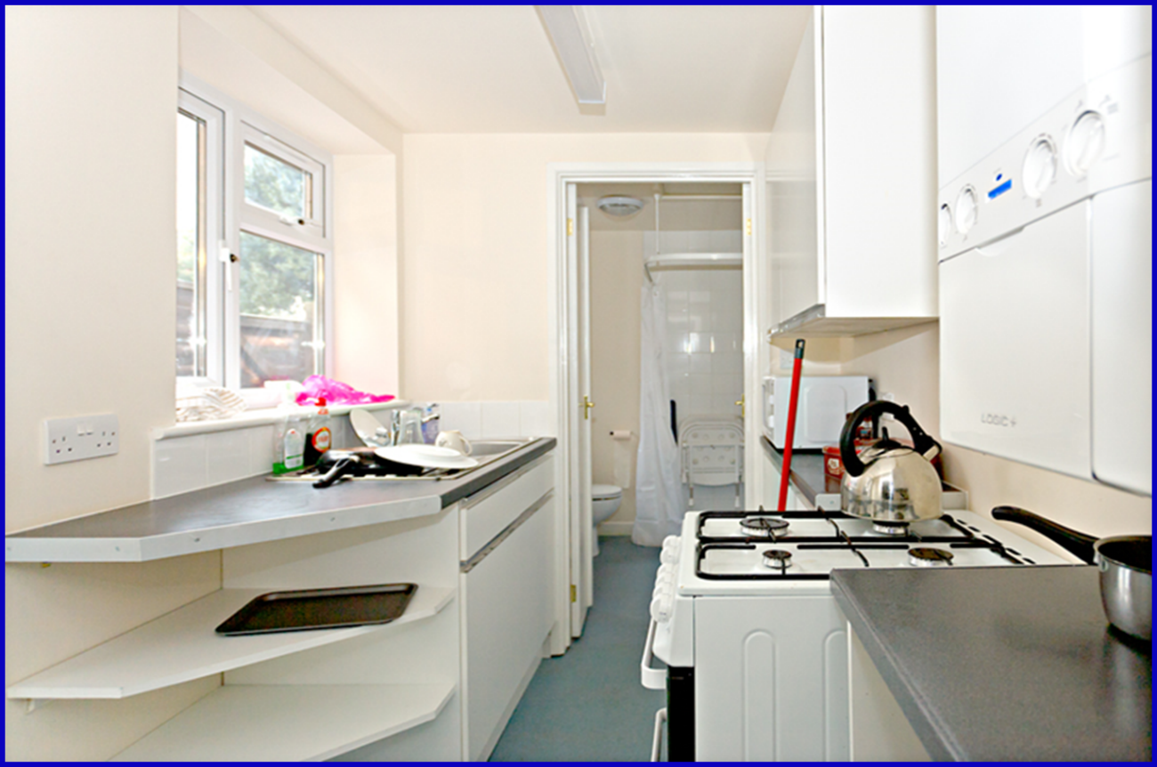
After

Slide 16

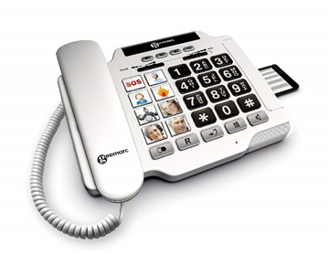
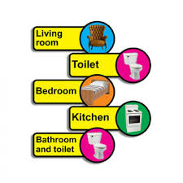
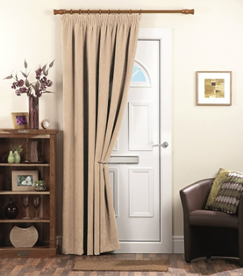
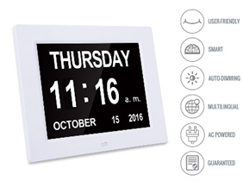
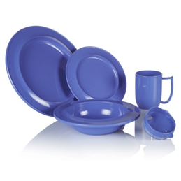
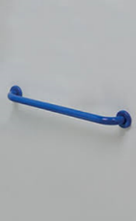

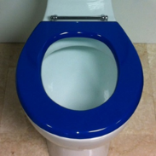

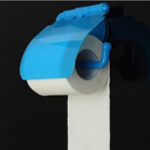
Dementia

Slide 17

A Lead Adviser @ Dementia Oxfordshire said “Dementia friendly radios are simple to use removing the frustration of complex buttons and dials – set your favourite station or create a much-loved playlist. The radio could improve confidence and allows people living with dementia to tap into memories, reducing the feeling of social isolation in Covid times.”

Slide 18

Questions
Becky Walker
Home Improvement Agency Team Manager
Oxford City Council
Phone : 01865 252788
Email : bwalker@oxford.gov.uk
Website : www.oxford.gov.uk/hia

