Slide 1
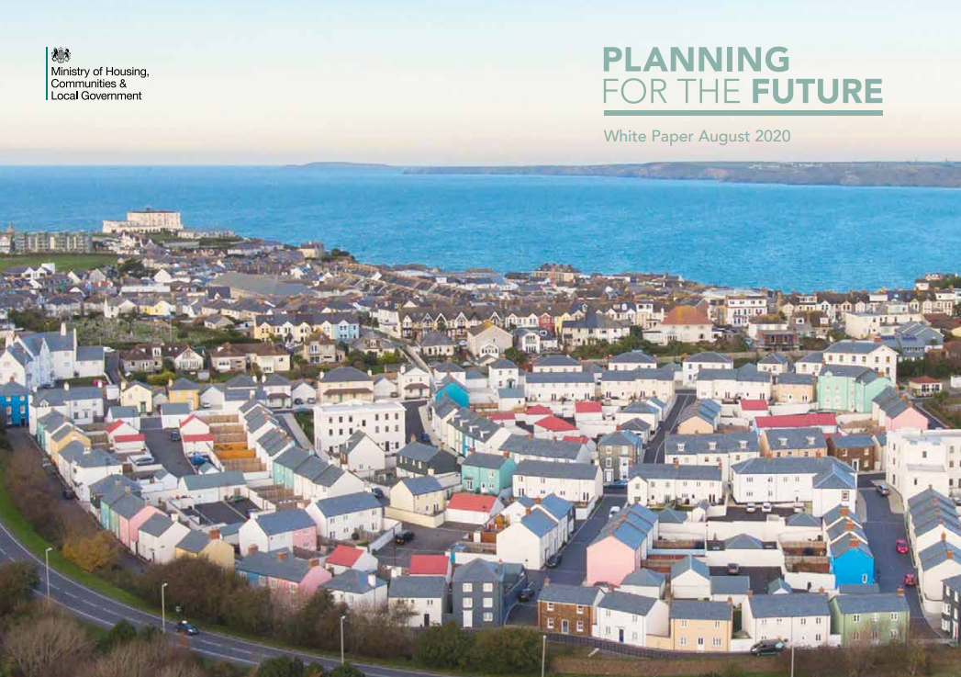
Planning for the Future
Proposes a wide-ranging package of policy and legislative reform
Includes extensive reform to plan-making, a new emphasis on design, and infrastructure funding
Consultation closes 11.45pm on 29 October 2020

Slide 2
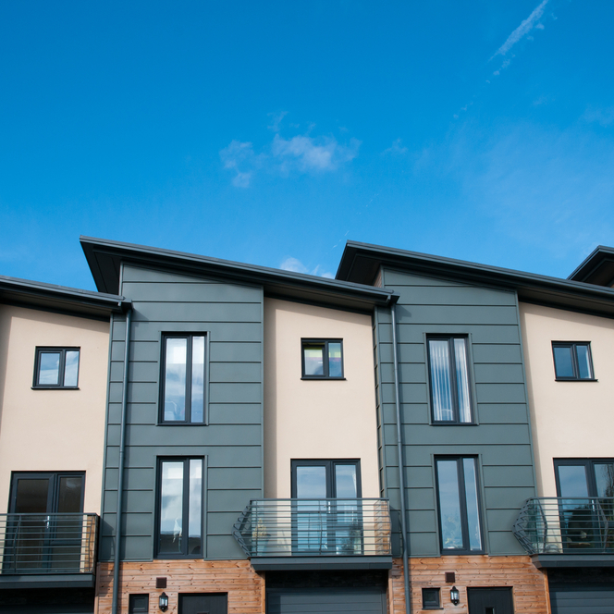

The three pillars for reform
Pillar 1
Planning for development
Pillar 2
Planning for beautiful and sustainable places
Pillar 3
Planning for infrastructure and connected places

Slide 3

Pillar 1: Planning for development
The role of the Plan
Proposal 1 – Land use plans simplified to include Growth areas, Renewal areas and Protected areas
Proposal 2 – development management policies would be set at the national level
Proposal 5 – Growth areas would automatically receive outline planning permission

Slide 4

Pillar 2: Planning for beautiful and sustainable places
Environmental issues
Proposal 16 - A quicker, simpler framework for assessing environmental impacts and enhancement opportunities
Proposal 18 - improvements in the energy efficiency standards for buildings to achieve net-zero by 2050 – buildings to be ‘net-zero ready’ by 2025.

Slide 5

Pillar 3: Planning for infrastructure and connected places
Changing the scope of CIL
Proposal 19 - CIL to be reformed as a fixed proportion of development value in line with nationally-set rate(s), to be termed the Infrastructure Levy
Proposal 20 - Infrastructure Levy to include permitted development rights schemes such as conversions
Proposal 21 – First Homes sold at a discount to market price for first time buyers/key workers, through developer contributions in the short term

