Slide 1
The forecast is for a winter of unprecedented pressure
The Tunstall remote patient monitoring and management platform is a comprehensive and versatile telehealth solution that can be deployed quickly and easily to help you protect vulnerable patients – and your staff
October 2020

Slide 2
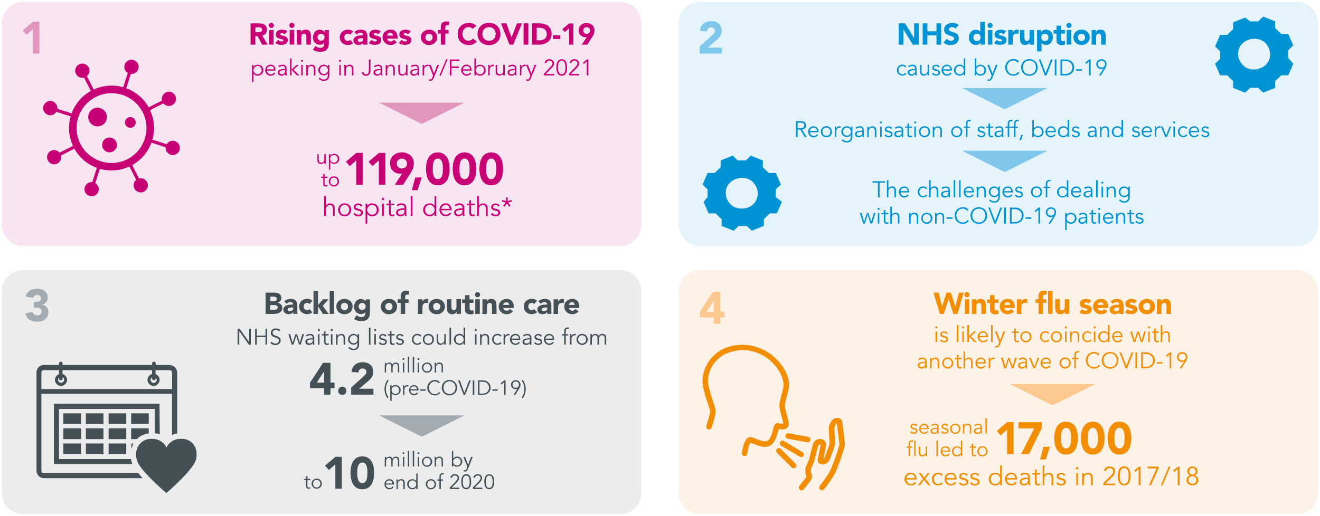
Living with COVID-19 this winter: what should we expect?
When asked by the Government’s Chief Scientific Advisor to look ahead to winter 2020/21,
The Academy of Medical Sciences identified four serious challenges:¹
The UK must prepare now for another potential wave of COVID-19 this winter that could be more serious than the first.
Combined with a growing NHS waiting list, the disruption to the delivery of care caused by the first wave of the
coronavirus and the risk of a winter flu epidemic, this poses a serious risk to health. We do not have long to act...
* Worst case scenario, not accounting for new drugs/treatments/vaccines and assuming no lock-down as strict as March 2020
1. Preparing for a challenging winter 2020/21. The Academy of Medical Sciences. July 2020.

Slide 3
The NHS will face unprecedented layers of pressure this winter
*from 13,906 in 2010/11 to 22,682 in 2014/15
People living at home with long-term conditions and those living in residential care already constitute a major challenge for the NHS. The pressures of COVID-19 have increased their vulnerability. It is likely that winter 20/21 will do so further.
1. Unlocking the power of information smart guide to engagement. Available to download here
2. NHS England website: www.england.nhs.uk/mental-health/adults/iapt/mus
3. Alzheimers Society website. www.alzheimers.org.uk/about-us/news-and-media/facts-media
4. Daily Telegraph. December 2015. Available to view here

Slide 4
A COVID-19 winter: a compelling case for telehealth
The Government has announced an additional £588 million, available to CCGs via the NHS until 31st March 2021, to help cover the cost of recovery and support services for up to six weeks following discharge from hospital.¹
Graphic adapted from: Hospital discharge service requirements: action cards for staff.
Available to download from https://www.gov.uk/government/publications/hospital-discharge-service-action-cards¹
1. Hospital Discharge Service: Policy and Operating Model www.gov.uk August 2020.

Slide 5
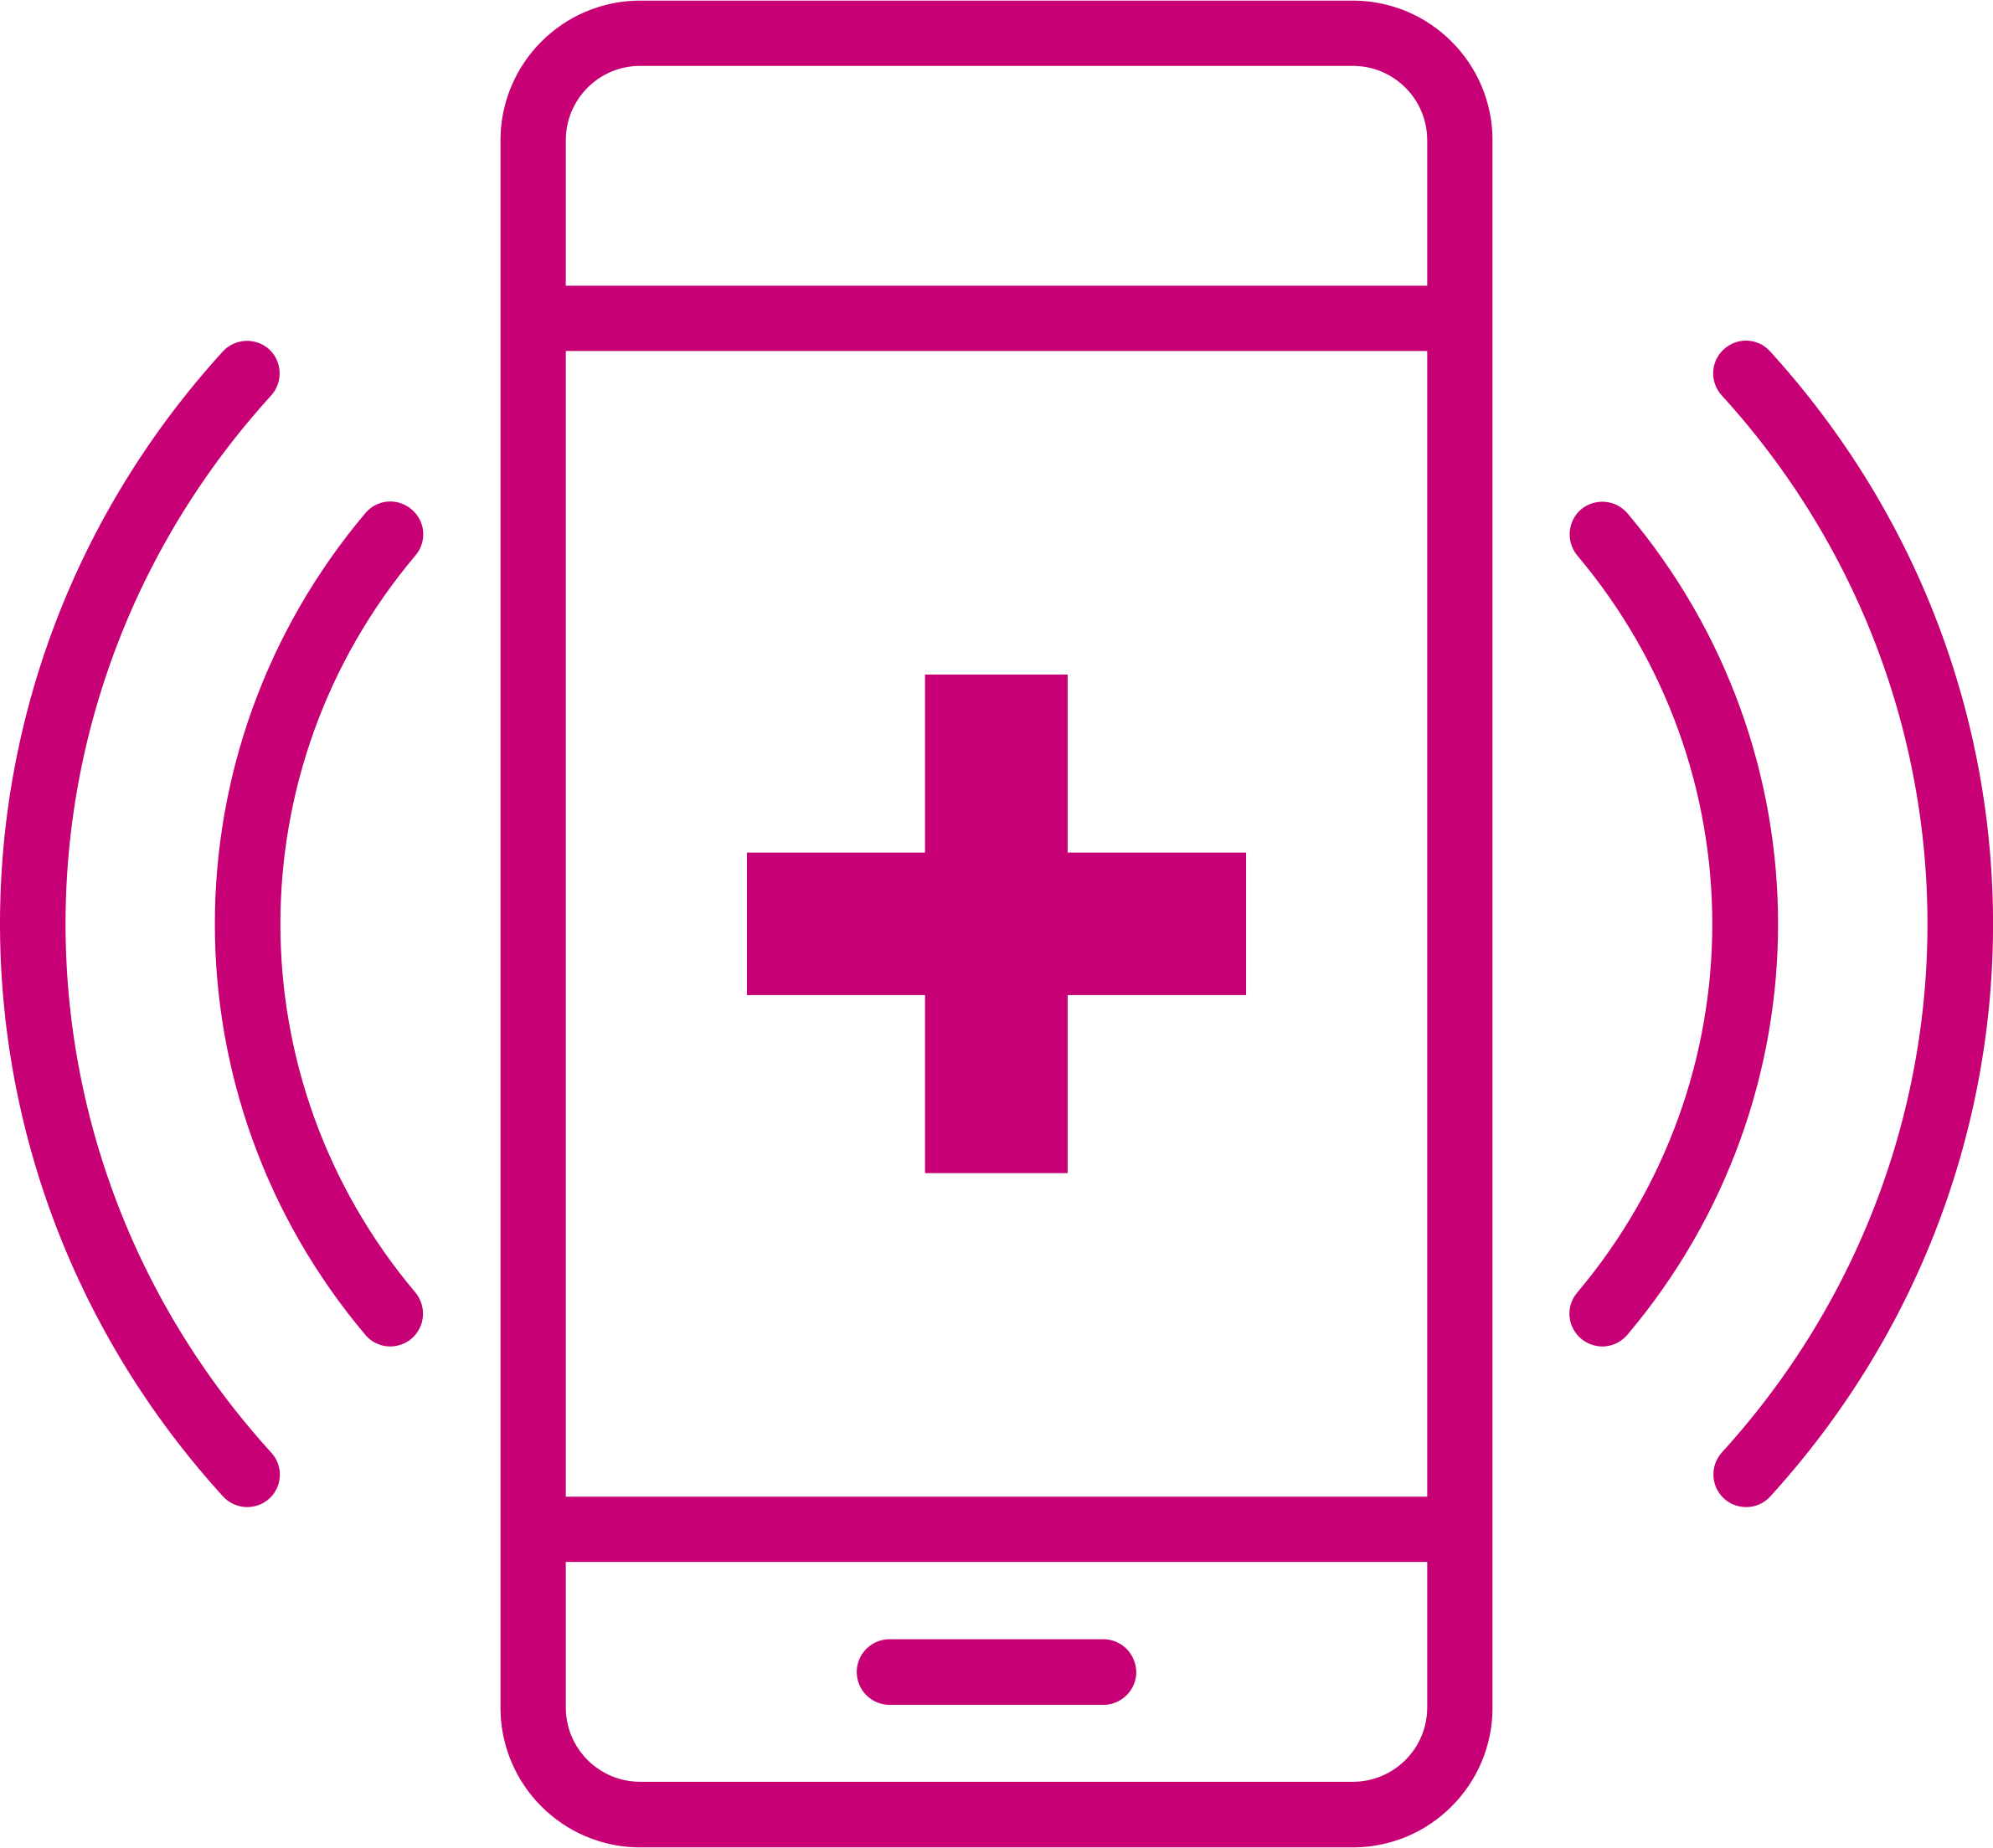
A COVID-19 winter: a compelling case for telehealth
Telehealth programmes that enable remote patient monitoring protect the wellbeing of vulnerable patients without the need for face-to-face contact with primary or secondary care teams. They are proven effective for:
This remote monitoring approach is helping us during the pandemic, but will also enable us to provide more proactive care over the longer term, improving the wellbeing of residents and helping to reduce the pressure on primary and secondary care.
Joanne Dorsman
Bolton NHS Foundation Trust
Improving outcomes in patients with long- term conditions, empowering them to take responsibility for managing their care and reducing the risk of emergency hospitalisations
Monitoring at-risk patients in the community for physical or mental health issues
Enabling faster discharge of patients from hospital and reducing the risk of readmission by providing continued monitoring and management in the community
The use of Digital Health Technology to support patients is a key part of the novel coronavirus (COVID-19) standard operating procedure: Community Health Services.
Vicki Slade
Digital Health Lead, Cornwall Partnership NHS Foundation Trust
Remote patient monitoring appears to be an effective approach for managing COVID-19 symptoms at home.¹
This program provided a safe and satisfying experience for patients
while minimizing COVID-19 exposure and in-person healthcare utilization.¹
Telehealth with remote patient monitoring improves outcomes and drives efficiencies in the management of patients with long-term conditions living at home or in care. It is now also being successfully used to monitor vulnerable patients for signs of infection and to manage those infected with COVID-19 in the primary-care setting.¹
1. Annis T et al. Rapid implementation of a COVID-19 remote patient monitoring program. J Am Med Inform Assoc 2020;27(8): 1326-30.

Slide 6
While Covid-19 has accelerated adoption, the benefits of telehealth are well established
2011
WHOLE SYSTEM DEMONSTRATOR PROGRAMME REPORT
Study with focus on COPD, diabetes and CHD
N=6191 (3 UK sites)
Substantially reduced mortality
Reduced number of hospitalisations
Reduced time in A&E
2008
PATIENTS KNOW BEST PORTAL LAUNCHED
Shared records between patients and health teams
Now used across multiple NHS Trusts
2019
RPM PUBLICATION REVIEW
Patent expectations and experiences of RPM for COPD, HF, diabetes, ESRD
N=307 (UK 56% )
Increased patients’ knowledge
Improved self-management
2015
Sustainability and Transformation Fund
£2.1 billion in 2016-17 to fund sustainable transformation in patient outcomes
AUGUST 2020
Hospital Discharge Services
£588 million available for post-discharge support
Increase use of telecare & telehealth included in CTA
2009
TELECARE NORTH PILOT STUDY (Telekat)
RPM for COPD patients (Denmark)
N=100
Significant economic and patient benefits led to increased adoption in region
Similar model operational throughout Denmark since 2019
2019
NHS LONG TERM PLAN
CTA: Make better use of data and digital technology
2020
STUDY OF RPM OF COVID-19 PATIENTS AT HOME
N=3701 (USA)
Minimised exposure to COVID-19
A safe and satisfying experience for patients
2020
CASE STUDIES
Avoiding face-to-face contact during pandemic, including monitoring :
Patients with eating disorders
Infection risk in community
2014
FIVE YEAR FORWARD VIEW
CTA for “Radical upgrade in public health”
&
models of care which shift care from hospitals to community
2014
PENNINE CARE NHS TRUST REPORT Telehealth Study patients including
COPD, CHF, diabetes, BP management
Significant clinical and economic benefits reported
References available upon request (notes)
A&E: Accident and emergency
BP: Blood pressure
CHD: Chronic heart disease
CHF: Chronic heart failure
COPD: Chronic obstructive pulmonary disease
CTA: Call to action
ESRD: End-stage renal disease
HF: Heart failure
Notes:
https://patientsknowbest.com
King’s Fund Report: Technology and Innovation for long-term health conditions. 2020.
Whole System Demonstrator Programme: Headline findings December 2011: https://www.gov.uk/government/news/whole-system-demonstrator-programme-headline-findings-december-2011
NHS England Five-Year Forward View 2014. Available to download: https://www.england.nhs.uk/wp-content/uploads/2014/10/5yfv-web.pdf
Pennine Care NHS Foundation Trust. Telehealth Evaluation Final Report. January 2014.
Sustainability and Transformation Fund: https://www.gov.uk/government/news/hospitals-get-18-billion-for-sustainability-and-transformation
NHS Long-term plan version 1.2: www.longtermplan.nhs.uk
Walker RC et al. Int J Med Inform 2019;124:78-85. doi: 10.1016/j.ijmedinf.2019.01.013. Epub 2019 Jan 29
Annis T et al. Rapid implementation of a COVID-19 remote patient monitoring program. J Am Med Inform Assoc 2020;27(8): 1326-30
Hospital Discharge Service: Policy and Operating Model. August 2020. https://www.gov.uk/government/publications/hospital-discharge-service-action-cards
Case studies available from Tunstall upon request

Slide 7
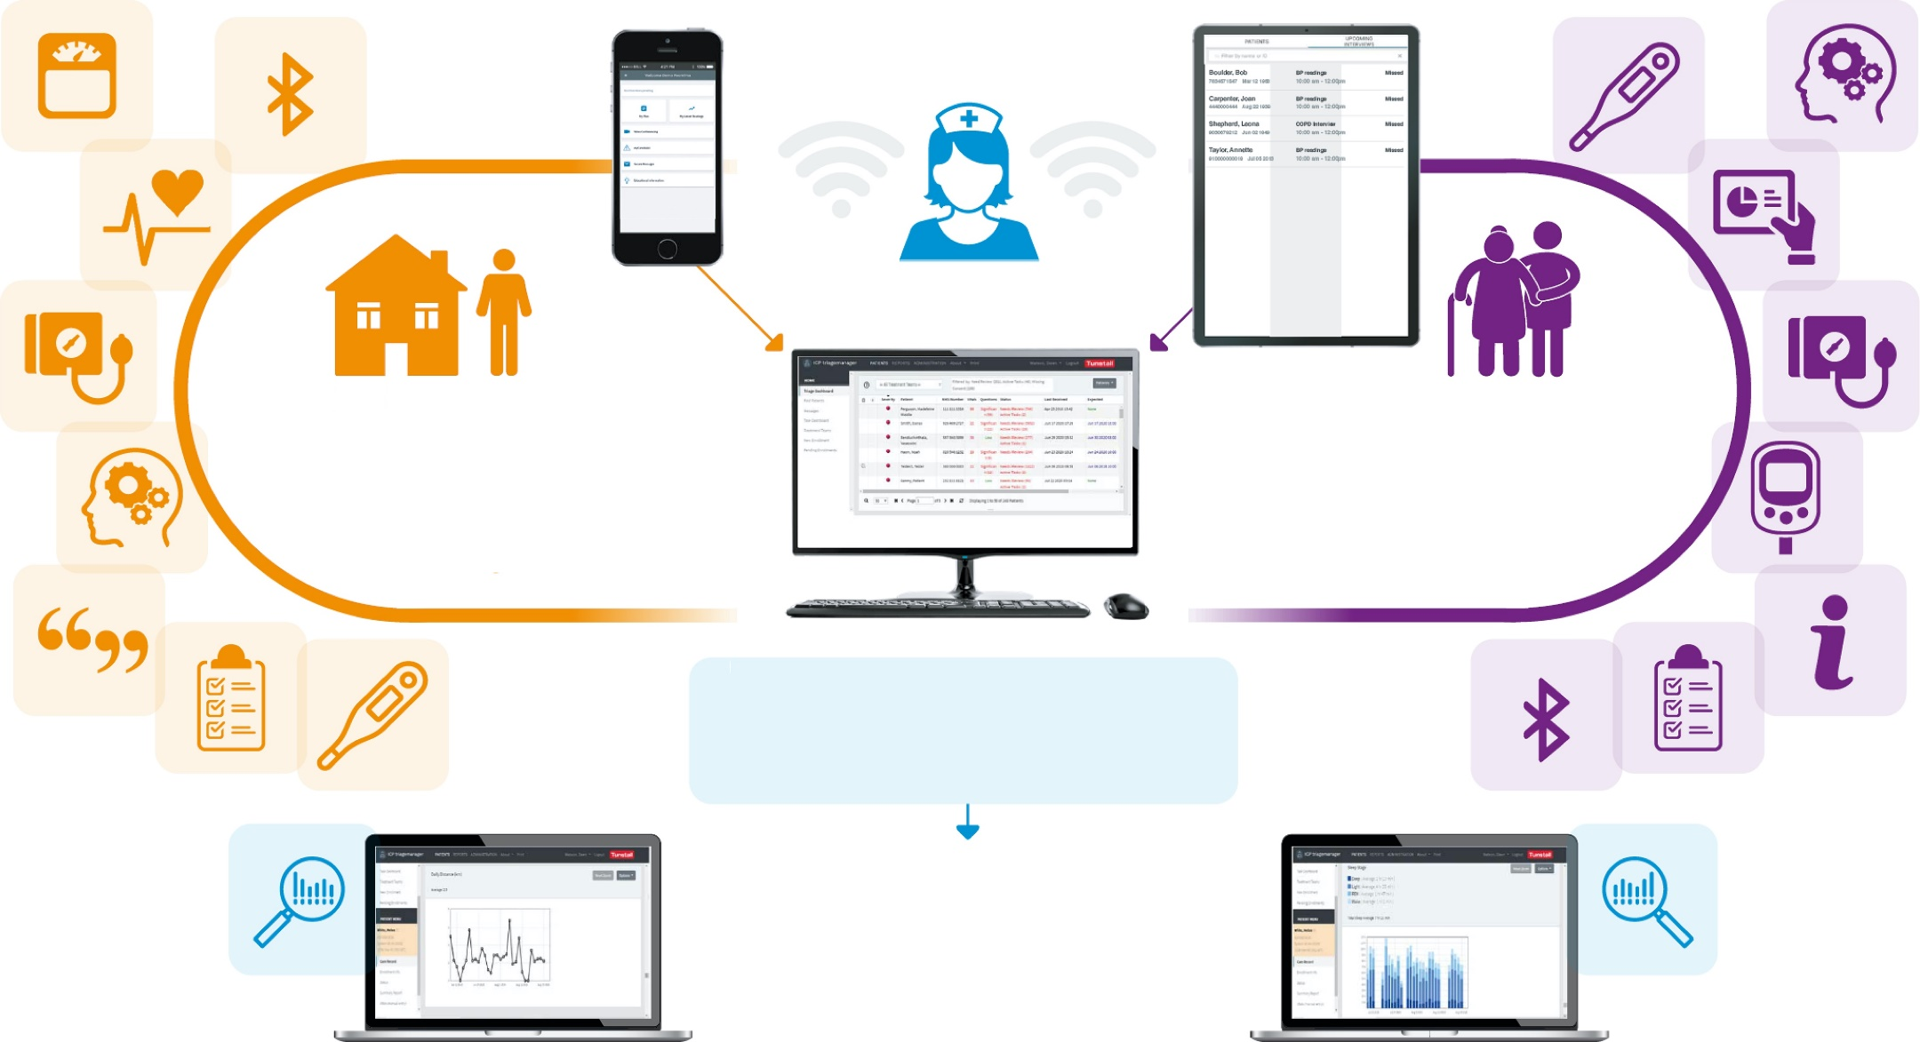
The Tunstall remote patient monitoring (RPM) and management platform
At the heart of the Tunstall RPM platform is Triagemanager™ – a world-leading, clinical triage system that effectively stratifies risk and prioritises NHS Trusts’ resources and action across any combination of existing or potential physical and mental-health conditions.
The Tunstall RPM platform
Triagemanager™
myMobile
single-user app
for individuals in the
community
myKiosk
multi-user app
for those in
residential care
Triagemanager is informed by app- based data inputs from best-in-class Bluetooth peripherals, combined with individualised questionnaires
Triagemanager insights:
Trend graphs – for comparison of historic results and data-driven clinical decision-making
Summary reports – for clinical management, auditing and regulatory reporting
RPM: Remote patient monitoring

Slide 8
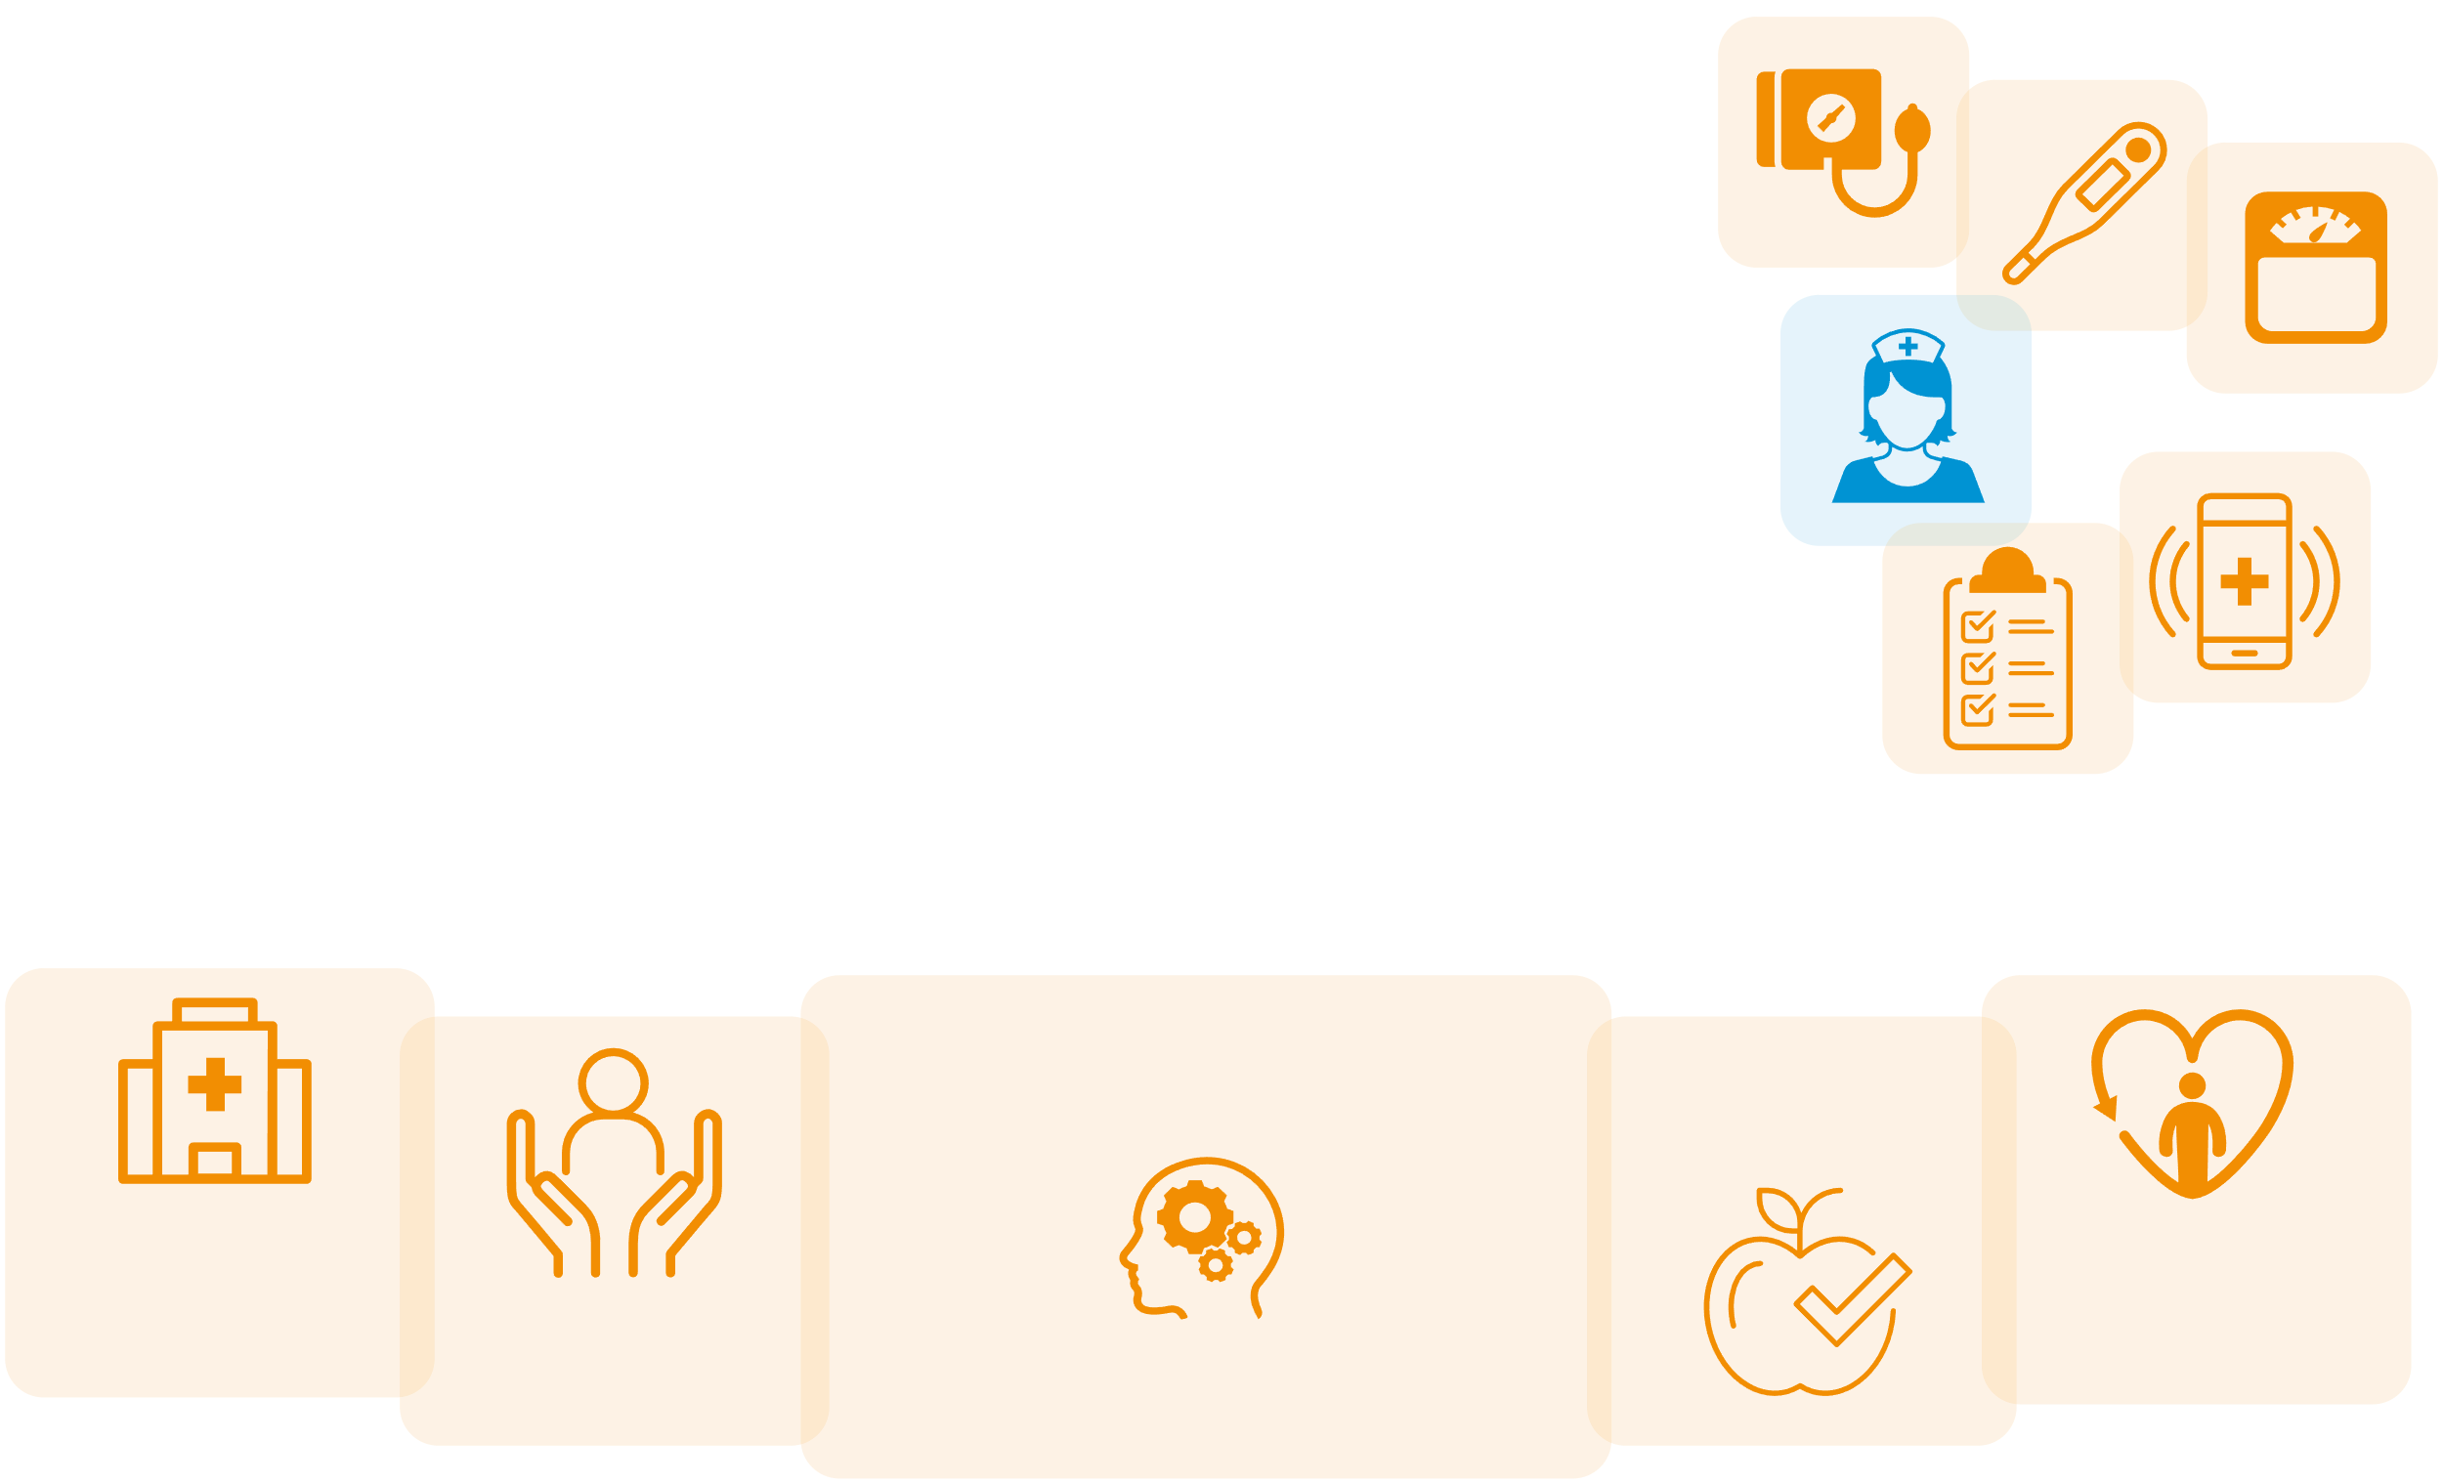
Case study: Remote patient monitoring for eating disorders using myMobile and Triagemanager™
The challenge
Children with eating disorders would normally receive
clinic-based care, but with the onset of the COVID-19 pandemic, an alternative approach was needed.
What we did
Tunstall worked with the Trust to introduce remote patient monitoring, using the myMobile app and Triagemanager software. A special health interview was developed in conjunction with the Tunstall Clinical Team, based on the Junior MaRSiPAN (Management of Really Sick Patients with Anorexia Nervosa) risk assessment framework. Once a week, patients use devices to take their vital signs (blood pressure, weight and temperature) and answer symptom-related questions. Through a patient dashboard and alert system, Triagemanager enables clinicians to monitor progress and prioritise patients for intervention.
Results
32* high-risk caseload patients have already been referred, and feedback from clinicians is very positive.
Outcomes are expected to include:
INCREASED
Background
Cornwall Partnership NHS Foundation Trust has a well-established Digital Health Service which provides remote patient monitoring to patients with respiratory and cardiac conditions using Tunstall Triagemanager and myMobile.
The Trust’s eating disorder service offers treatment and support to children over the age of 11 with a range of eating disorders including Anorexia Nervosa, Bulimia Nervosa and Restrictive Eating Disorder. The normal care pathway includes children attending clinics for monitoring of their vital signs and symptoms, however, due to the pandemic and the risks to patients
and staff, this was no longer possible.
wellbeing of patients and families as stress of exposure to infection elliminated...
IMPROVED
self-management
REDUCED
hospital admissions
INCREASED
concordance
(with medication)
EARLY
intervention
...while maintaining monitoring and management of eating disorder
The children we support are extremely vulnerable, and any delay or interruption to the treatment they receive could have serious implications for their recovery. Being able to deploy a solution so rapidly to enable us to continue helping them has been a real relief; it’s been amazing just how quickly we’ve been able to adapt.
Michele Boyce Service Lead Nurse, Kernow Health
* Figure correct as of May 2020

Slide 9
Case study: Safeguarding care home residents and professionals using myKiosk and Triagemanager™
The challenge
Care-home residents are at particularly high risk during the COVID-19 pandemic. Bolton NHS Foundation Trust and Bolton Clinical Commissioning Group needed
a way of delivering quality care while minimising
the risk to residents and staff.
What we did
The Tunstall team worked with care-home staff to train them on the system and to measure vital signs using Bluetooth-enabled peripheral devices.
34* care homes in the area have been provided with tablets loaded with myKiosk, along with peripheral medical devices
Pulse oximeters and blood pressure monitors
Thermometers
Staff use the myKiosk tablet to record residents’ vital signs and help them to answer questions about their health and symptoms using the touch screen. The information is then monitored via Triagemanager, and results which breach the parameters set for that patient raise an alert. This enables Advanced Nurse Practitioners to review the data and make an informed decision regarding next steps in the patient’s care.
Results
The COVID-19 crisis meant it became critical to look at ways we
could use technology to deliver more care without face-to-face contact. We have accelerated the transformation of our model of care, and the aim
is to change working practices for the long term, improving outcomes using technology and multi- disciplinary teams.
Paul Beech Head of Strategic Commissioning, Bolton Clinical Commissioning Group
The Tunstall Triagemanager and myKiosk system is enabling closer monitoring of vulnerable residents; care- home staff have been upskilled and the need for clinical staff attendance has been reduced. It is also helping clinicians to prioritise residents’ care, as the system clearly identifies those most in need of interventions.
The success of the programme will be measured over time, with metrics such as reduced ambulance call- outs, resident outcomes and the impact on caseload management.
The systems give us objective information to support effective clinical decision-making. This remote
monitoring approach will help us during the pandemic, but will also enable us to provide more proactive care over the longer term, improving the wellbeing of residents and helping to reduce the pressure on primary and secondary care.
Joanne Dorsman Bolton NHS Foundation Trust
* Figure correct as of May 2020

Slide 10
About Tunstall
Tunstall has been at the forefront of technology innovation for the health, housing and social care markets for over 60 years. Its pioneering software, hardware and services enable new delivery models which can transform services across the care continuum, and empower people to live independently and with an improved quality of life.
Tunstall works with social care providers, healthcare services, housing and retirement living providers and charities in 38 countries, improving the lives of more than five million people, including those living with dementia, learning disabilities, physical disabilities and long-term health conditions.
Tunstall’s innovation-led, person-centred Connected Care and Health solutions connect people and integrate services, enabling early intervention to avoid or mitigate adverse events, and improve outcomes. As technology advances, we have the capability to not just react to events, but to predict and even prevent them using data-driven insights.
The Tunstall Cognitive Care approach can help to create intelligent, personalised care programmes and effectively allocate resources, making sure those in need have the right levels of support and reassurance.
Our policy of continual development means that product specification and appearance may change without notice. Tunstall does not accept responsibility for any errors and or omissions contained within this document. This document should not be relied upon for product details, and reference should be made to current specifications.
© 2020 Tunstall Group Ltd. ® Tunstall is a registered trademark. ICP triagemanager is a trademark. Tunstall Healthcare (UK) Ltd is a member of the Tunstall Group.
t: 01977 660206 e: Hello@tunstall.com w: tunstall.co.uk @TunstallHealth

