Slide 1
Supported housing for people with long term needs: overcoming the barriers to development sue.ramsden@housing.org.uk www.housing.org.uk

Slide 2
Questions
What are the significant barriers?
How can housing associations better meet the needs of local commissioners?
How can commissioners support a sustainable model of development and management of new schemes?
What is the role of regulatory bodies in achieving a sustainable model?
How can Homes England/GLA/ MHCLG support a more sustainable model of long-term supported housing?
Is there a need for more oversight on costs and quality of schemes?

Slide 3
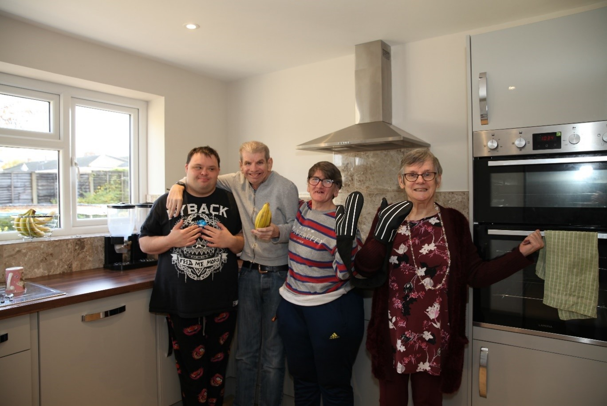
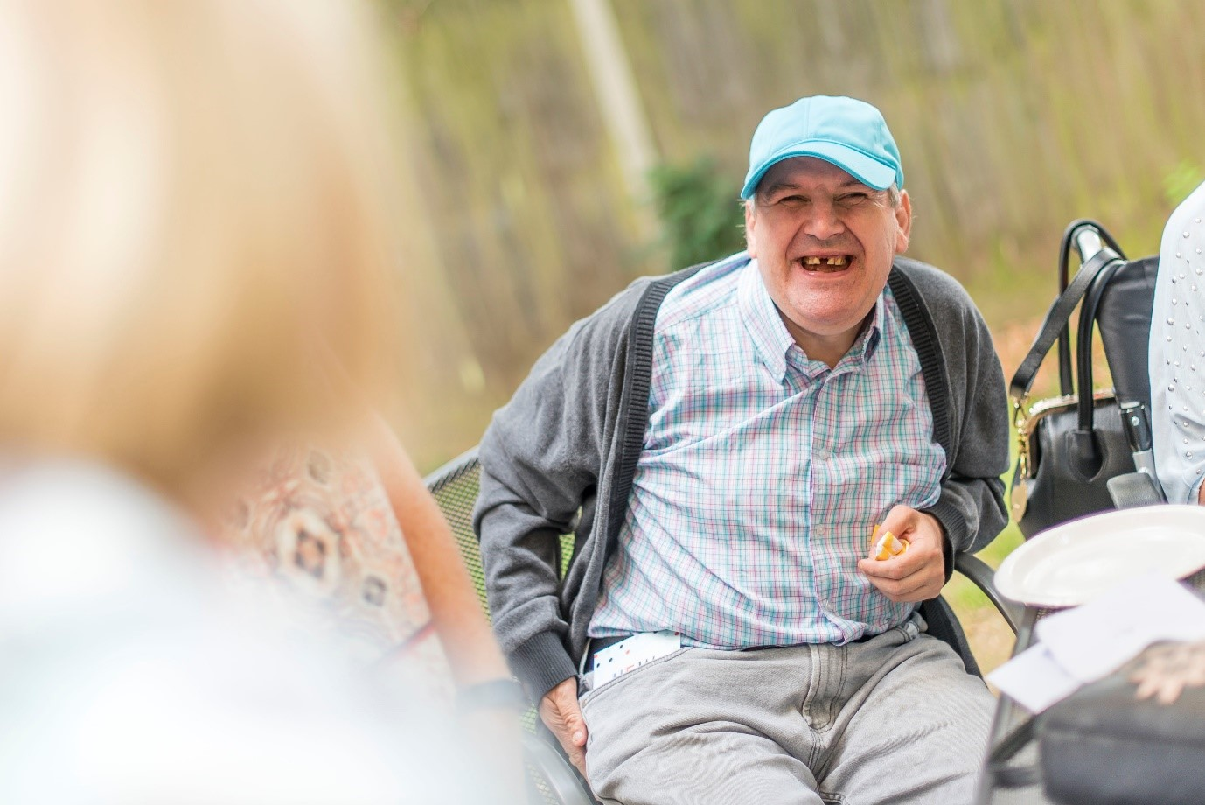
Golden Lane Housing, Leeds, 2 shared houses for 10 people Platform Housing Group, Droitwich Spa, 8 flats for young adults Grand Union Housing: High Oaks, St Albans, four flats
Progress Housing Group: Kingsbridge Way, Nottingham, shared accommodation
Southdown: Southdown Court, Hailsham, 6 flats
Thirteen Group: Fellows Hall, Loftus, 7 flats

