Slide 1
Homelessness & Covid-19: A Trigger for Values Change?
Dr Rachel Manning
Rachel.manning@wbs.ac.uk
NIHR funded project #200073

Slide 2
Innovation needed now more than ever in housing & health sectors.
Yet…even the most promising innovations often remain ‘stubbornly immobile’ within these sectors…
Why?
Lack of ‘Evidence’?
Lack of ‘Resource’?

Slide 3
A Values-Lens on Innovation
Evidenced / resourced innovations often spread “less frequently, less consistently, or less assiduously…so that little or no benefit is yielded” (Greenhalgh et al., 2004);
Evidence / resources, alone, cannot:
motivate appreciation or acceptance of an innovation.
make stakeholders willing to participate in innovation.
“Generalised and enduring beliefs about what is right” (i.e. ‘values’) are key.
Strong alignment of innovation and stakeholder values = consistent use.
Misalignment or conflict in values mean innovations less likely to be implemented.

Slide 4
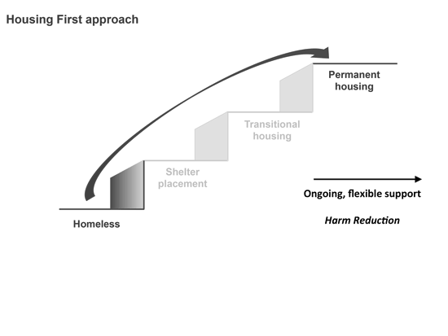
Example 1: Staircase Services Vs Housing First Services
Evidence: Manages rather than ends homelessness via institutional circuits: 10 years to exit this system.
Resource: Councils spent £1.1 billion on temporary accommodation between April 2018 and March 2019.
Evidence: Stable housing, fewer psychiatric symptoms, better addiction management & more integration
Resources: Housing First tends to have lower costs than fixed-site services.
Yet slow to spread…
Notes:
‘Housing First spread has been slow, fragmented, and varied’ (Pleace & Bretheron, 2017; Weaver, 2018).
It is, however, a contradiction of everything that has gone before. It involves unlearning our unconscious assumptions and beliefs. Particularly around what we believe homeless people are capable of,

Slide 5
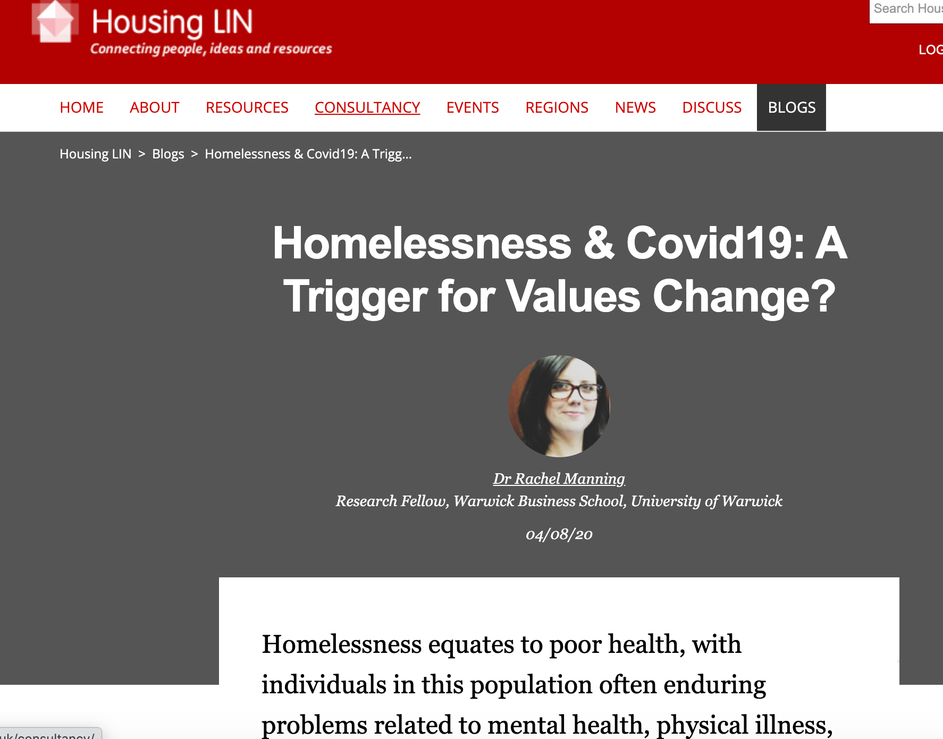
Example 2: Covid19
Unprecedented response deserves attention - largely explained in terms of hotel rooms
Hotel rooms, alone, cannot catalyse the effort to accommodate 90% of the UK’s rough sleepers.
Response driven, at least in part, by implications of homelessness for wider society - R rate increases, NHS pressures, extended lockdown etc.
Homelessness threatened the things we ‘value’ – triggered shifts in ‘value judgements’ about the merits of housing the homeless.

Slide 6
Going Forward…
Recognise that values play into past, present, and future responses to homelessness.
Fragmented, patchy HF spread due to values-judgements?
Covid-19 response shows homelessness can be overcome if valued by society.
Recent events should trigger a shift in our values toward the desirability of housing the homeless (with supports).
We can also support this using quality research, particularly understanding how and why values alignment occurs across settings.

