Slide 1



HAPPI days: what makes an award-winning scheme?
#HAPPIhour
@HousingLIN @HousingLINews
@PRP_News

Slide 2

We encourage you to keep your webcam on
All microphones will be muted throughout
Please type any questions in the chat box and Lois will read your question out, please put a ‘Q’ before your question so I can differentiate it from a comment
You can also use the chat box to talk to each other or make comments
If you have any technical problems please use the chat box to send me a direct message
This event is being recorded
#HAPPIhour
@HousingLIN @HousingLINews @PRP_News
https://www.housinglin.org.uk/Topics/type/Design-Principles-for-Extra-Care-Housing/

Slide 3
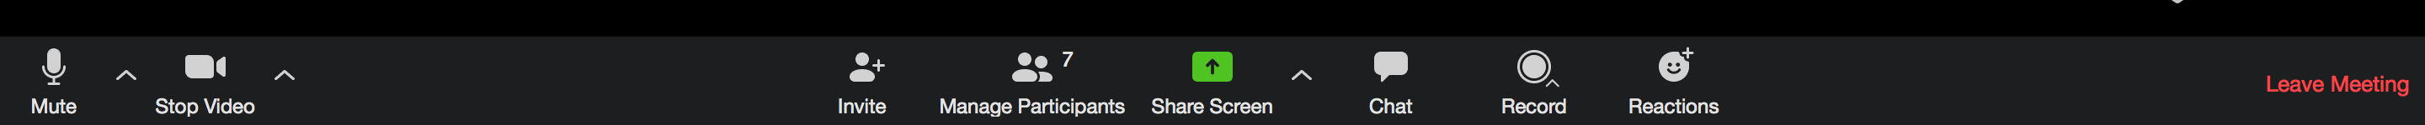
How to ask a question
Please add the letter ‘Q’ before your question
Chat Function

Slide 4

How to view the speakers during their presentations
Active Speaker View
Or click ‘Activate Speaker View’ in the top right of your screen

Slide 5
4.00pm Welcome to HAPPI Hour: About zoom - Lois Beech, Housing LIN
4.05pm About HAPPI Hour and purpose of this session – Jeremy, Housing LIN
4.10pm First round: 2020 HAPPI Award winner – background to Grants Hill Court, Uckfield, West Sussex for Wealden District Council - Jenny Buterchi, Partner, PRP
4.35pm Second round: What HAPPI design characteristics make it a winning scheme? What do the residents say? – Mary Hutchison, Associate Director, PRP
4.50pm Third round: Q&A with Jeremy and chat box (questions, comments and observations) – All
5.10pm Last orders: Summary and thanks
5.15pm Close
#HAPPIhour
@HousingLIN @HousingLINews @PRP_News

Slide 6
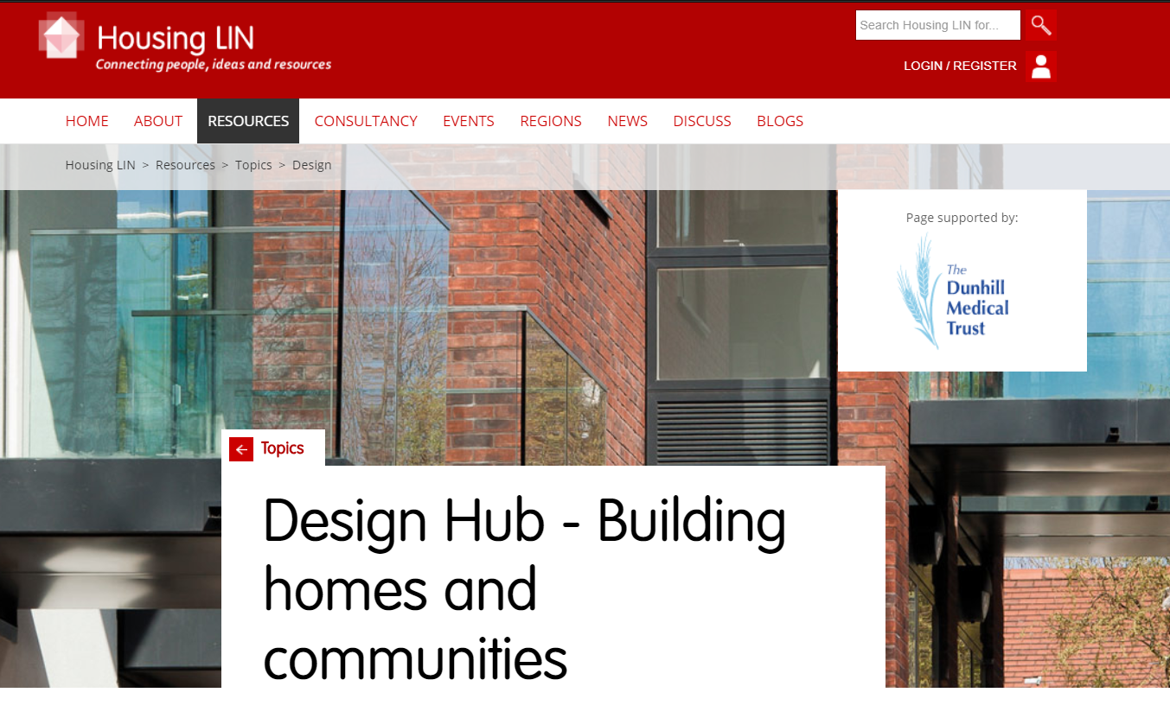
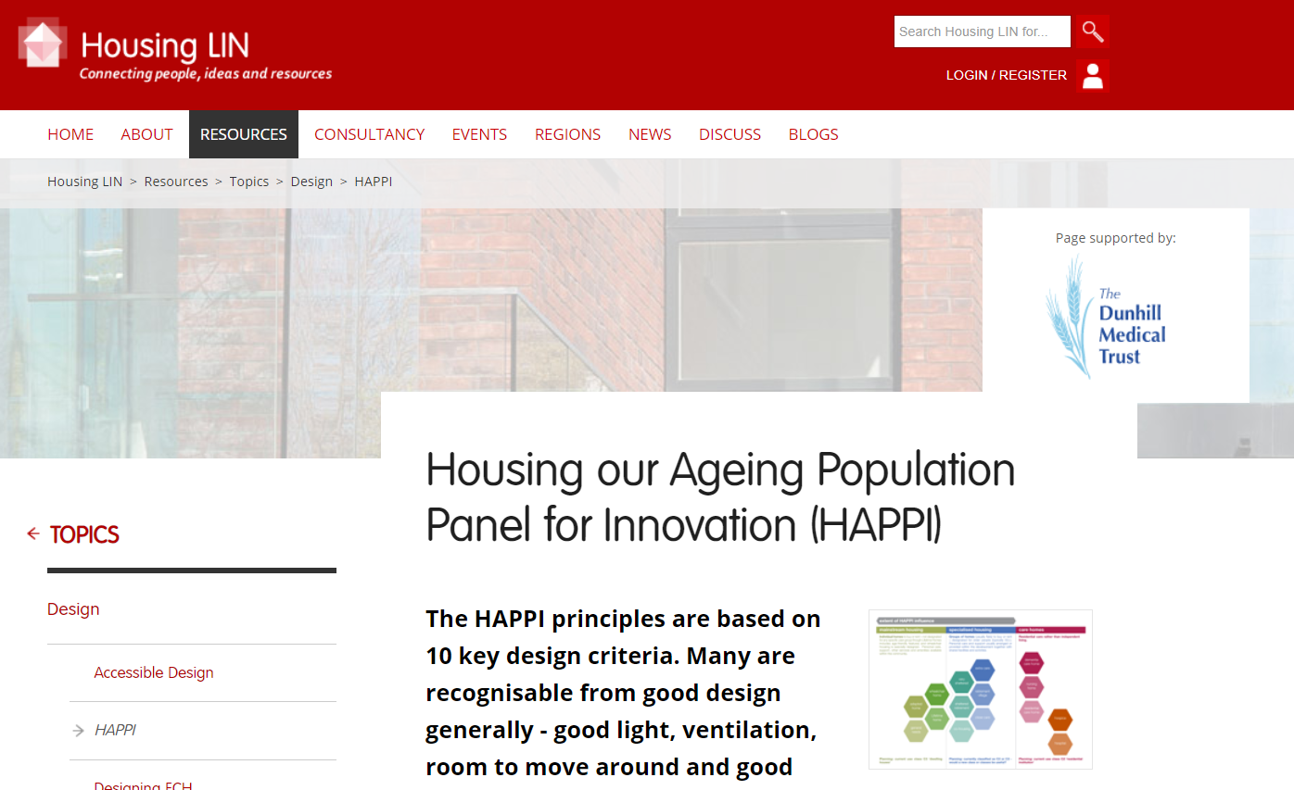
Also check out our Design Hub:
https://www.housinglin.org.uk/Topics/browse/Design-building/
https://www.housinglin.org.uk/Topics/browse/Design-building/HAPPI/
#HAPPIhour
@HousingLIN @HousingLINews @PRP_News

