Slide 1
Housing for an ageing population: Setting the context
Henry Smith, Senior Programme Manager, Homes
Housing LIN, Brighton, 2nd December 2019
Notes:
Ageing Better
National perspective on ageing and housing
What needs to change
Some examples of external work in this area

Slide 2
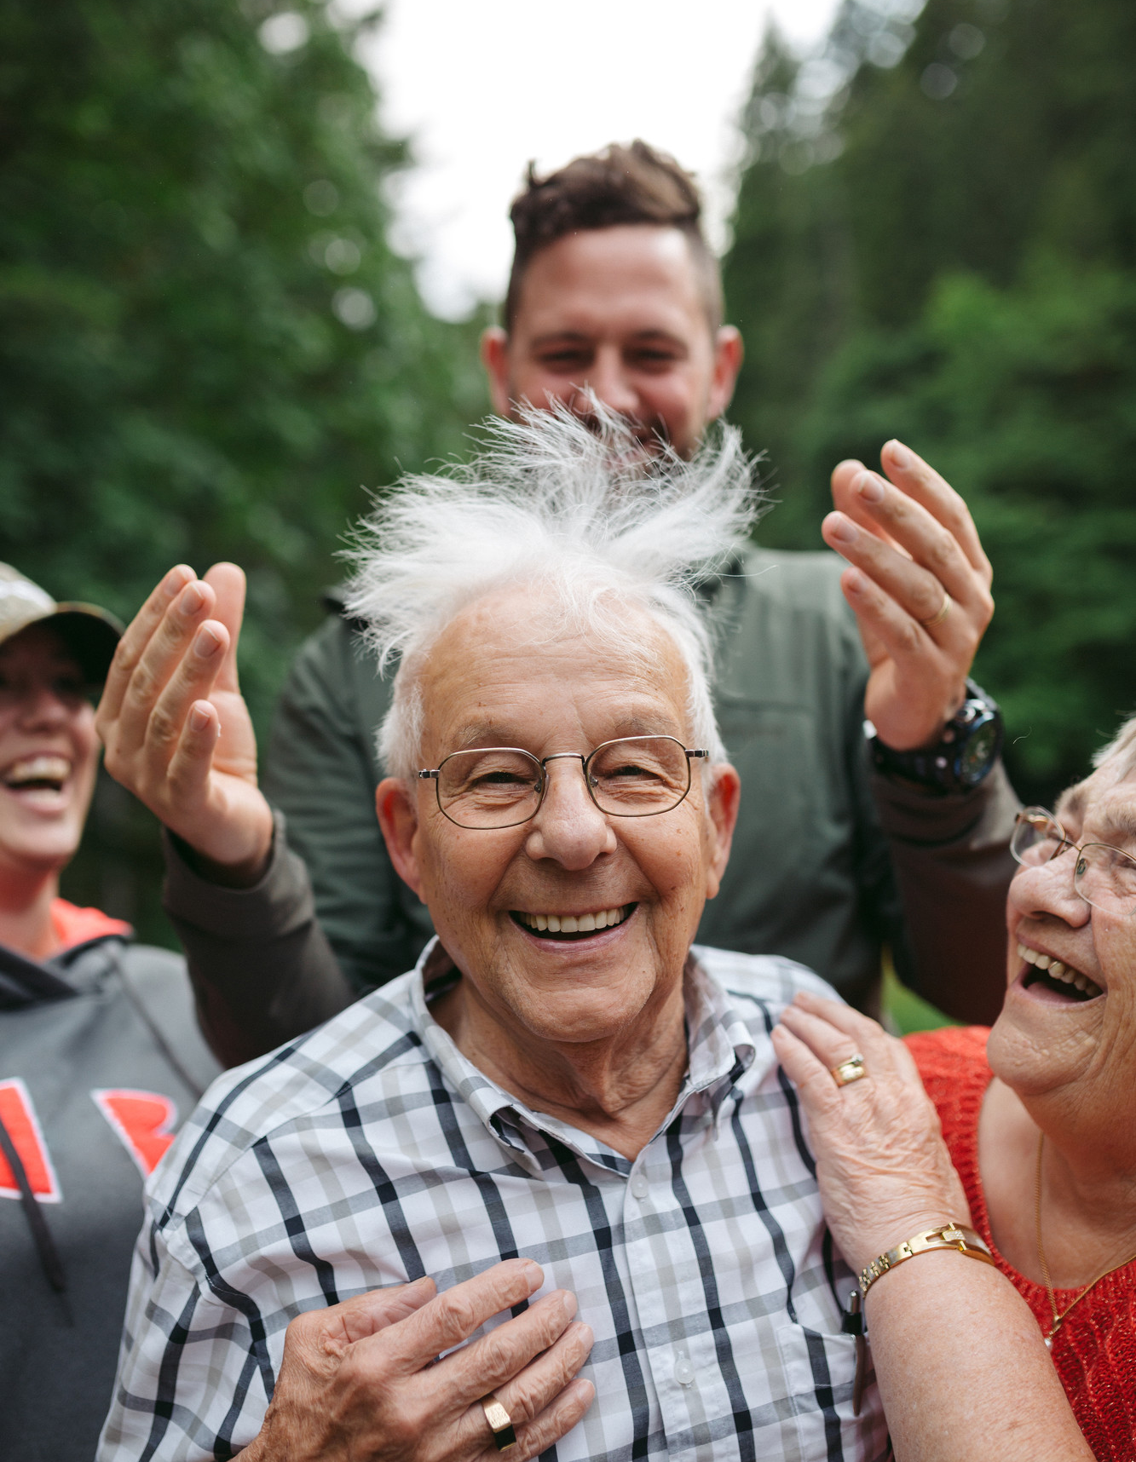
Our aim
Our vision is a society where everybody enjoys a good later life
By 2040, we want more people in later life to be in good health, financially secure, to have social connections and feel their lives are meaningful and purposeful
To achieve real and significant impact, we will focus on where we can make the biggest difference – those approaching later life, a life stage between mid-life and later life
2
Notes:
Who we are - independent charitable foundation, funded by an endowment from the Big Lottery Fund - England
We want more people to be in fulfilling work, in good health, in safe, accessible homes and CC
To achieve these changes, we will focus on people approaching later life, as well as those who are most at risk of missing out, such as those on low incomes and those more likely to experience health problems.
Working in partnership with national and local government, private, public and voluntary sector, we will seek to influence national policy and deliver long lasting changes locally
Centre for Ageing Better has strategic partnerships with

Slide 3
Our population
Projected demographic change over the next 15 years
A child born today has a 50% chance of living to 100
By 2032, ONS predicts a 26% increase in people aged over 65 and a 55% increase in those aged over 85
Source: ONS Table A2-1, Principal projection - UK population in age groups, 2017
3
Notes:
Opportunity of living longer
We are living longer than ever before:
a child born today has a 50% chance of living to 100
Someone aged 65 today can expect to live to 85, nearly ten years longer than their parents’ generation
By 2032, ONS predicts a 26% increase in those aged over 65, and 55% increase in those over 85
We are living longer than ever before but we are not getting the most from our extra years. This is a great opportunity for the economy, for society, and for us as individuals - But - We need radical change if we are to make the most of this opportunity

Slide 4
What we know about housing in later life

Slide 5
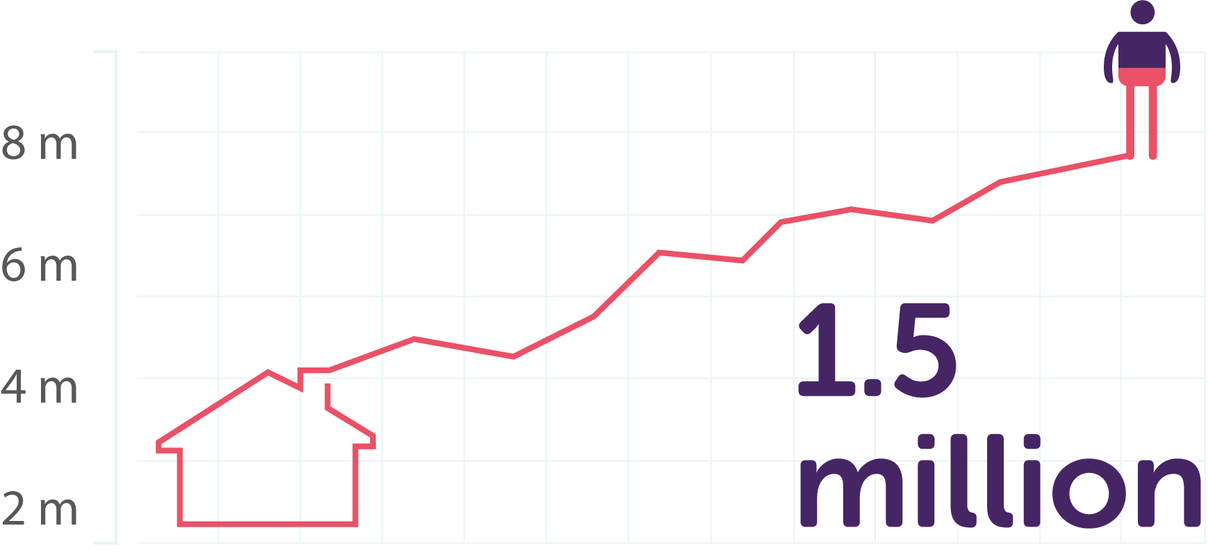
Homes headed by someone aged 85 and over are the fastest growing household*
By 2025 there are projected to be 1.5 million households headed by someone aged 85 or over – an increase of 54% from 2015*
*Source: Ageing Better calculations based on: Department for Communities and Local Government (2016), ‘2014-based Household Projections: England, 2014-2039’.

Slide 6
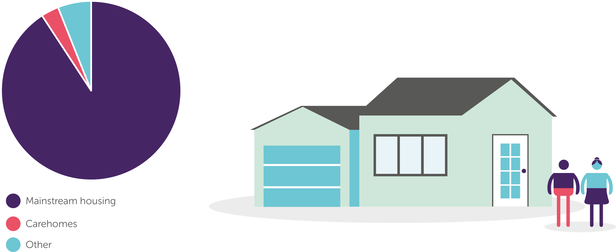
More than 90% of older people live in mainstream housing
80% of the homes we need by 2050 are already built*
*Source: Boardman et al, 2005
Notes:
What we know about housing in later life
Homes headed by someone aged 85 and over are the fastest growing household - By 2025 there are projected to be 1.5 million households headed by someone aged 85 or over – an increase of 54% from 2015
Homes that meet the demands of the ageing population will be increasingly in demand and we need to ensure our housing offer meets that need

Slide 7
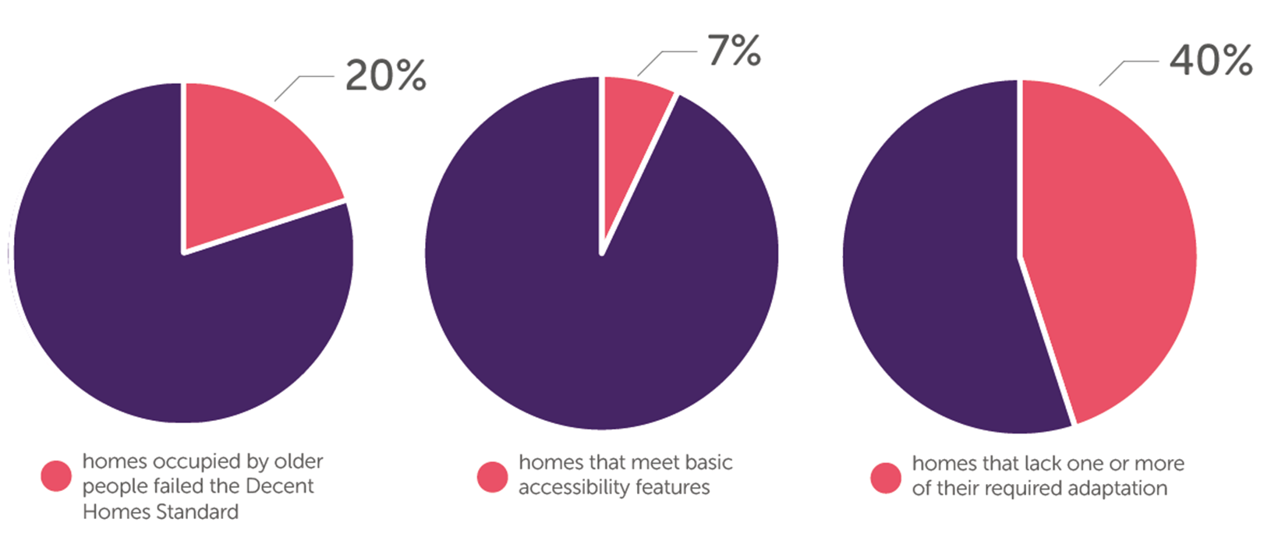
Current UK housing stock is not suitable, adaptable or accessible for people in later life
Only 7% of homes meet basic accessibility features*
*Source: DCLG (2016), English housing survey 2014 to 2015: adaptations and accessibility of homes report
Notes:
So most people in mainstream housing - And we know that while many of us will live in good health into later life, the chances are at some point we can all expect to have some difficulty with everyday activities as we get older, this is also not just about our own future selves but those who live around us – by late 80s more than one in three people have difficulty with 5 or more ADLs
But UK housing stock is currently not fit for purpose to support us to live independently across and into later life
Britain has the oldest housing stock in Europe
Non-decent - Homes that are cold, damp and in a poor state of repair are dominating the market, and these poor-quality homes are disproportionally lived in by older people – 20% are non decent
Accessibility – As well as homes being in poor condition, the vast majority are inaccessible – 7% have 4 basic features that make them visitable to most people – and new homes are perpetuating that failure
leaving people who have a disability or who have lost mobility with age at a huge disadvantage when looking for a home to live in, or when visiting friends and family, as they become increasingly disabled by their environment

Slide 9
Housing Supply and what needs to change
3.4% of people >50 move home each year
Motivations for moving are the same as other age groups
>50s are stuck due to a lack of decent & attractive options
Low-middle income groups least likely to be able to move
Notes:
On top of those factors that influence people’s capacity to move - The main reason people in later life cite for not wishing to move is a lack of appropriate, affordable and desirable housing stock in the places they want to live
Report commissioned by GMCA and funded by AB looked at the types of houses people live in across the UK, the house moves they make, and reasons why
3.4% move – half as many moves as other age groups
Motivations - motivated by the same desires as others. For example, wanting more space for guests, moving to a nicer area, and better access to green spaces
Stuck - many over 50s cannot move in the way that they would like, due to a lack of suitable housing options and inadequate provision of support and advice
Low middle income groups - trapped in homes which are no longer appropriate for them as they age.
To get market moving we need to better understand the homes people want to live in, and provide an offer to meet that need

Slide 10
What’s happening externally
Disabled Facilities Grant increased in April 2019
CLG Select Committee report on housing for older people
Industrial Strategy Grand Challenge: Healthy ageing
Future Homes 2030 – clean growth and ageing challenge
Focus on quantity over quality – e.g. proposals to further extend
permitted development rights, impact on future of housing stock
Update to Planning Practice Guidance on housing for older and disabled
people but subject to viability
Previous Government commitment to review mandatory accessible
housing standards in building regulations
Notes:
What is happening externally? Been a noticeable shift in interest at local and national policy level on the benefits of adapting the home– but still not enough change happening
DFG increase: In April increased by 8%, but many areas don’t have capacity and resources to deliver adaptations quickly
CLG select committee report: Clear recommendations to Government based on very strong evidence but not taken up yet
ISGC: The Industrial strategy sets out grand challenges to put UK at forefront of industries of the future, one of the 4 key areas if healthy ageing, which includes innovative products and services to ensure more people can remain in their own homes, and innovative housing models and funding models to support that
Commitment to new homes – but focus is on number not on standards
We need to expect better – know the role adaptations have, and yet services and products are not providing aspirational and desirable options that people want

Slide 11
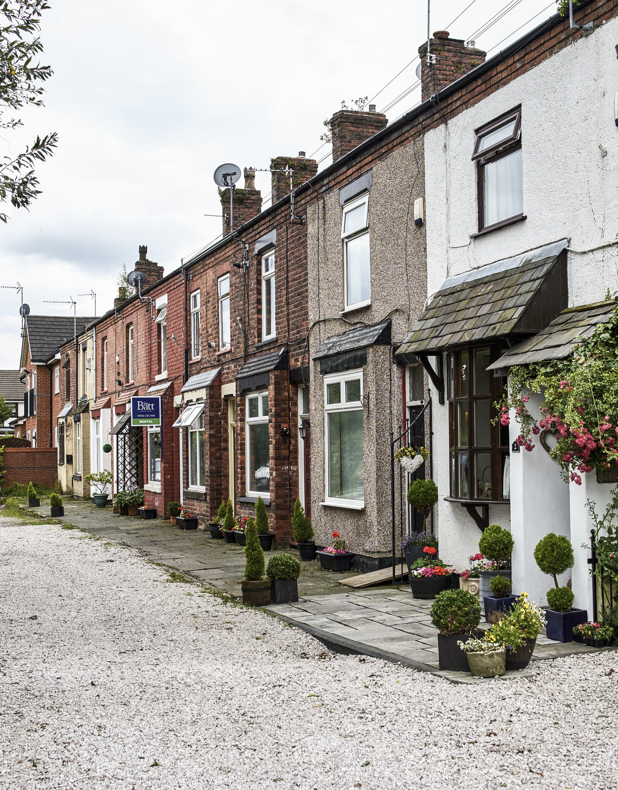
Centre for Ageing Better
Safe and accessible homes
Our aim is for more people to live in safe and accessible homes by:​
Improving the condition and accessibility of existing housing ​
Increasing the diversity of suitable homes for people approaching later life who choose to move​
Making information and advice more easily available to help people approaching later life make good housing choices
Our goal is that by 2030 there will be one million fewer homes defined as hazardous and half of all new homes will meet accessibility standards
11
Notes:
What Ageing better are doing
Initial work on housing – A&A – new strategy widened this out
Continue to maximise the legacy of the aids and adaptations work
New strategy
Improve condition of homes we have
Ensure new homes are being built better and futureproofed
And ensure people in later life know what their housing options are

Slide 13
The Charter
Higher mandatory standards for accessibility
More data on the number of accessible homes being built
Bold and confident planning policies from local authorities
Homes England to give priority to bids for accessible homes
Creation of an accessible housing database
Standard accessibility ratings from Estate Agents
Positive action from the home building industry

Slide 15
Henry Smith
Henry.smith@ageing-better.org.uk
@Henry_Smith_AB
Centre for Ageing Better
Angel Building, Level 3
407 St John Street, London, EC1V 4AD
020 3829 0113
www.ageing-better.org.uk
Registered Company Number: 8838490 & Charity Registration Number: 1160741

