Slide 1
Brighton and Hove Speak Out
25 years of advocacy for people with learning disabilities

Slide 2
What we do at Speak Out
We support people with learning disabilities to have their voices heard and their rights upheld with:
One to one casework
Self advocacy groups
User led campaign group
Drop ins
Outreach
Learning disability partnership board

Slide 3
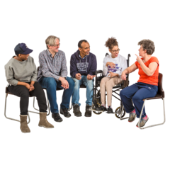
Some people come to us: Drop ins, self advocacy groups
Others are referred to us for one to one advocacy to address a specific issue
We speak to people at day services, colleges, supported living schemes, sheltered housing, residential homes and engagement events
People with different support needs, living situations and levels of independence tell us what life is like for them.

Slide 4
We write reports and make recommendations based on the views and ideas of people with learning disabilities.
People with learning disabilities are supported to attend engagement events so that their voices are heard

Slide 5
In 2018 we spoke to 50 people with learning disabilities to write two reports about accommodation and getting older
One report was to inform the Council Learning Disability Accommodation strategy
The other was about the needs of people with learning disabilities as they grow older

Slide 6
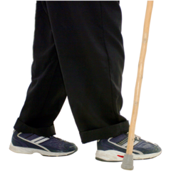
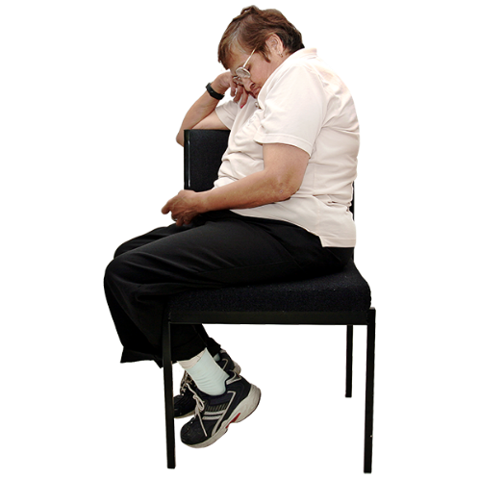
What we found out
There are significant health inequalities for people with learning disabilities
Men with learning disabilities die on average 14 years earlier
And women 18 years earlier
People with learning disabilities are 58 times more likely to die before they are fifty

Slide 7
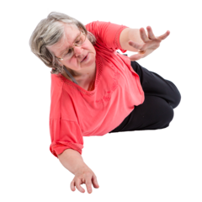
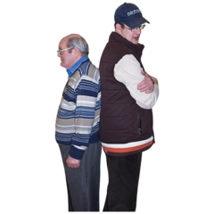
Falls are three times more likely in older people with learning disabilities. Especially people with Williams Syndrome
1 in 5 people with learning disabilities will develop dementia
We have higher rates of anxiety and depression

Slide 8
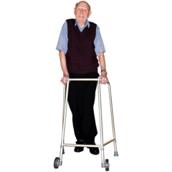
People with learning disabilities are at greater risk of age related health issues and multiple long term health conditions
Type 2 diabetes is twice as common in women with learning disabilities
Other higher risks include, obesity, epilepsy, high blood pressure and respiratory problems.

Slide 9
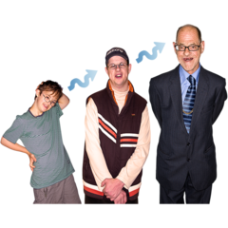
The good news is that life expectancy is rising rapidly for people with learning disabilities
It is predicted that the number of adults over 70 using services will have doubled by 2030

Slide 10
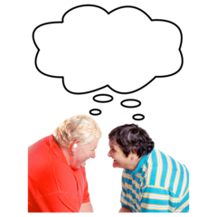
Multiple complex needs and an increasing demand for support present a growing challenge.
We think the views and experiences of people with learning disabilities can help those providing and commissioning accommodation to meet these challenges.

Slide 11
My Experience
What matters to me
What it’s like getting older
Why it matters where I live
Ian’s Story

Slide 12
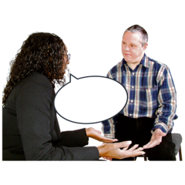
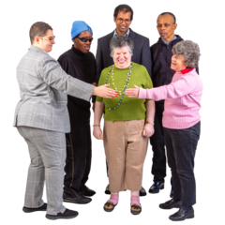
What people told us
People told us that they do not get the opportunity to talk about the realities of aging
People with learning disabilities need extra time to discuss options and process information
They would like choices that support them to continue to do the things that matter to them

Slide 13
They would like to start planning and making choices while they are younger. The same way that transition is planned into adult services
Some people loose lifelong friends and their peer group when they no longer receive a day service.
Isolation increases if people have to move because their support needs have changed

Slide 14
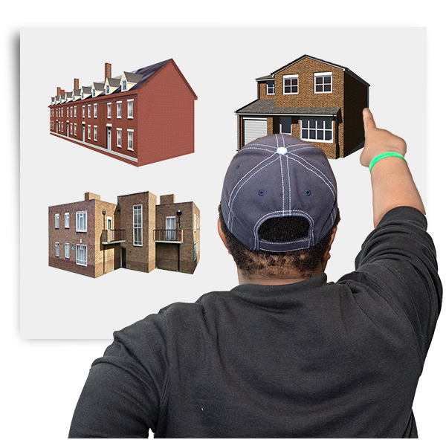
We asked people in
Residential care homes
Shared lives placements
Supported living
Sheltered housing
About where they live

Slide 15
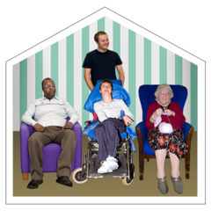
Care Homes
Staff on hand to meet support needs
Living with peers and friends
Adaptable to different levels of independence
Part of community

Slide 16
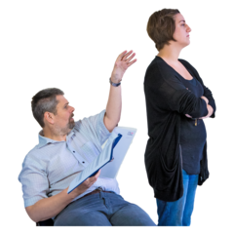
People say it can be restrictive and not offer choice
People told us they feel trapped if there are not enough staff to support them to go out
Some People told us they do not feel heard by staff or management
People’s changing access requirements are not always catered for
Managers say that getting dementia diagnosis and support for residents is extremely hard

Slide 17
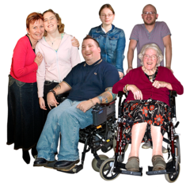
Shared Lives
Family home environment
Flexible care for individual needs
Support on hand at all times
A feeling of independence and community

Slide 18
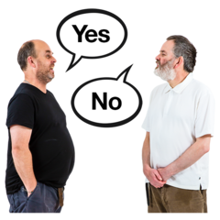
Placements may not be equipped to cope with changes in support needs
Relationships break down.
People are not offered choices or support
Shared lives carers say it is hard to get health care professionals to listen to concerns about dementia and access support

Slide 19
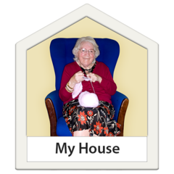
Supported Living
Independence, choice and control.
Learning life skills
A sense of ownership

Slide 20
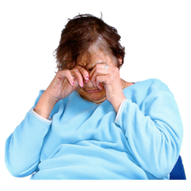
Accessing community is not easy. Without adequate support people can become isolated and vulnerable
People who have lost a day service no longer have a peer group or friends
Accommodation and support may not take into account changing needs as resident gets older

Slide 21
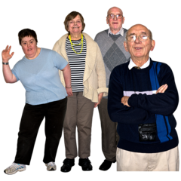
Sheltered Housing
Independence and choice
Support on hand when needed
Opportunities to socialize and take part in activities
Accessible facilities to meet people’s needs
Communal areas

Slide 22
Care must be taken to ensure that residents care packages are frequently reassessed so that the right level of support is being offered
Service is reliant on staff providing good quality support and access to activities that enrich the lives of residents
Staff say that accessing dementia support for residents is difficult if they also have a learning disability

Slide 23
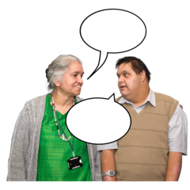
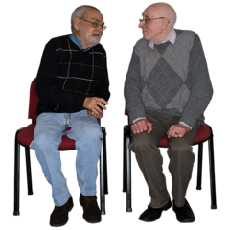
What we want
We want to talk about getting older
We want to talk about dementia and other changes that happen
We don’t want people to avoid talking about difficult subjects

Slide 24
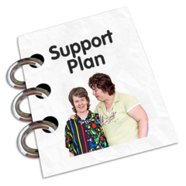
We want to have our say in planning where we will live when we get older
We would like to live in places that respect our choices
Having 24 hour staff on site is vital
A communal area is very important. It makes life much happier

Slide 25
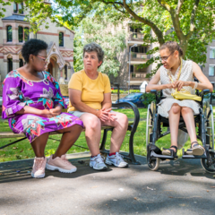
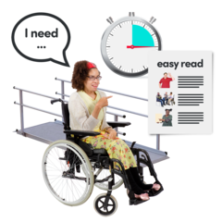
We want support to stay safe at home and go out in the community
We want to see our friends
Our own space is important
We want accessible adaptations in place before something bad happens

