Slide 1
Housing LIN Update
Clare Skidmore
Strategic Lead, Influencing and Networks
@SkidmoreClare
Autumn / Winter 2019
Housing Learning and Improvement Network
Notes:
Purpose of the presentation – let you know what’s going on at the LIN nationally, give you a flavour of the breadth of our work, and encourage you to make use of our free online resources (and even get involved).

Slide 2
Housing LIN regional delivery
We have boosted our central resource to support regional co-chairs by:
Jeremy Porteus, Chief Executive
Clare Skidmore, Strategic Lead for Influencing and Networks
Lois Beech, Stakeholder Engagement and Research Officer
Jerome Billeter, Corporate Services Manager
Sophie Fox, Business Support Officer
Darius Ghadiali, Knowledge Transfer Intern
Work closely with chairs to identify:
venues in each region (minimum of 2 meetings pa) and tour of schemes;
a range of interesting speakers on cutting edge themes
Highlighting national Housing LIN activities from influencing, research and consultancy programmes
identify possible case studies, blogs or other resources for future publication
Share findings and access or support learning from Housing LIN Consult

Slide 3
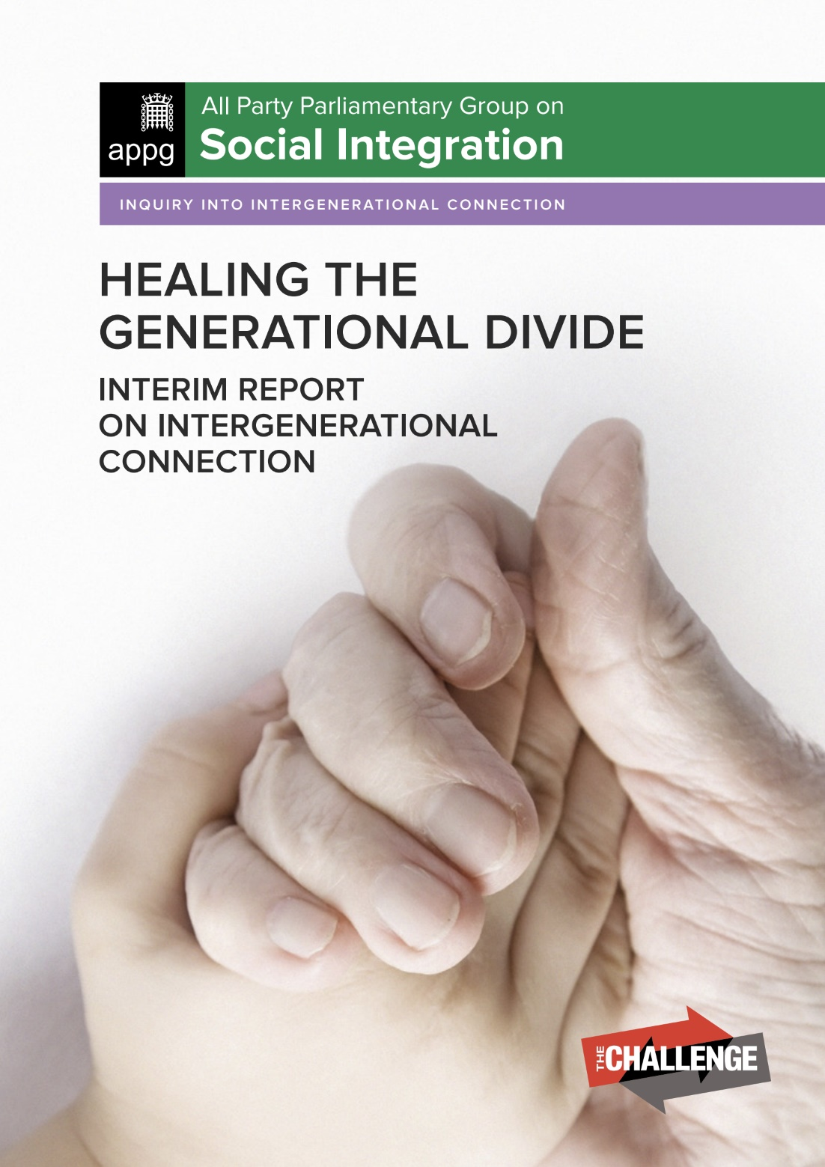
Our latest Housing LIN influencing activities
APPG on Social Integration on Generational Fairness (submission on intergenerational housing)
Responded to the Department of Health and Care Services’ Prevention Green Paper
Supported the development of the refreshed NHS England High Impact Changes paper (to ensure more focus on housing)
Supporting NHS England’s Transforming Care programme, hosted roundtable on future of specialised supported housing
Member of new Coalition for Accessible Housing – Homes made for everyone (HoME), launched 5 November
Notes:
We are active across themes relating to adult social care, public health, NHS, planning, design, housing and much more… so this is just a flavour

Slide 4
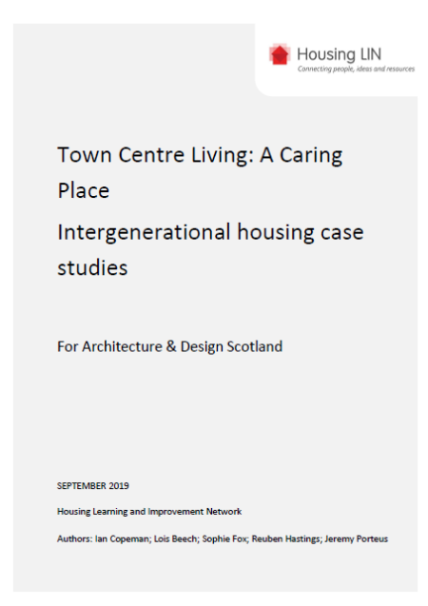
Recent Housing LIN case study report for Architecture & Design Scotland
Town Centre Living: A caring place. Intergenerational housing case studies
12 case studies on intergenerational living at: https://www.housinglin.org.uk/News/New-Housing-LIN-report-looks-at-intergenerational-housing/
Draws on examples from on UK, Europe and USA
Focussed on how could apply in Scottish Town Centre context as part of their wider programme at: https://www.ads.org.uk/a_caring_place_report/
Notes:
Growing interest in models of intergenerational living

Slide 5
Housing LIN case study report for Southampton City Council
Identifying the health care system benefits of housing with care – an evidence review
Findings of: reductions in the number of GP visits (by housing with care residents).
Reductions in the number of community health nurse visits
Reductions in the number of non-elective admissions to hospital
Reductions in length of stay and delayed discharges from hospital
Reductions in ambulance call outs, typically linked to reduced incidence of falls
Dividend to local health economy c£1,994.00 per person
Notes:
This piece of work was commissioned from the consultancy by Southampton City Council, our last SE meeting included a focus on this report and related themes

Slide 6
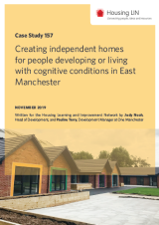
Other recent Housing LIN resources
Housing LIN Case Study 157 - Creating independent homes for people developing or living with cognitive conditions in East Manchester
Almshouse flats for homeless people: Sir Thomas White Court, Worcester: https://www.housinglin.org.uk/Topics/type/Almshouse-flats-for-homeless-people-Sir-Thomas-White-Court-Worcester/
Housing LIN review of the potential future demand for extra care housing, completed for Mears Group: https://www.housinglin.org.uk/Topics/type/The-market-for-extra-care-housing/
Notes:
We commission and author regular case studies, viewpoints, reports and other resources – for example

Slide 7
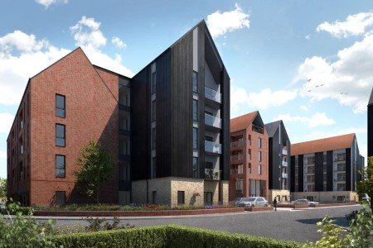
Other recent Housing LIN resources
Housing LIN Blogs, including a new one on marketing for senior living, and others on intergenerational living, co-operative living and the power of good design in home adaptations:
A selection of guest blogs at: https://www.housinglin.org.uk/blogs/
Housing LIN #InspirationalAchievements
Arden Quarter retirement living at the heart of Stratford-upon-Avon at: https://www.housinglin.org.uk/Topics/Inspirational-Achievements/orbit/
Notes:
Blogs are also becoming an important strand for us

Slide 8
Other useful recent publications
Kinship in the city: on urban loneliness- Future Spaces Foundation https://www.housinglin.org.uk/Topics/type/Kinship-in-the-City-Urban-loneliness-and-the-Built-Environment
Evidence guide to how to reduce isolation and loneliness for older people (Age Better in Sheffield / South Yorkshire Housing Association) https://www.housinglin.org.uk/Topics/type/Ageing-Better-Working-with-older-people-to-reduce-social-isolation-and-loneliness-A-guide-for-Housing-Associations/
NHS / SCIE Quick Guide – reducing deaths from cold homes https://www.housinglin.org.uk/Topics/type/Helping-to-prevent-winter-deaths-and-illnesses-associated-with-cold-homes-A-quick-guide-for-home-care-managers/
Notes:
We also publish resources produced by others, where we believe they are of interest to our members – for example:

Slide 9
Housing Design Awards 2019 - HAPPI
2 schemes won HAPPI awards this year (both PegasusLife)
Hortsley in Seaford, East Sussex (right and a future Housing LIN case study) and
Steepleton in Tetbury, Gloucestershire (below right and an existing case study at: https://www.housinglin.org.uk/_assets/Resources/Housing/Practice_examples/Housing_LIN_case_studies/HLIN_CaseStudy_152_ProctorMatthews.pdf
Other notable winners with HAPPI ingredients
Marmalade Lane, K1 cohousing in Cambridge (a Housing LIN guest blog) at: https://www.housinglin.org.uk/blogs/Eco-friendly-cohousing-in-Cambridge-Building-a-Shared-Future-across-all-ages/
Colby Lodge, Walthamstow with Walthamstow & Chingford Almshouse Charity
Notes:
Housing LIN has been a key influencer behind the development of the HAPPI standards, defining a set of principles for high quality design of housing for older people – we can see the impact of these through the most recent Housing Design Awards – great examples which we can learn from

Slide 10
Later Living: Housing with Care Guide
The Housing LIN wrote the opening Chapter
Several key messages for the sector, including:
The growth in the real estate sector
How Later Living can help solve the care crisis
The need for long-term planning and legislation, and
Creating aspirational places for the elderly
https://www.housinglin.org.uk/Topics/type/ULI-Later-Living-Housing-with-care-guide/
Notes:
This is a paid for guide, but provides a really useful collection of advice and sector intelligence on this topic

Slide 11
Upcoming HLIN resources/programmes
Housing with Care sector survey. A state of the nation survey to identify organisations’ ambitions for growing the housing with care choices over next 5 years. Deadline for responses, 31 December: https://www.surveymonkey.co.uk/r/Growing-H-w-C
A compendium of practice: repurposing sheltered housing (for 2020)
A compendium of practice: community led housing approaches (for 2020)
Programme of work jointly with Learning Disability England, co-produced with people with lived experience, to explore housing options for people with learning disabilities – Spring 2020
Housing options strategy briefing for RiPfA (due Spring 2020)
Housing LIN Putting Older People First in the South West: 5 year vision, 2020-2025 (out early 2020)
Developing autism and MCA training courses (several successful course held)
Future Leaders’ programme (ongoing engagement with early career HLIN members)
Notes:
Survey is still open.
A range of compendiums of practice

Slide 12
Housing LIN Consultancy – Underpinning your learning and improvement
Developed new service webpages setting our consultancy, training and wider fee paying services to supplement our free online and regional Housing LIN networking activities. Examples of work include:
Strategic Housing for Older People Market Analysis for several county councils and unitary authorities in Wales and England (the latter as part of the LGA Housing Advisor programme)
Worked with the Greater Manchester Combined Authority to produce an extra care housing resource pack, to support all the local authorities within the combined authority region
Undertaking sheltered housing ‘fit for purpose’ asset management reviews for housing associations, and supporting their work to plan for the needs of older tenants
Commissioned by NHS England to evidence and support their work to advise local commissioners about how best to respond to the needs of people with learning disabilities who need specialised supported housing
Notes:
Some of the other examples of work we’ve done with people through the consultancy include…

Slide 13
Connect with the Housing LIN
Over 25,000+ subscribers but still the ‘best kept secret’!
Sign up to receive our free weekly bulletin, HLINks
Check out our free-to-view online resources, including #InspirationalAchievements page at: www.housinglin.org.uk/InspirationalAchievements
Get involved and share your learning via a guest blog, viewpoint or case study, or at an event
Twitter at @HousingLIN, @HousingLINews @HLINConsult, @SkidmoreClare
Host a future regional Housing LIN meeting
Sponsor our website or an event
Notes:
If you think you’ve got a great idea for a blog or case study, or a suggested theme for a future event, please let us know. And we are always looking for generous hosts to support our meetings and events, to keep them free for our delegates.

Slide 14
Thank you!
Housing LIN c/o PRP, the Ideas Store 10 Lindsey Street, Clerkenwell London EC1A 9HP
email: info@housinglin.org.uk website: www.housinglin.org.uk
Twitter: @HousingLIN @HousingLINews @HLINconsult @SkidmoreClare

