Slide 1
Dementia and Mental Wellbeing in ExtraCare
Michael Spellman, The ExtraCare Charitable Trust

Slide 2



Approximately 14% of residents in ExtraCare live with dementia…
Between 2007 and 2009 ExtraCare completed research into a new approach to supporting residents living with dementia and other mental health issues in our schemes and villages
This research developed the staff role of the “Locksmith” who ‘unpicks’ issues around the person’s experience of their condition and ‘unlocks’ potential
Notes:
BPSD Affects up to 90% of people living with dementia, at some point, but how will greatly depend on the person.

Slide 3
Residents supported by a Locksmith were…
50% less likely to move into a care home
42% less time spent in hospital as an in-patient
More likely to have their mental health condition diagnosed
Residents also…
Rated their quality of life more positively
Experienced decreased symptoms of depression
Experienced greater feelings of social support and inclusion
(As detailed in the 2009 Bradford dementia group report, available on the ExtraCare website)
Notes:
BPSD Affects up to 90% of people living with dementia, at some point, but how will greatly depend on the person.

Slide 4
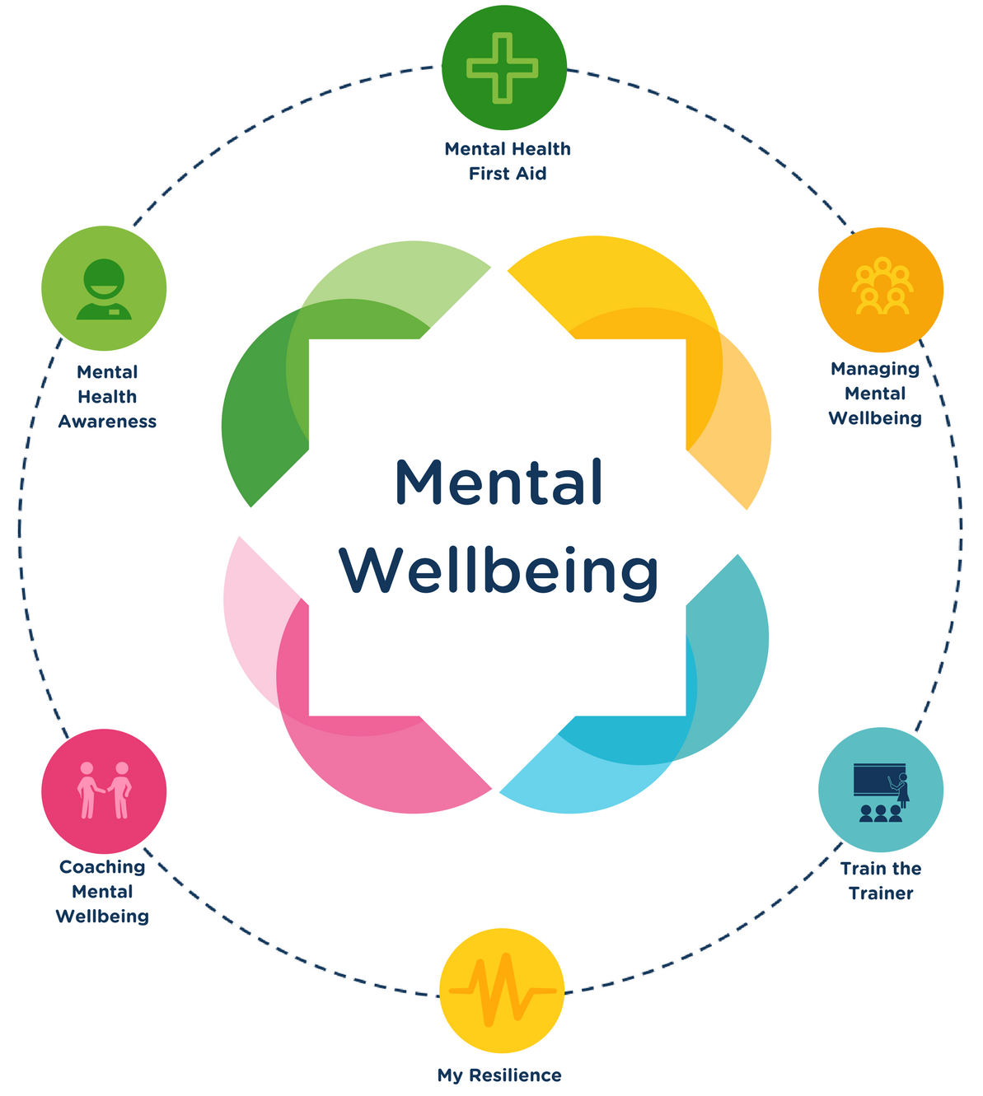



Dementia:
Kitwood’s Enriched Model
Mental Wellbeing:
Multifaceted approach
Neurological Impairment
Health
Biography
Social Psychology
Personality
Non-clinical solution focussed approaches
Introduction of talking therapies

Slide 5

Notes:
Make Guidance available

Slide 6
Notes:
Introduce VERA

Slide 7
Notes:
Provide an example of VERA in practice

Slide 8
Notes:
Provide an example of VERA in practice

Slide 9


Questions
Comments

