Slide 1
A holistic approach to development: Sharing ideals at Cranbrook Healthy New Town
Kenji Shermer
Urban Designer
East Devon District Council
Notes:
Outline how the two professional spheres share similarities but also have fundamental differences of approach.
How we are bringing together these professions to create better outcomes through a partnership across organisations
An example of how we have combined expertise to develop new, stronger evidence to healthy city design
A reminder of the structural barriers to achieving sustainable, healthy developments
A suggested structural fix.

Slide 2
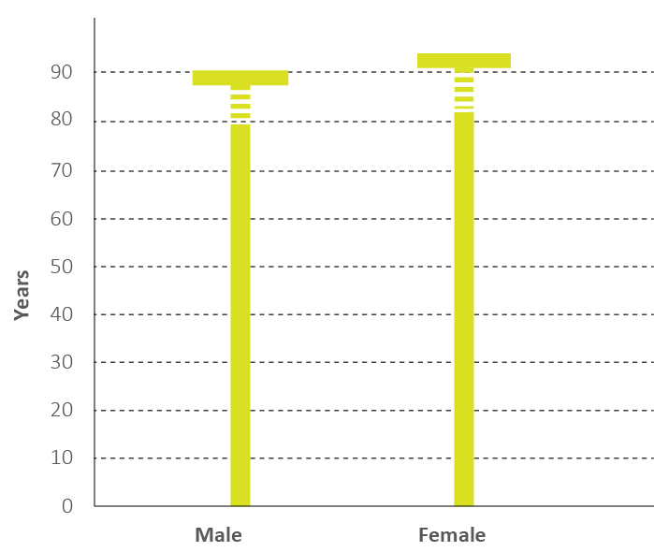
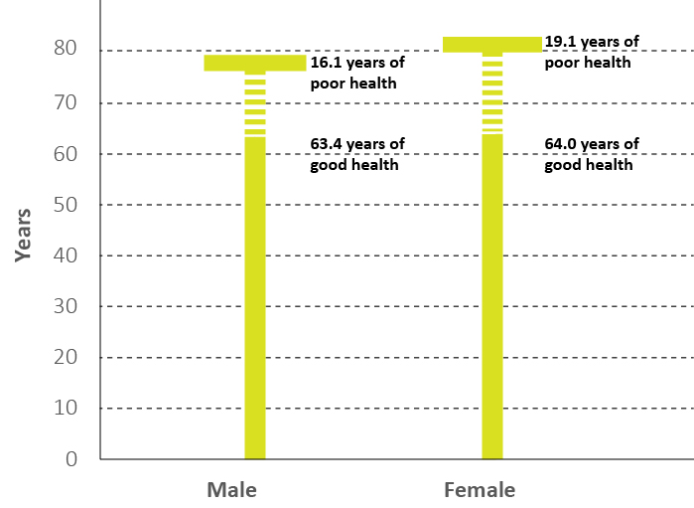
Building on the success of the Health Services
Keeping ill people alive…
…to keeping people well for longer
Notes:
The NHS has become very good at keeping ill people alive for longer.
The challenge for the NHS is now to keep people well for longer. This means that it has to operate outside of its usual boundaries and work within the wider environment in which we live.

Slide 3
The opportunity for Planning for Health
‘Prevention needs to be at the forefront of all national and local policies, weaved into plans for everything from health and social care to town planning, housing and transport.’ Prevention Green Paper 2019
‘Any geography with planned housing growth should use the healthy new town principles as a guide for collaboration between Local Authorities, NHS services and developers in ensuring new developments plan, design and build healthier environments.’ NHS Long Term Plan Implementation Framework 2019
Notes:
Public health, prevention and healthcare policy direction now is placing great emphasis on collaboration in planning . These are quotes from England but we know this is much broader –we are all looking for healthier futures for everyone
Public health has been saying this for a long time, a central message of WHO, the health sector is increasingly ready and signalling intent of the importance of engagement in new developments. That is great news.
Thinking differently about urban design
Planning for the wider determinants of health
Thinking differently about health models
Putting health advice where the people are
Planning differently and acting together
Building on our shared learning

Slide 4
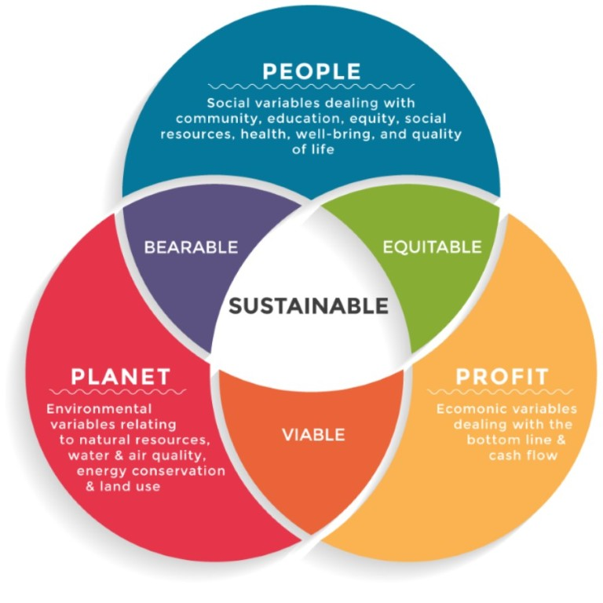
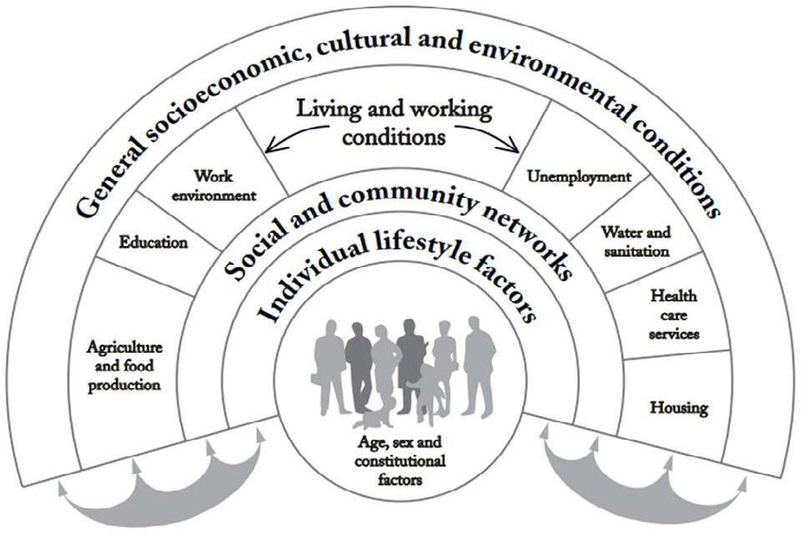
Planning and health – different perspectives
Sustainable development
Health and wellbeing
Notes:
These differences of perspective can be illustrated through these diagrams that underpin the core philosophies underlying each.
In the end, both try to achieve the same thing, they both cover the same issues, but one places people at the centre while the other places sustainability at the centre. In moving together we argue that the renewed focus on people, health and wellbeing, addresses some of the abstraction that comes from the terminology within Sustainable Development and enables us to achieve far more.
It has been helpful in enabling us to achieve more because sustainable development is very easy to argue and in all honesty you do not get all that upset about things that are unsustainable.
However, knowing that a new development is by its design going to make you more likely to live a shorter, unhealthier and unhappier life it is highly likely that you are going to get very upset indeed.

Slide 5
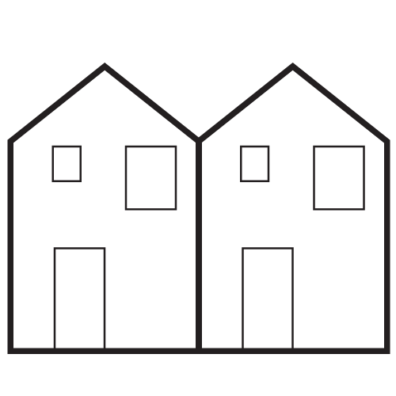
Planning and health – Different approaches
Things and Spaces
Atomised approach
Containing and controlling
Notes:
However, there are very different systemic approaches taken by Planning and Health.
To brings things down to the simplest level, Planning could be summarised as operating like this.

Slide 6
Planning and health – Different approaches
Sustainable New Town
Parking
Problem - People like parking
Solution – Give them parking – not too much
…
Privacy
Problem - People like privacy
Solution – Overlooking distance + a fence
“We know we’ve succeeded when we have annoyed everyone equally.”
Cycle paths
Problem – Cyclists need space away from cars
Solution – Cycle path away from cars
Walkability
Problem – People should walk to shops
Solution – Draw a 400m circle around a shop
…
Notes:
The Planning tradition is about Place.
Planning tries to address the complexity of the built environment by breaking it down into constituent parts, trying to produce something that pleases everyone in each part and then gluing it all back together again.
However, many of these constituents are mutually conflicting so it’s no surprise that when we develop Planning Policy and make Planning decisions we can get tied up in knots. We know we are going to make some people unhappy or dissatisfied because we are telling them all the things that conflict with day-to-day lives as they are currently. Hence the Planning adage that you know you’ve succeeded when everyone is equally upset.
It’s not a surprise that within this sort of process we end up with the urban equivalent ?? of Frankenstein’s monster. Sometimes you can’t simplify complex things.

Slide 7
Planning and health – Different approaches
People and experience
Promoting and enabling
‘Whole person’ approach
Notes:
The Health services, and particularly Public Health take a very different approach. This is explicitly holistic and puts the person at the very forefront of all decision making.
The revision in the way the Health Services work is also to tailor activities and interventions to the individual, understanding their way of life and creating interventions or treatments accordingly.
This has been demonstrated to have better health outcomes.

Slide 8
Planning and health – Different approaches
How do you feel?
Notes:
If this sounds complicated it can all be distilled into the first question any health practitioner ever asks:
How do you feel? What matters to you? How can we help?

Slide 9
Planning and health – Different approaches
How do you feel here?
Notes:
Applied to the built environment this brings a qualitative shift in the way we work, moving from individual disciplines focus towards a shared approach - taking away the abstraction that can result from working within organisational frameworks/ regulated environment.
This starts to give us the strength of argument necessary to enable our respective professions to adapt or challenge stardard norms that when working in isolation we are yet match the needs and expectations of our new communities.

Slide 10
Where would you like to live?
Sustainable New Town
Sustainable Old Town
Notes:
What this might mean is that in putting people first and planning holistically, based on how people experience places, we may move away from Frankenstein and towards places that people would recognise because until the industrial era we have always designed around out individual and collective needs.

Slide 11
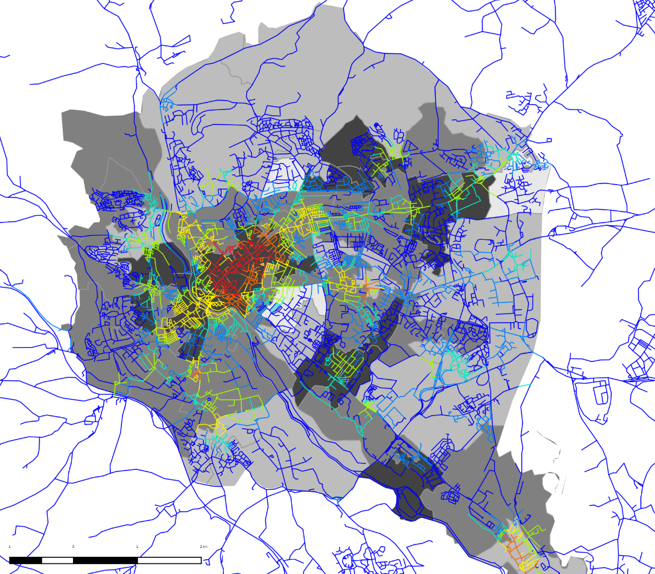
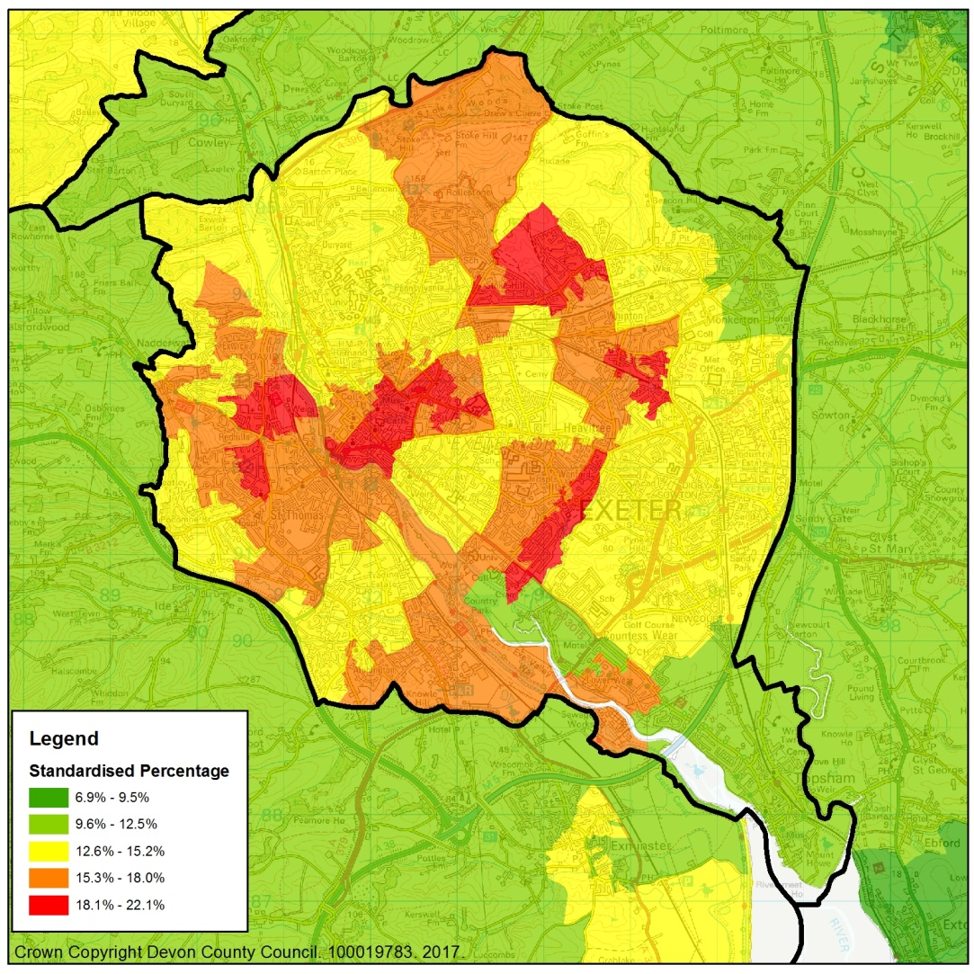
Opportunities through evidence
Negative outliers – Low deprivation, high frailty
Number of different land uses
Crown copyright. OS Licence No 0100192252
Deprivation score
Space Syntax © 2018. Land use Access to services / Deprivation
Crown Copyright Devon County Council 100019783. 2017
Notes:
Outliers: Low deprivation / higher frailty risk
From a health forecasting point of view, looking for places that appear to cause unexpectedly high levels of ill-health makes sense. These are the places where addition care resources will be necessary to offset the issues suffered in that location.
Last year we were able to show that these negative outliers shared the characteristics of being sub-urban, low density and car dependent.

Slide 12
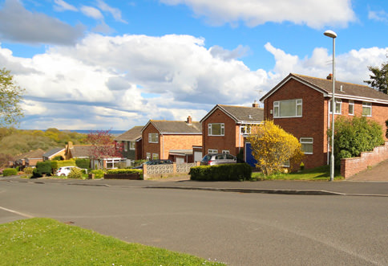
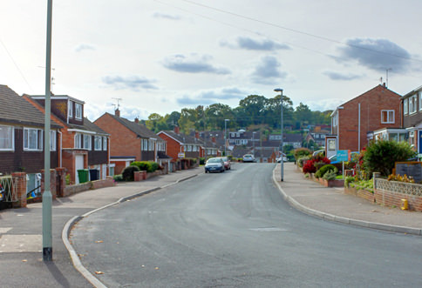
Reactive forecasting
Negative outliers – Low deprivation, high frailty
Suburbs built between the 50’s and 90’s
Home to couples and older families
Suffer excess loneliness, obesity and car dependence
Notes:
Outliers: Low deprivation / higher frailty risk
From a health forecasting point of view, looking for places that appear to cause unexpectedly high levels of ill-health makes sense. These are the places where addition care resources will be necessary to offset the issues suffered in that location.
Last year we were able to show that these negative outliers shared the characteristics of being sub-urban, low density and car dependent.

Slide 13
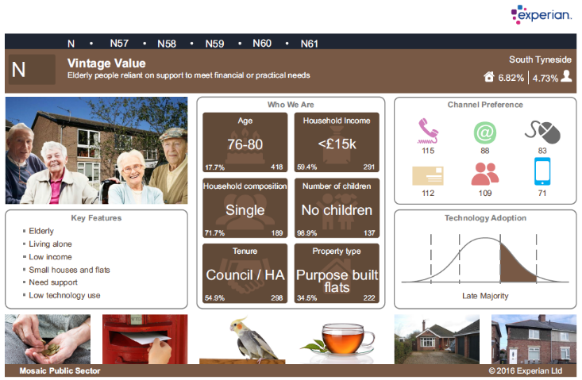
Reactive forecasting
+
=
Predicted health outcomes
Notes:
Demographic profiling is a powerful tool when used to look at the way frailty will develop.
Coupled with what we are starting to know of the interaction of the built environment and people’s health we can start to predict the likely health outcomes.

Slide 14
Reactive forecasting
Care and health messaging tailored to the community
Suitable services, technology and facilities
Predicted health outcomes
Notes:
This means that we can start to tailor the services offered to the community to best serve their needs.
This then allows a better knowledge of what sorts of health facilities will be needed, which can then be built into the town.
However, this is a very passive use of the data, especially when you know there is a chance that the built environment could be having a more positive impact. In many cases we will simply be mitigating issues caused by the developments we are building.

Slide 15
Positive outliers – High deprivation, low frailty
Number of different land uses
Crown copyright. OS Licence No 0100192252
Deprivation score
Space Syntax © 2018. Land use Access to services / Deprivation
Crown Copyright Devon County Council 100019783. 2017
Notes:
Outliers: High deprivation, low frailty
We also found that a positive outlier where people were significantly healthier than expected. This area of high deprivation has high levels of social and community infrastructure with strong social bonds.

Slide 16
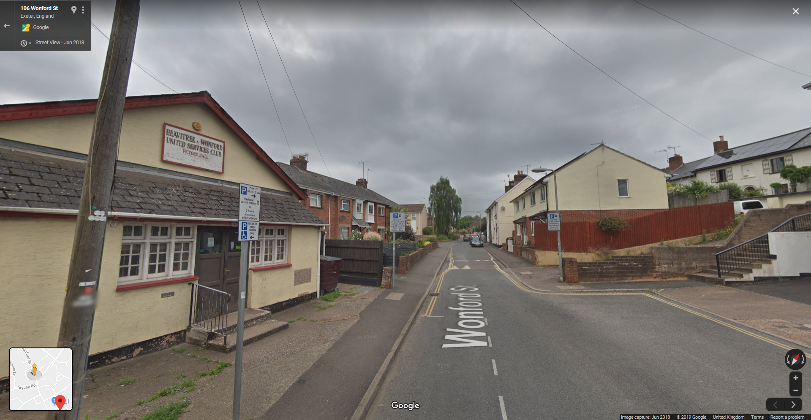
Proactive forecasting
Relatively high density
Strong social networks
Good community facilities
Notes:
To take a more proactive approach health and wellbeing must be a primary consideration before design or planning starts.
Being better informed about the outcomes we want to achieve Health professionals need to be involved in the location as well as the design of development.
In this way new towns can become significantly more able to benefit their communities which also has the additional benefit of creating sustainable development in a much more rounded sense.

Slide 17
Proactive forecasting
Better predicted health outcomes
Stronger communities
Better individual and collective wellbeing

Slide 18
What has come from the Healthy New Towns
‘Putting Health into Place’ 2019
Healthy New Town Principles
Plan, assess and involve
Plan ahead collectively
Assess local health and care needs and assets
Connect, involve and empower people and communities
Design, deliver and manage
Create compact neighbourhoods
Maximise active travel
Inspire and enable healthy eating
Foster health in homes and buildings
Enable healthy play and leisure
Develop and provide health care services
Develop health services that help people stay well
Create integrated health and wellbeing centres
Notes:
Public health, prevention and healthcare policy direction now is placing even greater emphasis on collaboration in planning . These are quotes from England but we know this is much broader –we are all looking for healthier futures for everyone
Public health has been saying this for a long time, a central message of WHO, the health sector is increasingly ready and signalling intent of the importance of engagement in new developments. That is great news.
Thinking differently about urban design
Planning for the wider determinants of health
Thinking differently about health models
Putting health advice where the people are
Planning differently and acting together
Building on our shared learning

Slide 19
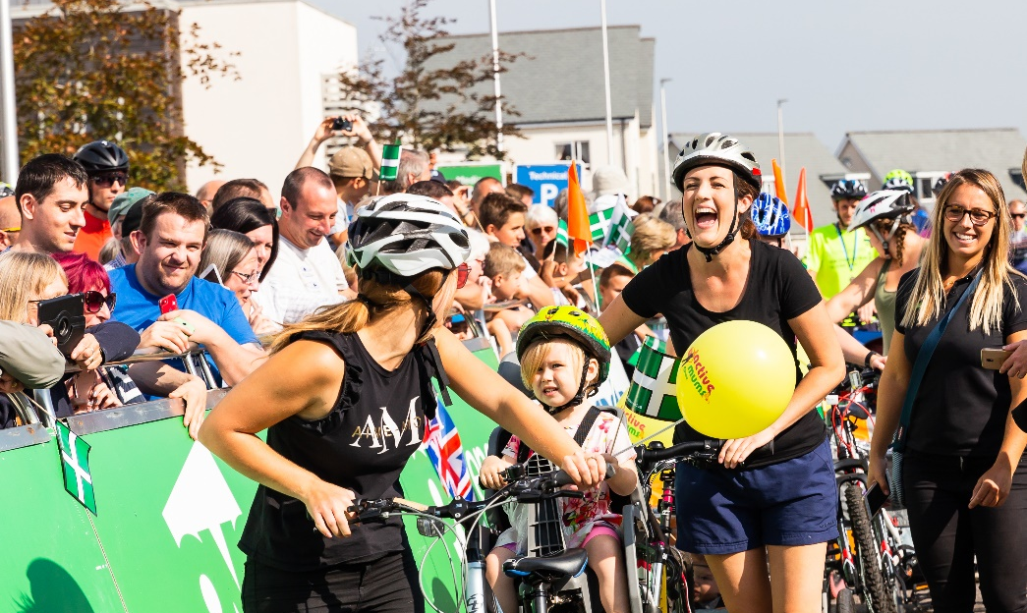
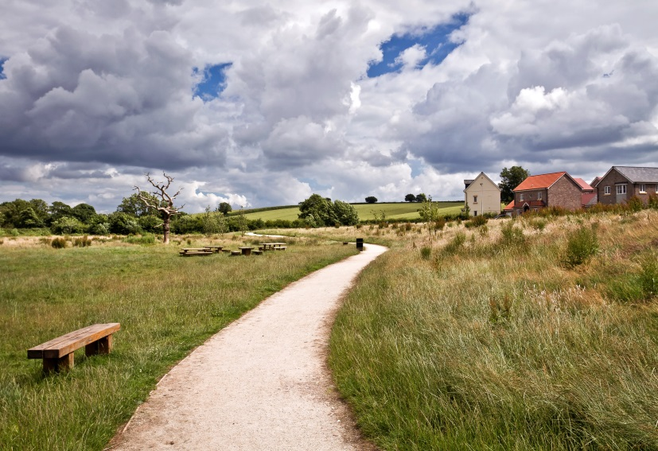
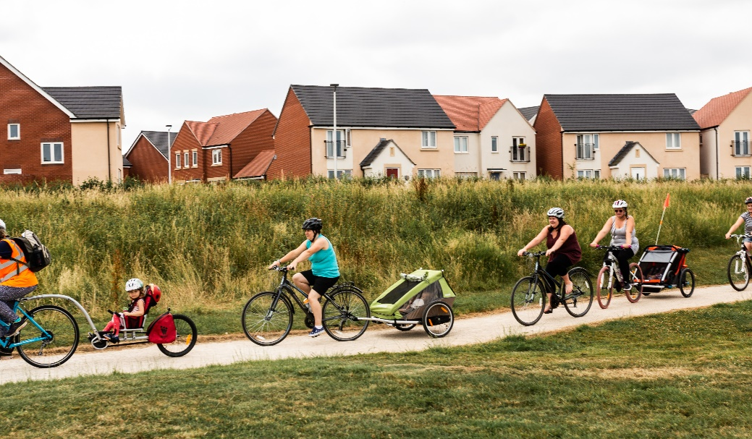
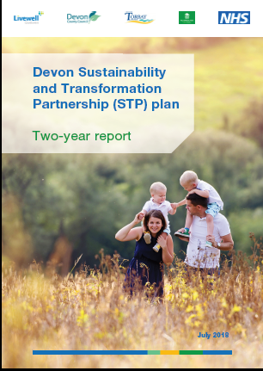
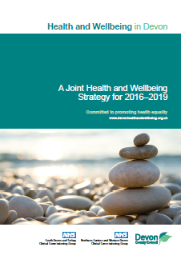
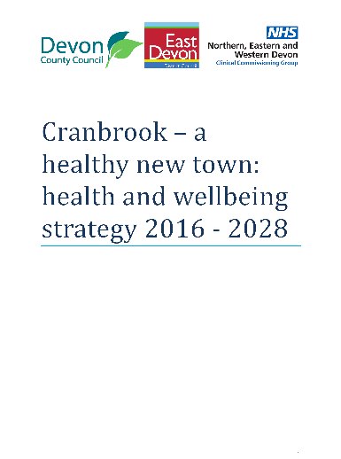
Communities of practice
People
Places
Partnership
Plans
Notes:
– It is about the approach we take – and a renewed focus on people, people we work with and the communities and families we serve.
It helps remind Planning that Places are about and for People.
It is also about a journey that has been taken from all sides as we get to know each others language and methods of working.
It is something from which we learn how leadership has to evolve significantly to be effective across organisations by being again, more people and relationship focussed, more about understanding and developing shared priorities.
Health needs to be influencing at the beginning of the process. Building expertise and capacity and understanding of each others practices. Shared focus, common language on things that we agree really matter.

Slide 20
A shared focus on people’s health Planning together for individual and population health
Notes:
What we found through the healthy new towns programme was we were starting to learn and understand the different worlds of planning and health – priorities, timeframes, policy frameworks. But more importantly we found the common ground - our conversation was changing to discuss what we could do to achieve healthier individuals and the populations.
Things we have learnt –
Health has to have a central role in Planning and Place making, helping set priorities for development
Different professional disciplines can define their own utopias in isolation from each other and their communities. Redefining our professional roles so communities to take the lead in defining what is important to them, allows our disciplines to advising how this can then happen rather than imposing external world views.

