Slide 1


Adaptations without delay
Presented by Rachel Russell (University of Salford)
Notes:
As an occupational therapist with over 25 years experience in housing, I am regularly reminded of the impact that an inaccessible environment can have peoples every day lives
Being restricted - Not being able to do the most simple and everyday things in your own home –such as getting up and down stairs, keeping clean, preparing meals – and being able to get out –
Every day all over the UK occupational therapists are faced with situations that they know can be resolved by simple straightforward adaptations – such as level access showers, stairlifts, or ramps
We are meeting people, who have already been waiting a long time to see us – who need these adaptations TODAY knowing that, if they are applying for funding, it may be several months if not longer before it is installed – and some places are better than others
Generally it is our experience that people who come to local authorities seeking an assessment, EITHER know what they need but cannot afford it OR can afford to fund themselves but just need advice on the best solution to meet their needs
So it was a brilliant opportunity to be involved in this project to have a chance to consider how we can reduce these delays

Slide 2
Adaptations without delay : purpose
Ensure a more responsive service to those needing adaptations
Reduce demand on occupational therapy services
Improve efficiency in response to uplifts in funding
A rationale for key stakeholders on when an occupational therapist is not needed
Make best use of the expertise of occupational therapists in complex situations
Being applicable in all four UK nations
Notes:
In response to the uplift in funding for adaptations this guidance is aimed at ensuring that services be flexible and responsive to demand and reduce delays

Slide 3
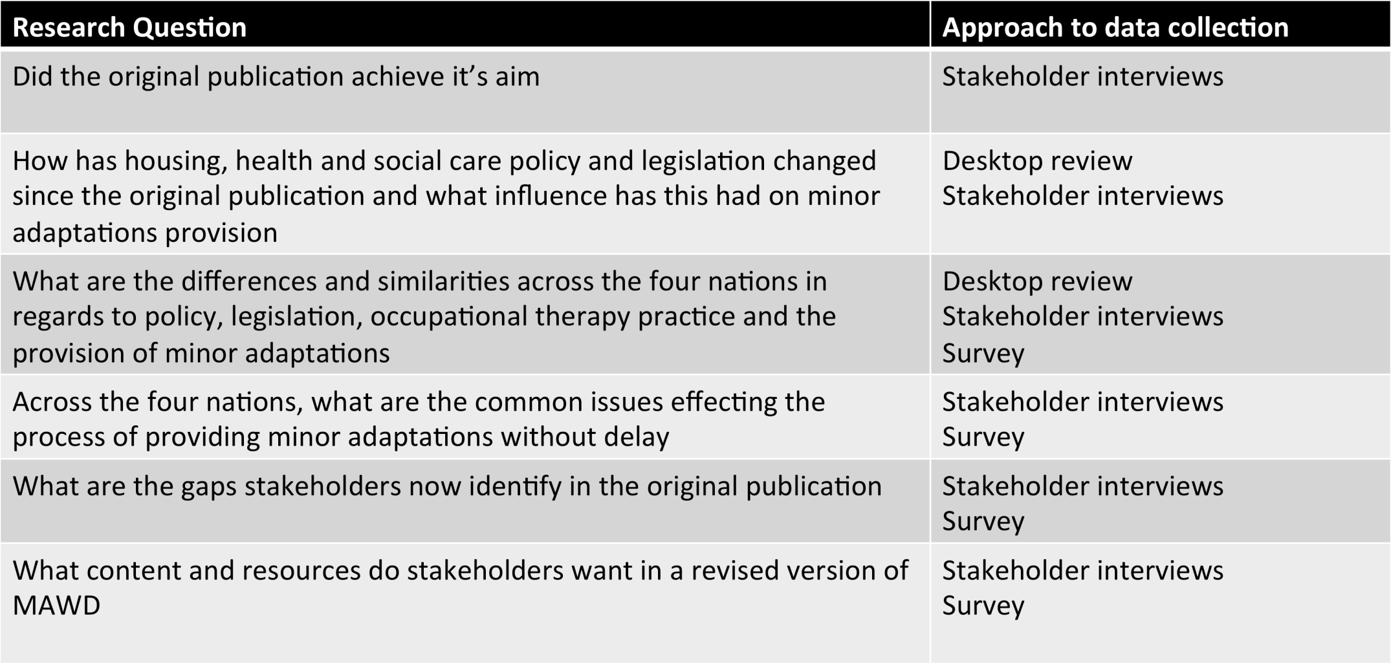
Project questions
Notes:
These are the questions that framed the consultation process
Did the orginal MAWD guidance achieve its aim ?
How has policy and legislation changed and what influence has this had on provision of minor adaptations?
What are the differences and similarities across the 4 nations ?
What are the common issuses affecting provision across the UK?
What do stakeholders identify as gaps in the original guide?
What do stakeholders what to see in a revised publication ?

Slide 4
UK Wide Stakeholder consultation : methodology
Desktop Review
Legislation Policy and Practice
Stakeholder interviews
Occupational therapy managers
Home Improvement Agencies
Care and Repair
Housing providers and Housing Associations
Royal College of Occupational Therapists representatives
Survey of front line practitioners
(800 + respondents)
  Occupational therapists
  Staff working in Home Improvements Agency
  Staff working Housing Associations
  Technicians
  Trusted Assessors
Focus Groups
Manchester, London, Cardiff, Belfast, Glasgow
Steering Group: meetings and reviews
Foundations, Care @ Repair, RCOT Specialist Section Housing, CIH, RCOT
Notes:
The proposed new approach has been informed by stakeholder consultation That included
Desktop review of legislation, policy and practice across the UK
Stakeholder interviews that informed the questions in a survey of front line practitioners
We used the findings from these to host focus groups to consider what was needed in a new version
The whole process was overseen by a Steering group with members from key stakeholder organisations including Foundations, Care and Repair, Chartered Institute of Housing and RCOT specialist section in housing

Slide 5
Stakeholder consultation : key findings
  Common themes in policy and legislation that place an emphasis on prevention
  Waiting for a social care assessment is contributing to delays
  That integrated approach to assessment , design and installation can deliver better person centred outcomes
  The most common major adaptations are showers, stair lifts and ramps where the situation is simple and straightforward
  Typically the need has been defined by the type or cost of the adaptation rather than the complexity of the situation
  Significant numbers of people who are self-funding need information and advice
Notes:
Many of these findings wont be a surprise to you and will echo your experience : Key findings across all nations are that there are
Common themes in policy and legislation that place an emphasis on prevention
Waiting for a social care assessment is contributing to delays (but also that there are a significant number of people who would benefit from the preventative benefits of adaptations who are not getting through due to eligibility criteria)
That integrated approach to assessment , design and installation can deliver better person centred outcomes
The most common major adaptations are showers, stair lifts and ramps where the situation is simple and straightforward
Typically the need has been defined by the type or cost of the adaptation rather than the complexity of the situation
Significant numbers of people who are self-funding are not getting the information and advice they need

Slide 6
Adaptations without delay : contents
A fresh approach to respond to growing demand
The value of occupational therapy in complex situations
Demonstrating how other staff can carry out simple assessments
    Describes adaptations based on complexity rather than type and cost
    A framework to support a proportionate response
    Tools on work force and operational considerations
    Innovations in practice from around the UK
    Sources of design guidance
Notes:
The Adaptations without Delay guide presents a fresh approach to respond to the increasing demand for home adaptations
The rationale for this new approach is informed by the findings from a UK wide stakeholder consultation process
The core intention is to provide a better understanding of when an occupational therapist is needed and the value of occupational therapy input in complex situations
Whilst at the same time demonstrating how other staff, with the appropriate training, can carry out simple assessments and make recommendations for straightforward adaptations
It presents a A NEW WAY TO DESCRIBE ADAPTATIONS based on the complexity of the situation rather than the type and cost – moving away from the MAJOR or MINOR classification
IT PRESENTS A FRAMEWORK derived from Balanced system that has been adopted in healthcare, to provide a more proportionate response according to the presenting need –using the categories of UNIVERSAL, TARGETED AND SPECIALIST levels of interventions
The guide provides TOOLS that detail the factors to consider in terms of the skill mix of the workforce as well as operational implications at each level of intervention
And we have included detailed list of resources on design guidance and organisations involved in the delivery and installation of adaptations
Essentially this guide is a reflection of existing best practice and innovations in service delivery around the UK that we hope will act as a useful resource to show how services can be redesigned to deliver adaptations more quickly

Slide 7
A new way to describe adaptations : based on the complexity of the situation
Simple or complex (not minor Vs major)
A person centred approach
Provide a proportionate response
Prioritise prevention
Values occupational therapy as a complex intervention
Notes:
The definition of adaptations as Major or Minor has been linked to the way these items are funded Broadly speaking adaptations that cost over about £1000 have been defined as MAJOR (And there is evidence to demonstrate that the most common of these are straightforward stairlifts, ramps, showers )
-For those who are not able to afford these– in England the funding route is via a Disabled Facitlies Grant
To approve a grant the legislation requires the local authority to agree that the proposed adaptation is necessary and appropriate for the individual
The responsibility to confirm this has fallen to occupational therapists employed by Local Authorities - Where there a long waiting lists for Social Care Assessments – this has lead to the perception that waiting for an occupational therapist is contributing to the delays
These adaptations have therefore come to be defined by their cost rather than the situation that they are addressing
The Adaptations without Delay guidance proposes a new way to describe adaptations based on the complexity of the situation
It shows how – there are many people who have simple needs that can be met by straightforward solutions that do not need an Occupational Therapy Assessment
The aim is to enable services to provide a proportionate person centred response that maximises the preventative benefits of adaptations
With some basic training many more support staff and trusted assessors should be able to carry out simple assessments that can contribute to reducing the delays and maximise the preventative benefits
Whilst at the same time recognising the value of occupational therapy where the situation is complex – for example people with deteriorating conditions, children whose needs change as they develop,
Above all the aim is to deliver adaptations in timely manner – as quickly as possible

Slide 8
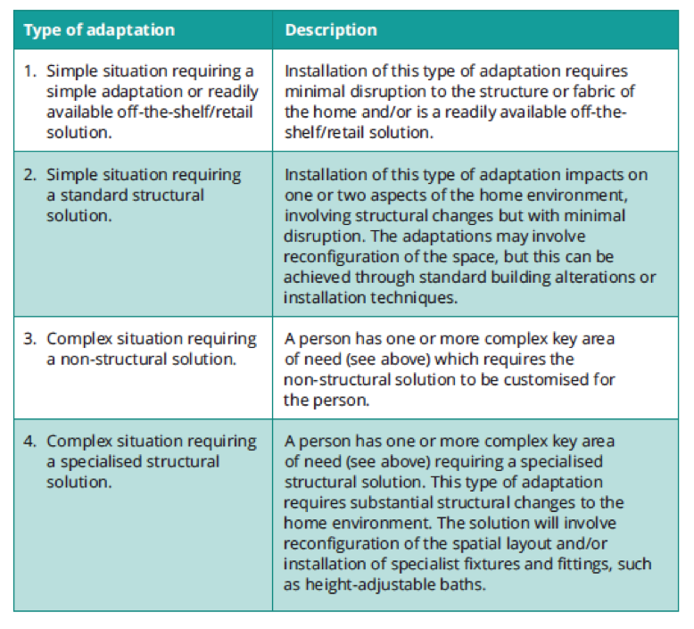
A new way to describe adaptations : based on the complexity of the situation
Dimensions of complexity
The person, their priorities and needs
The nature of the activities the person is having difficulty performing
Environmental barriers to independence
The types of solutions required
Notes:
We are presenting a new way to describe adaptations based on the complexity of the situation –
This is derived from a framework developed by the Australian occupational therapist Elizabeth Ainswoth and presented in this table
That defines the different types of adaptations according to how simple or complex they are – whether thy are off the shelf,non-structural structural or specialised bespoke solutions
This new way to describe adaptations considers these solutions alongside the complexity of the situation in 4 key areas
The person, their priorities and needs
The nature of the activities that person has difficulty with
The environmental barriers to independence
The types of solutions required
EG the need for a simple grab rail may be just one solution that is part of a complex situation
Where an occupational therapist will consider a number of other factors that impact on the persons safety and wellbeing
-Conversely a shower adaptation can be a solution to a simple problem where the person benefits from the design and installation skills of a technical officer and building contractor

Slide 9
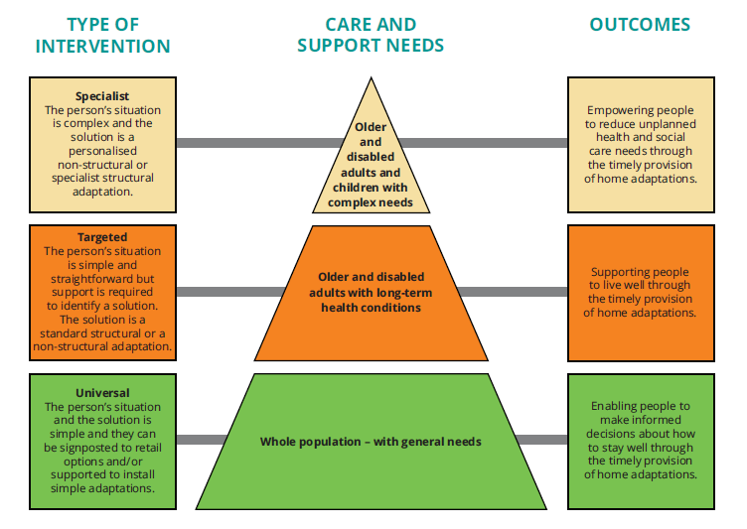
Developing the Adaptations without delay framework:
Key Learning
Providing a more proportionate response
Establishing the right skill mix
A guide for the retail market on when a targeted or specialist response is needed
Helping members of the public understand the type of service they might need
Notes:
The adaptations without delay framework illustrates the link between
the level of complexity in terms of a health and social care needs
and the type of intervention that can deliver the best person centred outcome.
The levels of intervention are categorised as universal, targeted and specialist
At the Universal level – the situation and the solutions are simple and can be met by retail options or basic help to install simple adaptations- AN OCCUPATIONAL THERAPY ASSESSMENT IS NOT NEEDED
At the Targeted level – the situation is still simple and straightforward but some basic guidance and support is needed to select the best option from a range of standard solutions ( e.g. showers, stairlifts) and can be provided by support staff with the right level of training AND WHERE SUPPORT CAN BE MADE AVAILABLE FROM AN OT IF NECESSARY
At the Specialist level the persons situation is complex and requires personalised solutions which could be either structural or non-structural WHERE DIRECT OT IS REQUIRED
The purpose of a the framework is to
Enable Services to establish a workforce with the right skill mix to provide a more proportionate response
As well as providing information for both the retail market and members of the public as to when they may need to seek more advice and support

Slide 10
Work force and operational considerations – and level of complexity
Notes:
Detailed guidance is provided in the form of tables in Section – for each level of interventin – universal / targeted / and specialist to outline the key factors to consider in terms of Nature of complexity/ Workforce skills/ Operational Considerations
I have taken some typical situations as means to illustrate how these tables might be applied

Slide 11
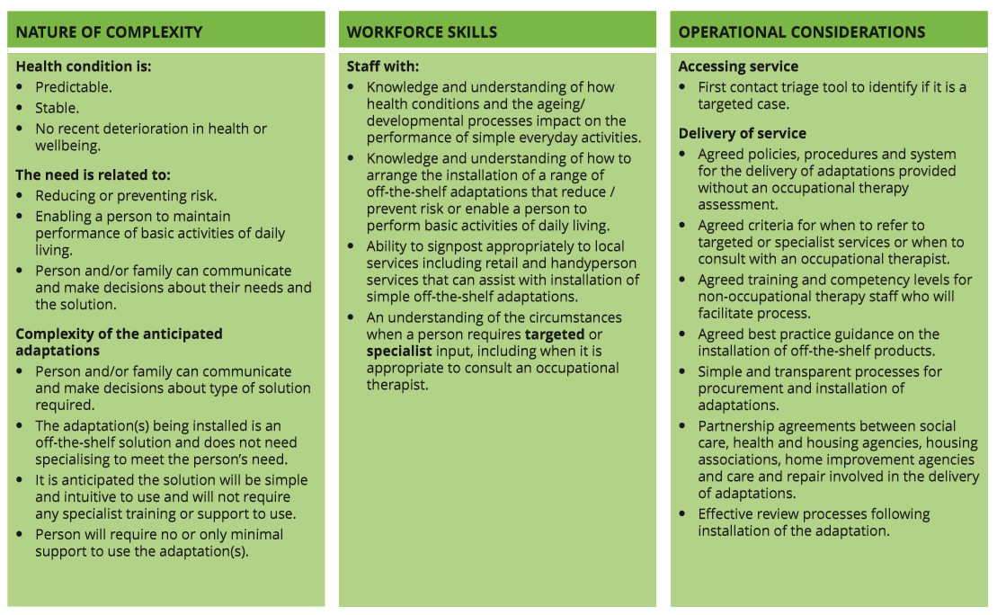
Universal

Slide 12
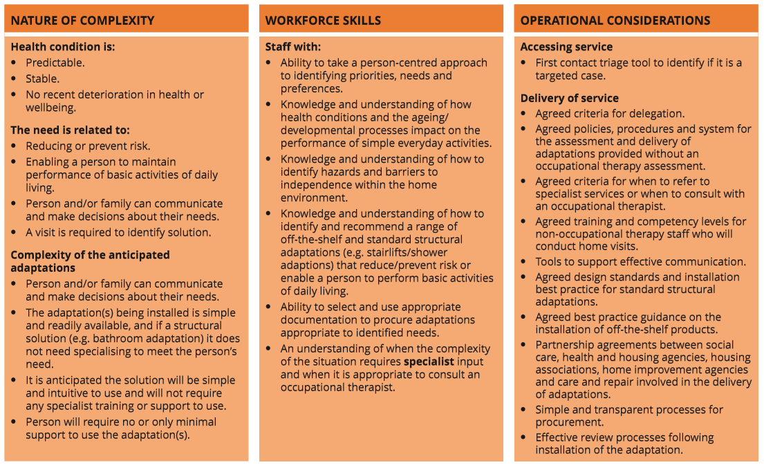
Targeted

Slide 13
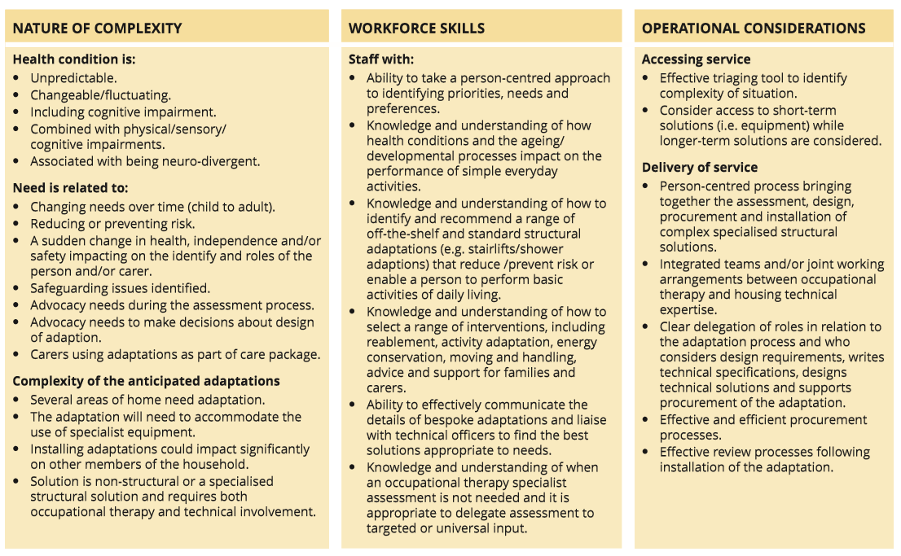
Specialist

Slide 14
Service Delivery Examples
Training –DLF (England) – Housing Solutions Change programme i(Scotland)
Agreed levels of responsibility – example from RBG
Communication Tools – example from Northern Ireland Housing Executive
One stop shops – example from Borders Care and Repair
Integrated teams – example from Lightbulb Project in Leicesteshire
Strategic Forums - HAC (England) , AHG (Scotland) , HASG (Wales) JASG (NI)
Notes:
For many people concerned with the delivery of adaptations, what we are proposing in this guide is not new - It is simply a reflection of how existing practice is developing to respond to the growing
One of the best parts of being involved in this project has been the opportunity to learn about local service innovations
We have included a number of examples that we hope will act as a useful resource for organisations who want to make changes to the way they work – that include:
Trusted Assessor Training – such as that delivered by DLF in England and Housing Solutions Change programe Scotland
Checklists that could be used as a Triage tool to consider when an occupational therapist is or is not needed from the DLF and guidance on agreed level of responsbility from the OT service in Greenwich
And a brilliant example of how Communication tools to ensure that for the adaptation are fit for purpose frm Northern Ireland
Examples of how integrated teams and one stop shop service models can reduce delays such as the Lightbulbproject in Leicerstershire and Care and Repair Cymru Rapid Response Adaptations Service and Borders Care and Repair that enables cross tenure self referral
We have been shown the value of cross agency forums at a strategic level to support ongoing partnerships(Home adaptations Consortum in England , Joint Adaptations Steering Group NI, the Accesible Housing Group in Scotland, and the Housing Adaptations Steering Group in Wales .

Slide 15
Sources of design guidance
Guidance on space and layout for home adaptations
Organisations that provide technical expertise
Organisations that specialise in the needs of people with sensory and cognitive impairments
Notes:
This guide is presenting a new way to consider who is capable of carrying out assessments and making recommendations for adaptations to meet individual needs
It is not a guide on the technical aspects of how these adaptations are installed- and this will be dependent – not only what is feasible – but also what best meets the individual needs of the person concerned.
We have provided a detailed list of sources of design guidance
What we consider to be the best examples of
guidance on space and layout for home adaptations
Organisations ( like home improvement agencies and care and repair ) who are best place to provide the technical expertise
And Organisation that specialise in specific needs including sensory and cognitive impairments
Our hope is that this guide provides the a framework, tools and resources that will support partnership working across agencies to address the delays in the of adaptations

Slide 16
Intended audience
Services concerned with providing advice and information to disabled and older people and their families :
    Occupational therapy services in health, social care and housing
    Housing providers and housing associations
    Home improvement agencies, care and repair
    Handy persons services
    Training providers
    Voluntary organisations
    Members of the public

Slide 17
The final message : How the guide can help to reduce delays
Avoid service design that is based on type and cost of adaptation
Avoid misinterpretation of legislation and the role of occupational therapists
An understanding of the type of situation where an occupational therapist does not need to be involved
To make more effective use of occupational therapists where the situation is complex
To enable redesign of services that prioritise person-centred and preventative outcomes

Slide 18

Thank you!
Royal College of Occupational Therapists
106-114 Borough High Street,
London SE1 1LB
email: Professional.Enquiries@rcot.co.uk website: www.rcot.co.uk
Twitter: @theRCOT
Housing LIN
C/o PRP, the Ideas Store, 10 Lindsey Street,
Clerkenwell, London EC1A 9HP
email: info@housinglin.org.uk
website: www.housinglin.org.uk
Twitter: @HousingLIN; @HousingLINews

