Slide 1
Housing 21’s work around dementia
Vanessa Pritchard-Wilkes
Head of Strategic Engagement

Slide 2
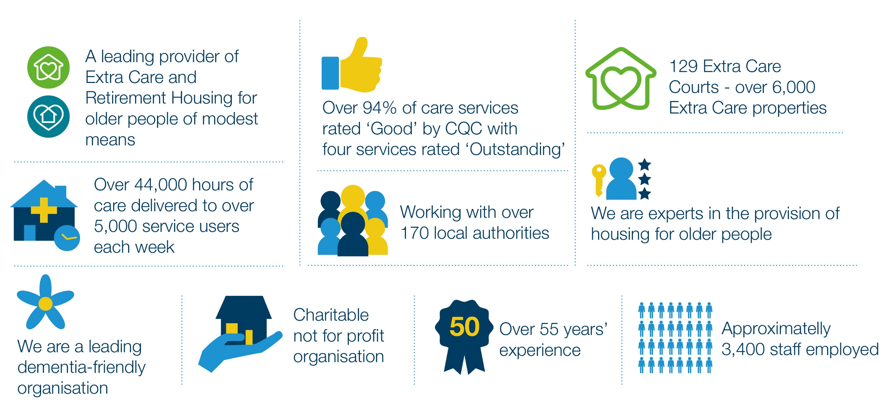
Housing 21

Slide 3
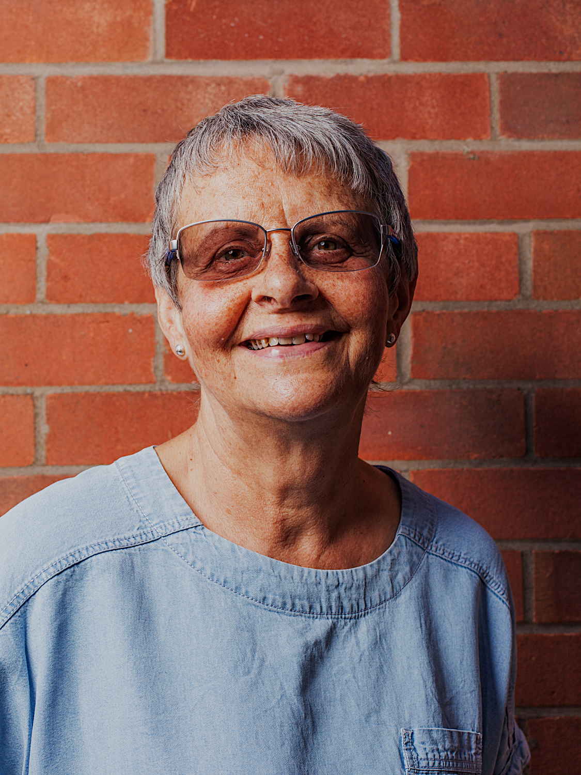

Wendy Mitchell
The ‘right housing’:
what does it mean to me?

Slide 4
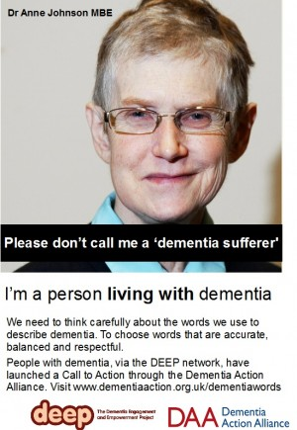








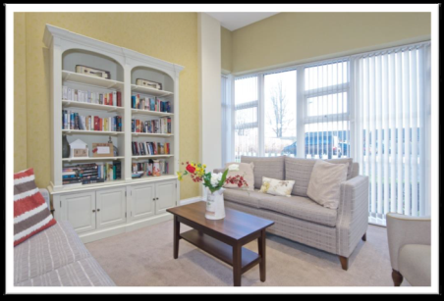

Becoming a dementia-friendly organisation
Action Plan - people, places and processes
Embed consideration of dementia throughout Housing 21
Dementia Advocates
Dementia-friendly London

Slide 5
Dementia-friendly housing charter
Help housing professionals to support people living with dementia
in their own homes
To engage with stakeholders
Relevant resources and good practices
Key deliverable from Prime Ministers Challenge on Dementia
2020
Involvement of lived experience
Wide consultation
Refresh early 2020

Slide 6
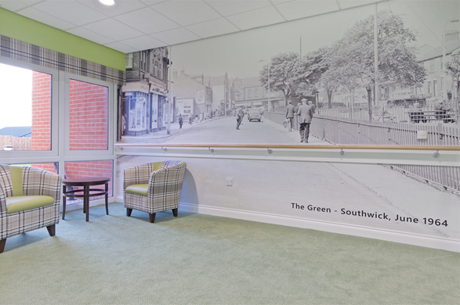
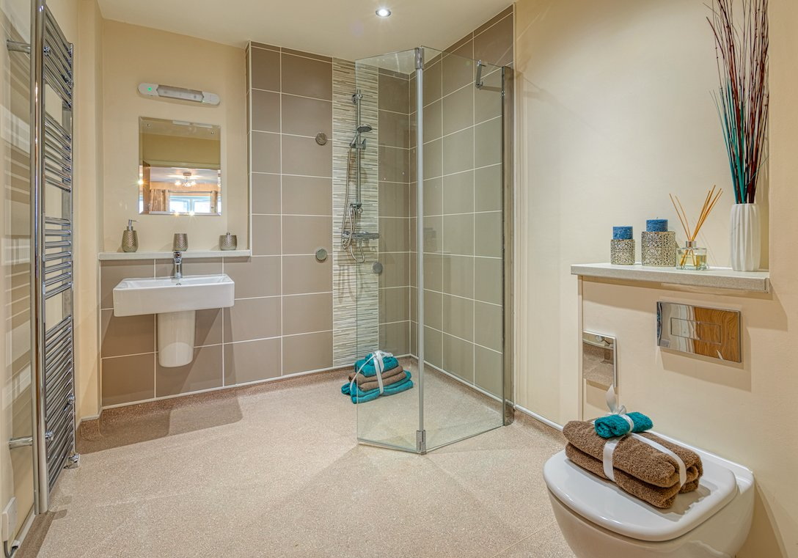
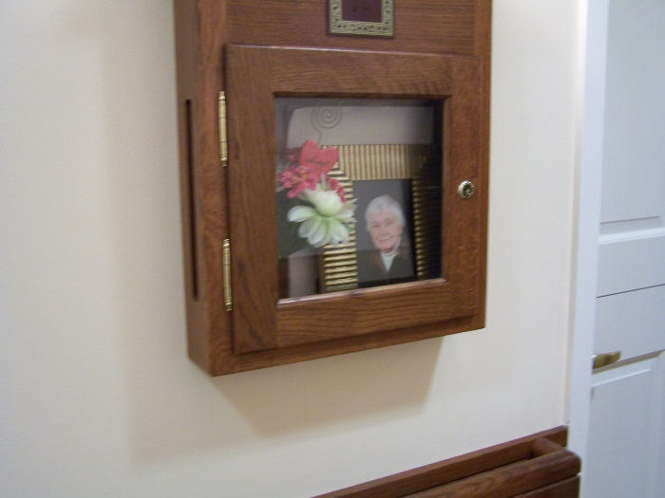
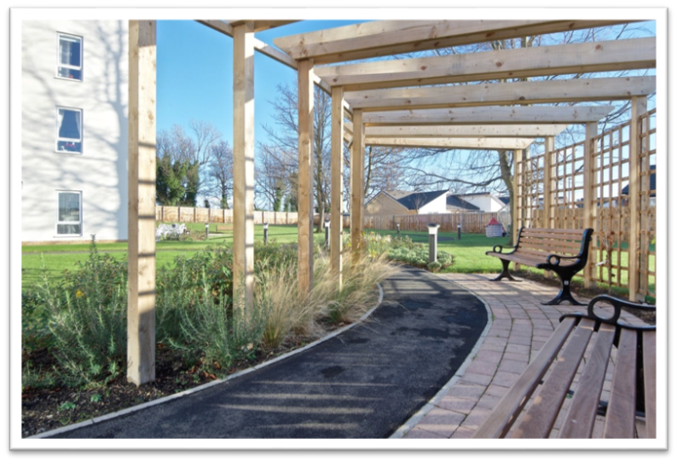
Good design

Slide 7
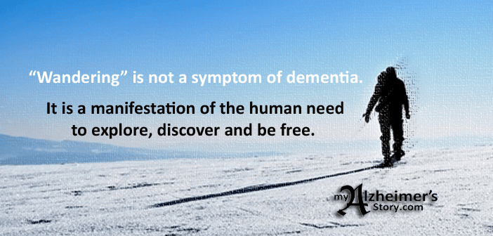
Walking with purpose
Research aim:
To explore and understand walking with purpose among people living with dementia in extra care, retirement and domestic housing settings
Literature review
Online survey c. 100 respondents
Case studies
Notes:
Prevalence
Policies and procedures
Perceptions
Understanding
Impacts (people living with dementia, family carers, care staff, other residents)
Purpose / reasons
Risks
Responses / addressing / managing / supporting (techniques, design of the environment)
Outcomes
DoL / ethical issues
Challenges
Successes

Slide 8
Survey results
48% did not carry out a risk assessment on residents who walk with purpose
58% of staff had not received any training on understanding and addressing walking with purpose
19% of schemes have policies, procedures or guidelines for supporting safe, risk free walking with purpose
29% felt polices have been successful
49% consider it a challenge
12% of respondents say walking with purpose creates problems relating to human rights or deprivation of liberty.
The majority of the respondents (58%) felt that staff were ‘moderately effective’ in supporting safe walking with purpose.
Notes:
Purpose / reasons / triggers:
All the case study residents’ walking had an identifiable purpose
The reasons for the case study residents’ walking with purpose were varied and unique.
Some related to personal life history
Others due to internal triggers
Other residents
Other residents can play an important part
Tripping / falling and resulting injuries
Becoming lost
Health (dehydration, hypothermia)
Other people (e.g. stolen purse)
Depended on:
personality,
mobility,
where and for how long they walked
ability to get back to their chair/apartment/the scheme

Slide 9
Staff responses (Extra Care and Retirement Housing)
Takes up a disproportionate amount of time and effort and can cause stress, especially with residents who regularly leave / try to leave.
“So I used to go around her routes and I’d spot her.” (EC manager)
“It’s trying, it’s hard” (RH manager)
“It was awful, because she's got nobody else, I was really sick, I never slept.” (EC manager)
Residents who are determined to leave the scheme can become becomes agitated or distressed or even angry or aggressive towards staff.
There is a sense of responsibility / duty
“You feel like you’ve let her down, you know.” (EC manager)
“I have to leave my family to go and get him.” (RH manager)
When a resident out of sight, the manager can no longer ensure their safety.
“The affect for me was the worry, again, the worry of being gone too long.” (EC manager)
“Just the worry of her falling.“ (EC manager)

Slide 10
Research into practise
Challenge perception that it is a problem - support
Discourage a risk adverse culture – encourage positive risk taking
Equip staff to be able to support
Dementia Advocates
Design audits
Dementia-friendly communities
Embed

Slide 11

On a journey

Slide 12

Vanessa.Pritchard-wilkes@housing21.org.uk
@VanessaPWH21

