Slide 1
Addressing LGBT+ people’s concerns about housing and home later in life
Professor Andrew King
@andrewdhking
Andrew.king@surrey.ac.uk

Slide 2
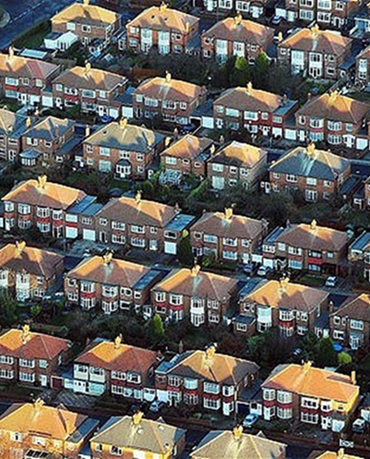
Why research about LGBT+ people and housing later in life is needed
Most LGBT+ people want to and will age in place
Social networks, LGBT+ friends and ‘families of choice’ are very important, so connections within community are key
Care homes/Retirement Housing/Sheltered Housing/Housing with care are of key concern
Lack of evidence concerning older LGBT+ people and housing and LGBT+ people who live in social housing

Slide 3
Two studies we’ve conducted
Brochure available here
Brochure available here

Slide 4
Two studies we’ve conducted
SAFE Housing (2016-17)
HomeSAFE (2017-18)
LGBT+ aged 50 years of age or older
Topics covered included:
Feelings about where they currently lived
What types of housing for older people would they like?
Had they experienced discrimination and prejudice?
What they thought housing providers should do and examples of good practice
Survey and focus groups (175/26)
majority ‘young-older’ (75% over 50 but under 65)
LGBT+ Adults living in social housing
Experiences, concerns and preferences about housing provider, neighbourhood and neighbours, community, making complaints
Feelings about current home
Sense of belonging to their neighbourhood
Feelings about current housing provider
Examples of good practice and poor practice
Survey, focus groups and interviews (225/37)
Just over half sample 45 years and older

Slide 5
What were the concerns?

Slide 6
Feelings about people entering the home
Varied, but amongst older LGBT+ in SAFE Housing study

Slide 7
Feelings about people entering the home
I’m very, very wary of who they’re going to be sending here. Are they going to pick up the fact that I’m gay? When it’s a male that’s coming here, is there enough time for me to get rid of those pictures or whatever, they all come off the shelf (Gay man, BAME, 50s, City)
I think in housing terms you are having to think about who are your neighbours and how are your neighbours going to act, and are your neighbours going to cause you problems. (Bisexual Trans woman, White, 50s, City)
I’m not bothered. I’ve got everything that would indicate I’m not straight (laughs). Pictures, pictures of me at Pride, lots of different things, books, you know, masses and masses of books… I know that bothers some people because I know that people who are frailer hide stuff away… if I live long enough and I’m in my nineties or something and I’m much frailer… I might feel more vulnerable (Lesbian, White, 70s, City)

Slide 8
Housing later in their lives
58% of SAFE Housing survey respondents had concerns about housing in the future
But 72% had not made any plans
“Risk of homophobia in mainstream services”
“Lack of appropriate housing due to cutbacks”
“Intimidation and harassment because of my HIV status”
“Don’t have a partner and have no children”
“Because of possible isolation”
“Concerned the Housing Association I live in might be sold off”
“Housing services assume everyone is heterosexual”
“I’m planning to think about this when I retire in two years’ time”
“I’m fit and healthy. I don’t feel challenged by my environment at the moment”
“I’m too busy looking after my elderly mother… I can’t move”
“I know there’s a chance when I get to 65+ there may be LGBT specific housing
“Because options are not clear.

Slide 9
Who to turn to for support?

Slide 10
Different types of support
Do people have someone to turn to for support if they needed it?

Slide 11
Support, Community, Connections
I worry about, as I get older, if anything happened to <partner>, the less able I am, whether I’d be able to be independent at home, because… I couldn’t go into sheltered (Gay man, BAME, 50s, City)
I see all the other people here [other residents] with their little cliques and stuff… You know, I think they [housing provider] could do a bit more to make it known that they do offer support. (Trans, non-binary, 60s, White, Town)
The [housing association] manager’s very supportive and understanding and in the main foyer the pro-active rainbow LGBT group is there. It’s good (Lesbian, White, 70s, Town)

Slide 12
Support, Community, Connections
Cannot take community connections as source of support for granted

Slide 13
What housing do LGBT+ people want later in life?

Slide 14
Choices according to gender and sexuality?
A lot of variability between different types of housing, we asked about
Housing for anyone
Gender specific housing
Sexual orientation/sexuality specific housing
LGBT specific housing
And also these combinations of housing with care

Slide 15
Comparing lesbians and gay men
But when ‘with care’ included, everyone wanted more specific forms of housing

Slide 16
Importance of difference
It’s a teensy bit of a fantasy to think we could ever be in a totally gay environment where everyone will be at one with one another. That’s not going to happen. I’m more likely to be at one with my straight friends (Gay man, BAME, 60s, City)
Transphobia’s there in the LGBT world (Bisexual Trans woman, White, 60s, City)
I think if I’m going to be sitting around you know watching television or listening to the radio, I want to be sure that what they want to listen to is Radio 3 (Gay man, White, 70s, City)

Slide 17
Have a mark of quality and inclusion?
Three quarters of participants in both surveys felt that is was a good idea
The pledge is free to sign up to and offers an easy-to-adopt framework to encourage dialogue with involved LGBTQ+ residents.
HouseProud_LGBT@outlook.com

Slide 18
What we need to see
More research with specific groups and better understanding of diverse needs
More active engagement between housing providers and LGBT+ housing support organisations
More active engagement with LGBT+ people about housing
Housing
with Pride
Workshop about Pledge Scheme in January 2020
email Andrew.king@surrey.ac.uk for details

Slide 19
Thank you
andrew.king@surrey.ac.uk

