Slide 1
Housing LIN South East Regional Event
Autumn 2019
Housing Learning and Improvement Network
@HousingLIN
#HLINSE

Slide 2
Housing LIN Update
Jeremy Porteus
Chief Executive
@HousingLIN
Autumn 2019
Housing Learning and Improvement Network

Slide 3
Housing LIN regional delivery
We have boosted our central resource to support regional co-chairs by:
Jeremy Porteus, Chief Executive
Clare Skidmore, Strategic Lead for Influencing and Networks
Lois Beech, Stakeholder Engagement and Research Officer
Jerome Billeter, Corporate Services Manager
Sophie Fox, Business Support Officer
Darius Ghadiali, Knowledge Exchange intern
Work closely with chairs to identify:
venues in each region (minimum of 2 meetings pa) and tour of schemes;
a range of interesting speakers on cutting edge themes
Highlighting national Housing LIN activities from influencing, research and consultancy programmes
identify possible case studies, blogs or other resources for future publication
Share findings and access or support learning from Housing LIN Consult

Slide 4
Our latest Housing LIN influencing activities
APPG on Social Integration on Generational Fairness (submission on intergenerational housing)
Responded to the Department of Health and Care Services’ Prevention Green Paper
Responding to upcoming NHS England High Impact Changes paper on delivery of NHS 10 year plan (now includes housing)
Supporting NHS England’s Transforming Care programme, hosted roundtable on future of supported housing
Member of new Coalition for Accessible Housing – Homes made for everyone (HoME), launched on 5 November

Slide 5
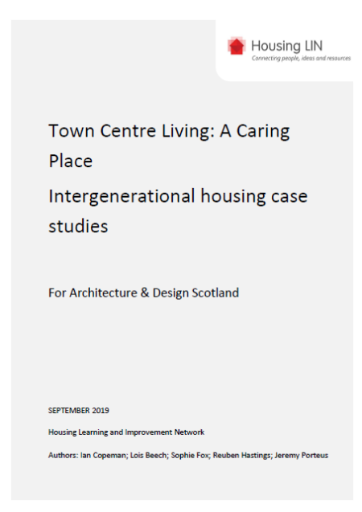
Recent Housing LIN case study report for Architecture & Design Scotland
Town Centre Living: A caring place. Intergenerational housing case studies
12 case studies on intergenerational living at: https://www.housinglin.org.uk/News/New-Housing-LIN-report-looks-at-intergenerational-housing/
Draws on examples from on UK, Europe and USA
Focussed on how could apply in Scottish Town Centre context as part of their wider programme at: https://www.ads.org.uk/a_caring_place_report/

Slide 6
Housing LIN case study report for Southampton City Council
Identifying the health care system benefits of housing with care – an evidence review
Findings of: reductions in the number of GP visits (by housing with care residents).
Reductions in the number of community health nurse visits
Reductions in the number of non-elective admissions to hospital
Reductions in length of stay and delayed discharges from hospital
Reductions in ambulance call outs, typically linked to reduced incidence of falls
Dividend to local health economy c£1,994.00 per person

Slide 7
Other recent Housing LIN case studies
A strengths based approach to delivering the Disabled Facilities Grant – Thurrock Council: https://www.housinglin.org.uk/Topics/type/A-strengths-based-approach-to-delivering-the-Disabled-Facilities-Grant-Thurrock-Council/
Creating independent homes for people developing or living with cognitive conditions in East Manchester https://www.housinglin.org.uk/Topics/type/Housing-LIN-Case-Study-157-Creating-independent-homes-for-people-developing-or-living-with-cognitive-conditions-in-East-Manchester/

Slide 8
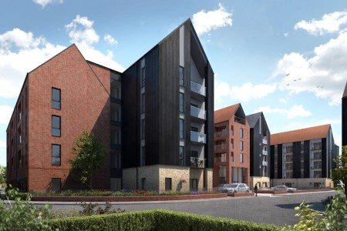
Other recent Housing LIN resources
Housing LIN Blogs, including new one on intergenerational housing by Housing LIN Eastern region co-chair
A selection of guest blogs at: https://www.housinglin.org.uk/blogs/
Housing LIN #InspirationalAchievements
Arden Quarter retirement living at the heart of Stratford-upon-Avon at: https://www.housinglin.org.uk/Topics/Inspirational-Achievements/orbit/

Slide 9
Other useful recent publications
Just Living design guide: https://www.housinglin.org.uk/Topics/type/Just-Living/
NHS England Healthy New Towns guide: https://www.housinglin.org.uk/News/NHS-England-publishes-guidance-on-Healthy-New-Towns/
Housing and Ageing Alliance Manifesto, Time for Action: https://www.housinglin.org.uk/News/Housing-and-Ageing-Alliance-publishes-2019-manifesto/

Slide 10
Housing Design Awards 2019 - HAPPI
2 schemes won HAPPI awards this year (both PegasusLife)
Hortsley in Seaford, East Sussex (right and a future Housing LIN case study) and
Steepleton in Tetbury, Gloucestershire (below right and an existing case study at: https://www.housinglin.org.uk/_assets/Resources/Housing/Practice_examples/Housing_LIN_case_studies/HLIN_CaseStudy_152_ProctorMatthews.pdf
Other notable winners with HAPPI ingredients
Marmalade Lane, K1 cohousing in Cambridge (a Housing LIN guest blog) at: https://www.housinglin.org.uk/blogs/Eco-friendly-cohousing-in-Cambridge-Building-a-Shared-Future-across-all-ages/
Colby Lodge, Walthamstow with Walthamstow & Chingford Almshouse Charity

Slide 11
Later Living: Housing with Care Guide
The Housing LIN wrote the opening Chapter
A number of key messages for the sector, including:
The growth in the real estate sector
How Later Living can help solve the care crisis
The need for long-term planning and legislation, and
Creating aspirational places for the elderly
https://www.housinglin.org.uk/Topics/type/ULI-Later-Living-Housing-with-care-guide/

Slide 12
Upcoming HLIN resources/programmes
Housing with Care sector survey. A state of the nation survey to identify organisations’ ambitions for growing the housing with care choices over next 5 years. Deadline for responses, 31 December: https://www.surveymonkey.co.uk/r/Growing-H-w-C
A compendium of practice: repurposing sheltered housing (for 2020)
A compendium of practice: community led housing approaches (for 2020)
A compendium of practice on a good death: end of life care in extra care (for 2020)
Housing and older people strategy briefing for RiPfA (due this autumn)
Housing LIN Putting Older People First in the South West: 5 year vision, 2020-2025 (out early 2020)
Developing a dedicated page featuring resources on loneliness & isolation
Developing autism and MCA training courses (several successful course held)
Future Leaders’ programme (ongoing engagement with early career HLIN members)

Slide 13
Housing LIN consultancy
Expanding consultancy, training and wider fee paying services to supplement our free online and regional Housing LIN networking activities. Examples include:
Strategic Housing for Older People Market Analysis for several county councils and unitary authorities in Wales and England, including for ADASS regionally
Analytical support for several housing associations to evidence strategic reviews of older people’s housing and independent living services and support
Delivery of the ‘Adaptations without Delay’ report for the Royal College of Occupational Therapists
Bespoke intelligence to support local and regional authorities’ thinking and planning for their future requirements for extra care housing, ‘care ready’ housing suitable for older people and / or supported housing
Notes:
Selection of resources that important
Series of other compendium of best practise – e.g. sheltered housing, community led housing approaches
Future Leader Prog - 8 early career individuals from a wide range of practitioner backgrounds provide the opportunity to meet key industry leaders, and to produce and present a cooperative project and share their learning.

Slide 14
Connect with the Housing LIN
Over 25,000+ subscribers but still the ‘best kept secret’!
Sign up to receive our free weekly bulletin, HLINks
Check out our free-to-view online resources, including #InspirationalAchievements page at: www.housinglin.org.uk/InspirationalAchievements
Get involved and share your learning via a guest blog, viewpoint or case study, or on our discussion forum and at these events
Follow us on twitter at @HousingLIN, @HousingLINews @HLINConsult
Host a future regional Housing LIN meeting
Sponsor our website or an event

Slide 15
Thank you!
Housing LIN c/o PRP, the Ideas Store 10 Lindsey Street, Clerkenwell London EC1A 9HP
email: info@housinglin.org.uk website: www.housinglin.org.uk
Twitter: @HousingLIN @HousingLINews @HLINconsult

