Slide 1
Pemberley Place and Partnerships
Kirstie Garlick; Area Manager – Anchor Hanover
Sam Robinson; Admin Assistant & Activity Angel – Badminton Gardens, Anchor Hanover
Notes:
Good morning and I would first like to thank Housing Lin for the opportunity to speak today. My name is Kirstie Garlick and I am an Area Manager for Operations with Anchor Hanover responsible for the Bath and North East Somerset and South Gloucestershire area. I would also like to introduce you to Sam Robinson who works at our extra-care estate in Downend. I am here to tell you alittle about our new development that Anchor Hanover are building in Bath; Pemberley Place and the new approach we have to extra-care. However before I do that I would first…..

Slide 2
“Success isn’t about how much money you make it is about the difference you make in peoples lives”
“Good people bring
out the good in people”
“If you want to go fast, go alone. If you want to go far go with others”
‘Great things can happen when you surround yourself with great organisations…’
Success cannot be measured in wealth, fame or power, but by whether you have made a positive difference for others.
Organisations may partner to increase the likelihood of each achieving their mission and to amplify their reach.
“No man is an island”
PARTNERSHIP
Notes:
Like you to keep this in mind.
‘PARTNERSHIPS’ this is the foundation of which Pemberley Place has been built on. I have been involved in the project for the past 2 1/2 years and in that time I have been working to develop Partnerships with key organisations that will positively impact the lives of those living with us and those that live within the local community. I will come back to this but would like to emphasis that this is at the heart of what we are trying to achieve at Pemberley Place.

Slide 3
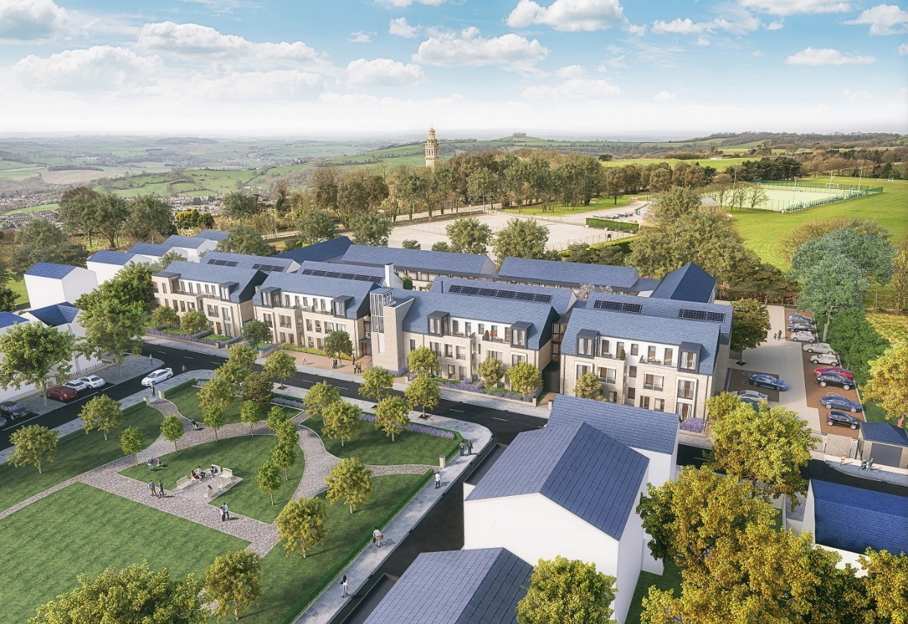
Pemberley Place – A new vision of Extra-care
Notes:
Pemberley is the future design for Anchor Hanover – A new vision of extra-care. Thoughtfully designed around an attractive landscaped courtyard.
Pemberley Place offers flexibility to adjust to changing needs of residents, with access to onsite support that can grow with the individual along with privacy for those who want it.
It embraces many of the HAPPI principles of good design for older people including ample storage, space, light and inside and outside space that supports whatever your needs maybe.
Built as part of a wider master planning for the former MOD site in Lansdown, Pemberley Place will feel very much part of this new community which includes 250 new homes, a shop and a new primary school. There is a real focus to make the Ensleigh area Dementia friendly and through our partnership with Bath Dementia Action Alliance we are working with them to make this a reality.

Slide 4
Pemberley Place – A new vision of Extra-care
Notes:
Designed for people over the age of 55 it brings much needed housing to the area.
There are 72 apartments with a mixture of 1 and 2 beds, 43 of these for shared ownership and 29 for affordable rent. We have and continue to work very closely with BANES Local Authority who will see 29 of the rented apartments going to local residents that have a care and support need.

Slide 5
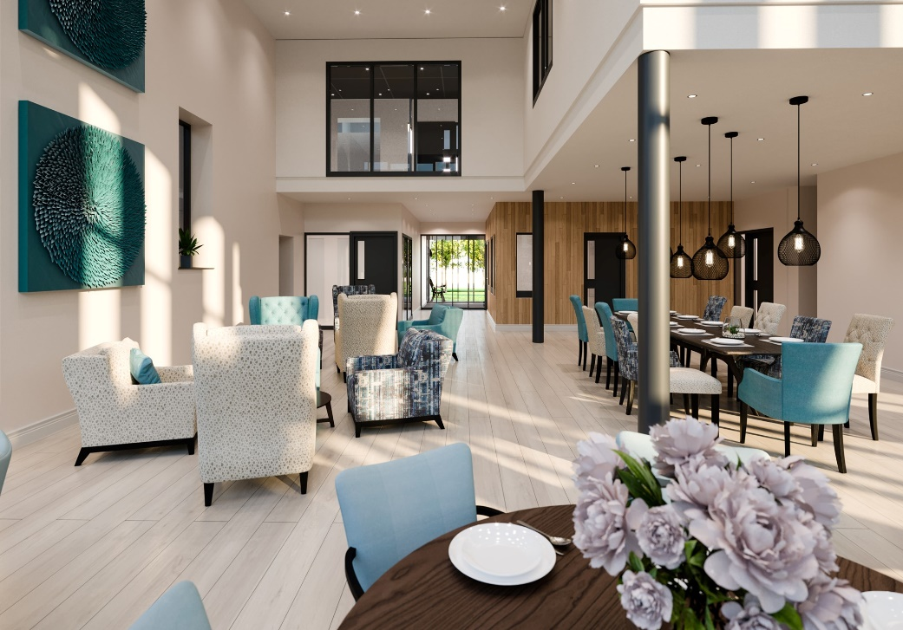
Pemberley Place
‘Inside and out’
Notes:
The services on offer are Anchor Hanover’s estate team which consists of an Estate Manager and 2 Housing Assistants, 1 with a focus on property and the 2nd on Wellbeing.
There is a reassurance service that will be onsite from 8 till 8pm that will provide assistance during the evenings. Customers have the freedom to purchase their care when they need it and from whomever they choose. However we have purposely contracted the reassurance service through a partner that is CQC registered given customers the option to purchase direct from them if they so wish.
At the heart of the development is Pemberley café which offers a café style menu and opens up to the court-yard area where there is bistro style seating.

Slide 6
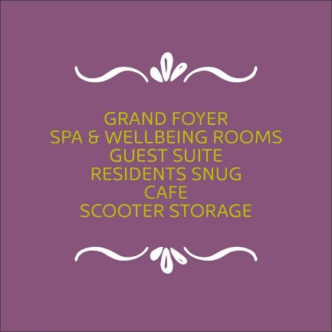
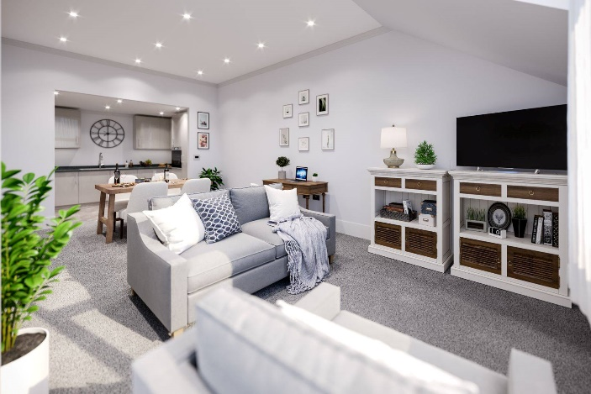
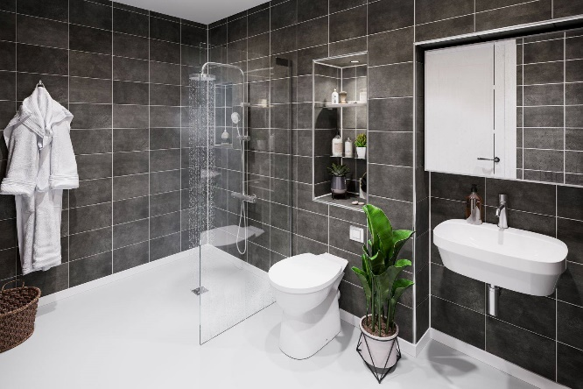
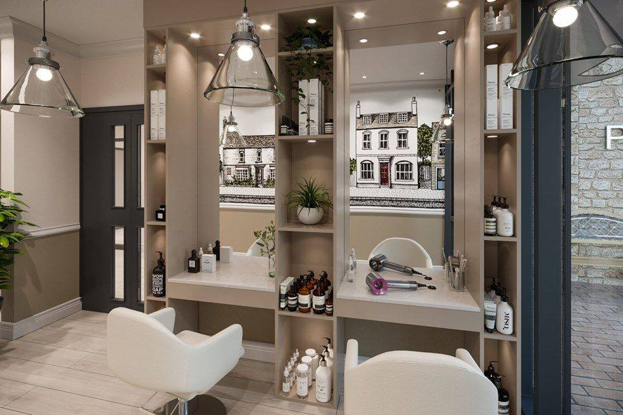
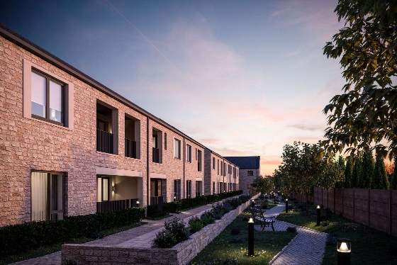
Housing for the over 55’s – Redesigned….
Notes:
We have worked with an interior-designer who specialises in design for those living with dementia which was really important for us. The result is beautiful design with subtle changes that doesn’t compromise the feel of the development.
We wanted to give mental health equal focus along with the physical health and have utilised every aspect of the building to be functional.
An example of this is the ‘Wellbeing pods’ which fills 4 areas of the corridors which will provide a different scenery for someone who might not want to be in a big open space that is noisy or who isn’t able to get outside so freely. These 4 areas are themed; Music, Travel, Reminiscence and Literature. We hope which will appeal to customers.

Slide 7
Created to reduce the fear and stigma often associated with dementia
The Archie Project
A national and regional award winning
Intergenerational Dementia Awareness Project
Notes:
I would like to focus on one particular fantastic partnership we have with Reminiscence Learning; who are based in Wellington, in Taunton. We are working to bring Reminiscence Learning’s “Archie” project to Pemberley Place.
Fiona Mahoney, is the CEO of Reminiscence Learning and the founder of the intergenerational dementia awareness project that links local primary schools with those residents living within retirement accommodation.
Archie is a colourful scarecrow that provides an opportunity for children to learn and gain an understanding of dementia. Archie’s aim is to reduce the fear and stigma associated with dementia.
By educating and creating a generation who have an awareness and understanding of those living with the disease and how best to support them in their community. This project has shown positive shifts in the way children interact with older people and how this benefits those living with dementia, their families and the community as a whole. Children aged 7 to nine are the most receptive and the key age for positively changing their stereotypes about older people.
The fact that ‘Our children are the workforce of the future’ means we have an opportunity to create a more inclusive community that truly does support those living with dementia. It is exiting to see how this may impact future careers as these children are our future carers, doctors, nurses and housing managers!

Slide 8
Notes:
The success of this project at Pemberley Place is dependant on the 4 partners involved. All 4 are key to the success and sustainability of the positive impact we can have in this area.
Anchor Hanover provide the development, the hub of the community and the residents and connections.
Reminiscence Learning provide ‘Archie’, the training and the resources.
Abbot Alphege is the primary school located next door to Pemberley Place and the pupils will work through the Archie programme as part of their Personal Social Health Education curriculum.
And Bath Rotary who are very big supporters of the Archie project have very kindly sponsored this project which will be the 5th project they are support in the BANES area.

Slide 9
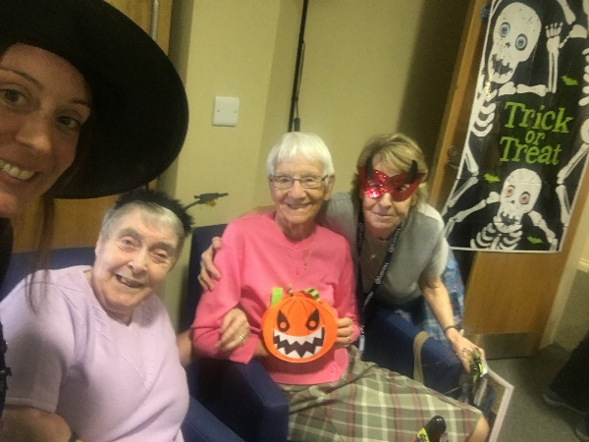
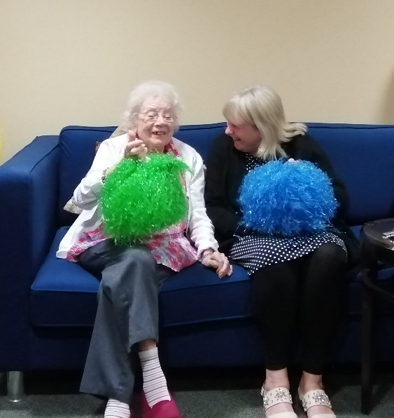
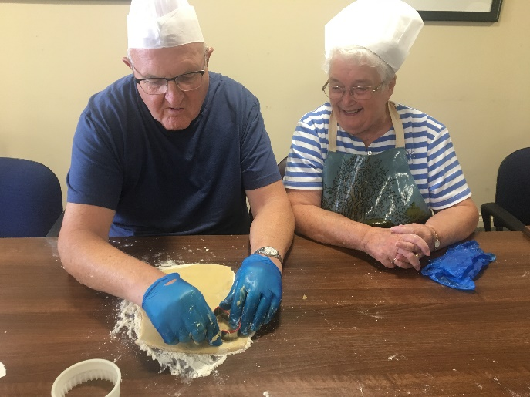
Activity Angels – Badminton Gardens – Pilot
Cooking
Music & Fun
Armchair travel
Arts & Crafts
Lifestyle work
Reminiscence
Notes:
So all this got me thinking about the extra-care sites that aren’t currently with an Archie project that I have in my area team. Badminton Gardens is a traditional extra-care estate in Bristol. We wanted to bring a wellbeing strategy, using existing resources, upskilling existing members of my team to provide activities to improve the wellbeing of existing residents, future customers and the local community.
So we worked with Reminiscence Learning and obtained funding for an Activity Angels pilot. We have been running a pilot since April this year with Reminiscence Learning where we have provided 18 sessions over 6 weeks / 6 fortnightly and 6 monthly intervals; social, stimulating and inclusive activities for free; to residents and the local community.
They have been so successful we now run these sessions weekly due to demand! Sessions run for 1hr 1/2 and cover a range of activities that is co-ordinated by the Activity Angel.
Alongside this we have paid for Sam who is the Admin Assistant at Badminton Garden to become a fully qualified Creative Activity Therapist which means we are able to run a sustainable programme after the 18 sessions through Reminiscence Learning comes to an end; we have invested in existing member of staff and provided Sam with a recognised qualification; we have a resource which we can utilise throughout the rest of the team and region which ultimately means we can reach more people.
Sam now runs the weekly sessions by herself and has been absolutely key to the success of this pilot.
The difference Sam has made to the wellbeing of those residents living at Badminton Gardens is immeasurably.
Let me tell you about Smiles… Smiles is 99 yrs young, resident who has been living with us for around 8 yrs. She moved in to Badminton Gardens the same time as her best friend and they spent a lot of time together. She has a lovely family who visit every day and has the care team onsite that support her on a daily basis. She lost her husband at a very young age, their daughter was only 5yrs old when he died. She spent years working various jobs often more than one at a time to support herself and her daughter.
The diagnosis of Dementia was given around 6 yrs ago and initially the family had the support of a Dementia nurse but unfortunately funding was cut. Smiles would always talk of her late-husband but around a year ago this stopped. More recently Smiles tends to forget the names of her grandchildren. Sadly her best friend passed away just before Christmas last year and Smiles found herself more isolated and struggled socialising.
Smiles is someone who loved being with other people and her daughter really wants her mum to keep this aspect in her life and is upset that this has decreased over time due to the many changes Smiles has faced.
Smiles attended the taster session we held last Christmas. She sang every word to Bing Crosby’s ‘White Christmas’ and ‘smiled’ the whole time. Her daughter said she was able to see her mum come back alive during this time and had the opportunity to be her daughter again for a short while.
Smiles has been back to every Activity Angel session since and this Christmas we will be celebrating her 100th birthday – and of-course we will make sure we play White Christmas.
For some people attending these sessions, they wont remember them; but during and for a moment they felt happy.
Time for an Activity Sam??? - Sam does activity.

Slide 10
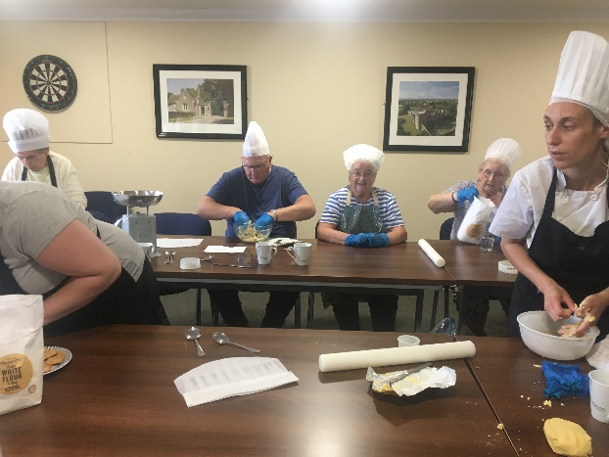
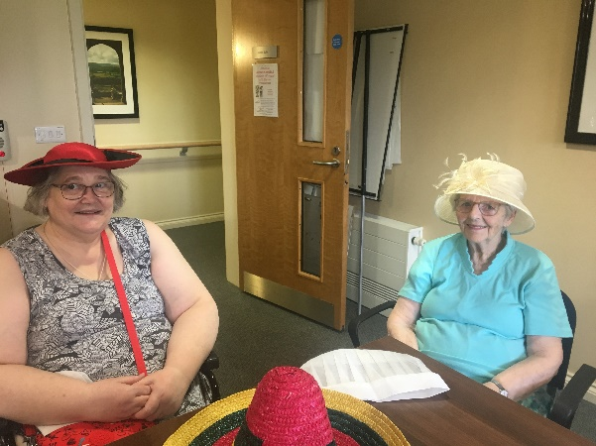
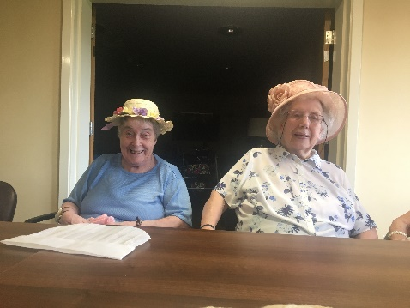
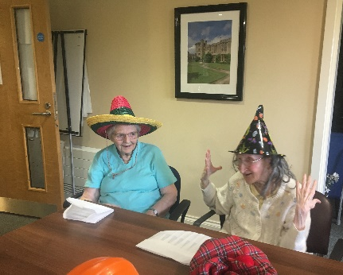
Hats on!
Notes:
(Hats to be on the table at the start of the conference so candidates have time to look at them, try them on etc – already thinking about them.)
Sam has very kindly agreed to take us through an activity so you are able to experience first hand what it feels like to be in one of these sessions and the impact it can have.
Sam to explain about the hats and what we would like candidates to do.
Welcome to the session
Reminder that memories affect us all in different ways, be reassured no pressure to share!
Object of the session is to trigger a memory (person/ event/ job/ place)
Hats on tables – Open up to audience to take a look, have a feel, try them on and then pick one
Ask if there is anyone that would like to share why were they drawn to a particular hat? (2-3 people to share dependant on time)
Thank everyone – especially those who contributed and explain that we hope that the taster session has provided them with a feel for how these sessions develop and the incredible benefit to our residents wellbeing and also the social impact these sessions are having which has already been proven at Badminton Gardens.

Slide 11
PARTNERSHIP
Notes:
I’d like to end at the very beginning - ‘PARTNERSHIPS’
Pemberley is about ensuring when people move in, they feel like they have moved in to a community and a home; where links are established and activities are in place; community services are supporting people including those living with dementia to develop meaningful relationships that are firmly established.
Relationships that the partnership work has created to reduce social isolation and loneliness. And I am so pleased that Sam in addition to her role as Admin Assistant at Badminton Gardens has secured the Housing Assistant - Wellbeing role at Pemberley Place and will enable her to continue her Activity Angels work there which will reach a whole new audience.
Thank you so much for your time today and for the opportunity to share alittle of the work that has been taking place behind the scenes at Pemberley Place.

