Slide 1
Integrating Health and Wellbeing
Anna Coles
Plymouth City Council

Slide 2
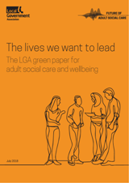
National Context
Rising Demand and Complexity
Funding
Workforce Issues
Lack of Clear Policy Focus
Integration and Joint Working
Better Care Fund (High Impact Changes)
Sustainability and Transformation Partnerships to Integrated Care Systems
The NHS Long Term Plan

Slide 3
SW ADASS Strategic Priorities
Priority 1: Improving the quality of social care practice
Priority 2: Effective commissioning and utilisation of resources
Priority 3: Market sustainability
Priority 4: New health and social care models and devolution
Priority 5: Increasing the confidence of the Adult Social Care voice

Slide 4
SW ADASS Care and Housing Network
Purpose
Connecting the SW ADASS Network with the SW Housing Lin the Network seeks to understand best practice and what works in relation to care and housing, promoting and enabling collaborative working across the different sectors with the aim of developing your local care and housing offer.
Themes
Supported Living Options (Private Rented/Sheltered/Retirement/Extra Care/Supported Living) Includes both Working Age and Older Adults.
Care and the Home (DFGs, Housing Aids, Adaptations, Handyperson Schemes and Housing Related Support Services)
ASC, Homelessness and Rough Sleeping
Health and Housing (High Impact Change Model, Pathway Flats)

Slide 5
Integrating Health and Wellbeing in Plymouth

Slide 6
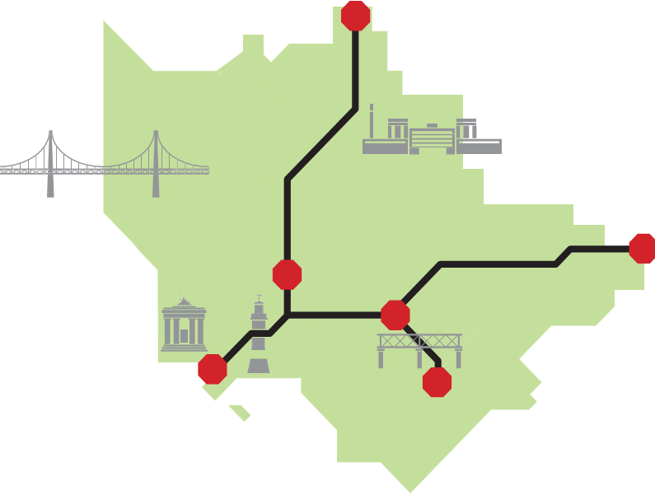
Our Local Challenges
Demographics and Complexity of Need
High levels of deprivation, child poverty, health inequalities and an ageing population.
Rising demand and increasing acuity across the City
The Health of Plymouth
Significantly higher childhood and adult obesity
Rate of deaths due to drug misuse higher than England average
Above average Preventable Mortality rates
Financial Sustainability and Equity
Rising cost of care and the equity challenge
Performance and Outcome Challenges
Performance against NHS Constitutional Standards
Educational Attainment
Workforce and Market Sufficiency
Significant workforce gaps in certain areas
Placement Sufficiency
Fragility of Primary Care
Number of GP vacancies across the city, an ageing workforce and contract handbacks
stop
Southway
81 years 2 months
Plympton Chaddlewood
84 years 10 months
Stoke
78 years 5 months
stop
stop
Sutton and Mount Gould
80 years 6 months
stop
St Peter and the Waterfront
77 years 1 month
stop
stop
Plymstock Radford
84 years 4 months

Slide 7
Local Vision for Health and Wellbeing
The Health and Wellbeing Board set the level of ambition and timeline for our system integration but stayed out of the operational detail, taking a System Leadership approach
Vision of Improving Population-Based Wellbeing through Integration:
Integrated Commissioning
Integrated Health and Social Care
Integrated System of Health and Wellbeing
Delivered through the Integrated Health and Wellbeing Programme, the aims of this are:
To improve health & wellbeing outcomes for the local population;
To reduce inequalities in health & wellbeing of the local population;
To improve people’s experience of care; and
To improve the sustainability of our health & wellbeing system.

Slide 8
Integrating Health and Wellbeing-”One system, One Budget”
The Plymouth Plan
Healthy City, Growing City, International City
Integrated Health and Care
Children and Young People
Early Help Gateway
Children’s Social Care- End to End Review
Integrated System of Health and Wellbeing
Integrated Commissioning
Family Support
The Hub
Catered
R.A.A
Emotional Health and Wellbeing in Schools
Thrive Plymouth
Targeted provision
Co-location of commissioners
Integrated Governance Arrangements
Section 75 - Pooled Fund and Risk Share
Four System Commissioning Strategies
Director of Integrated Commissioning
One Team-Organisational Development- Big Events
DELT
2005- Residential Care to Independent Living (Extra Care)
2011 - Transformation of ASC- personalisation centre of new operating model
2015- Integrated Community Health and Care Provider (Physical and Mental Health)
Wellbeing Hubs
Focus on preventative Services
Information and advice offer/POD
Befriending
Caring for Carers
Dementia friendly city
Complex lives-Alliance Contract
Strategic Partnerships
2018-19- Improving System Flow
Development of ICP
Creative Solutions Forum
Trauma Informed City

Slide 9
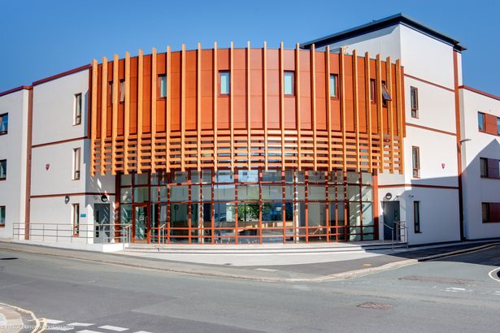
Care and Housing within our System
Housing and Wellbeing
Plan for Homes 3
Promoting Independent Living
Extra Care
Pathway Flats
Supporting the most vulnerable
Purpose Built Hostel and Refuge
The Alliance
Creative Solutions Forums

Slide 10
Learning and Next Steps
Learning and Reflection
Integration takes time
Integration is complex
Integration is a journey
Integration is not a panacea
Integration is the right thing to do!- people are what matter not organisations or artificial boundaries
Integration is about people, behaviours, culture, relationships and trust
What’s Next
Caring For Plymouth
Developing the Alliance Contract for Complex Lives
Roll out of Homelessness and Rough Sleeping Strategy
Developing Primary Care Networks
Maximising the Public Estate (Wellbeing Hubs and Family Centres)
Commissioning an Integrated Care Partnership
Local, Integrated and Responsive Mental Health Services
Breaking down eligibility and service criteria

