Slide 1
Adaptations at Southway
Karen Carlton
Head of Asset & Compliance

Slide 2
Facts & Figures

Slide 3
Major Adaptations - Our Clients
Your Housing
Mosscare
Anchor
Arcon
Guinness
Manchester tenants
Equity Housing
Great Places
Manchester Methodist Ministers
And of Course Southway Customers

Slide 4
Major and Minor Adaptations

Slide 5
A Case Study – Mrs G

Slide 6
The Brief
MSIL - Creation of a ground floor WC within the confines of the existing ground floor.
OT input- Mrs G is unable to use the stairs and a stairlift is not feasible due to the current stairs/landing configuration.

Slide 7
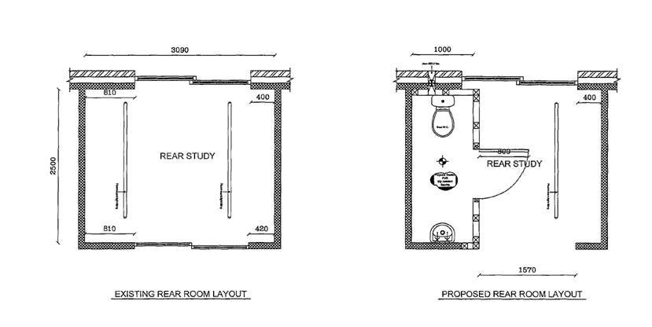
The Brief

Slide 8
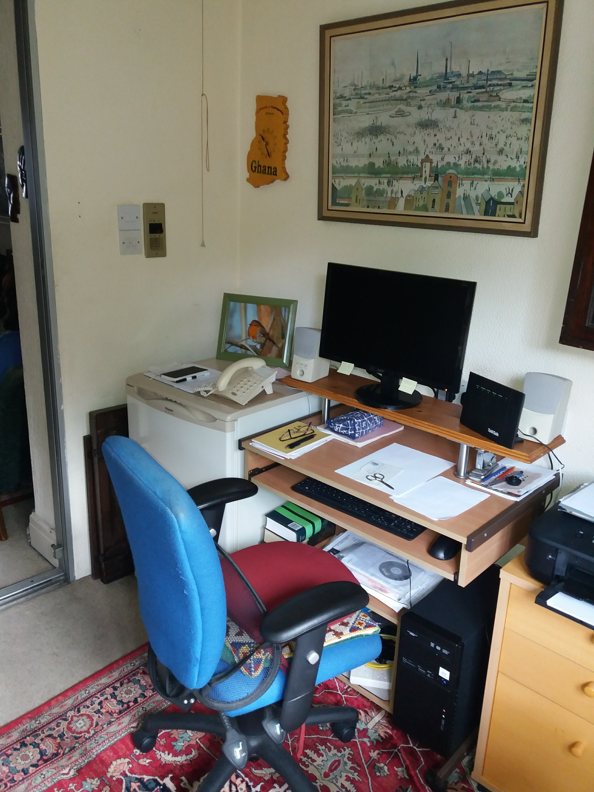
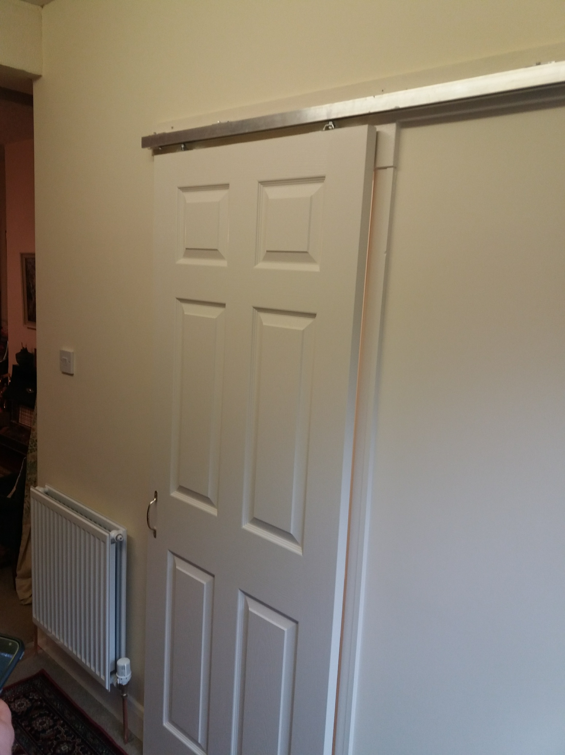
Before & After

Slide 9
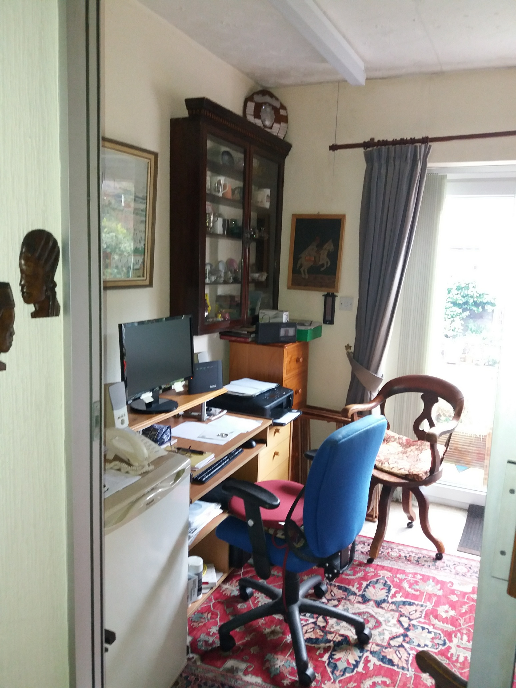
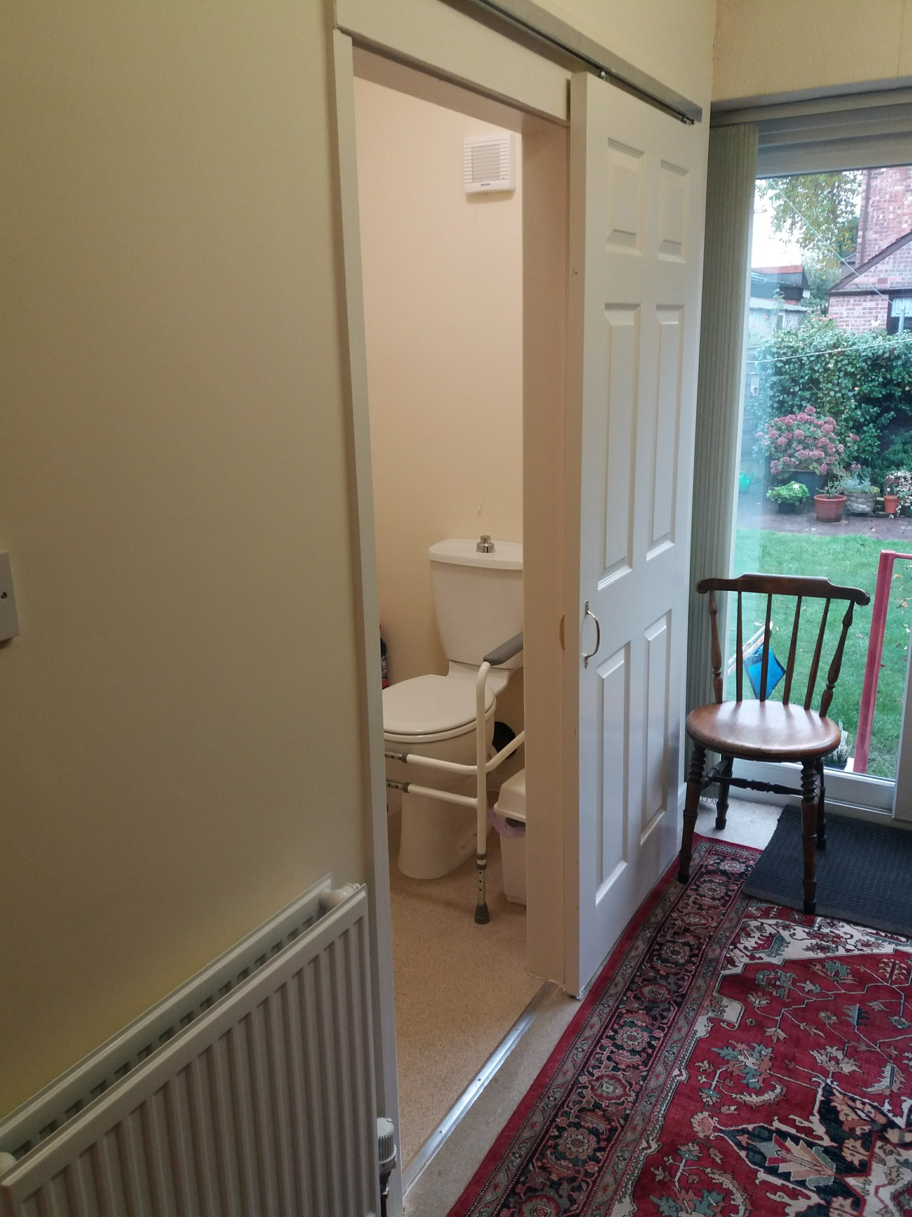
Before & After

Slide 10
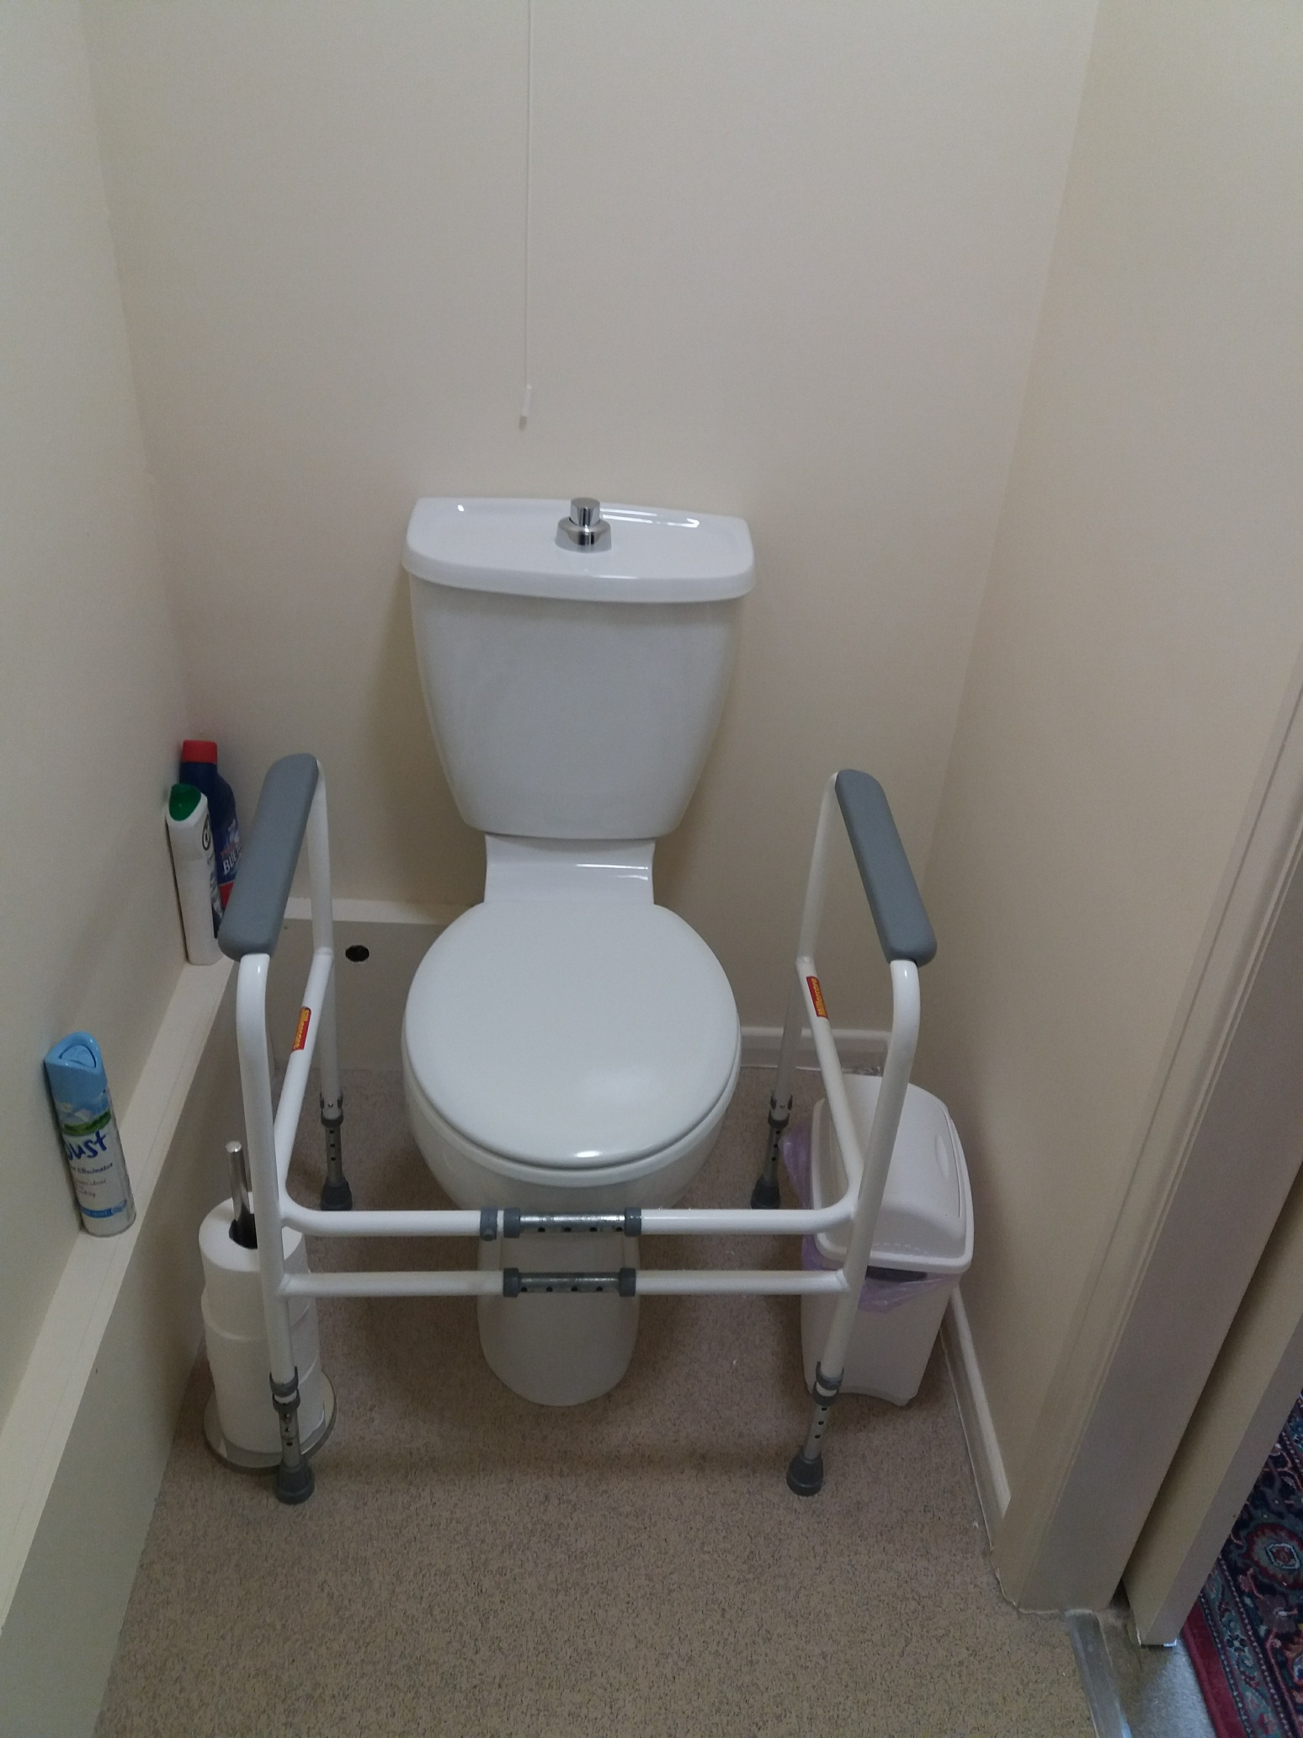
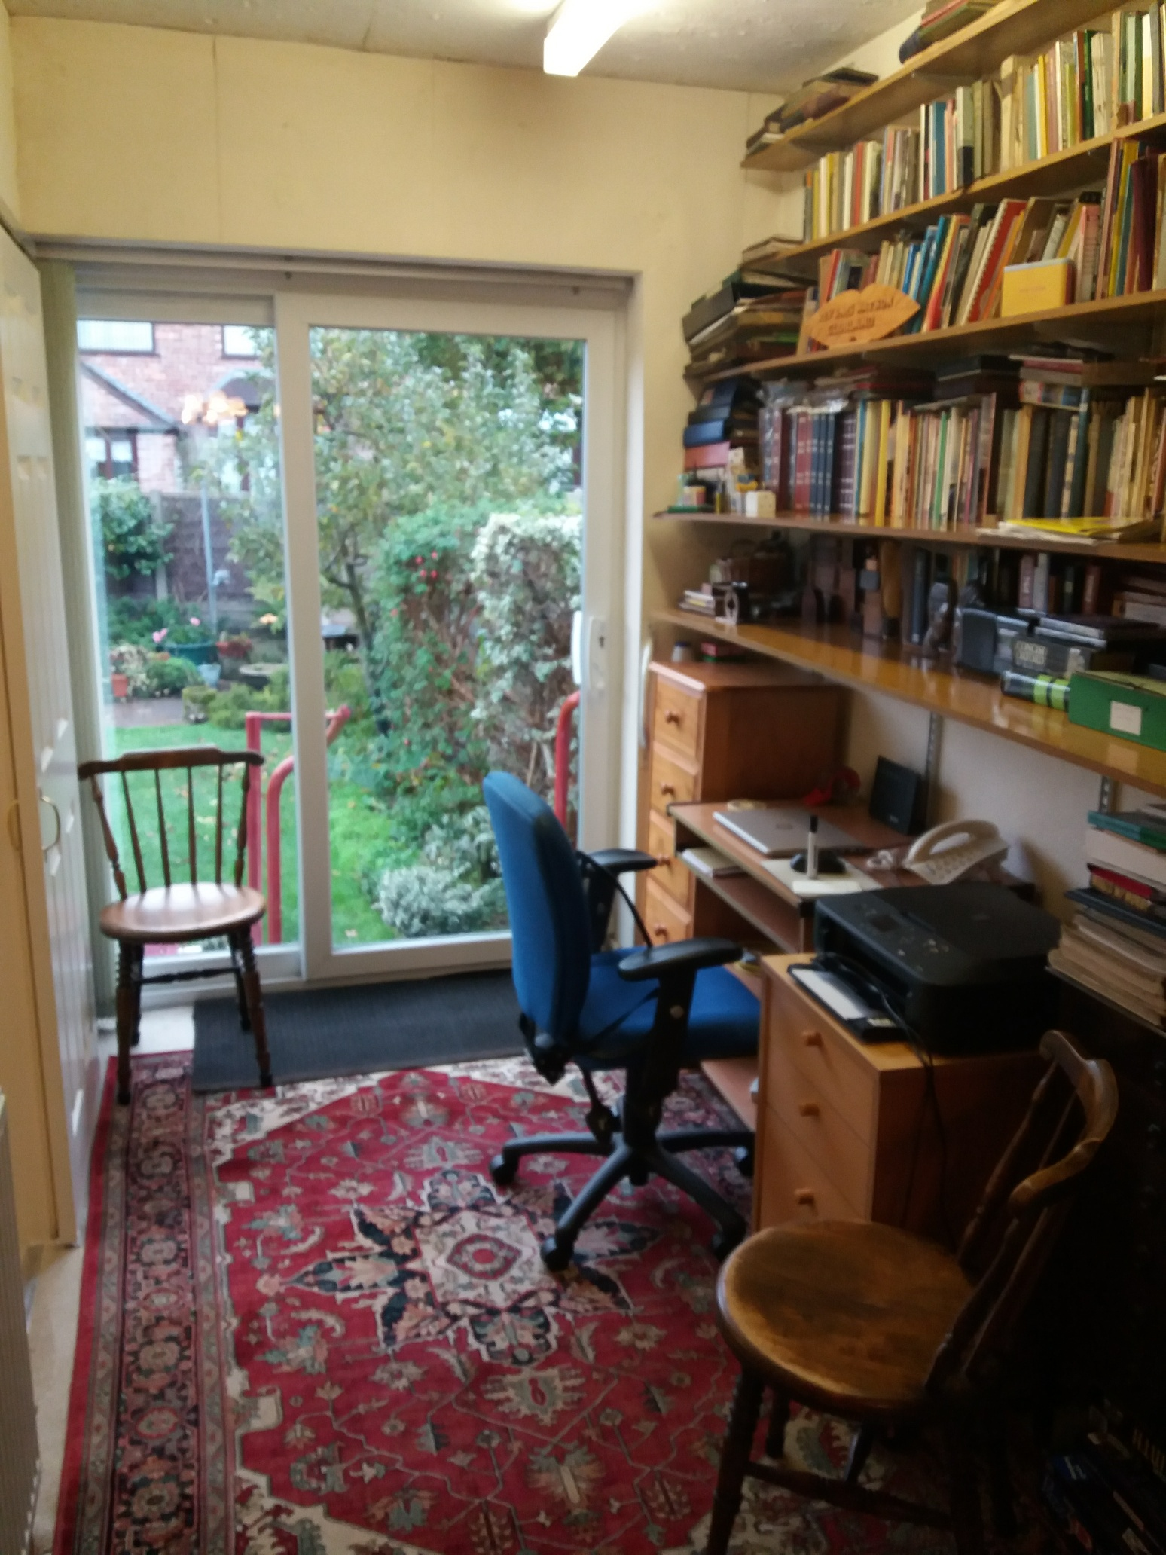
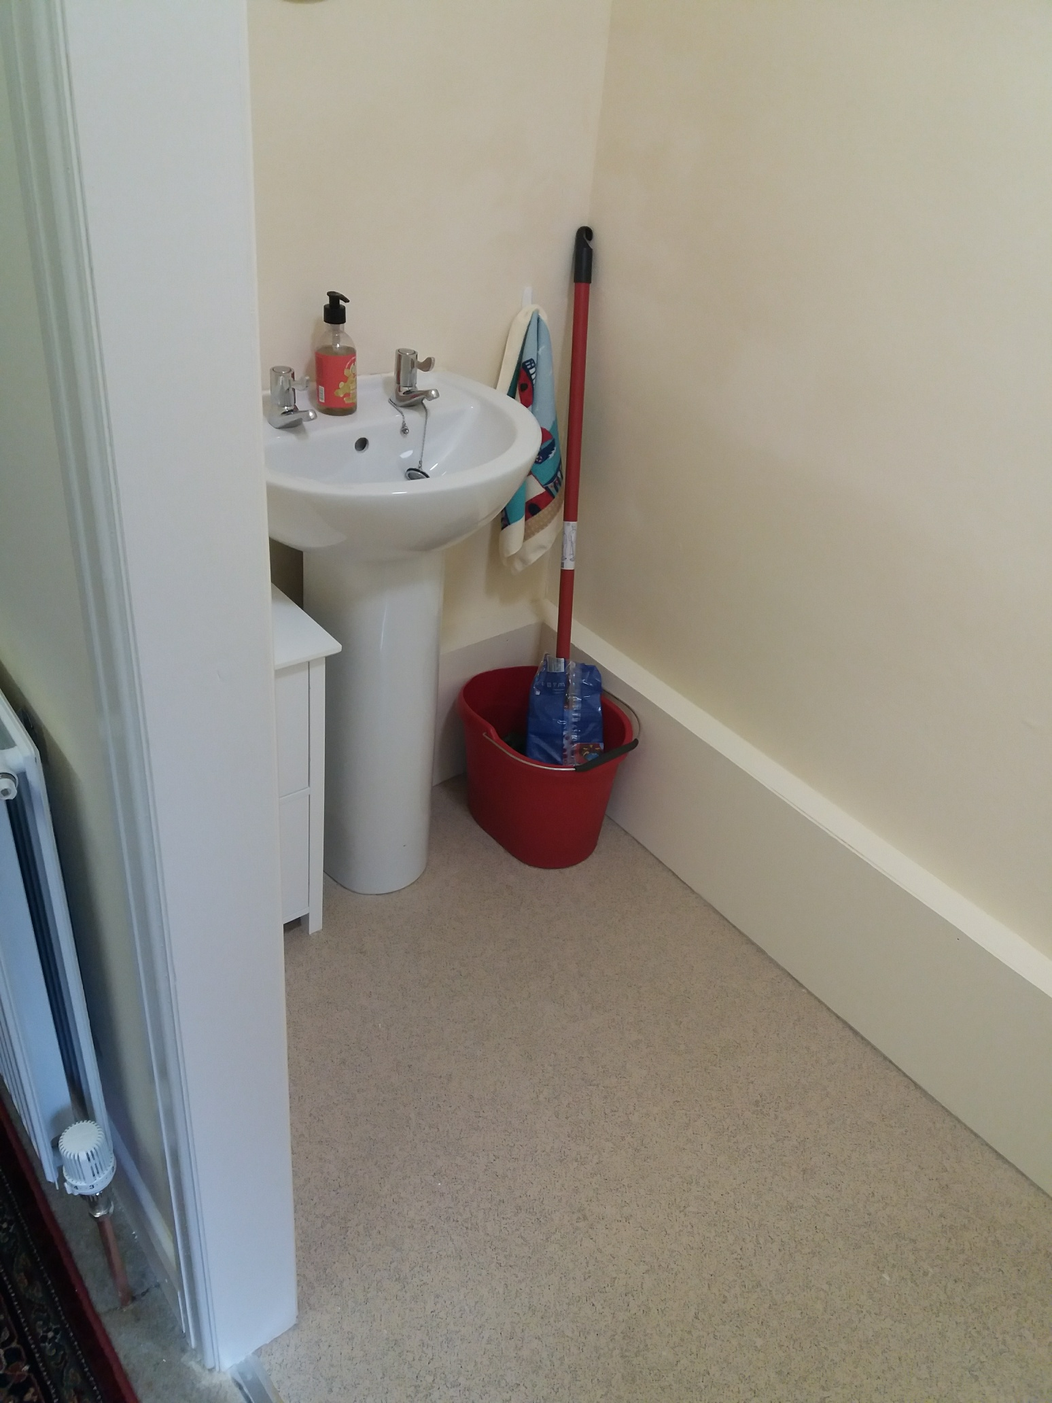
After

Slide 11
Customer Feedback

Slide 12
Thank you – Any Questions

