Slide 1
Improving lives through outcomes-based design. A case study at scale.
TIM BARCLAY, CEO, APPELLO

Slide 2
WHAT YOU WILL LEARN FROM THIS PRESENTATON?
Who Appello are
How we are leading the way with digital TECS in the UK.
How we are meeting the needs of users
Housing and technology high impact changes
How Appello is helping to make these a reality.

Slide 3
INTRODUCING APPELLO
UK’s largest telecare monitoring centre with over 190,000 connections.
Developed the first end-to-end digital telecare solution, Smart Living Solutions in 2016.
Have grown to become the de-facto digital telecare solution in the UK.
3 | 29/10/2019

Slide 4
LEADING THE WAY WITH DIGITAL TECS IN THE UK.
c200
+2,500,000m
c8,000
1st England
1st Scotland
1st Wales
4 | 29/10/2019

Slide 5
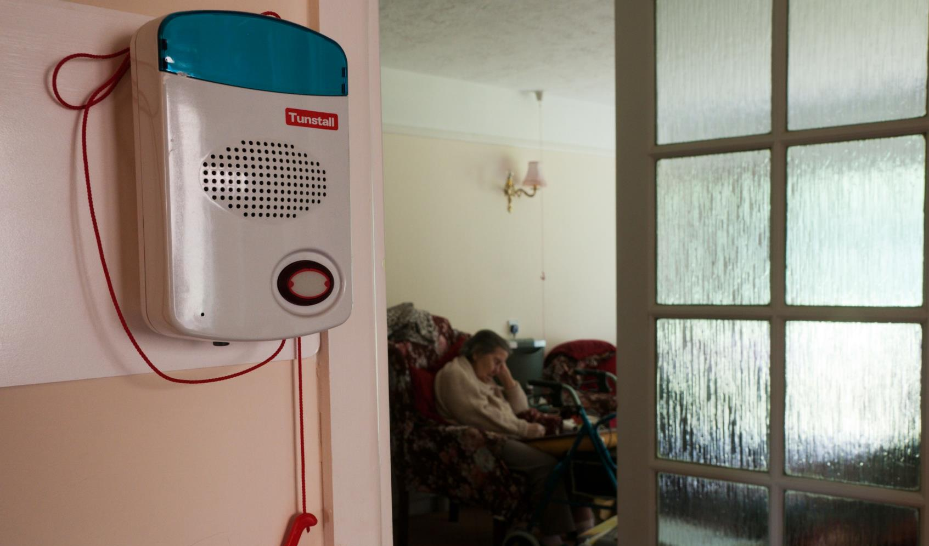
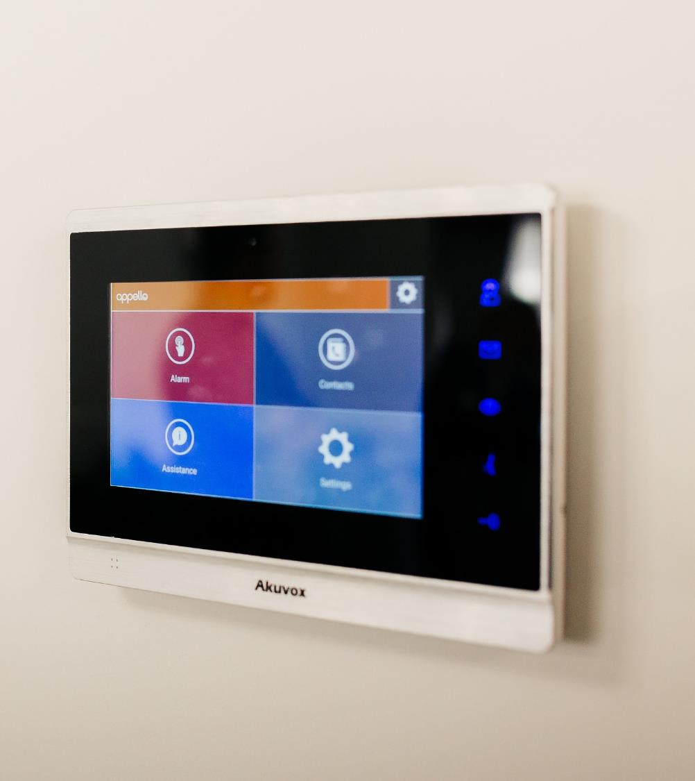
25,000
THEN
NOW

Slide 6
CUSTOMER AND USER LED DESIGN
We want to feel safer and more secure
We want greater independence
We want to be more connected
We want to less associated stigma
We want to know what's happening
Future-proofed for digital network
I’m OK notifications to staff
Video and voice calling between apartments
Modern equipment aesthetics
✓
✓
✓
✓
✓
24hr access to information
Reduced connection speed to just 3s
Access to the internet through Wifi connectivity
Discreet appearance of equipment
Insights provided through AppelloHQ
✓
✓
Video calling with site staff
✓
✓
✓
Access to services through App
Bluetooth connection to speakers
Extended benefits and functionality
✓
Integrated video door entry
✓
✓
✓
✓
Voice assistance
6 | 29/10/2019

Slide 7
WHY YOU NEED TO ACT NOW
82% of residents feels that the connection speed of the new digital system gives them greater reassurance.
89% of residents feel safer being able to see who is entering their property.
81% of residents strongly agree or agree that communicating with the Court Manager via video is less obtrusive.
50% of residents feel that their wellbeing has been improved now they can communicate via video with residents.
6 | 29/10/2019

Slide 8
HOUSING AND TECHNOLOGY HIGH IMPACT CHANGES
Preventative measure
Wearable monitoring
Home telehealth
Access to Care and Advice
Health and care information Apps
Video appointments
Treatment/Clinical support
Donor registration through Apps
GoodSAM CPR App
Supporting time management
Assisting in diagnosis and treatment decisions
E-Rostering staff
Streamlining workloads
AI in supporting MRI and CT scans
8 | 29/10/2019

Slide 9
HOUSING AND TECHNOLOGY HIGH IMPACT CHANGES
Preventative measure
Access to Care and Advice
Video appointment to GPs
Treatment/Clinical support
Supporting time management
GPS Tracking
Pendants/Fall Deection
Home Environment Sensors
Smart Watches
Video/Voice calling with housing staff
Online access to housing and health information
Vital signs monitoring through telehealth devices
Staff prioritisation through greater insight.
Insight into high impact customers and regions
Remote access and management of multiple locations
8 | 29/10/2019

Slide 10
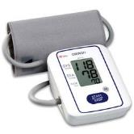
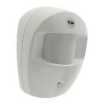
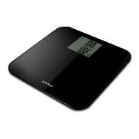
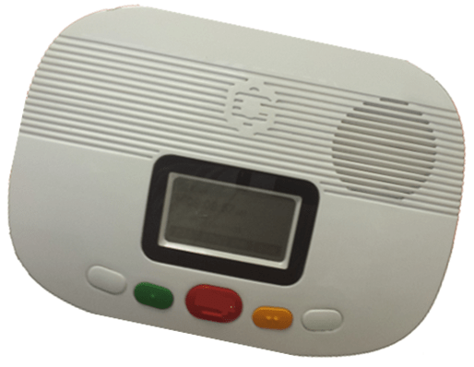
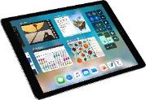
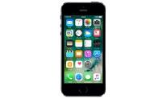
PROVIDING INSIGHTS
TELECARE
TELEHEALTH
FITBIT
CANARY CARE
WEIGHT
WATCHERS
PRIVATE HEALTHCARE
MONITORING CENTRE
CCSW SERVICE USER
FAMILY
CARER
10 | 29/10/2019 | IN STRICT COMMERCIAL CONFIDENCE

Slide 11
Any questions?
Improving lives through outcomes-based design. A case study at scale.
TIM BARCLAY, CEO, APPELLO

