Slide 1
LGBT+ affirmative services in housing
Alan Allton-White
Regional Manager, Independent Living

Slide 2
Optivo
The Why
The How
Good Practice
My Journey

Slide 3
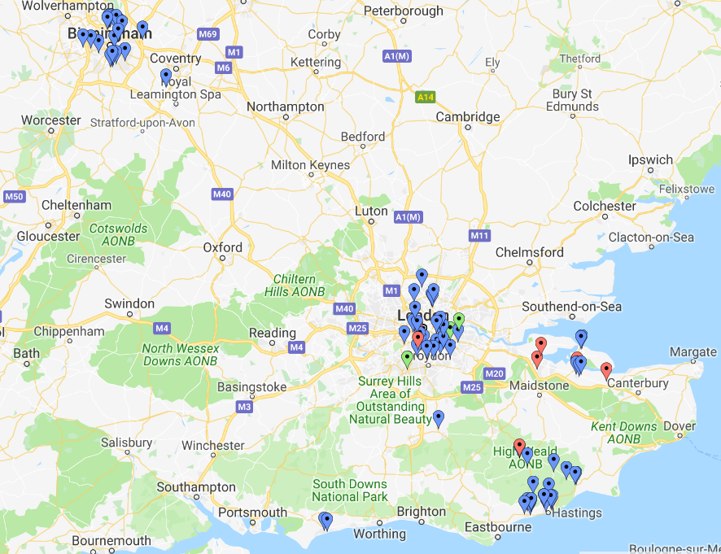
Optivo
Formed in 2017
45,000 homes
Four regions – Midlands, London, Kent & Sussex

Slide 4
Optivo’s CORE Values
Customer Focused
One Team
Respect
Enthusiastic

Slide 5
Our Staff Networking Groups

Slide 6
Our Staff Networking Groups
Firm TOR
Chair & Co Chair
Developmental Vice Chair role
Budget
Staff from all parts of the organisation
Let members choose how involved they want to be
Non-disclosure agreement
Influence policy
Joined up work with other networking groups
Visible to the whole organisation
Allies
Senior level involvement

Slide 7
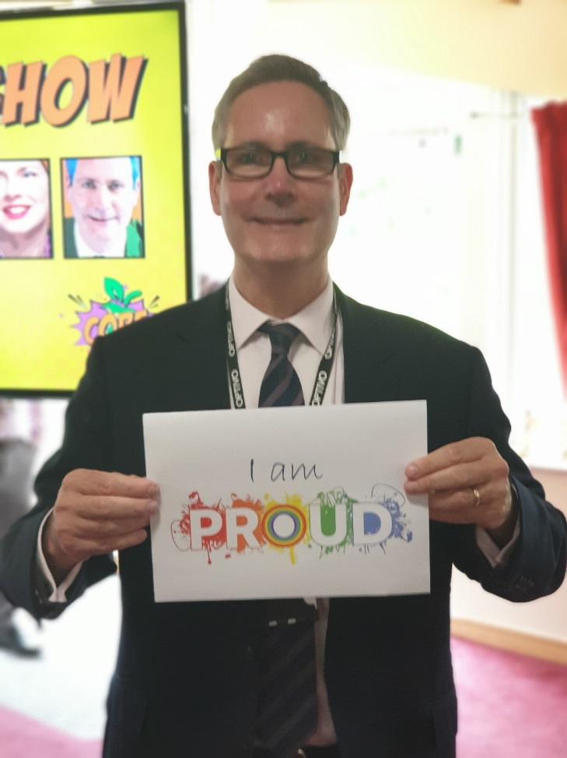
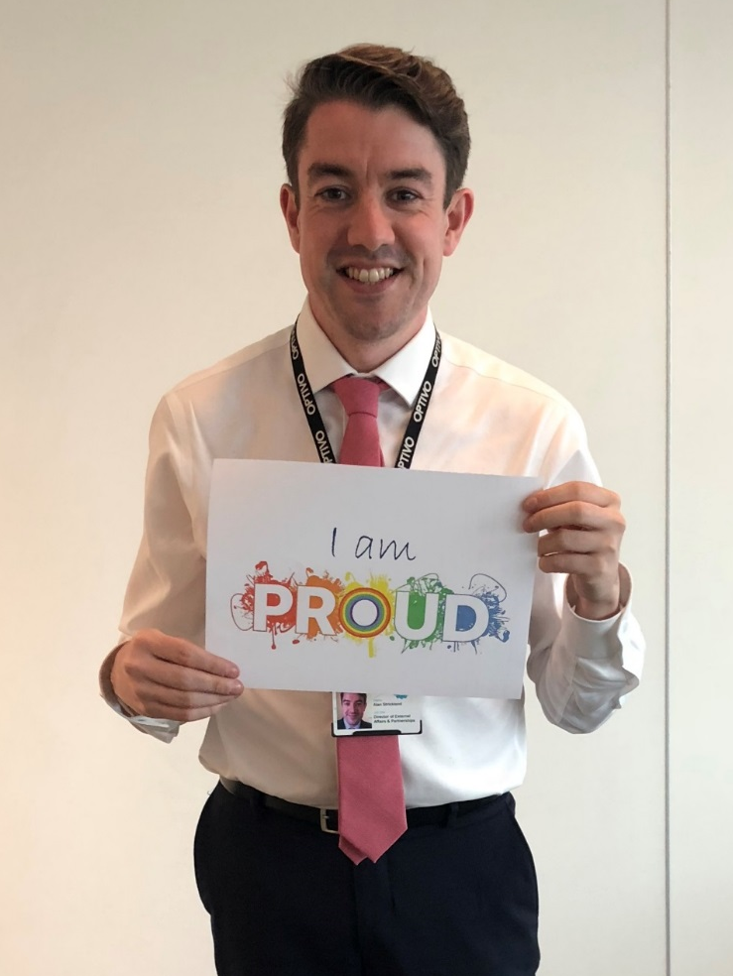
Senior Level Involvement
Paul Hackett
Chief Executive Officer
Alan Strickland
Director of External Affairs & Resident Involvement

Slide 8
More than just a networking group
It’s great to have a strong LGBT+ group but to provide a totally affirmative service, the whole organisation needs to get involved
Training on offer to all
Allies
Domestic Abuse Service
Relaunching our service and policy
Inclusive Steering Group
Webpages, awareness campaigns and training targeted at all protected characteristics
Creating guidance on sensitive ways to reach everyone in training and awareness campaigns
DA Champions

Slide 9
Stonewall Workplace Index -2018/19
This submission was in September 2018
We rank 217 of all employers – we leapt 37 places in one year.
During a time of massive change for the organisation.
We rank 10th out of 45 for the sector
I understand why my employer is committed to LGBT equality…
98% of your non-LGBT employees agreed
I feel confident in supporting my LGBT colleagues…
100% of your non-LGBT employees agreed
Now included in our Management Training programme:
Conscious bias and discrimination
Unconscious bias
How to tackle bias
I would feel confident challenging inappropriate behaviour or discrimination towards LGBT people in the workplace…
76% of your non-LGBT employees said yes

Slide 10
Visibility

Slide 11
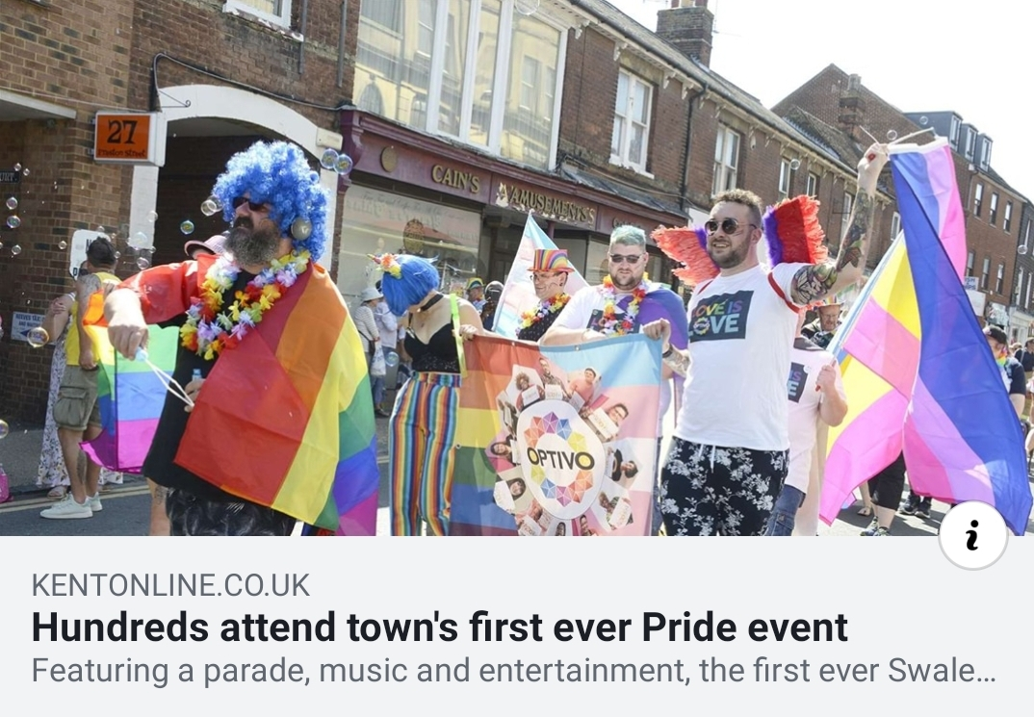
Visibility

Slide 12
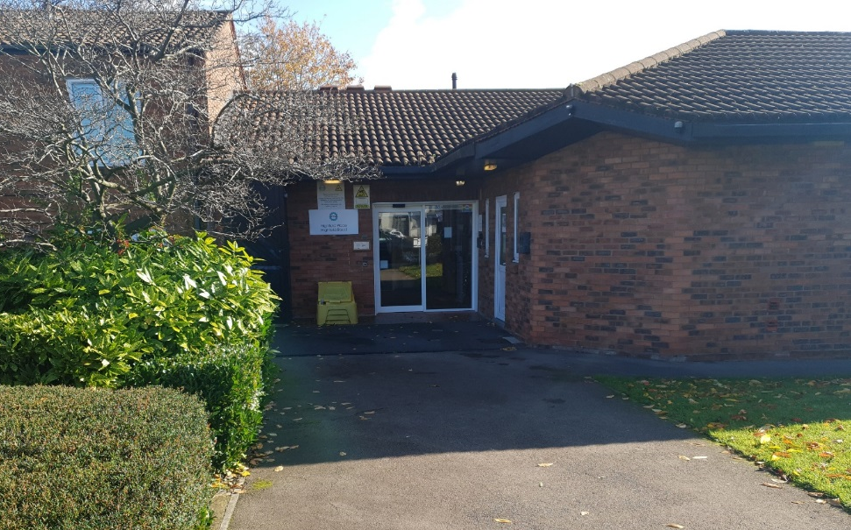
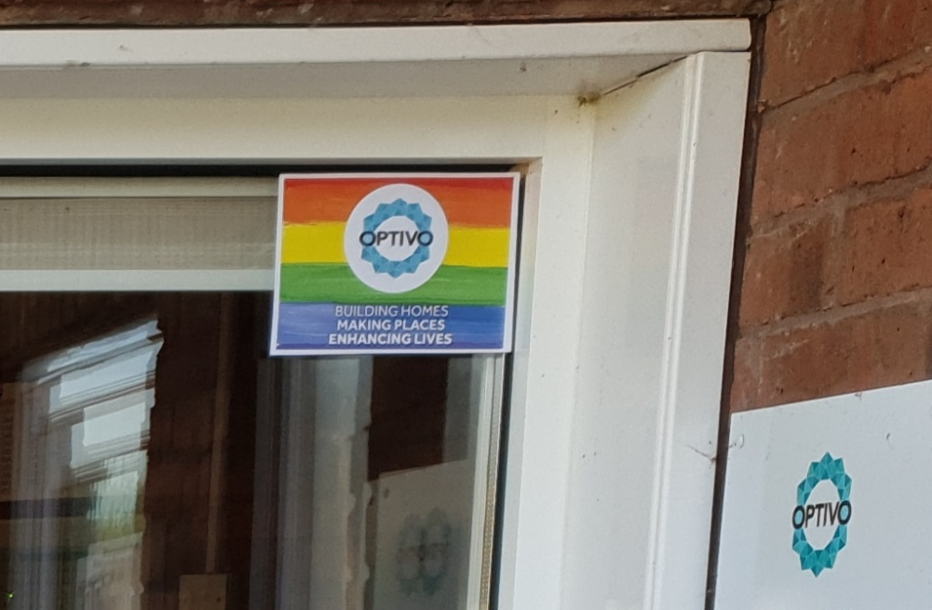
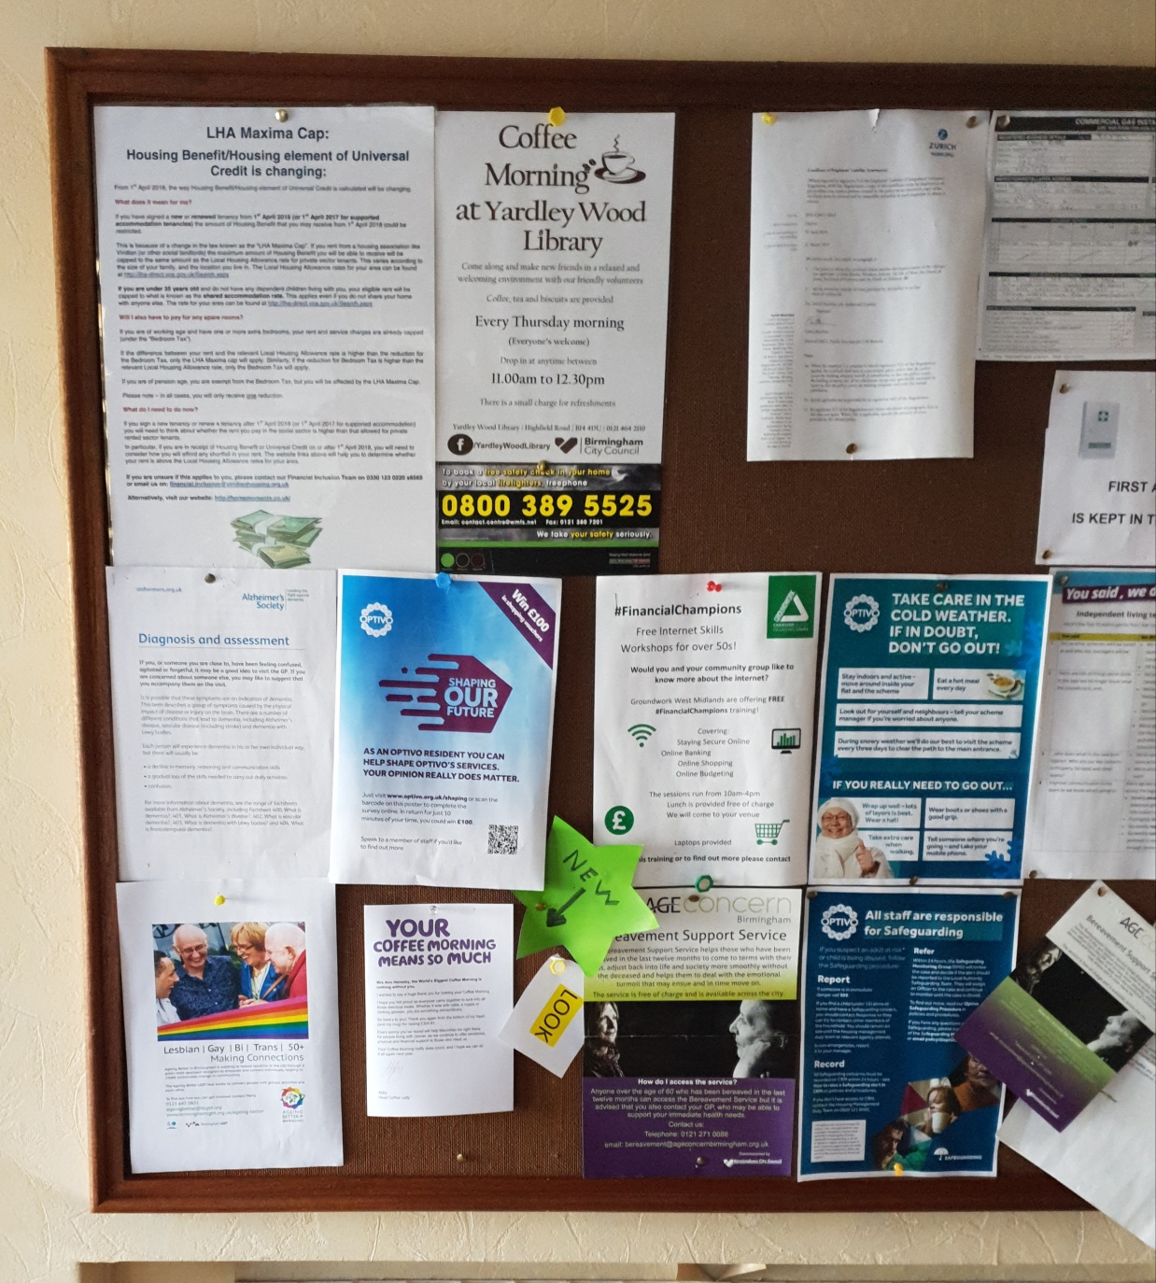
Visibility

Slide 13
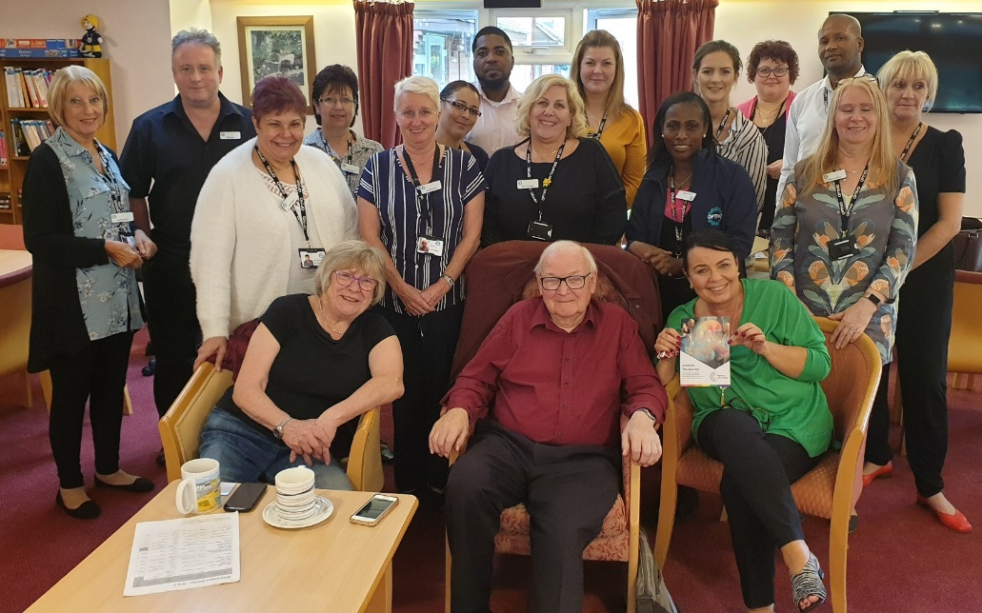
Bringing LGBT+ issues to life
After the session, staff said –
Feel more knowledgeable
Fascinated by their experience
Didn’t realise there could be such an issue
I’ll do all I can to make sure everyone is comfortable
I’ll recommend Rainbow Bridge in my scheme
Everyone here should have a visit from them

Slide 14
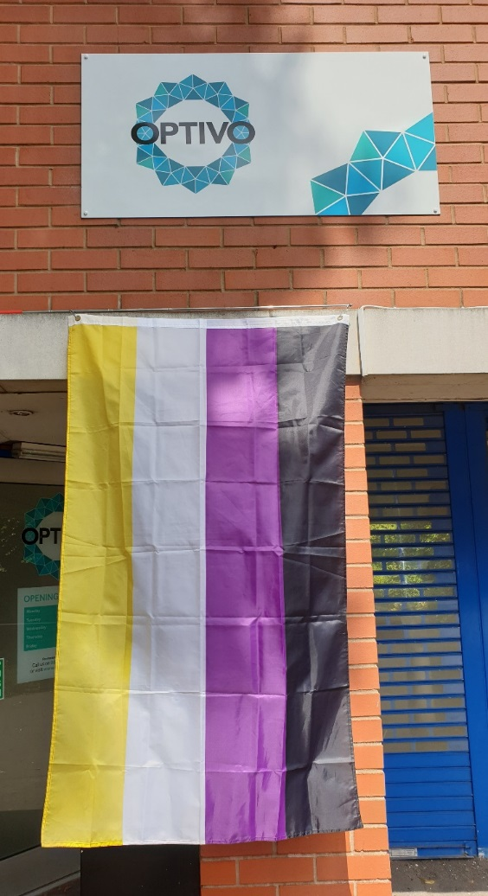
More than just L & G
It’s really important to include and support staff and residents who may not identify as Heterosexual, Lesbian or Gay.
’LGBT+’
IDAHOBIT
Bi Visibility Day
Asexual Awaress Day
Non-Binary Day

Slide 15
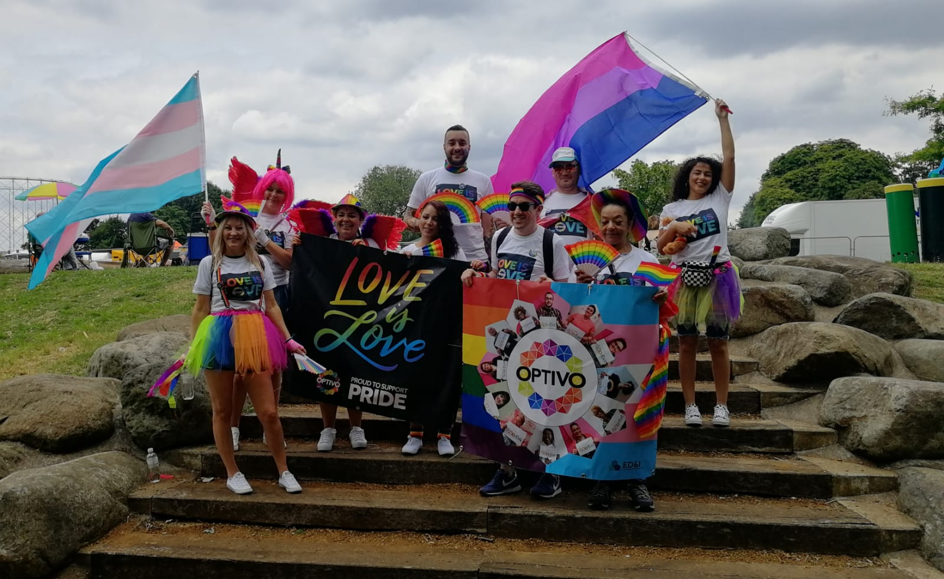

Slide 16
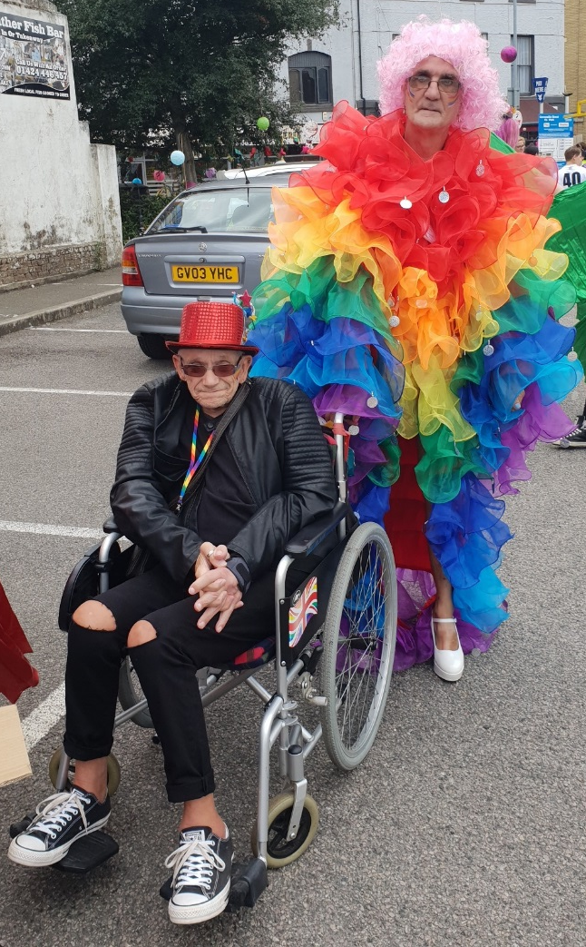
Resident Involvement

Slide 17
Resident Involvement
As a more formal method of involving residents we have four regional Equality & Diversity Forums for our residents.
This was piloted in Sussex and has now been adopted across the organisation
The Midlands forum meets quarterly, comprising of residents from the East & West Midlands of all ages
The E&D residents forum feeds into Resident Panels and Scrutiny Groups

Slide 18
Stonewall
I would feel confident challenging inappropriate behaviour or discrimination towards LGBT people in the workplace…
76% of your non-LGBT employees said yes

Slide 19
Erosh Good Practice Guide
➢ Provides some key definitions
➢ Identifies the links with housing, health and social care legal, regulatory, and policy frameworks
➢ Considers the housing and support needs of older LGBT+ people
➢ Examines what housing providers can do to support older LGBT+ people
➢ Looks at what older LGBT+ people experiencing discrimination and homophobia can do
➢ Signposts to other sources of information and advice

Slide 20
My Journey

Slide 21
Thank You

