Slide 1
Ageing Well in our Communities
Sarah Mitton
Neighbourhood Investment Manager, Age Friendly Communities
Repairs

Slide 2
Age Friendly Communities
Shaping a Clarion-wide offer for our residents and embedding resident voice in our decision-making.
Age Friendly communities strategy
Housing and Development
Communities
Clarion 55
The voice of our over-55 residents

Slide 3
OUR POPULATION IS OLDER AND MORE FRAIL THAN EVER
THE NUMBER OF PEOPLE AGED 65 AND OVER WILL RISE
14.5M
9.7M
65%
2015
2035
MORE OLDER PEOPLE WILL BE LIVING WITH DISABILITY
BY 2035
49% INCREASE
(Age UK 2017a)
(Age UK 2017a)

Slide 4
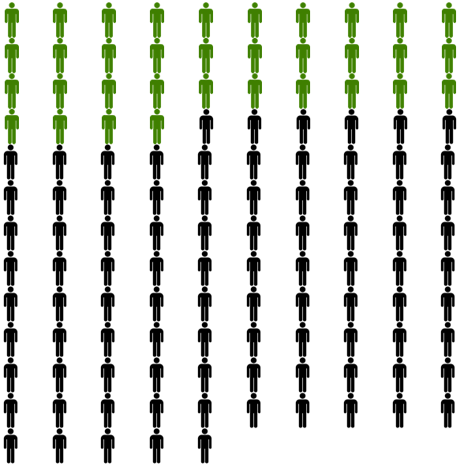
Clarion context
5th largest provider of housing for older people
Of residents aged 55+:
49% say they have a disability
50% say they have a long standing health problem
33% say they only have enough money for essentials
57% live alone
48% never use the internet
40,000 households where lead tenant aged 55+ (out of approx. 125,000 households)
Notes:
Despite the fact that we’re overwhelmingly general needs, we’re one of the largest providers of housing for older people
The age profile of our residents is older than the general population

Slide 5
Project Bridge
Project Bridge was put in place to review all supported, retirement housing, and alarm services across the group and agree what the resident offer would be if they lived in an existing scheme, whether this was managed by Centra or the Housing Association

Slide 6
Clarion Futures
Social purpose is at the heart of Clarion Housing Group
Clarion Futures provide national services to all residents and people living in our communities;
Jobs & Training – helps people into work & training including apprenticeships
Money & Digital – supports residents with money and energy problems and improving their digital skills
Communities – improves Clarion communities and supports our young people
Strategic Partnerships and Projects – focus on social value, volunteering and grants

Slide 7
Emergent themes…
-
Digital inclusion
Isolation and Loneliness
Health and Wellbeing
Employment
Intergenerational connections

Slide 8
Some of our projects
Dementia Awareness training for all staff
Innovation Labs
Developing innovative solutions for an ageing population
Jobs and Training support
Money and digital support
Food poverty
Digital Inclusion
Welfare support
Communities-based projects
Dementia cafes
Dementia maths
Physical activities

Slide 9
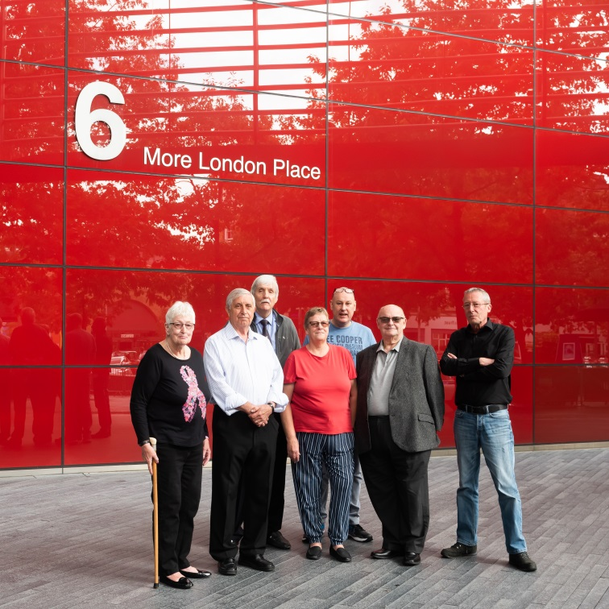
Clarion55
A national voice for our over-55 residents…
Monthly meetings
3 priorities
Buddies in the business
Attending events
Working with National Ambassadors

Slide 10
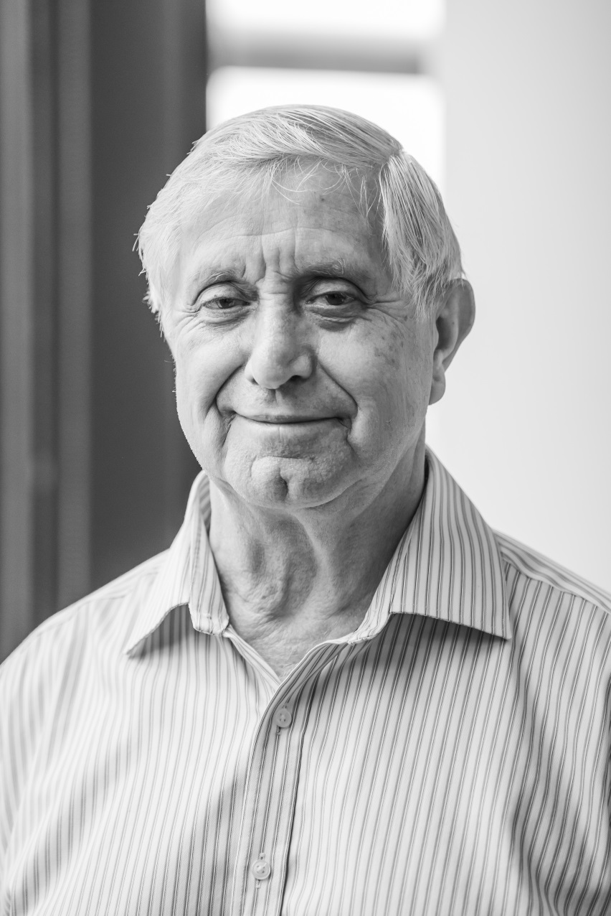
Noel Da Silva

Slide 11
Repairs
Thank you
Sarah Mitton
Sarah.mitton@clarionhg.com

