Slide 1

The NHS Long Term Plan: making it work for people with a learning disability, autism or both
Wendy Hicks
Policy Lead, Learning Disability Programme
NHS England and NHS Improvement

Slide 2
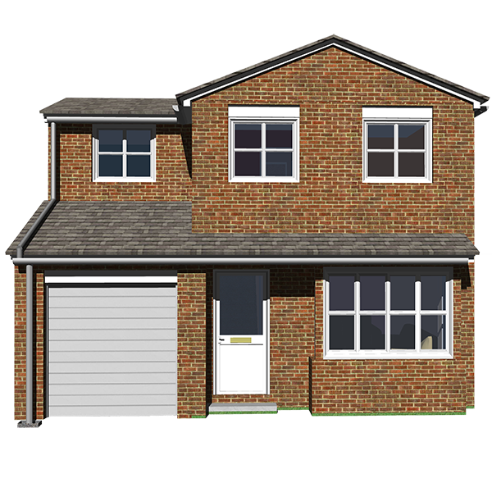
Introduction
The NHS 10 year and what it says about people with a learning disability, autism or both
Supporting local commissioners to develop supported and specialist housing for people leaving hospital
NHS capital programme to support development of new housing

Slide 3

Changes in the NHS
  NHS England and NHS Improvement have now joined together
  There are 7 NHS regions that cover the country
  The East of England region covers: Norfolk, Suffolk, Cambridgshire and Peterborough, Essex, Hertfordshire and Bedfordshire, Luton and Milton Keynes

Slide 4
NHS Long Term Plan 2019-2029
Lots about prevention of ill-health
Keeping people out of hospital and delivering more care at home
NHS Assembly to help deliver the plan
www.longtermplan.nhs.net including easy read version and a film

Slide 5
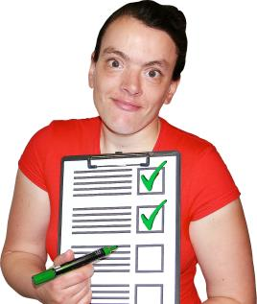

Overall commitments in long term plan
In line with the rest of the NHS, we will
Make sure the NHS works in the best way possible. So people can get help more easily, close to where they live, when they need it
Get better at helping people stay well – prevention and reducing health inequalities
Make care better - improve care quality and outcomes
Support staff better
Improve access to digital care eg. technology and online services
Make best use of tax payers’ money
Support local areas to plan and develop services in line with the long term plan

Slide 6




Long Term Plan: people with a learning disability, autism or both
Tacking Health Inequalities
75% of people will have an annual health check
Pilot annual health checks for people with autism
Continue the Learning Disability Mortality Review
Carry on with STOMP and STAMP (stopping over-medication and making sure medication is used properly for children and young people)

Slide 7

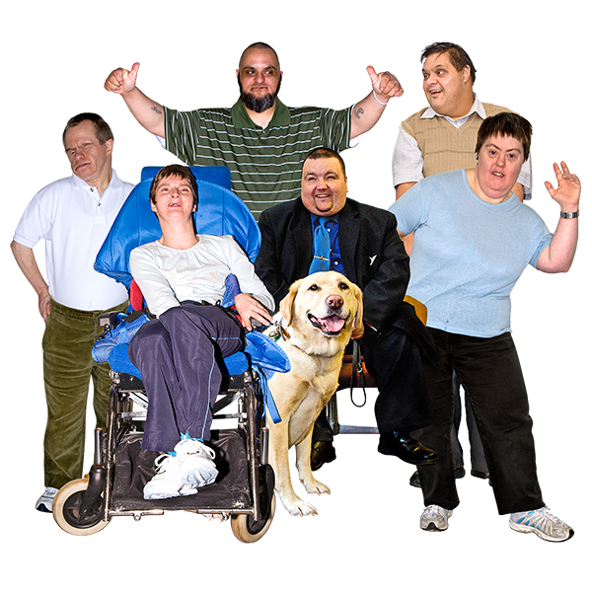
All of NHS to understand needs and work together to improve health and wellbeing
NHS staff will receive information and training on supporting people with a learning disability, autism or both
The Department of Health and Social Care has recently run a consultation on mandatory learning disability and autism training

Slide 8

All of NHS to understand needs and work together to improve health and wellbeing
By 2023/24, there will be digital ‘flags’ on patient electronic records
These will show health staff if a patient has a learning disability or autism
This will help different health services communicate better about people’s needs and wishes

Slide 9

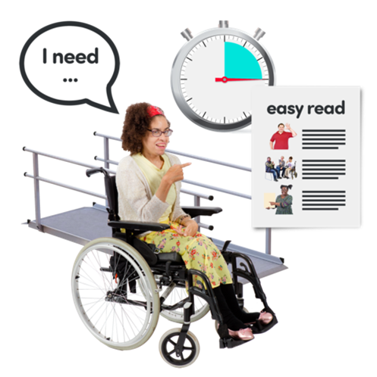
All of NHS to understand needs and work together to improve health and wellbeing
Sustainability and Transformation Partnerships (STPs) and Integrated Care Systems (ICSs) will ensure that healthcare providers make reasonable adjustments for people with a learning disability, autism or both
Local STPs bring health and social care planning closer. STPs are all becoming Integrated Care Systems by 2021
Reasonable adjustments are things such as easy read and longer appointments

Slide 10
All of NHS to understand needs and work together to improve health and wellbeing
By 2023/24, there will be digital ‘flags’ on patient electronic records
These will show health staff if a patient has a learning disability or autism
This will help different health services communicate better about people’s needs and wishes

Slide 11
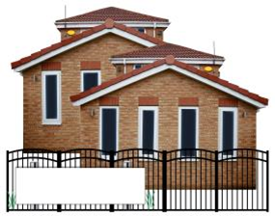


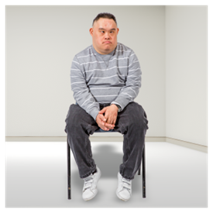
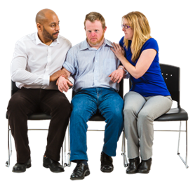
Quality of inpatient care
Continuing work that was started under Transforming Care
By March 2023/24, half the number of people in hospital than 2015:
  No more than 30 adults per million
  No more than 12-15 children and young people per million
Continue and review care and treatment reviews – CTRs and C(E)TRs
We will work with the Care Quality Commission (CQC) to restrict the use of seclusion, long-term segregation and restraint

Slide 12



Intensive, crisis and forensic community support
Continuing work started under Transforming Care work
More investment in 7 days a week intensive, crisis and forensic community support
More people to receive personalised care in the community, closer to home
More to reduce preventable admissions to inpatient services
Specialist community teams for children and young people, to stop children from going into institutional care

Slide 13
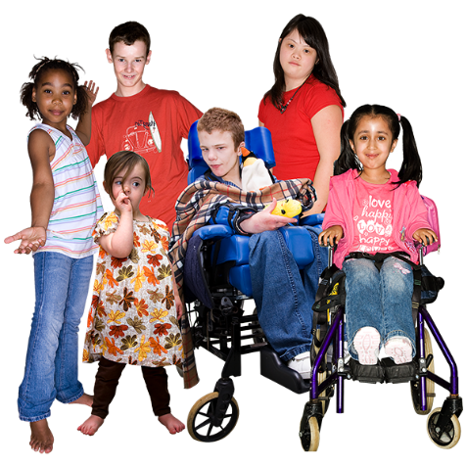
Supporting better care for people with autism
Long Term Plan commitments to:
  Explore, test and implement the best approaches to autism diagnosis for children in order to reduce waiting times and improve support for children and their families during and after diagnosis
  Test an annual health check for people with autism
  ‘Digital’ flag on GP records to improve ‘reasonable adjustments’
  Help with the Government’s refresh of the Autism Strategy

Slide 14
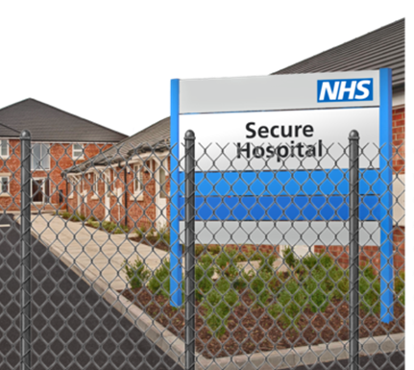



What about Transforming Care?
620 people in hospital for more than 5 years now live in the community
About 22% fewer people in hospital overall
In the future:
No more than 30 adults in hospital per million adults
No more than 12-15 children and young people per million children
Transforming Care and the Building the Right Support plan will still be an important part of our work

Slide 15
Housing actions for Transforming Care Partnerships
Having a housing plan until 2023/24 (next five years) that says what the local gaps in housing are
A named person who leads on housing for people with a learning disability, autism or both
Housing people are on the Transforming Care Board or the Learning Disability workstream meeting or similar
There is a pipeline of new housing for people with a learning disability, autism or both
There are links with the local Market Position Statement or other local housing plans

Slide 16
NHS money to support new housing
£10 million over 5 years to support Transforming Care across the Country
In 2018-19 we approved over £15 million (fifteen million pounds)
In 2019-20 we have requests for about £37 million (but not all the requests will turn into projects)
East of England, currently there are requests for 7 housing projects
Mixture of new build, refurbishment and open market purchase

Slide 17

Example 1: Southwark supported living
4 x 1 bedroom flats and 2 x 2 bedroom flats
Converted a care home for older people
People living outside Southwark or in residential care to be closer to their families
Partnership of Southwark Council, Southwark CCG, South London and Maudsley NHS Foundation Trust, Optima Care and Golden Lane Housing
People can have support from the Enhanced Intervention Service- an outreach service provided by the health trust
Notes:
Cost £1m

Slide 18

Example 2: Hillingdon, London
Money to do work at a 4 bedroom bungalow to make it suitable for one person leaving hospital
Property to be adapted to meet his environmental and sensory needs
The property means he can safely build his independence skills and explore his interests
BUT it cost more than planned: the OT and support team looked at the works and did not think they were right for the person. There has been more work to get the property ready for the person to move in- and still more to do after he moves in
Make sure the OT is involved at the beginning in deciding the works and checking the work when its done
Make sure everyone agrees the property is ready
Put more money in the budget for unplanned costs
Notes:
Home for as long as he wants it

Slide 19
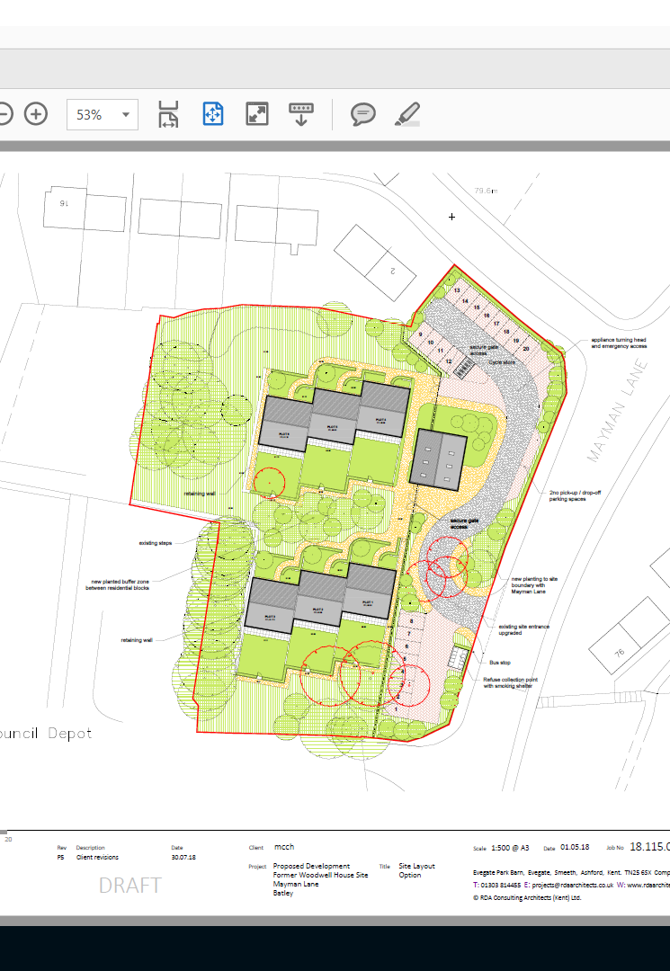
Example 3: Kirklees
Approved in 2018 so is still being built
For adults with a learning disability, autism and mental health needs
Land was a Council depot
6 single storey terraced properties
Big flats: Gross internal area (GIA) of 61m2.
Private garden at front and back of each property
Also a building that is for support staff and an office
Notes:
Pip -

Slide 20
What we have learnt from the capital programme
Housing often takes longer than planned
We would like to see more sharing of good designs and costs
Still quite a lot of ‘institutional’ features being suggested and not enough talking to the Care Quality Commission
Some good examples of co-production with people and their families- but not enough

Slide 21
What next?
Focus on design and sharing good practice
Inviting Expressions of Interest for capital programme 2020-21
Hospital discharge and housing project
Accommodation to support people and their families in a crisis
Helping commissioners to plan a pipeline of delivery over 5 years

Slide 22
For more information
Wendy Hicks
National Policy Lead, Learning Disability Programme
NHS England and NHS Improvement
07714 778819
Wendy.Hicks1@nhs.net

