Slide 1
North East and Yorks & Humber Housing LIN Meeting
#HLINNEYH @HousingLIN @HousingLINews
July/October 2019
Housing Learning and Improvement Network

Slide 2
Housing LIN Update
Lois Beech
Research and Stakeholder Engagement Officer, Housing LIN
July/October 2019
Housing Learning and Improvement Network

Slide 3
Housing LIN regional delivery
We have boosted our central resource to support regional co-chairs by:
Jeremy Porteus, Chief Executive
Clare Skidmore, Strategic Lead for Influencing and Networks
Lois Beech, Stakeholder Engagement and Research Officer
Jerome Billeter, Corporate Services Manager
Sophie Fox, Business Support Officer
Work closely with chairs to identify:
venues in each region (minimum of 2 meetings pa) and tour of schemes;
a range of interesting speakers on cutting edge themes
Highlighting national Housing LIN activities from influencing, research and consultancy programmes
identify possible case studies, blogs or other resources for future publication
Share findings and access or support learning from Housing LIN Consult
Notes:
Central team who focus on the delivery of events in partnership with the regional chair
Introduce Sophie new member of staff to support regional activity
Work with the regional chair to identify themes, venues, speakers
Want to share findings from our consultancy projects that we think are worthwhile – bespoke consultancy and support on regional basis – eg Brighton city council (conducted an Older Persons Housing Needs Assessment) – Southampton report – (Health care system benefits of ECH – local perspective)

Slide 4
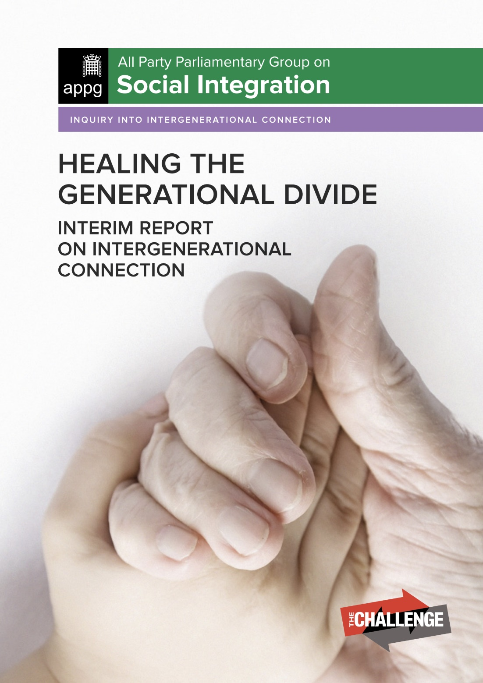
Our latest Housing LIN influencing activities
APPG on Social Integration on Generational Fairness (submission on intergenerational housing)
Responding the Department of Health and Care Services’ Prevention Green Paper (closing date 14 October 2019)
Responding to upcoming NHS England High Impact Changes paper on delivery of NHS 10 year plan (forthcoming)
Supporting NHS England’s Transforming Care programme, hosting roundtable on future of supported housing
Notes:
Influencing - Lead by Clare Skidmore
APPG – 1st submission gave some good practise egs of intergenerational housing. They have now asked for a 2nd submission that thinks about how these might be possible going forward, such as key ingredients to success and how to align with other gov policies
DoHSCS – Outline the relationship housing has in relation to preventative services.
NHS High Impact Change Model (used by Health & Care systems across the country to improve timely hospital discharges) – HLIN response looks at how housing and technology can be better integrated with health to enable this.
NHS England TCP – around Learning Disability Services – Experts in the field to discuss common issues / future of SH and how its funded and regulated. Providing better housing choices for LD.

Slide 5
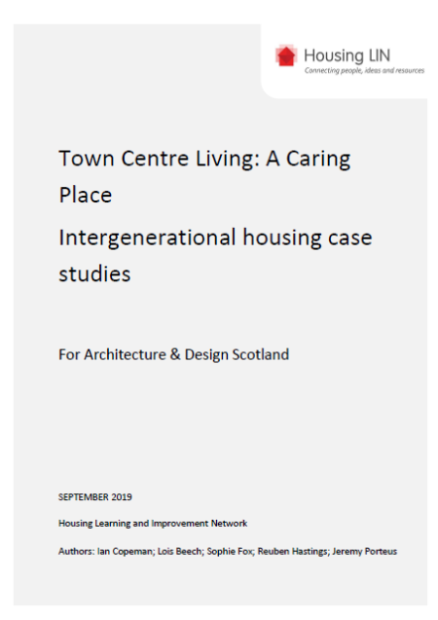
Recent Housing LIN case study report for Architecture & Design Scotland
Town Centre Living: A caring place. Intergenerational housing case studies
12 case studies on intergenerational living at: https://www.housinglin.org.uk/News/New-Housing-LIN-report-looks-at-intergenerational-housing/
Draws on examples from on UK, Europe and USA
Focussed on how could apply in Scottish Town Centre context as part of their wider programme at: https://www.ads.org.uk/a_caring_place_report/
Notes:
Reports HLIN have completed for people
Town Centre Living report BY ADS looks at how to use town centres more effectively, what are the essentials for creating caring places?
Our report identifies examples of intergenerational housing that fit with the Town Centre Living report
Casestudies from across UK, Europe and USA
How to apply in a Scottish Town Centre context
Applying IL in an urban area – interested in this then speak to me after

Slide 6
Housing LIN case study report for Southampton City Council
Identifying the health care system benefits of housing with care for residents – an evidence review
Findings of: reductions in the number of GP visits
Reductions in the number of community health nurse visits
Reductions in the number of non-elective admissions to hospital
Reductions in length of stay and delayed discharges from hospital
Reductions in ambulance call outs, typically linked to reduced incidence of falls
Notes:
Just go through some headline findings
Links to green paper
Report quantified £2000 Financial cost-benefits (per housing with care resident per year)
More detail and how to apply to your locality come and talk to us

Slide 7
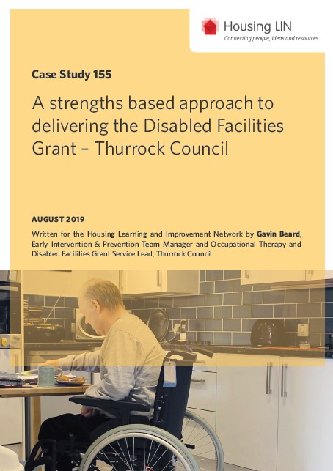
Other recent Housing LIN case studies
A strengths based approach to delivering the Disabled Facilities Grant – Thurrock Council: https://www.housinglin.org.uk/Topics/type/A-strengths-based-approach-to-delivering-the-Disabled-Facilities-Grant-Thurrock-Council/
Almshouse flats for homeless people: Sir Thomas White Court, Worcester: https://www.housinglin.org.uk/Topics/type/Almshouse-flats-for-homeless-people-Sir-Thomas-White-Court-Worcester/
Extra Care Housing - the heart of the community in Porthmadog: https://www.housinglin.org.uk/Topics/type/Extra-Care-Housing-the-heart-of-the-community-in-Porthmadog/
Notes:
Selection of case studies
Outlines how Thurrock Council OT and Disabled Facilities Grant (DFG) service team have adopted a strength based approach to delivering DFGs to enhance individual’s independence and provide overall improvements to their health and wellbeing. Choice to make simple modification themselves.
Came from our recent Midlands meeting – Highlights the architectural qualities of the award winning scheme which comprises 10 apartments (4 from converted apartment block and 6 built on a redundant car park), Part of the Worcester Municipal Charities to provide homes for young people at risk of homelessness in the city of Worcester. – homelessness awareness day
Fourth extra care scheme and was developed in partnership with Gwynedd Council. Not that much EC in wales due to population, in many areas difficult to develop but made it into a community hub so serves the wider community too. How to make it work as a community resource.

Slide 8
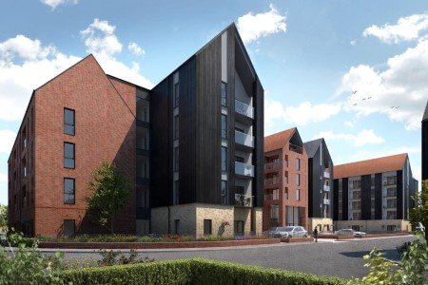
Other recent Housing LIN resources
Housing LIN Blogs
A selection of guest blogs at: https://www.housinglin.org.uk/blogs/
Housing LIN #InspirationalAchievements
Arden Quarter retirement living at the heart of Stratford-upon-Avon at: https://www.housinglin.org.uk/Topics/Inspirational-Achievements/orbit/
Notes:
Produce a blog a week – open to entries
Inspirational Achievements – where we showcase a project we think to be a real highlight – only available to our sponsors
Arden Quarter Development by Orbit in Stratford upon avon on site of old cattle market.
189 for first time buyers and over 55s (58 general needs and 102 extra care)
Truly intergenerational community – mix of housing options and facilities
Transport hub
Mixed use site
Useful regeneration site
A bridge to the town centre
How to do master planning for an area

Slide 9
Other useful recent publications
Just Living design guide: https://www.housinglin.org.uk/Topics/type/Just-Living/
NHS England Healthy New Towns guide: https://www.housinglin.org.uk/News/NHS-England-publishes-guidance-on-Healthy-New-Towns/
Housing and Ageing Alliance Manifesto, Time for Action: https://www.housinglin.org.uk/News/Housing-and-Ageing-Alliance-publishes-2019-manifesto/
Notes:
1st one will be expanded upon today
We’ve been part of thinking. Captures lessons from healthy new towns and aspects about how to live well across all ages.
Members of HAA host them on our website - Manifesto published by HAA to coincide with party conferences that thinks about how we would to see housing and ageing. 1.better accessible housing 2.better flexible designed housing (adapted) 3. Investment in info & advice

Slide 10
Housing Design Awards 2019 - HAPPI
2 schemes won HAPPI awards this year (both PegasusLife)
Hortsley in Seaford, East Sussex (future Housing LIN case study)
Steepleton in Tetbury, Gloucestershire (existing case study at: https://www.housinglin.org.uk/_assets/Resources/Housing/Practice_examples/Housing_LIN_case_studies/HLIN_CaseStudy_152_ProctorMatthews.pdf
Other notable winners with HAPPI ingredients
Marmalade Lane, K1 cohousing, Cambridge (HLIN guest blog): https://www.housinglin.org.uk/blogs/Eco-friendly-cohousing-in-Cambridge-Building-a-Shared-Future-across-all-ages/
Colby Lodge, Walthamstow with Walthamstow & Chingford Almshouse Charity
Notes:
HLIN sponsor HAPPI category of design awards. 1 of 18 categories.
This year submission so great that there were 2 winners of award!
Seaford – soon to be case study
Tetbury – have this as a case study
Impressive that other winners also had HAPPI ingredients
Colby Lodge – Would like to be a future case study?

Slide 11
Upcoming HLIN resources/programmes
Housing with Care sector survey. A state of the nation survey to identify organisations’ ambitions for growing the housing with care choices over next 5 years. Deadline for responses, 25 October 2019: https://www.surveymonkey.co.uk/r/Growing-H-w-C
Housing with Care guide (Urban Land Institute) due out 1 November 2019
A compendium of practice: repurposing sheltered housing
A compendium of practice: community led housing approaches
A compendium of practice: housing for people with learning disabilities
Housing and older people strategy briefing for RiPfA (due this autumn)
Housing LIN Putting Older People First in the South West: 5 year vision, 2020-2025 (out early 2020)
Developing autism and MCA training courses
Future Leaders’ programme
Notes:
Selection of resources that important
Series of other compendium of best practise – e.g. sheltered housing, community led housing approaches
Future Leader Prog - 8 early career individuals from a wide range of practitioner backgrounds provide the opportunity to meet key industry leaders, and to produce and present a cooperative project and share their learning.

Slide 12
Housing LIN consultancy
Expanding consultancy, training and wider fee paying services to supplement our free online and regional Housing LIN networking activities. Examples include:
Strategic Housing for Older People Market Analysis for several county councils and unitary authorities in Wales and England
Analytical support for several housing associations to evidence strategic reviews of older people’s housing, services and support
Delivery of the ‘Adaptations without Delay’ report for the Royal College of Occupational Therapists
Bespoke intelligence to support local and regional authorities’ thinking and planning for their future requirements for extra care housing, ‘care ready’ housing suitable for older people and / or supported housing
Notes:
Selection of resources that important
Series of other compendium of best practise – e.g. sheltered housing, community led housing approaches
Future Leader Prog - 8 early career individuals from a wide range of practitioner backgrounds provide the opportunity to meet key industry leaders, and to produce and present a cooperative project and share their learning.

Slide 13
Connect with the Housing LIN
Over 25,000+ subscribers but still the ‘best kept secret’!
Sign up to receive our free weekly bulletin, HLINks
Check out our free-to-view online resources, including #InspirationalAchievements page at: www.housinglin.org.uk/InspirationalAchievements
Get involved and share your learning via a guest blog, viewpoint or case study, or on our discussion forum and at these events
Follow us on twitter at @HousingLIN, @HousingLINews @HLINConsult
Host a future regional Housing LIN meeting
Sponsor our website or an event

Slide 14
Thank you!
Housing LIN c/o PRP, the Ideas Store 10 Lindsey Street, Clerkenwell London EC1A 9HP
email: info@housinglin.org.uk website: www.housinglin.org.uk
Twitter: @HousingLIN @HousingLINews @HLINconsult @SkidmoreClare

Slide 15
What are your biggest two issues with the allocation and panel process?
What would two solutions be?

