Slide 1
Coproduction and Creative Communities
Chris Barber | Engagement Coordinator
Rachael Dinnage | Arts & Partnerships Lead

Slide 2
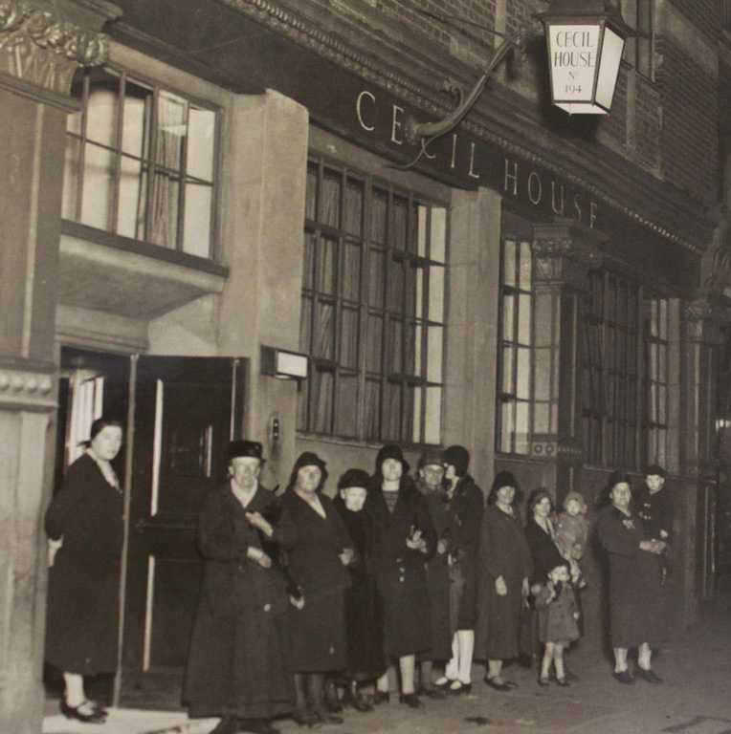
Mrs Chesterton founded C&C over 90 years ago to provide refuge to homeless young women. Since then we have continued to offer inspirational, person-centred care and support to people over
the age of 55

Slide 3
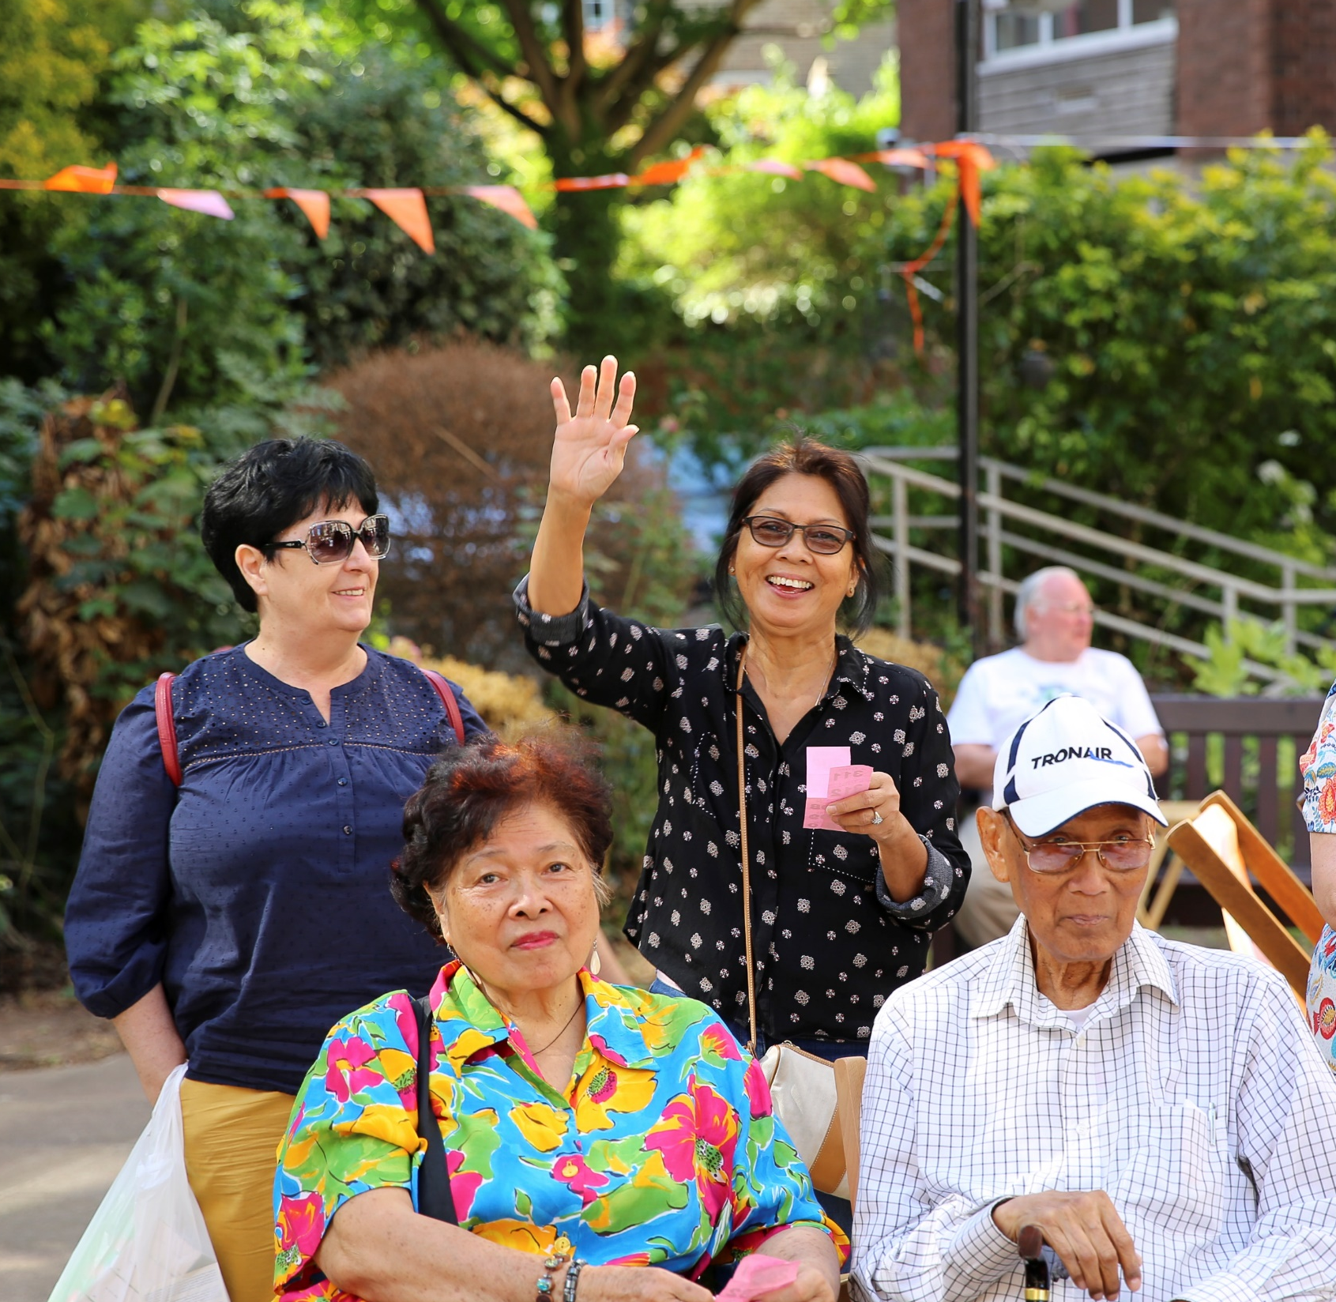
2019
Housing and support exclusively for over 55s in London
Sheltered Housing, dementia specialist Care Homes and Supporting Living services
Extensive resident engagement programme which has evolved over the years

Slide 4
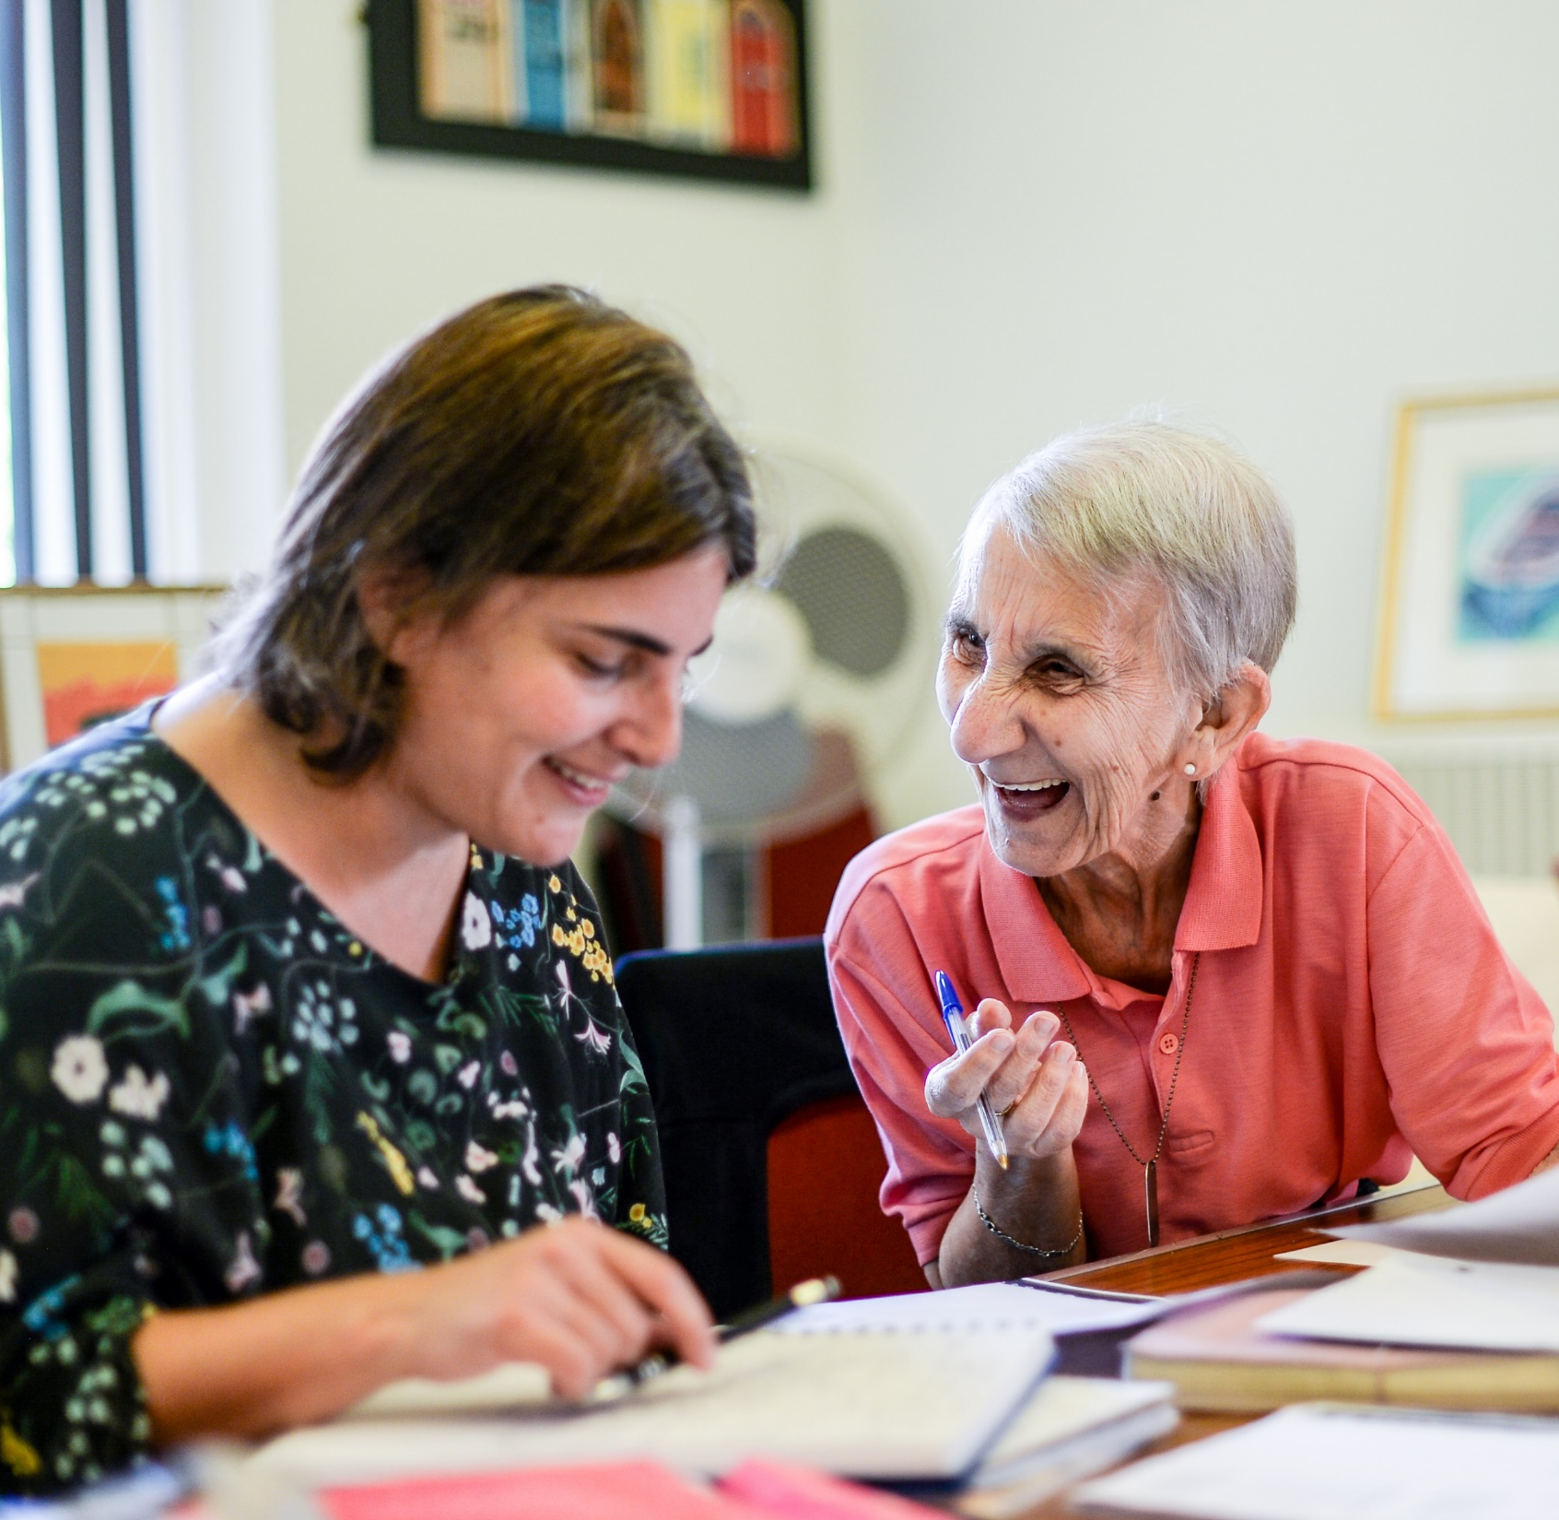
Resident Engagement
Engaging residents in the development and running of our homes and services
Engaging residents in arts, health and community based projects to connect them with all that London has to offer

Slide 5
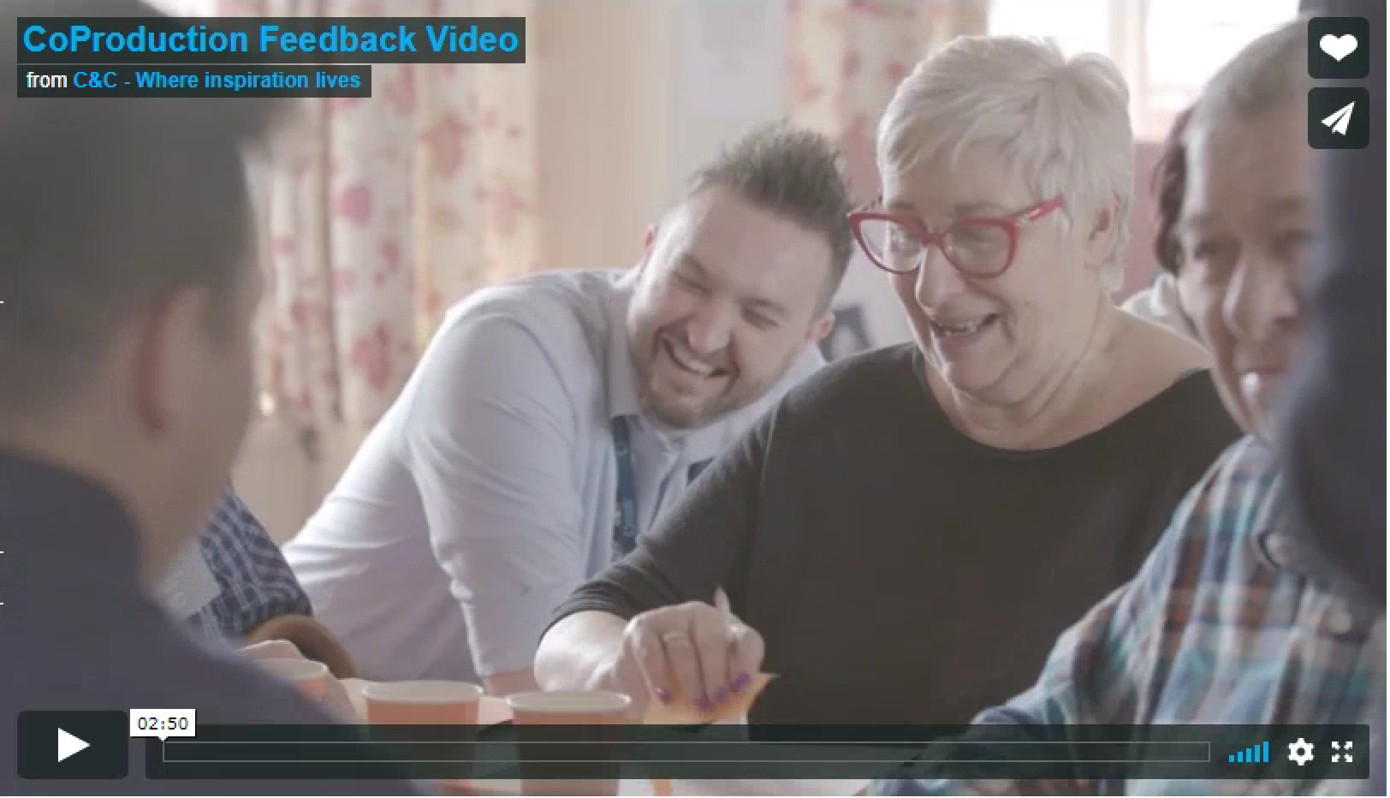
Assembly

Slide 6
Assembly Projects
The Resident Welcome Experience
Community & Mental Wellness
Support & Signposting Programme
Next Steps

Slide 7
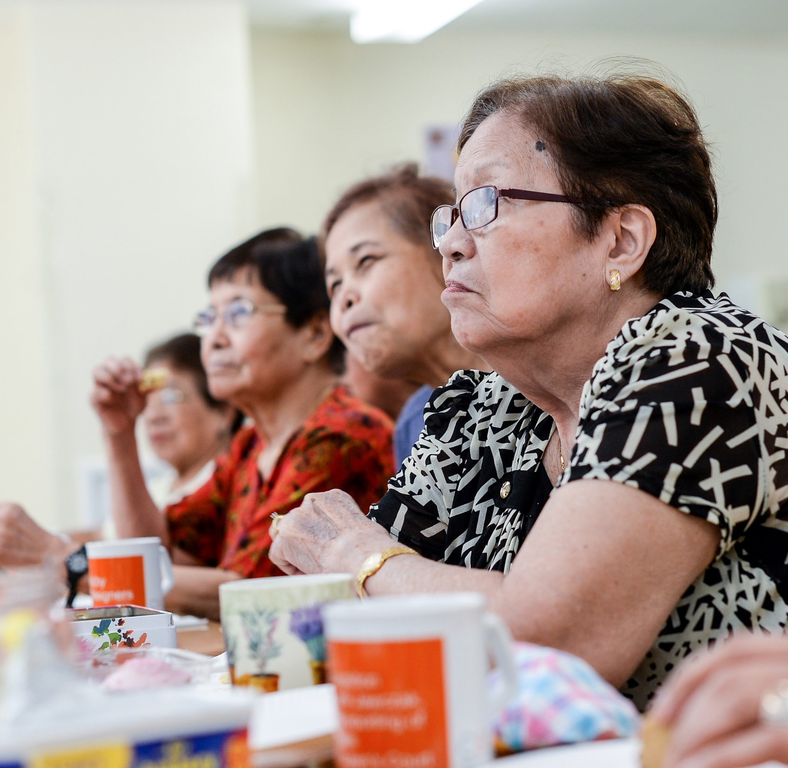
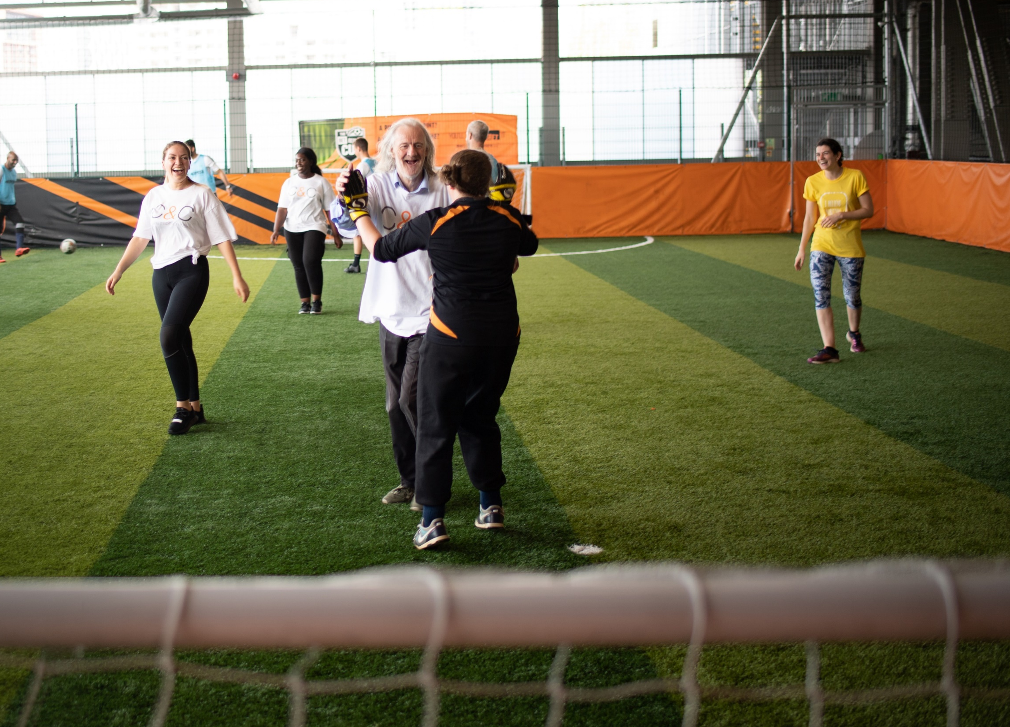
Together with Tenants
National Housing Federation
Four Point Plan
C&C – Early Adopters

Slide 8
Roadshows
Held twice a year across C&C Sheltered Housing schemes
Opportunity for residents to find out what’s going on behind the scenes at C&C
Key decision makers discuss improvements and developments within the organisation

Slide 9
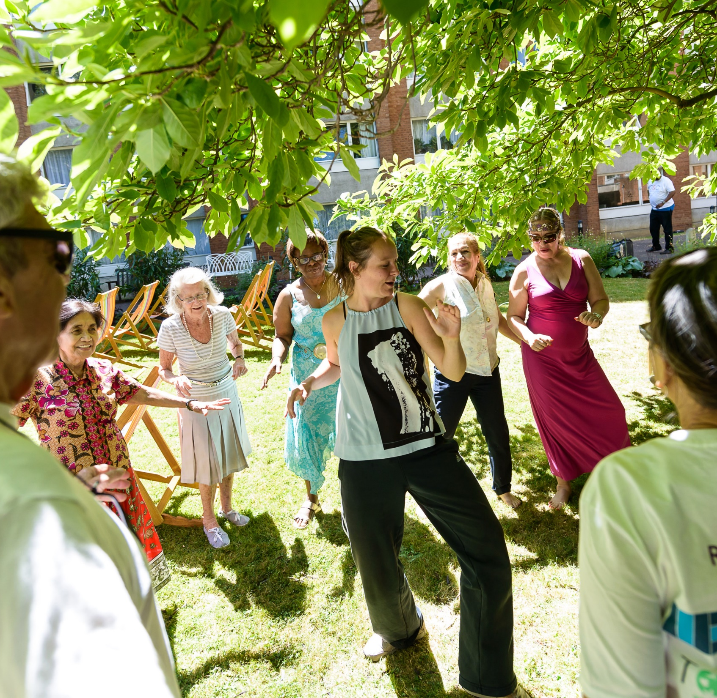
Arts & Health
C&C’s ‘Creative Arts’ programme was founded over 35 years ago
Choice based programme across schemes and homes - ‘What’s On’
Engages a wider group of residents, builds homes and a sense of community

Slide 10
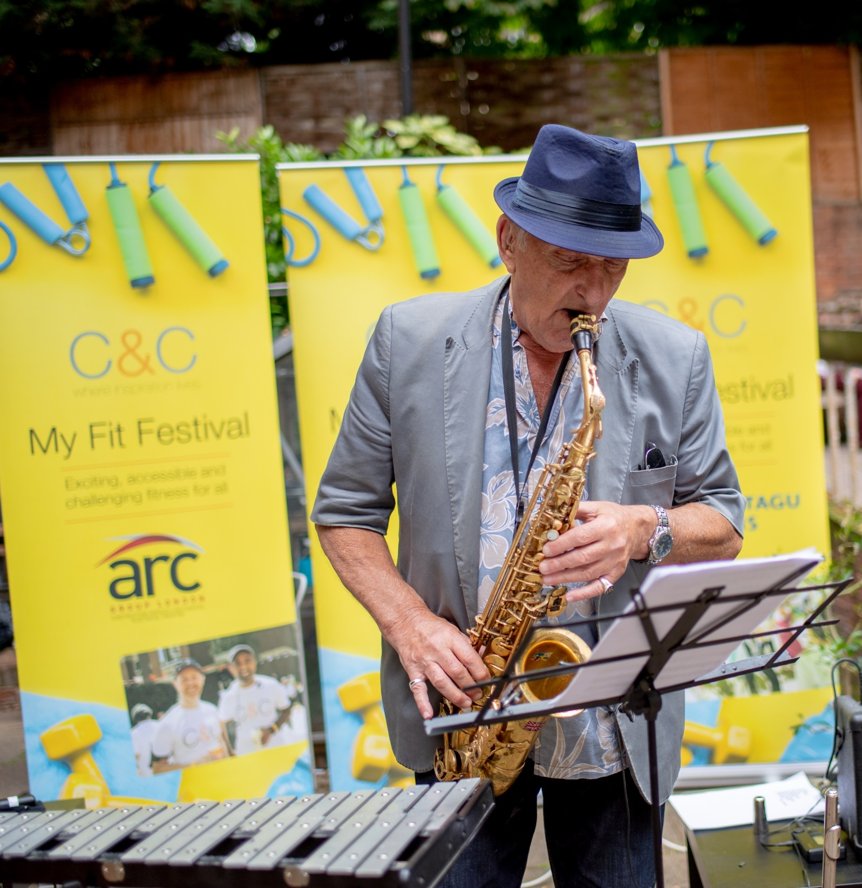
Evidence and Benefits
Age UK Wellbeing Index 2017 ‘Creative & Cultural Participation’ top indicator for wellbeing in later life followed by ‘Physical Activity’
Social Prescribing
Residents engaged in C&C’s wider aims and activities -Coproduce publications, write material and perform at events

Slide 11
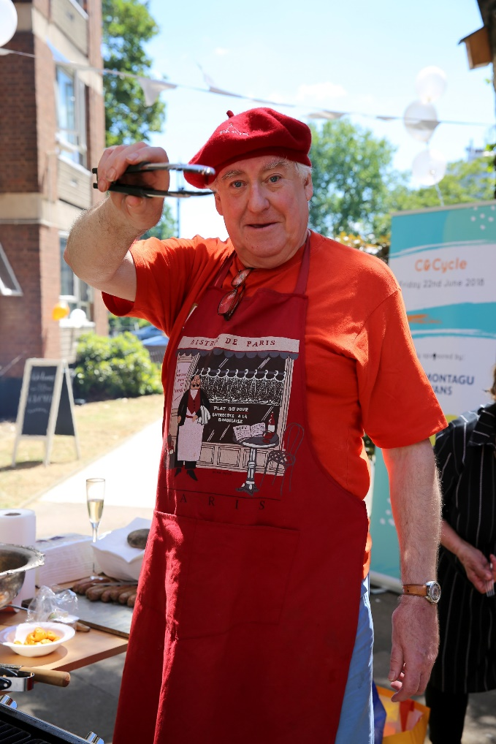
Case Studies
Ibrahim
Social Inclusion
David
Resident Volunteering
Upholstery
Creative Coproduction

Slide 12
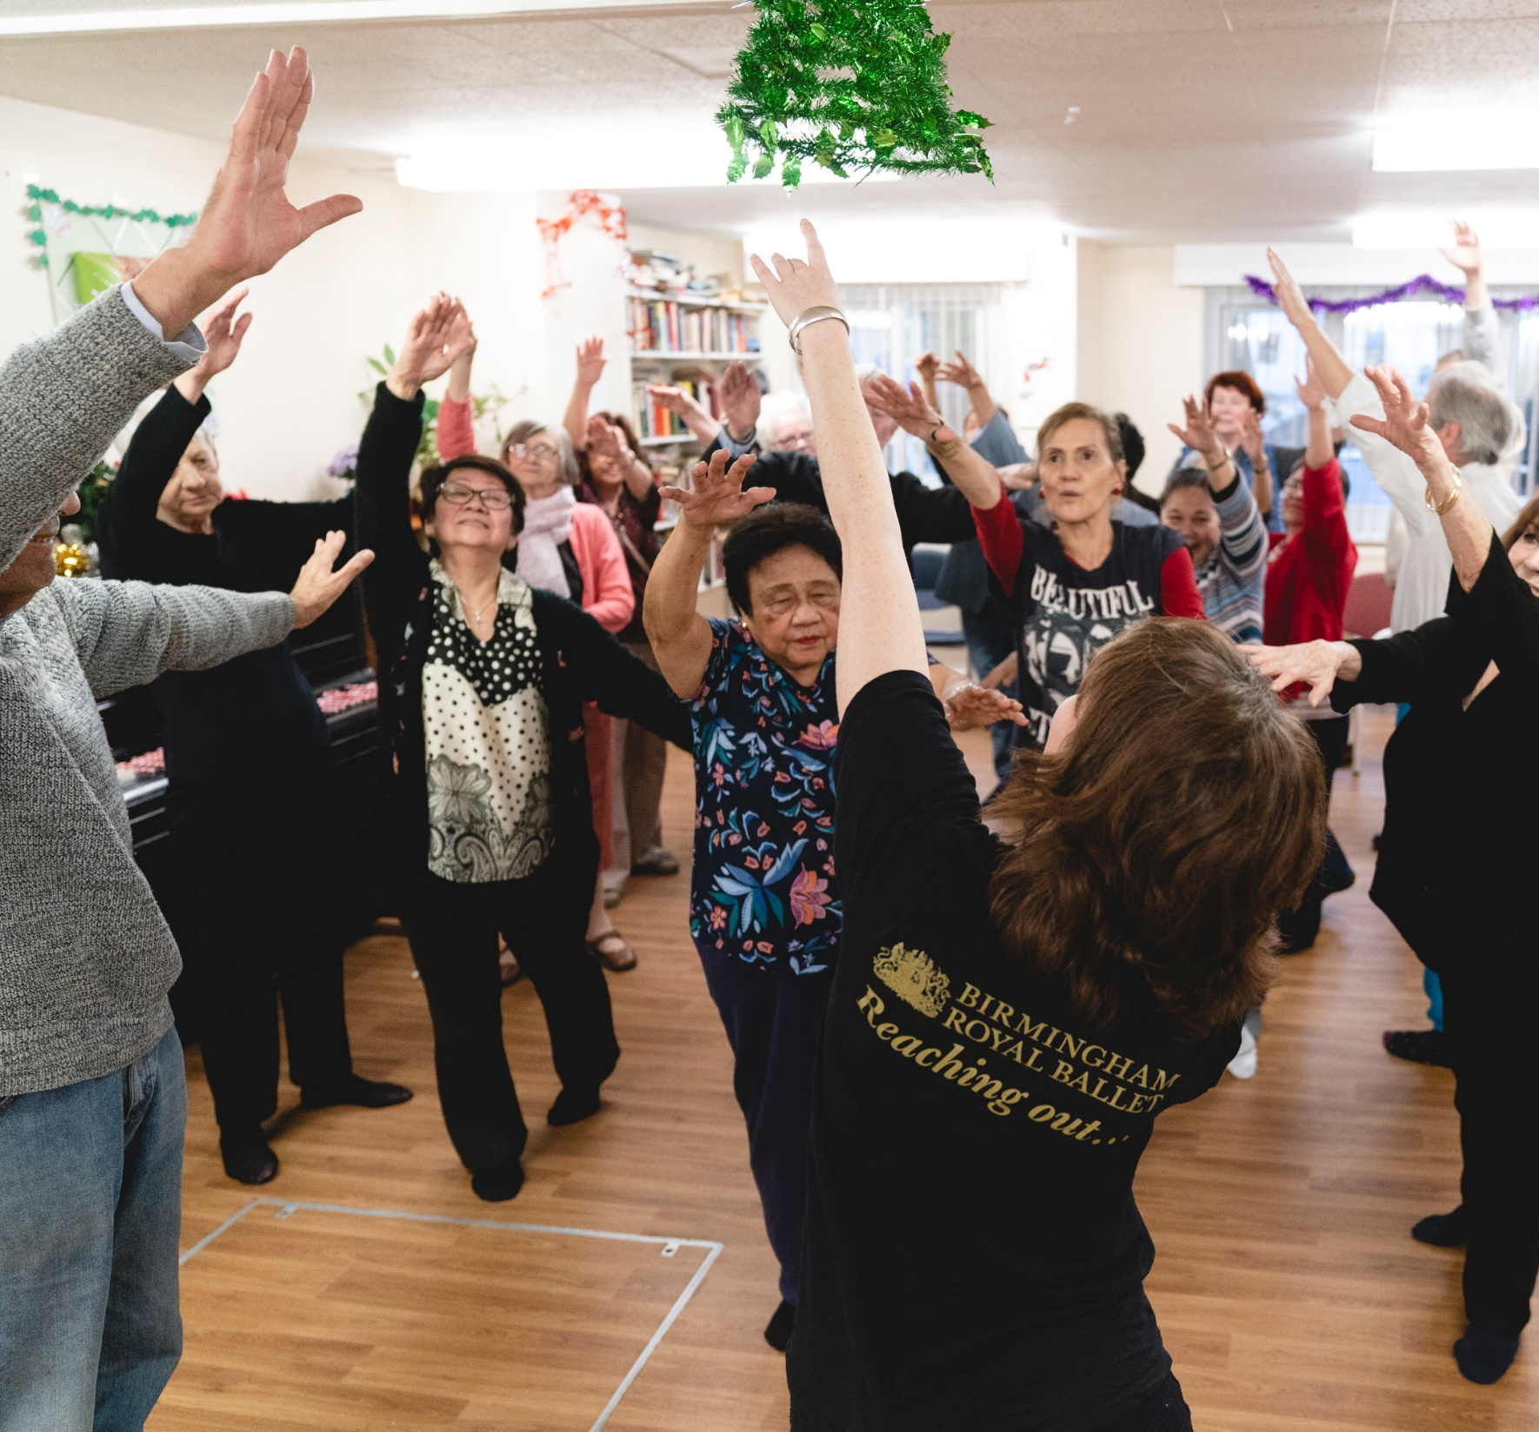
Partnerships
‘Big names’ – Increases engagement and participation
Reduce social isolation and improve sense of belonging
Positive impact on residents relationship with C&C

Slide 13
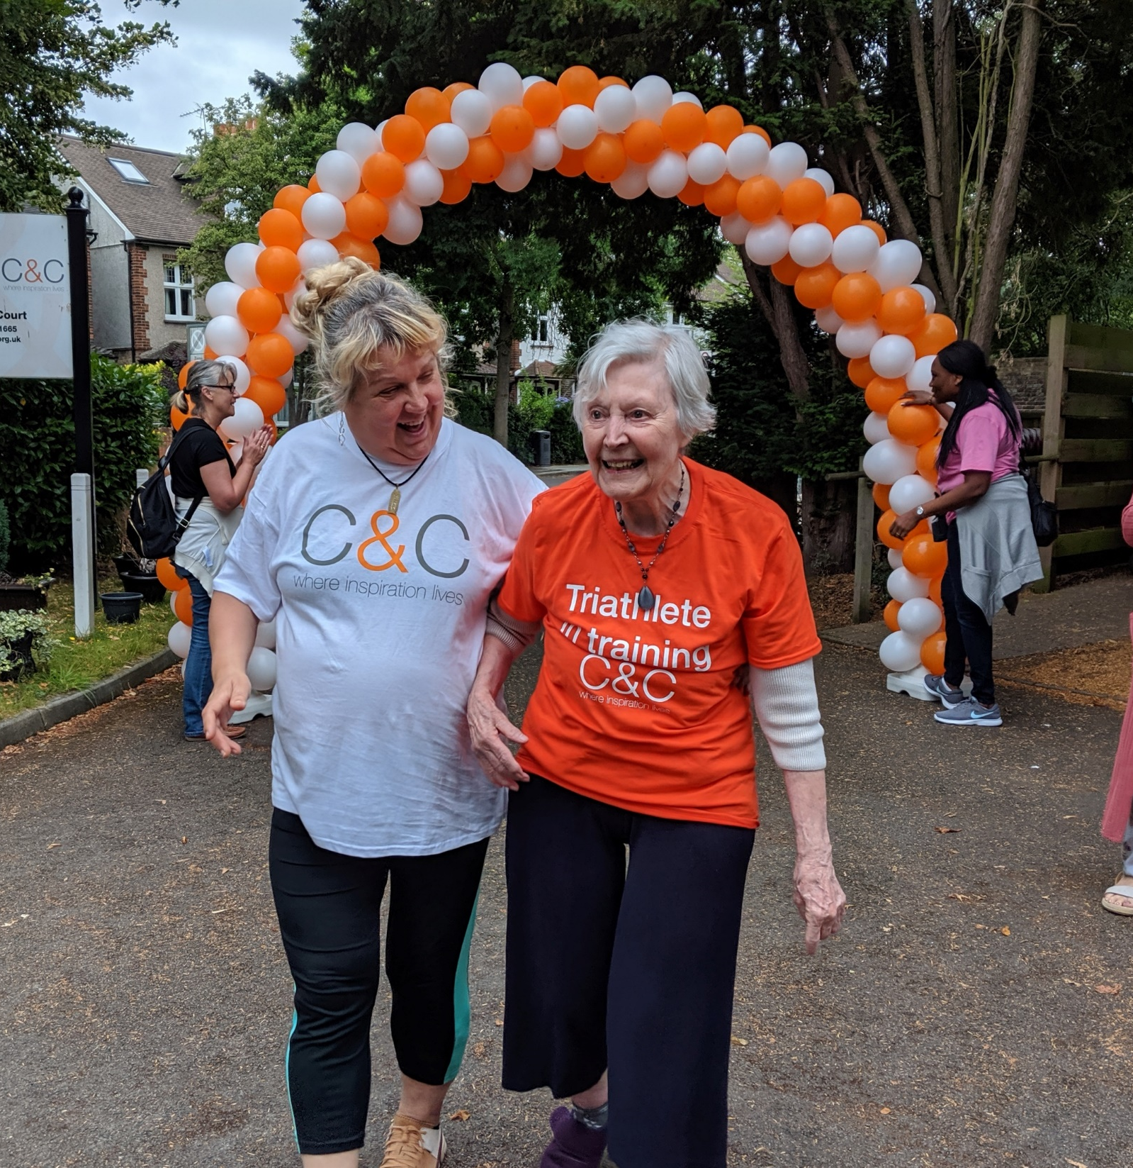
My Fit Festival
Resident request following C&Cycle event
Corporate Sponsors – Raise awareness and fundraising
Idea provoking – Golf, walking football next year
Risk
Video

Slide 14
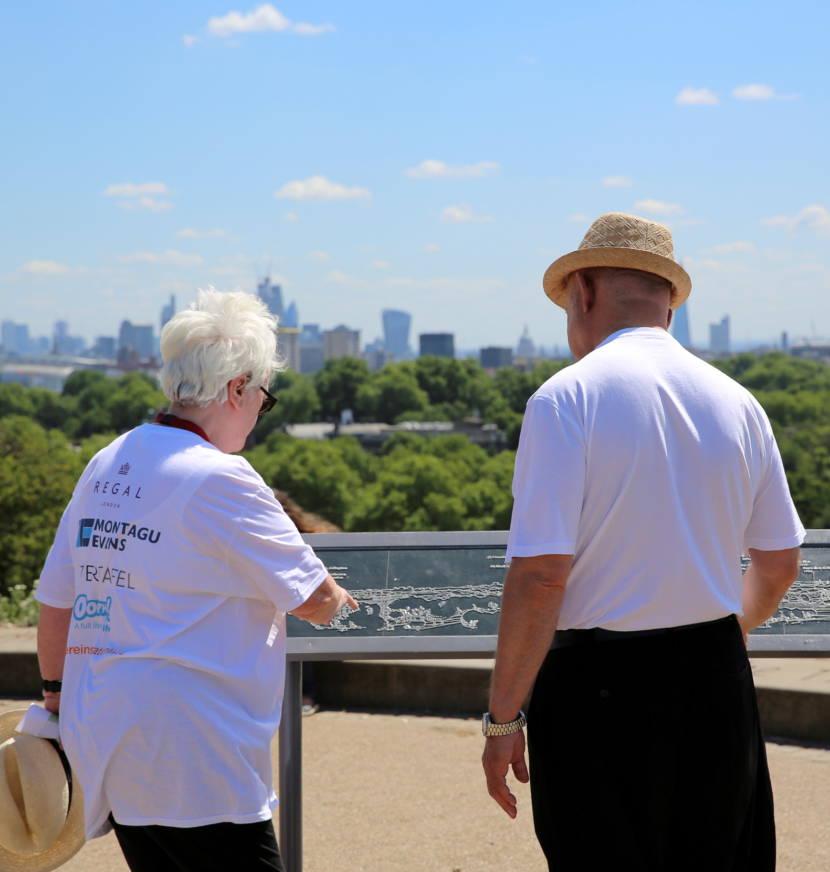
What’s Next…
C&C Fit Club – Focus on health, working towards a club culture
Snowdon
Men’s Activities – Introduction of new initiatives to engage more of our male residents
Assembly – Coproduction next steps

Slide 15
Chris Barber | Chris.Barber@ccht.org.uk
Rachael Dinnage | Rachael.Dinnage@ccht.org.uk

