Slide 1
A Supported Journey back in to the Community

Slide 2
Home Group
National Housing Association & Registered Charity
Mix of health, social care and housing services
Mental Health, Learning Disability & Reablement
10,000 new homes
Homes England Strategic Partner

Slide 3
Clinical Team
Central Clinical Team
    Clinical Governance
    Clinical Practice
    Implementation Team
Clinical staff directly employed by services
    Psychologists
    Occupational Therapists
    Positive Behaviour Support Leads
    Nurses
“People were supported to achieve their goals, through excellent person centered care. Positive risk taking was encouraged throughout the service, balancing the potential benefits and risks of choosing particular actions over others; allowing people to reach their full potential through greater independence.”
CQC Inspector

Slide 4
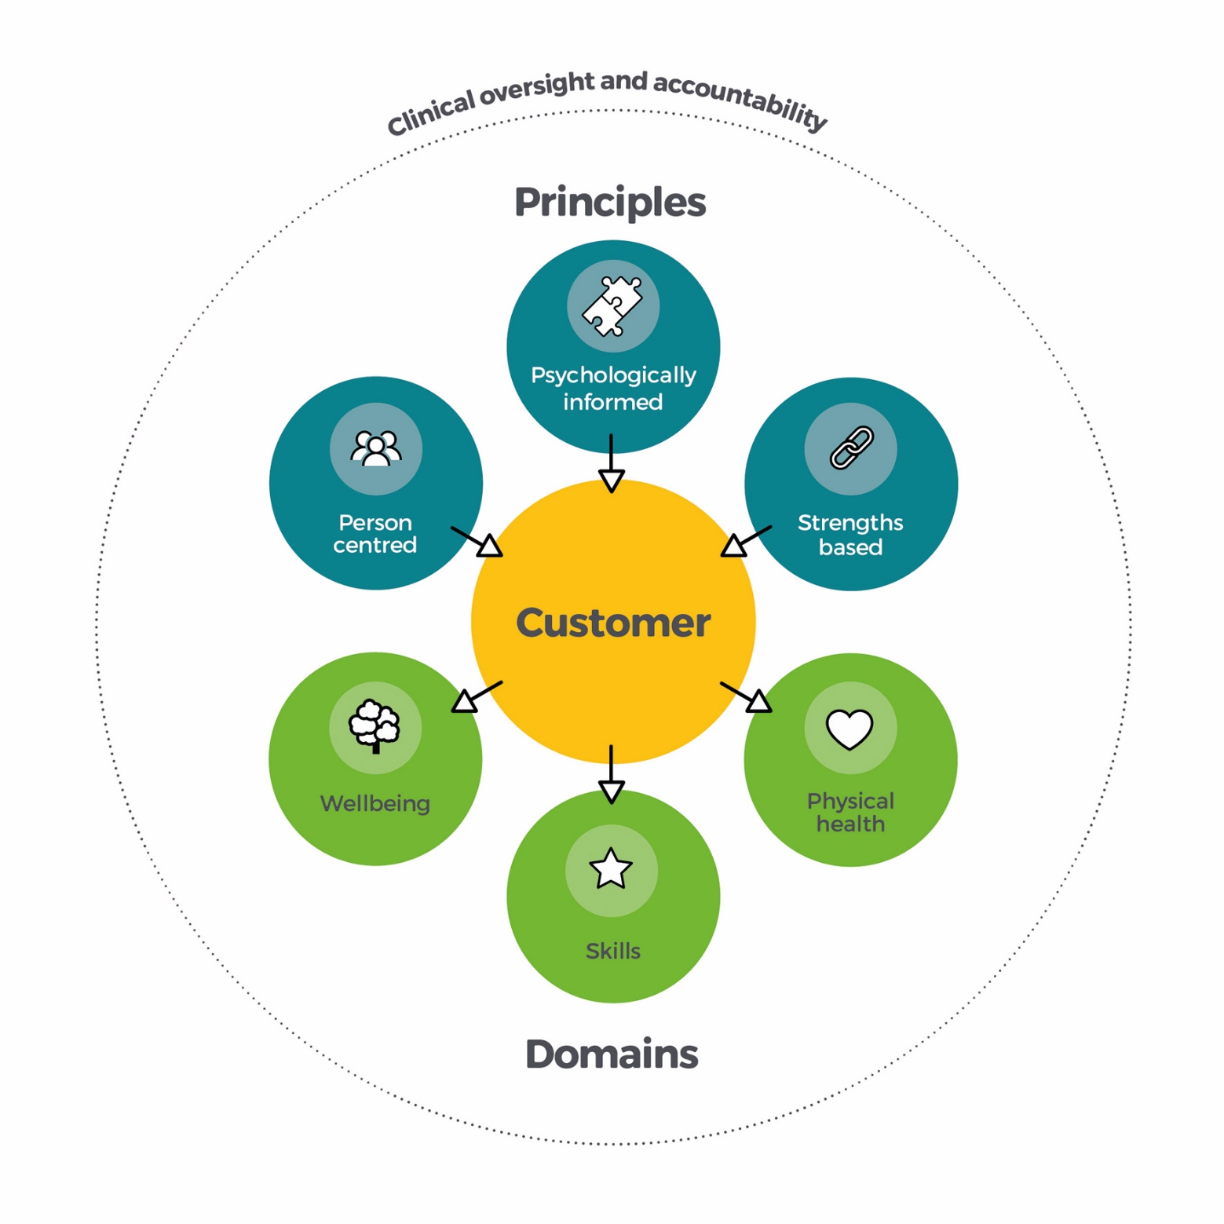
LIFE Living Independently, Feeling Enabled

Slide 5
Property
Design Philosophy
Development
PropCo
Refurbish Assets

Slide 6
Technology
Gateshead Innovation Village
Northumbria University
Gainford House

Slide 7
Case Studies
Kent PBS Service
Suffolk Urgent Respite Service
Kingston House, Hull
Gainford House, Hartlepool

Slide 8
Thank you
To find out more about our new models of care services contact:
https://www.homegroup.org.uk/Corporate/Care-and-Support-Partners
or
francis.Clarke@homegroup.org.uk

