Slide 1
Community Circles
Extra Care
Produced by Sharon – Community Circles Connector

Slide 2


Slide 3
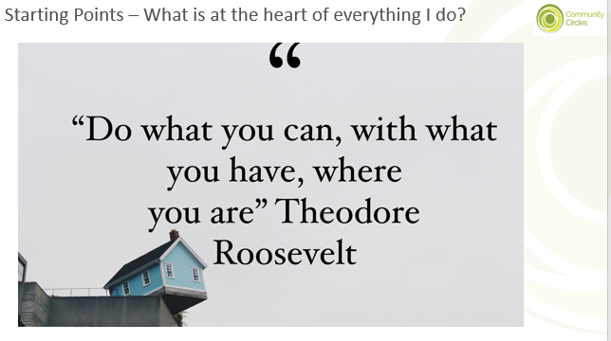

Slide 4


Slide 5
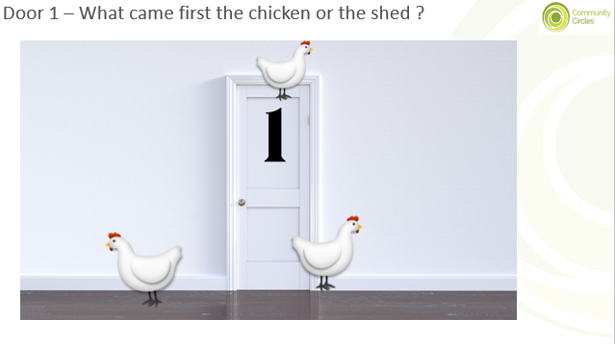

Slide 6
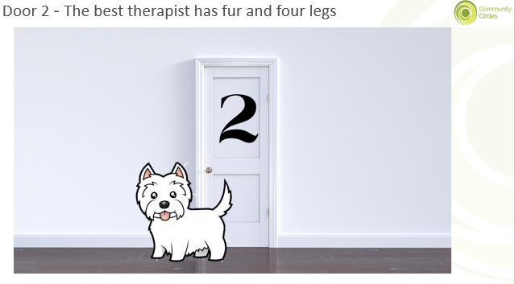

Slide 7
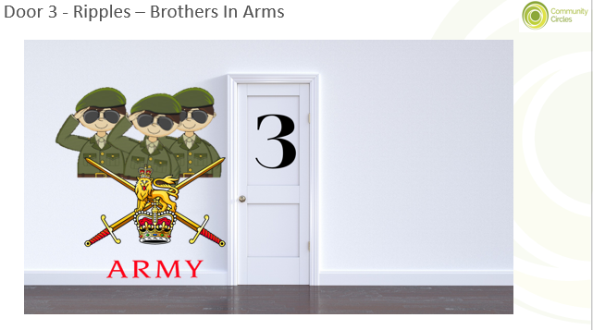

Slide 8
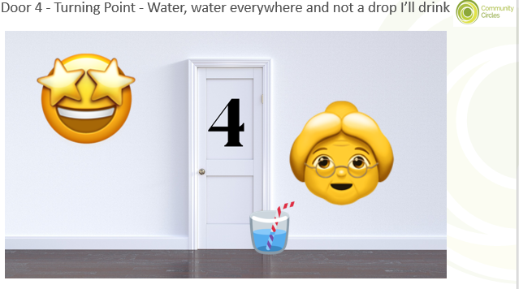

Slide 9
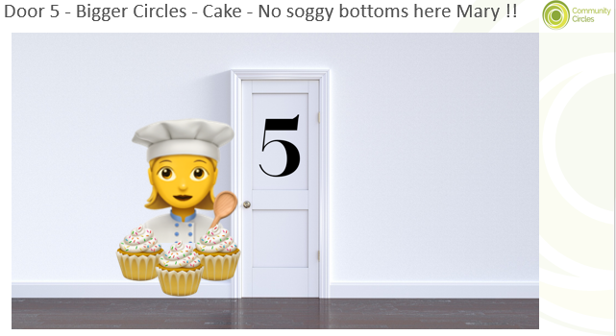

Slide 10


Slide 11
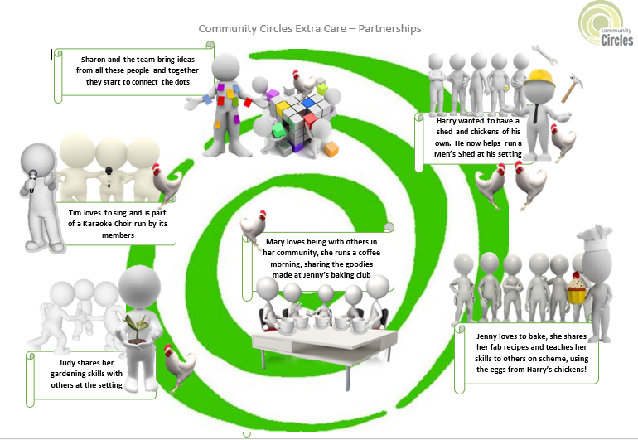
Doing what we can, with what we have, where we are

Slide 12
Want to stay in touch ?
Website: https://www.community-circles.co.uk/
Twitter: @C_Circles @SharonC_Circles
Facebook: https://www.facebook.com/CommunityCircles/

Slide 13
Thank you…..

