Slide 1
The Wigan Deal - Our Strategic Approach to Housing and Care
Jo Willmott, Assistant Director, Wigan Council

Slide 2
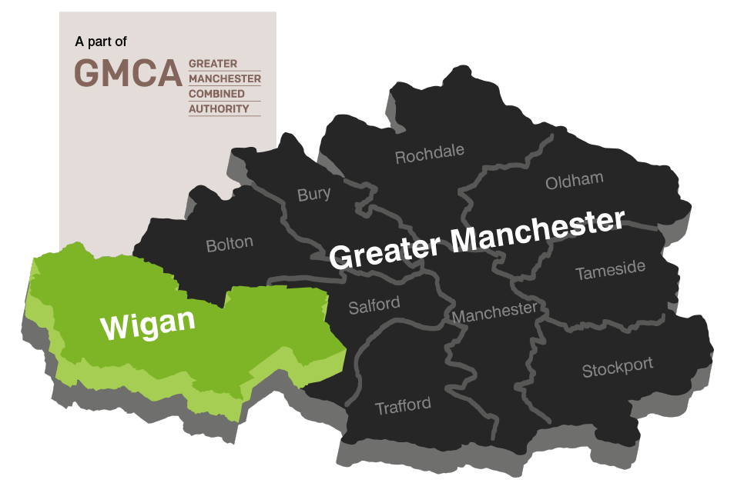
Wigan
Population of 323,000
70% green space
136,000 households
21,500 Council Homes

Slide 3
How we deliver – Asset Based

Slide 5
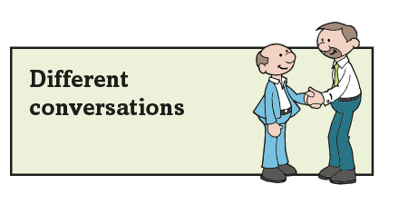
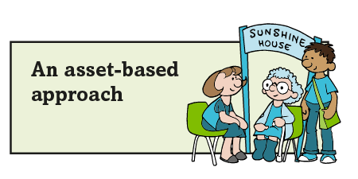
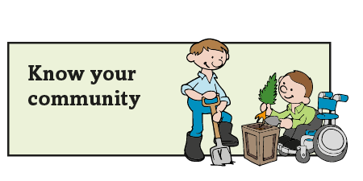
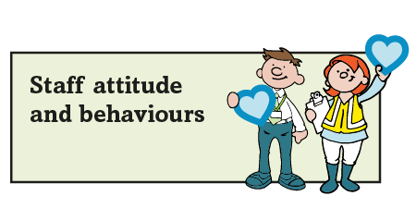
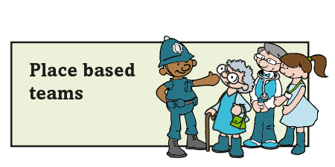
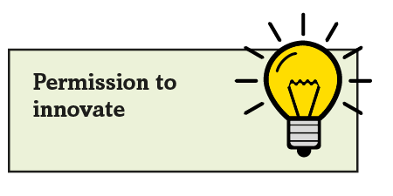
The Deal principles

Slide 6
How we deliver – Be Wigan
Be Positive… take pride in all that you do
Be Accountable… be responsible for making things better
Be Courageous… be open to doing things differently
Because how we do things is just as important as what we do

Slide 7
Housing for Health - Our Vision
Valued, connected and resilient people, living in the right home, with the right support will be happier, healthier and more independent
Conceptual framework and number of interlinked programmes
Notes:
Already doing good things….opportunity t make flagship programme in the corporate plan
Scope of the work - rest

Slide 9
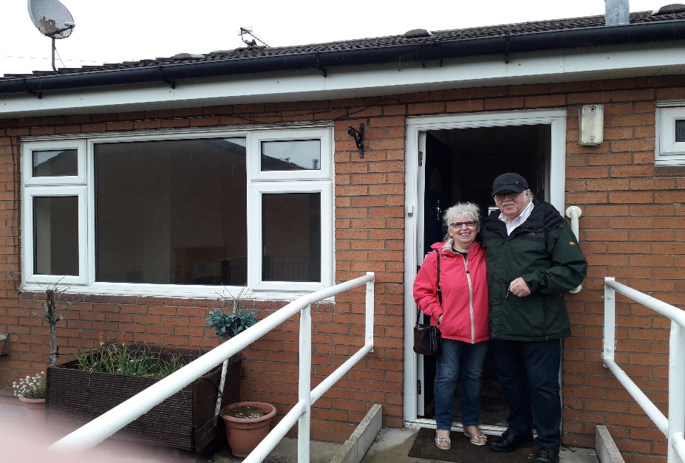
Example - Mayfield
Inclusive community approach
Includes specialist facility for people with Autism, focus on high level needs
Enabled 5 high cost specialist OOB placements to be repatriated closer to family and community, better outcomes, less cost
£2.5 million – 12 self contained apartments, includes staff accommodation and sensory room
“This place is like gold dust. We looked across the whole country for somewhere for Stephen. To find this in Wigan is really positive”.
30 bungalows for older residents
Notes:
Due to open in Spring 2018

Slide 10
Strategic Integration
April 2017 Wigan and Leigh Homes (Housing ALMO) integrated back into Council
Strategic opportunity to maximise contribution of housing to people living their best life and effective management of demand
Creation of Healthy Wigan Partnership
Accelerated synergies between housing, health and social care
Notes:
Due to open in Spring 2018

Slide 11
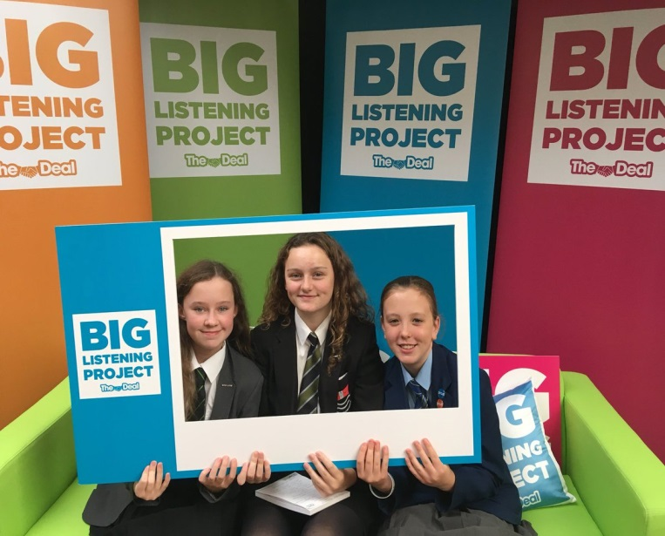
The Big Listening Project
Almost 6,000 people have had their say
The big green sofa – an open & honest conversation
No pre-defined agenda
We went out into our communities, schools, hospitals, high streets – evenings & weekends
Listening Booth to capture real voices
Online survey
Staff engagement

Slide 12
Deal 2030
Deal 2030 builds on the success of the Deal for the Future with a plan for the place
Co-designed and delivered with partners, our communities and staff
A bigger focus on inclusion – celebrating diversity and a fair borough for all

