Slide 1
Thinking Intergenerationally
Karen West, Professor of Social Policy and Social Gerontology, School for Policy Studies, University of Bristol

Slide 2
Have generations become more segregated?
Culturally?
Physically/spatially?
Politically?

Slide 3
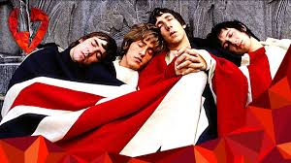
Cultural Segregation
I am utterly fed up with being told by nice young people that their opinions are more important than my own.
Generation as cultural experience at a point in time. Shapes generational consciousness. A necessary component of social change. (Karl Mannheim, 1928.)

Slide 4
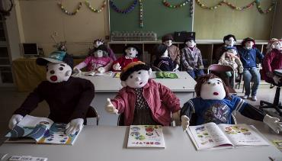
Physical Segregation
‘Government policy also often tacitly endorses age segregation by being designed to address the needs of specific age groups, particularly policy towards the built environment (e.g. “community safety initiatives targeting young people (stereotypically associated with ‘anti-social’ behaviour) or older people (stereotypically associated with being fearful and vulnerable))”. Given the general acceptance of age segregation within society, spatial patterns of age segregation have generally been viewed as benign by demographers, as they are often seen as the outcome of people’s personal choices to live with who they want. However, there now appears to be an increasing awareness of the importance of geographical age segregation in both Europe and America, and the issues which this raises for policy
in these ageing societies.’ (Kingman/Intergenerational Foundation, 2016)
Notes:
Physical segregation is what IG programmes are mainly dealing with. We’ve been sleep walking into this situation.
IF research
This original research has found that rural areas have aged nearly twice as
rapidly as urban ones over the past 25 years, as cities have become magnets
for young people.
• It shows that age segregation has also got worse within our 25 biggest cities,
where over half of over-65s would now have to relocate for different age
groups to be evenly spread out.
• It found that children are no longer growing up in the same areas where retirees
are growing old, undermining mixed-age communities – for the typical child in
these 25 largest cities, just 5% of their neighbours are now over 65.
IG programmes and age-friendly cities can only go so far in addressing this.
Image of rural village of Nagoro in Japan where older people have made stuff toys to replace the missing children.

Slide 5
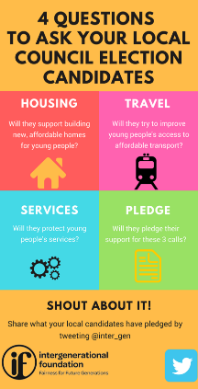
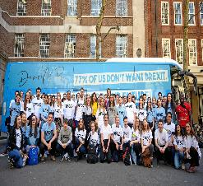
Political segregation.
Generational division as the ‘go to’ diagnosis for all that is wrong with the world …
and the catch-all prescription for putting everything right with the world.
Generation as ‘the new class’.
Notes:
There are elements of ‘truth’ and elements of political manipulation in play.

Slide 6
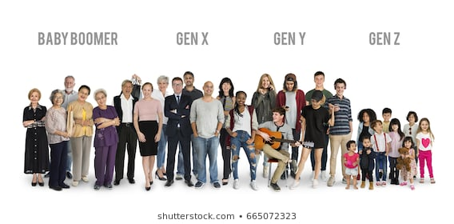
The meanings and experiences of ‘generation’.
Lineage/family: daughter/son, parent, grandparent.
Life course: childhood, youth and education, middle age and work, older age and retirement.
Cohort: age cohort; social cohort (baby boomers/post-war; ‘jilted generation’; Gen-X/Gen-Y; internet generation, extinction rebellion generation (?) etc.)
Notes:
These are the basis of generational identity and radical change is challenging/disrupting all of these.
Radical change – demographic, family, political, environmental, cultural etc.
Meanings change with social changes;
Life course – our lives don’t fit into this neat boxes any longer. We may still be working and learning till well into later life.
Generational cohort labels tend to mix up age and social factor – e.g,. Baby boomers have something to do with age, but they are also a social/political category and a demonised one at that.
Social change challenges these – e.g. family change – lineage – where there may have been overlap and proximity between generations – e.g. a family with 5/6 children in which the oldest may be having children at the same time as the mother – so uncles and nephews of similar ages… Now, age of child bearing has gone up, people have fewer children – this creates bigger gaps between generations. Also with increasingly longevity, we may have contact 3, 4 or 5 generations.
Sociologists have tended to differentiate between different kinds of experience (Burholt etc societal generation and family generation) and have tended to think that families act as buffers for generational conflict outside of families. But, all of this is increasingly questioned.

Slide 7
Precarious generational identities and loose ‘generational talk’.
Biggs and Lowenstein (2011): Our experience of generation has something to do with our attitudes to all facets of generation, but is not reducible to them.
We are living in a period of ‘radical change’, which has disturbed our ‘generational identities’, but we haven’t spent enough time thinking this through.
At the same time, ‘generation’ and ‘generational identity’ is the prism through which we are making sense of radical change – social, political, cultural, demographic, environmental.
This results in loose and damaging ‘generational talk’.

Slide 8
Some consequences of loose generational talk.
Generational labelling has consequences.
E.g. ‘Selfish millionaire baby boomer’ gives rise to the idea that all people of that generation can afford to pay for things that have traditionally been free.
Policy and benefit changes have differential impacts on groups who appear to be of the same generation.
e.g. WASPI women, potential removal of free TV licences for over 75s .
Gender matters.
Gender pay gap is bad enough, but the gender pension gap is even worse!
People accumulate advantage/disadvantage over the life course.
How can it be in young people’s interests to cancel important elements of social protection in perpetuity?
Notes:
I’m arguing the point from a gerontological perspective, but my colleagues in childhood studies would make similar points about the demonising of youth and the wasting of childhood.
My colleague Simon Biggs argues that part of the issue here is that demographic change itself is turning up the heat on intergenerational conflict. Changing in the demographic shape of nations from pyramids to rectangles (generations of equal size) to inverted pyramids in which there are more older people at the top than younger people at the bottom. We haven’t faced this situation together before and we need to think about how to do it.
Women against state pension inequality – stark difference between those born in 1940s compared with 1950s.

Slide 9
The limitations of episodic intergenerational projects.
I-gen projects are part of the answer, but …..
We need a far better understanding of the meaning and salience of generation in our everyday encounters;
More ‘generational intelligence’ (Biggs and Lowenstein, 2011) – how and why we might feel generationally different from others.
We need policies and plans for thinking intergenerationally on a much larger scale.
Less loose talk and sharper thinking!
Notes:
Generation doesn’t explain everything about how we might feel threatened. On the other hand, there may be instances in which we cleave to members of our felt generation to gain some sense of security.
We need to understand that how we feel about our generational position and our difference form generational others is a function of multiple experiences in families, in the work place, in society etc etc. Without this nuanced understanding we give oxygen to certain political agendas that want to talk up intergenerational conflict. We need to understand that our confusion about our ‘generational position’ is a function of multiple social, political and cultural factors that we have yet to fully work through.

