Slide 1
Almshouse Flats for Homeless People
Worcester Municipal Charities Partnership with Worcester CAB SmartLets Social Lettings Agency

Slide 2
Worcester Municipal Charities - Background
1559 First Bequest
1899 Worcester Consolidated Municipal Charity 27 Charities
2016 Worcester Municipal Charities CIO Charitable Incorporated Organisation
End 2018: 32 ‘Traditional’ Almshouses 37 Almshouse for Single Homeless
Annual Grants Programme of C.£500,000
Organisations £400,000
Individuals £100,000
Commercial Property Portfolio £7.8m

Slide 3
Challenges Facing WMC Following 2008 Financial Crisis
Impact of austerity led to closure of a number of charities supported by WMC through provision of rent free premises. Generally less demand for office space
Recession and changing retail environment led to reductions in income from retail property investments

Slide 4
In 2013 Change in WMC Investment Strategy
Residential investment to relieve homelessness – Almshouses for the homeless
As properties became available for re-letting either sold (£1.5m)
or
Converted to residential use. Also purchased properties suitable for conversion 2015/16 WMC incorporated (CIO) and became registered housing provider
Member of ACL
Grant applications to Homes England

Slide 5
Worcester Citizens Advice Bureau & WHABAC - Background
Provides a wide range of Citizens Advice Services – over 10,000 Clients Annually
25 year history of delivering projects helping the single homeless – significant problem in Worcester City
Private rented sector access schemes:
SmartMove – Deposit Guarantee Scheme
SmartLets – Social Lettings Agency For
Single homeless or those at risk
Unable to afford to access PRS
Low income As at 31st March 2019 – 102 units of accommodation under management including:
13 Shared Houses (HMO’s) – 51 Rooms
51 Self Contained Flats
Worcester CAB/WHABAC has a long established relationship with WMC and is a major recipient of financial support

Slide 6
SmartLets Clients
Last Year
CAB/WHABAC helped 414 single people or childless couples who were homeless or at risk
There were 318 applications to our SmartMove/SmartLets Schemes 132 applicants were directly assisted to secure suitable accommodation – 122 of these in properties managed by SmartLets or in the private sector with a SmartMove Bond
94 applicants had slept rough in the 12 months prior to approaching the Scheme – 28 secured accommodation
Over 90% of applicants had a level of vulnerability in addition to homelessness - 40% had a history of homelessness - 31% mental health issues - 22% history of offending - 18% drug/alcohol problem

Slide 7
A Partnership to Deliver Affordable Accommodation to Single Homeless People in Worcester
WMC recognised that the development and management of accommodation for the single homeless would present different challenges to the traditional Almshouse Model
CAB/WHABAC, already an established partner, had extensive experience of working with the single homeless and managing accommodation through SmartLets
WMC Board agreed to work with CAB/WHABAC in delivering their new strategy and delegated responsibility to SmartLets for housing management, allocations and support

Slide 8
Other Partners
Maggs Day Centre for the Homeless (including free clothing store)
Armchair Furniture Recycling Project
Worcester City Discretionary Welfare Assistance Scheme – Co-ordinated with WMC individual grants programme - £100,000 on white goods, carpets etc
Worcester City Council – Supported CAB/WHABAC initiatives over many years and supported WMC Almshouse Development

Slide 9
What Has Been Achieved
WMC has successfully implemented its residential investment strategy
- Directly contributed to its charitable objectives with the provision of 37 almshouses at affordable rents for the single homeless
- Generated income to maintain its organisations and individual grants programmes
CAB/WHABAC
- Has an additional 37 units of accommodation for SmartLets substantially increasing the accommodation options for applicants
- A new income stream to support its homelessness prevention activity

Slide 10
Almshouses for the Homeless – Programme to Date
2013 – 9 Sansome Place, 6 studio flats (converted from offices)
2014 – 16/17 St Swithins Street - 6 one bed flats (empty space above shop)
2016 – 21 the Cross - 3 one bed flats (empty space above shop)
2017 – 15 St Swithins Street - 4 bed HMO (above shop) 19 Foregate Street - 5 one bed, 1 studio flat (converted from offices)
59-60 The Tything - 2 one bed flats (retail unity converted to charity clothing store, offices and flats)
2018 – St Thomas White Court - 10 one bed flats (6 new build flats – 4 converted from offices)

Slide 11
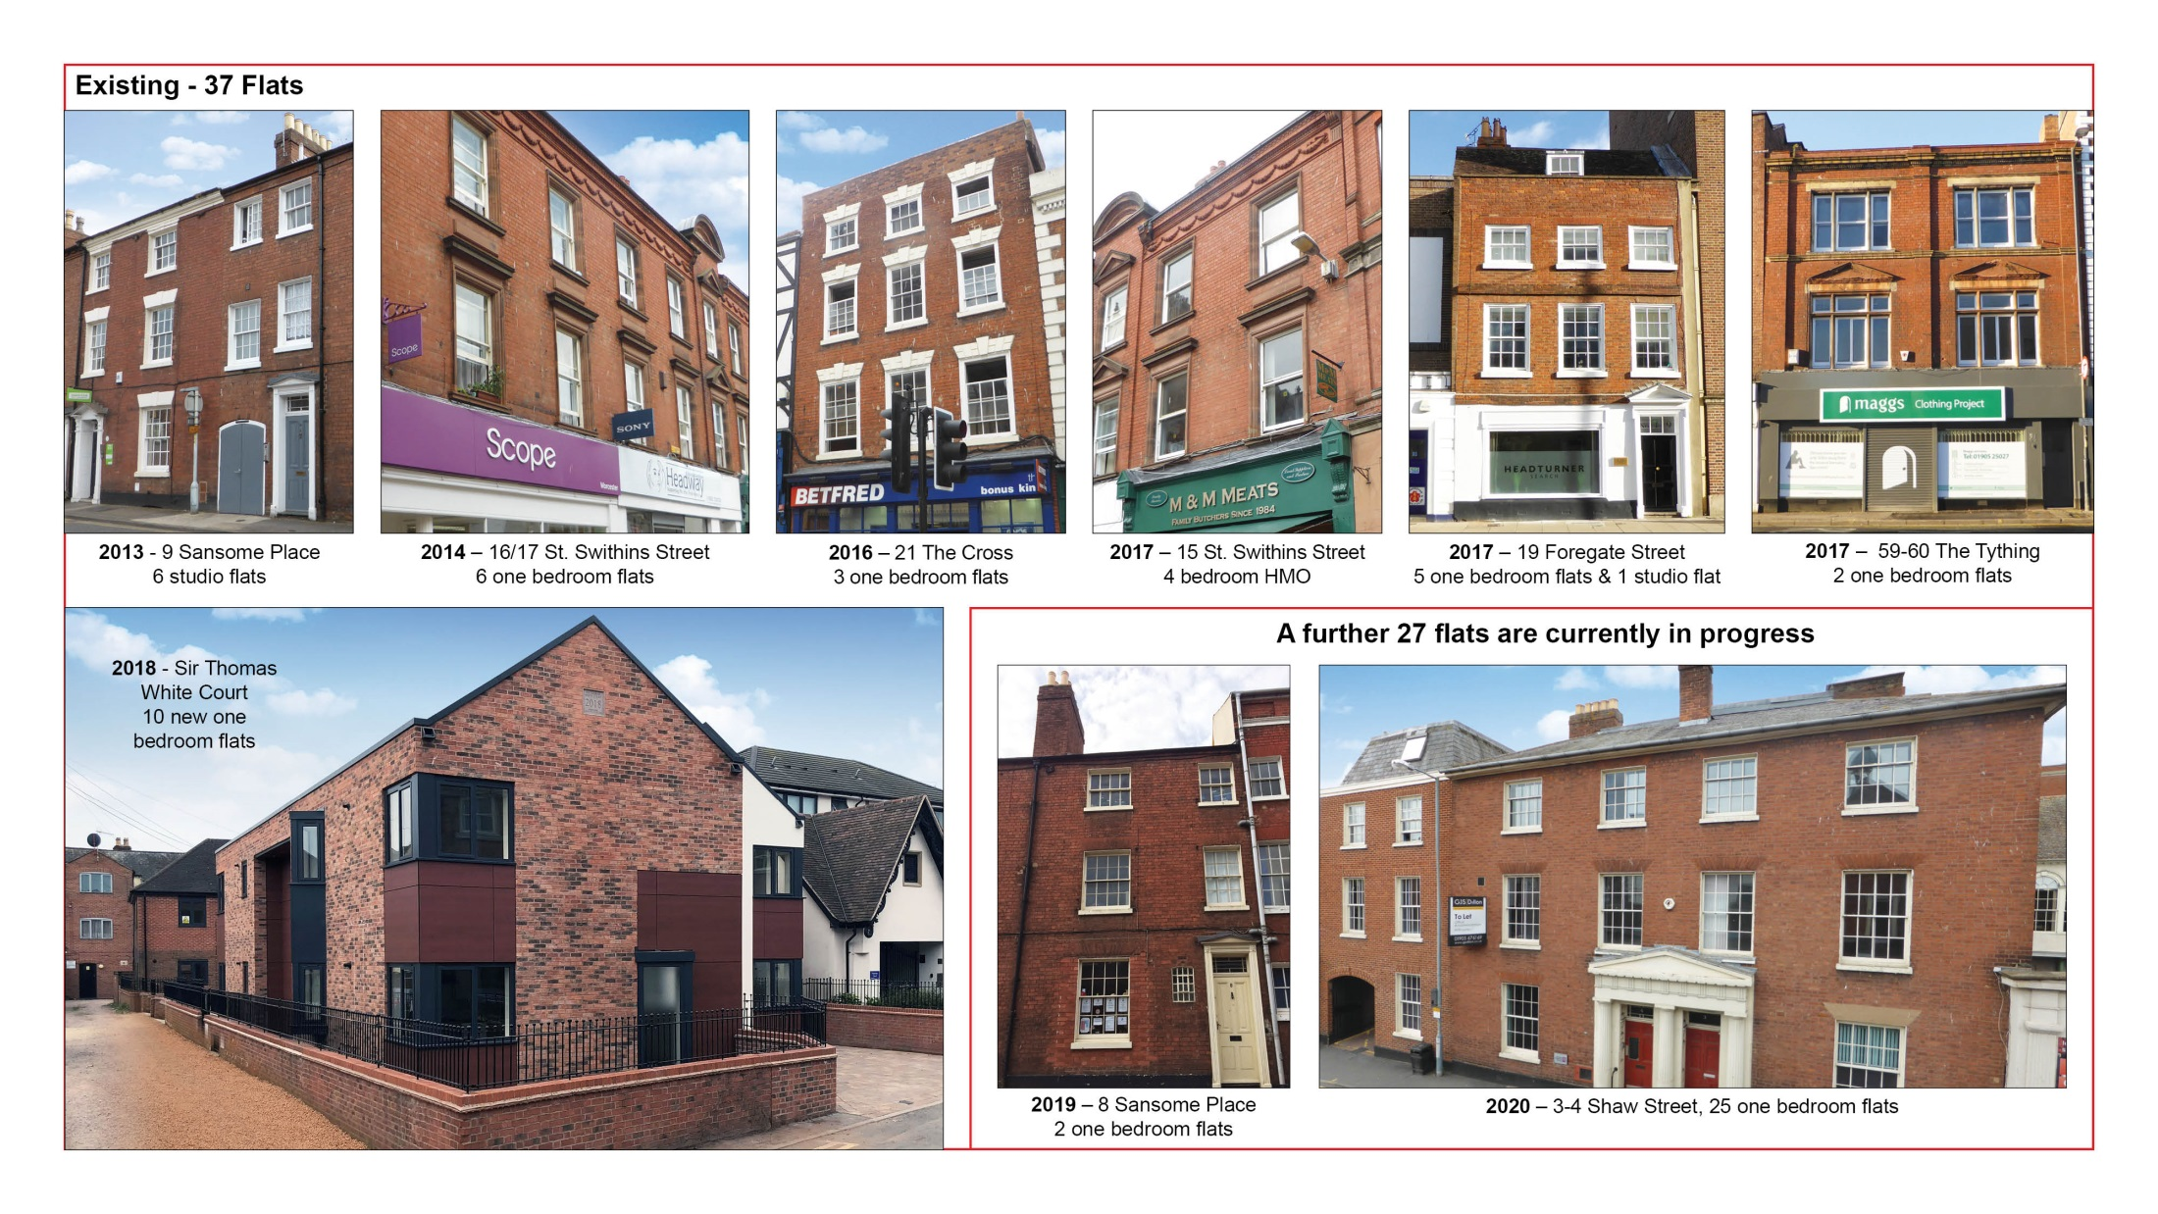

Slide 12
Proposed
2019/2020 – 8 Sansome Place - 2 one bed flats (previously used as clothing store)
3-4 Shaw Street – 25 one bed flats (previously Probation Service HQ)

Slide 13
The Future
27 further Almshouses are planned for completion in 2020
WMC are committed to the continuation of their residential investment programme and the partnership with CAB/WHABAC
CAB/WHABAC are in advanced discussions with Worcester City Council who wish to develop a Housing Hub in Worcester. This will involve co-location with the City’s Housing and Homeless Team and CAB/WHABAC staff to provide a range of services focussed on the prevention of homelessness, other agencies will join the Hub as it develops to provide a seamless service to those in need in Worcester. The Hub is likely to be located in a WMC property in the City.

