Slide 1
PROMOTING HEALTH AND WELL-BEING IN CHILDHOOD AND OLD AGE
SHARING PLACE & SPACE
A NEIGHBOURHOOD APPROACH

Slide 2
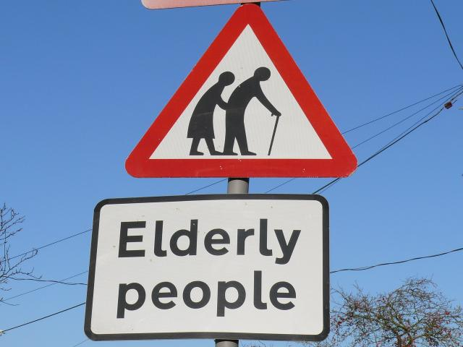
THE PROBLEMS

Slide 3
CHILDREN
Current situation
Consequences
England - 40% failing in school
700,000 in schools judged less than good
143,000 are in failing schools
Under performing secondary schools = no more than a postcode lottery
800,000 experience mental health difficulties
Even more struggle with low self esteem
160,000 children in 2016 permanently excluded from school
PISA results still poor
Ageist attitudes
Children’s Commissioner June 2018 /Chief Inspector of Schools 2016
FG2G FROM GENERATION TO GENERATION

Slide 4
OLDER PEOPLE
Current situation
Consequences
Ageing population
Burden-OADR
Ageism
2 million living alone
Loneliness and isolation
Stress on society’s limited resources
In a month 1 million have spoken to no-one
Ageism wastes &harms
Costs & benefits for disability preventive strategies not known
FG2G FROM GENERATION TO GENERATION

Slide 5
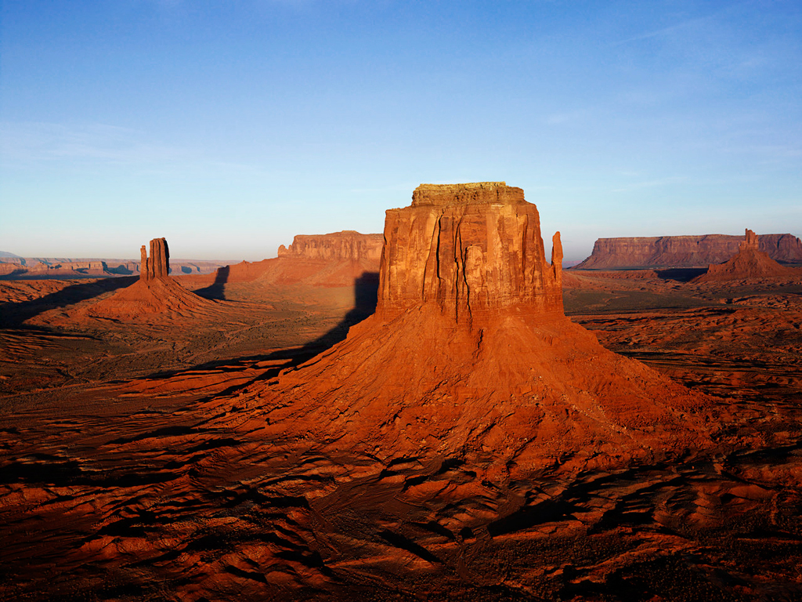
CURRENT SOLUTIONS: SILOS & DESERTS

Slide 6
A NEIGHBOURHOOD SOLUTION
Bring them together in local schools
They solve their problems via their interaction
In a safe place and a safe space
No silos
A public health approach to solving problems of two populations in one place and one space
Cost savings
Mutual positive benefits

Slide 7
BRING THEM TOGETHER IN ONE PLACE & ONE SPACE IN THEIR LOCAL COMMUNITY

Slide 8
FG2G:THE INTERGEN MODEL
INPUTS
OUTPUTS
OUTCOMES
COST

Slide 9
FG2G:THE INTERGEN MODEL
Schools – primary & secondary
Old people aged 55 to 101
The Model
Pupils aged 4 -18
Transport provided for free

Slide 10
INPUTS: 5 YEARS PILOT
SCHOOLS & HEADTEACHERS | 24
NEIGHBOURHOODS | 8
TEACHERS | 110
ADMINISTRATOR | 1
EXTERNAL EVALUATIONS | 2
HEALTH ECONOMIST PART TIME | 1

Slide 11
INPUTS: VOLUNTEERS & COORDINATORS
MEN COORDINATORS MEN VOLUNTEERS | 4 22
WOMEN COORDINATORS WOMEN VOLUNTEERS | 4 88
AGE RANGE MEDIAN AGE | 55-101 68
ETHNIC MINORITIES RELIGIOUS FAITHS | 5 4
DIRECT CONTACT SUPPORT ROLES | 105 5
IN PRIMARY SCHOOLS IN SECONDARY SCHOOLS | 100 10
TOTAL AVERAGE VOLUNTEER HOURS PER ANNUM | 5,744

Slide 12
INPUTS: VOLUNTEERS & PUPILS

Slide 13
INPUTS: VOLUNTEERS & PUPILS

Slide 14
OUTPUTS
Children
Older People
Get more hours
Meet wider range of adults
See more older people
Meet older people they know outside of school
Get more opportunities to leave home & meet more people
Get to go on trips with staff & children
Get to learn about schools & kids today
FG2G FROM GENERATION TO GENERATION

Slide 15
OUTCOMES
Older People
Teachers
Reduction in loneliness
Increase in self worth
100% back In school next year
Part of a community-inclusion
Time
The future
The flexibility
Reassure parents
Young People
Community Cohesion
Academic performance
Life chances
Ageist attitudes
Cindy & the Hoodies
Barbara & the boys
Norma & the little girl & mum
Santa Claus & the headteacher

Slide 16
OUTCOMES: SOME REFLECTIONS FROM THE INTERGENERS
“ Where else can you get out of the house, not spend money and have a good time?”
“I have only been an Intergen volunteer since April, but already it has become part of my life. I was lucky to be allocated to a very vibrant, diverse school. I have been listening to children who may not be getting the support they need at home”
“I will be starting my fourth year in school and get more involved every year”

Slide 17
OUTCOMES: SOME REFLECTIONS FROM THE PUPILS
“They help us, they help us doing our work when we are stuck, they just come round and help us”
“When you fall out with a friend she kind of sorts it out for you and make you friends again”
“She is kind. You are allowed to go to lunch with her”
“He is very interesting. He tells us about stars & when to look out for Jupiter”

Slide 18
OUTCOMES:SOME REFLECTIONS FROM HEAD TEACHERS TEACHERS
It’s been a positive experienced for us –we have had a wealth of people with a wide range of experience.
It’s a positive link for us to the community –can link us with whole life experience of older people coming into school. Lots of staff have been impressed by it and found it useful. The volunteers have become part of our school community.

Slide 19
ENGLAND: A FUTURE VISION

Slide 20
The model & tools are FREE to use September 2019
JOIN IN & USE IT
Headteachers willing to do baseline testing and repeat measures in literacy and maths in primary schools
Use national well-being measures

Slide 21
Help build the evidence Help mainstream the model
WHERE YOU COME IN
EVIDENCE
“As we do more research we must not be afraid to investigate such nebulous concepts as love, friendship and play. They are the glue that keep us together, enable us to overcome adverse childhood experiences and be better...members of better communities.” Professor John Middleton President UK Faculty of Public Health, Autumn 2017
Change Agent
System Wide
Evaluate
Data
Data
Data

Slide 22
Contact us for more information, to help us mainstream the model and fill in the evidence gaps
E: enquiries@fromgeneration2generation.org.uk
T: +44(0) 7900051215
www.fromgeneration2generation.org.uk

Slide 23
Thank you
And thanks also to:
All our volunteers & Schools, the teachers & pupils
Cambyse Jafari-Pak
Anna Varela-Raynes
Dan Cahill
Howard Barlow
The Northern Film School, Leeds Metropolitan University
Manchester Business School
The Board members and trustees of FG2G

