Slide 1


Jenny Pannell, Housing LIN Associate jennypannell@virginmedia.com
Introducing almshouse charities: Quiz
Q: Guess how many people live in almshouses?
10,000? 20,000? 30,000? 40,000?
A: around 36,000 people in 30,000 units
Q: Guess how many new almshouse units have been built in the past 10 years?
1,000? 2,000? 3,000? 4,000? 5,000?
A: over 2,500 units, with £50m HCA/HE/GLA grant:
1600+ new-build units, 40% with no grant; 900+ remodelling (eg bedsits conversion/extension to 1-beds)
Notes:
30,000 - 40,000: around 36,000 people in around 30,000 almshouse units
Housing 21: 20,000 units (rent & sale)
Hanover: 19,500 units (rent & sale)
TOTAL: OVER 2,500 UNITS
New-build: over 1,600 units
(40% self-funded; over £50m grant)
Remodelling: over 900 units

Slide 2
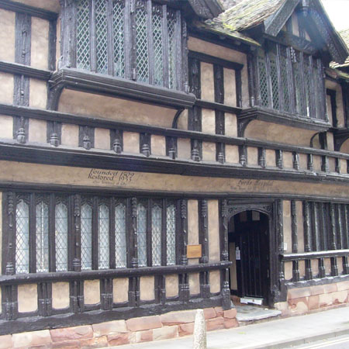
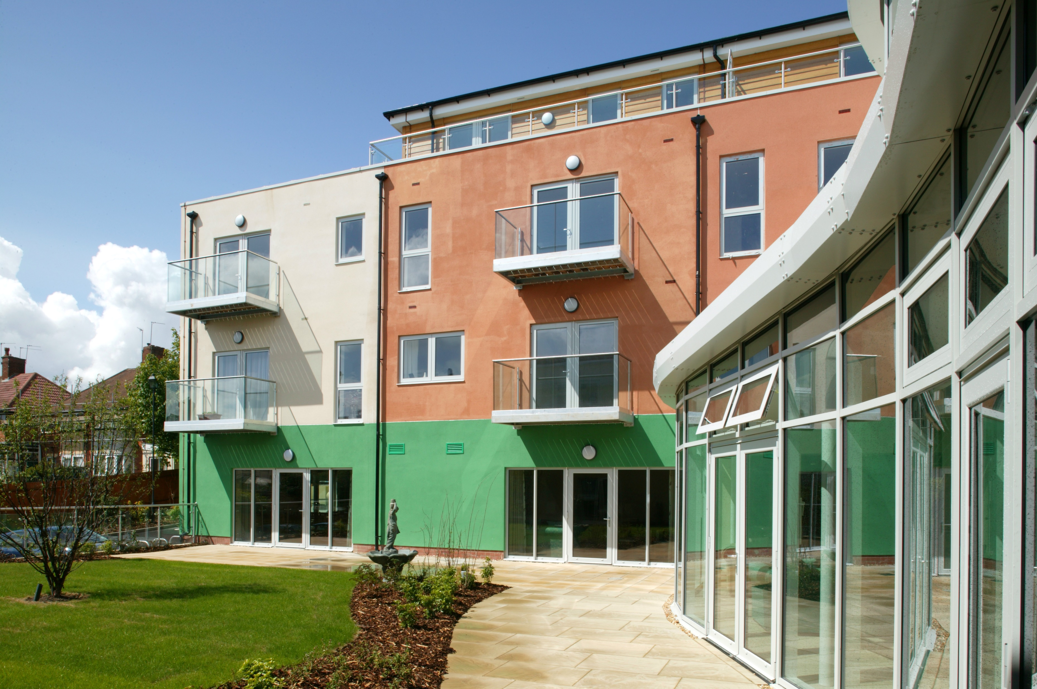
Q: Which of these is an almshouse? A: All of them!
Lench’s Trust, Quinton, Birmingham Ford’s Hospital, Coventry: Grade l listed, 16C extra-care, see Pannell 2013 LIN report Coventry Church (Municipal) Charities

Slide 3
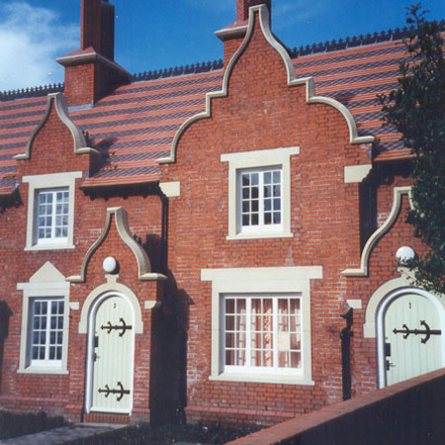
Holy Trinity Heathtown Almshouse, St John’s Hospital, Lichfield:
Wolverhampton: Grade ll listed New almshouse next to Grade l listed 15C
Built 1850, derelict for years almshouse: LIN case study no. 150,
Rebuilt 1996: 6x1-bed cottages January 2019

Slide 4
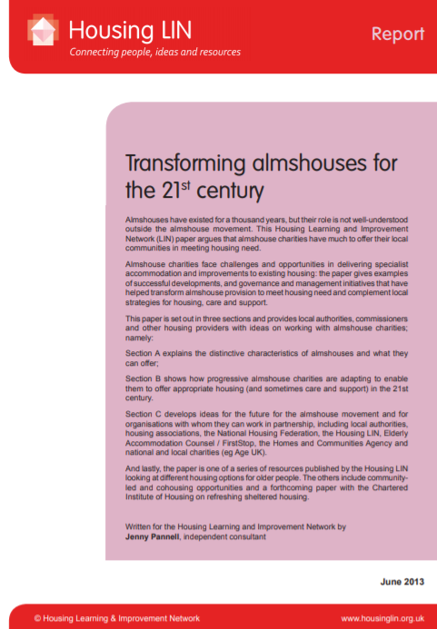
For more information on almshouses for the future, for younger people as well as older people, see Worcester Birmingham LIN meeting presentation (2/7/19) and: https://www.housinglin.org.uk/Topics/browse/Housing/HousingforOlderPeople/Almshouses/
Almshouses into the next millennium:
Paternalism, partnership, progress?
Jenny Pannell
with Caroline Thomas
Policy Press, University of Bristol, 1999

