Slide 1

Housing LIN Update
Ian Copeman
Principal Associate
June/July 2019
Housing Learning and Improvement Network

Slide 2

Housing LIN 2018 Year Book
Sets out 2018 highlights
Key statistics (analytics about our membership and online engagement/interests)
Major influencing activities
  incl. Grand Challenge on Ageing
Significant consultancy work
  incl. the LGA Housing Advisor Programme
Regional events
  incl. Wales (with Older Persons’ Commissioner last year)
Acknowledge our sponsors’ generous support

Slide 3

Housing for Older People 2019 Awards
EAC awards voted by over 18,990 older residents. Held last month in Manchester
Housing LIN Wales regional winner
  Gold: Llys Enfy, Cardiff, Linc Cymru Housing Association
Overall national Housing LIN winner
  Gold: West End Village, Stoke. Managed by Staffordshire Housing Association

Slide 4
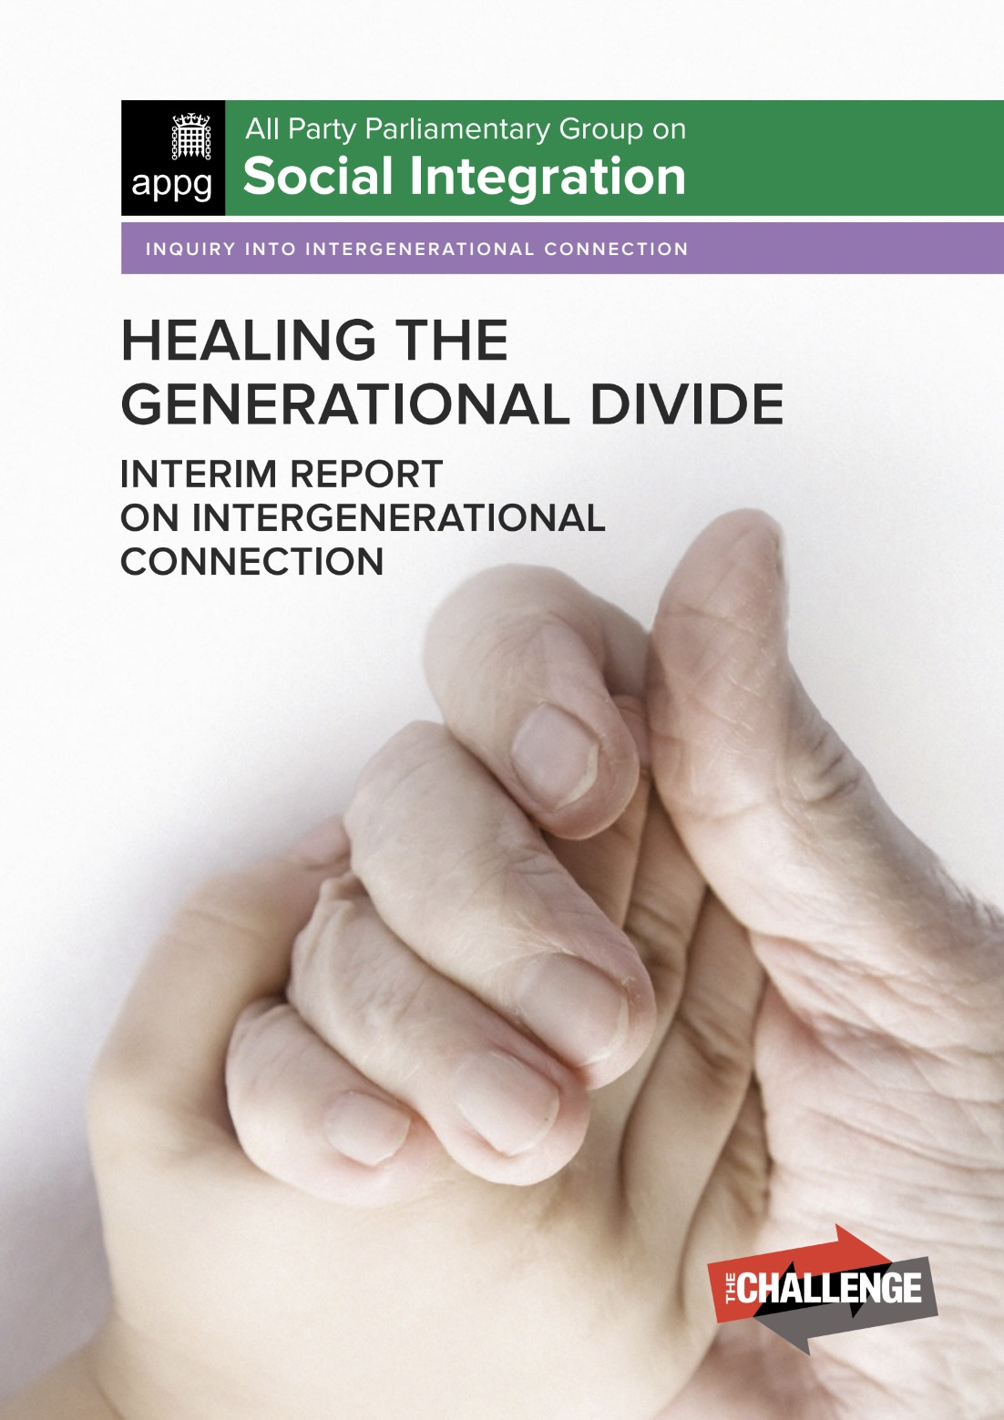
Some of our Housing LIN influencing activities
APPG on Social Integration on Generational Fairness (submission on intergenerational living). Findings on HLIN website
APPG on Older People and Ageing inquiry (oral evidence on housing standards and older people’s housing). Findings on HLIN website
APPG on Housing and Care for Older People on housing and technology hearing (oral evidence on TAPPI = Technology for an Ageing Population: Panel for Innovation).

Slide 5

Spotlight on extra care housing videos
What is extra care housing?
Designing homes for extra care
Living with dementia in extra care
Extra care: a reabling and caring environment
A Digital Revolution in Extra Care Housing
Bridging the Health and Housing Gap
The Future for Extra Care Housing
Listening to residents in extra care housing: findings from the ECHO research project
Influencing policy and operations: outcomes from the ECHO research project

Slide 6
Recent work in Wales
Assessment of Older Person’s Housing and Accommodation: For Cardiff & Vale of Glamorgan Regional Partnership Board
Assessment of Specialist Housing and Accommodation Need for Older People in West Wales: For West Wales Care Partnership
Housing and accommodation needs assessment for people with learning disabilities in West Wales: For West Wales Care Partnership
Bron Afon: assistance with older people’s housing review
Welsh NHS Confederation Conference 2019

Slide 7
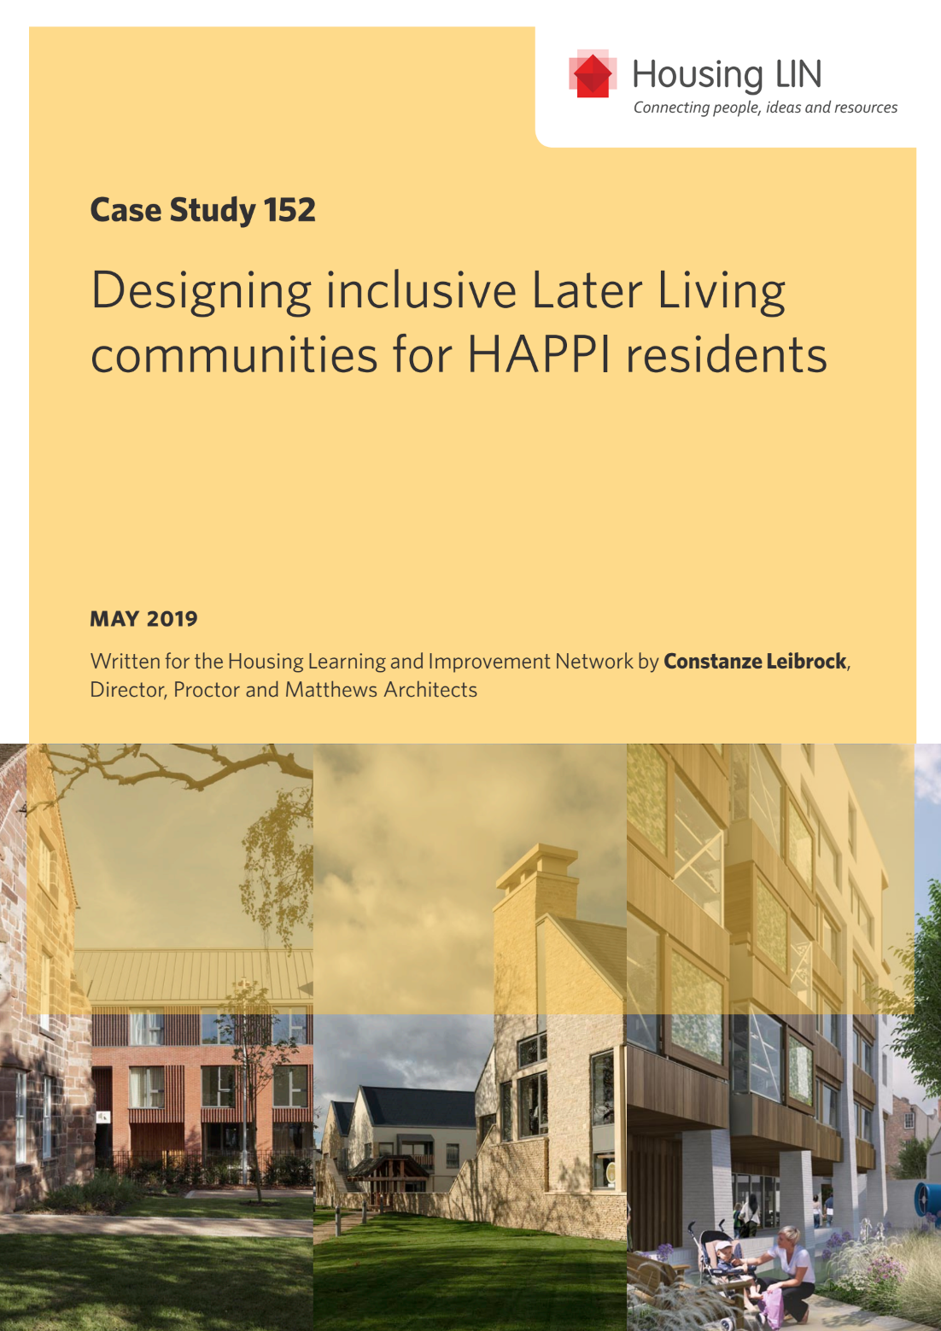
Other recent Housing LIN resources
Housing LIN case studies
  Designing inclusive Later Living communities for HAPPI residents
  Creating Quality Supported Living Homes with tailored person centred support for Adults with Learning Disabilities in Cornwall
Housing LIN viewpoint
  Exploring how to develop effective services to reduce loneliness
Selection of Housing LIN blogs at ww.housinglin.org.uk/blogs

Slide 8

Upcoming HLIN resources/programmes
RCOT Adaptations without Delay (updated report launched in Cardiff on 19 June)
Later living survey findings with Shakespeare Martineau (report launched in Manchester on 25 June)
National housing design awards (ceremony on 11 July) 4 schemes celebrated HAPPI recognition
APPG on Housing and Care for Older People HAPPI 5 report on Private Rented Sector and housing for older people (published on 17 July)
Future Leaders programme for Early Career professionals (sponsored by Thirteen Group). 1st cohort met last week
A selection of forthcoming training courses inc Autism and MCA

Slide 9

Connect with the Housing LIN
Over 25,000+ subscribers but still the ‘best kept secret’!
Sign up to receive our free weekly bulletin, HLINks
Check out our free-to-view online resources, including #InspirationalAchievements page at: www.housinglin.org.uk/InspirationalAchievements
Get involved and share your learning via a guest blog, viewpoint or case study, or on our discussion forum and at these events
Talk to us about your business needs and find out about our consultancy
Host a future Housing LIN Cymru meeting
Sponsor our website or an event

Slide 10

Thank you!
Housing LIN
c/o PRP, the Ideas Store
10 Lindsey Street, Clerkenwell
London EC1A 9HP
email: info@housinglin.org.uk
website: www.housinglin.org.uk
Twitter: @HousingLIN @HousingLINews

