Slide 1
Greater Manchester health and social care partnership: housing and health programme
HELEN SIMPSON AND MARY GOGARTY

Slide 2
Devolution and the gm health and social care partnership
HOUSING LIN NORTH WEST MEETING
GREATER MANCHESTER
HOUSING AND HEALTH PROGRAMME
Decision making powers transferred to regional level – £6bn budget for health and social care
More decisions about Greater Manchester made here
Provides the means and the opportunity to do things differently to meet the needs of our residents
Drives the integration of health and social care

Slide 3
WHO WE ARE
HOUSING LIN NORTH WEST MEETING
GREATER MANCHESTER
HOUSING AND HEALTH PROGRAMME
Greater Manchester Health & Social Care Partnership
NHS organisations and councils
Primary care
NHS England
Voluntary, community and social enterprise sector
Healthwatch
Greater Manchester Combined Authority
Greater Manchester Police
Greater Manchester Fire and Rescue Service

Slide 4
Our Vision:
HOUSING LIN NORTH WEST MEETING
GREATER MANCHESTER
HOUSING AND HEALTH PROGRAMME
“
To deliver the greatest and fastest possible improvement to the health and wellbeing of the 2.8m people of
Greater Manchester
”

Slide 5
OUR TRANSFORMATION THEMES
HOUSING LIN NORTH WEST MEETING
GREATER MANCHESTER
HOUSING AND HEALTH PROGRAMME
1
3
STANDARDISING ACUTE HOSPITAL CARE
RADICAL UPGRADE IN POPULATION HEALTH PREVENTION
TRANSFORMING COMMUNITY BASED CARE & SUPPORT
4
STANDARDISING CLINICAL SUPPORT AND BACK OFFICE SERVICES
2
5
ENABLING BETTER CARE

Slide 6
HOUSING AND HEALTH PROGRAMME
HOUSING LIN NORTH WEST MEETING
GREATER MANCHESTER
HOUSING AND HEALTH PROGRAMME
Poor housing condition
GM Healthy Homes Service
Precarious housing circumstances
Homelessness and Health
Suitability and accessibility
Supported Housing
Development of a scalable model to provide consistent service over 10 localities
Financially sustainable model
Aiming to:
Support independent living
Improve stock condition
Improve adaptations services
Prevent falls
Support discharge and prevent readmission
Ensuring that GP ‘right to register’ is universally applied
GM Homelessness Hospital Discharge Protocol
Supporting localities to develop health outreach offer to rough sleepers and TA
Mental Health outreach pilot
Implementation of Homelessness Reduction Act / Duty to Refer
Development of long term commissioning strategy
Enabling work stream in Adult Social Care Transformation
Facilitating a housing with care market promoting independence and community living
Age friendly housing (inc. upscale of Extra Care)
LD and MH accommodation
Building our evidence base
Enabling planning and delivery
Housing & Health Programme Board

Slide 7
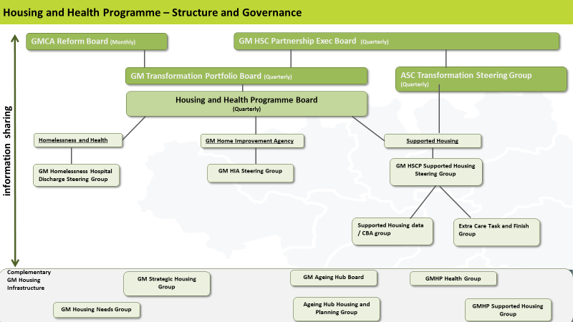
HOUSING LIN NORTH WEST MEETING
GREATER MANCHESTER
HOUSING AND HEALTH PROGRAMME

Slide 8
GM Healthy homes
HOUSING LIN NORTH WEST MEETING
GREATER MANCHESTER
HOUSING AND HEALTH PROGRAMME
Why?
Priority work stream in Population Health Plan
Evidence that interventions to improve the home environment can be effective in preventing, delaying and reducing demand for social care and health care
The right housing enables people to manage their health and care needs and can allow people to remain in their own homes for as long as they choose.
Aspiration to create similar offer across all 10 localities
Achievements to date
Foundations audit of existing services to understand current offer
GM Healthy Homes Report with recommended baseline service, enhanced service, funding and policy changes required
Engagement with localities to understand the local offer
Consultation with key stakeholders and partners
What’s next?
Governance review including establishment of a Practitioner Group
Implementation plan reflecting the Foundations Review, identifying delivery over short and medium term
Private Sector Housing Assistance Policies review
Living Well at Home Trailblazer

Slide 9
WHAT SHOULD A GM HEALTHY HOMES SERVICE LOOK LIKE?
HOUSING LIN NORTH WEST MEETING
GREATER MANCHESTER
HOUSING AND HEALTH PROGRAMME
Handyperson
Disabled Facilities Grants
Warm Homes
Information and advice on housing
Information and advice on care
Hospital discharge
Home from hospital support
Home improvements and repairs
Falls prevention
Healthy Homes inspections
Social prescribing and referrals
Technology Enabled Care
Project management for self- funders
Minor adaptations
Grant or loan assistance
Income generation
Locality investment
Notes:
On the back of workstream set out in Pop health plan, agreement across health, care and housing colleagues that any new model of provision should be set in a health context and should be able to…
Demonstrate the effectiveness of housing interventions on health priorities
But also from a service delivery perspective…

Slide 10
homelessness
HOUSING LIN NORTH WEST MEETING
GREATER MANCHESTER
HOUSING AND HEALTH PROGRAMME
Why?
Very poor health outcomes for population experiencing homelessness
Support key mayoral priority to reduce the need for rough sleeping in GM by 2020
Homelessness Reduction Act and MHCLG Homelessness Trailblazer projects
Better alignment of health support for people accessing GM homelessness programmes
Achievements to date
Better understanding of the health services across GM that support people experiencing homelessness and sharing this excellent practice.
GM wide Homeless Hospital Discharge Protocol
Ensuring the ‘right to register’ with a GP is universally applied
Coordinated support to ‘A Bed Every Night’, including Hepatitis C screening, flu vaccinations for rough sleepers
Support to localities to develop health outreach models, including additional mental health pilots
Training for healthcare staff on homelessness, including Homelessness Reduction Act and Duty to Refer
Overseen the investment of £2m health funding into rough sleeper services
What’s next?
Support continued delivery and improvement of ‘ABEN’, ensuring better clinical input and better links to health services
Pilot of Voluntary Duty to Refer extension to GPs
Development of a 10-year strategy to radically reduce homelessness and rough sleeping
Development of commissioning guidance and standards for homeless healthcare commissioning

Slide 11
Supported housing
HOUSING LIN NORTH WEST MEETING
GREATER MANCHESTER
HOUSING AND HEALTH PROGRAMME
Why?
Integral enabling workstream in the Adult Social Care Transformation programme
Effective supported housing offer enables delivery of the rest of a health and social care system that promotes independence and prevents people going into more acute settings and care homes
Our vision: utilising the opportunities presented through devolution, empower residents to live healthy, independent lives in a suitable home within their own communities and draw on their skills and strengths to contribute to health, wellbeing and economic growth within Greater Manchester.
Achievements to date
Evidence base- supported housing census, Housing LIN modelling of accommodation for older people, people with a learning disability, people with a mental health need, need for wheelchair adapted properties
Facilitating and enabling in localities- resources to produce Supported Housing Strategies
Engagement with Homes England, NHS Estates, One Public Estate to facilitate conversations on use of land for supported housing
What’s next?
Market shaping through engagement with ASC Transformation Market Shaping group, NW ADASS market shaping workstream, Extra Care prospectus, resource pack and workshop
Review of locality Supported Housing Strategies to inform GM market position statement
Supported housing landlord and care provider forum
Continued engagement with Homes England in partnership with GMCA
NHS Estates workshop pilot

Slide 12
Thank you

