Slide 1
Evidence Based Guide to Intergenerational Activity for Older People
Rachael Dutton Head of Research and Intelligence,
St Monica Trust

Slide 2
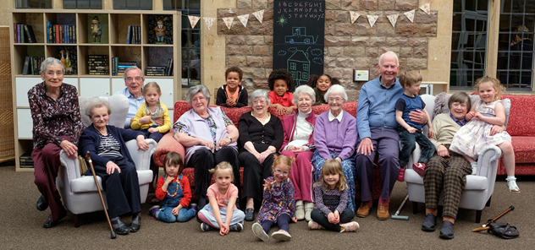
Coming up:
IGA: Evidence Based Guide
* Positive effects
* Need / demand and expectation
* Ways to create more / tips for success / essential components
Evidence of IG Benefits at St Monica Trust
* OPHf4YOs / Soundtrack / TCQ
Notes:
Hamish

Slide 3
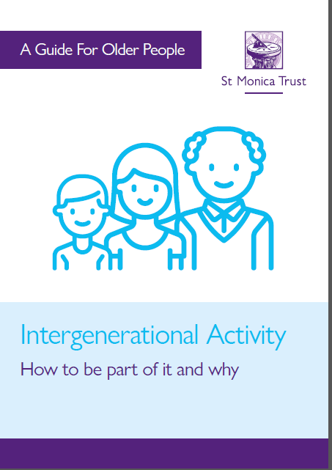
* info and ideas * inspiring success stories * tips for success https://www.stmonicatrust.org.uk/guide
IGA Guide
Based on evidence
re-use of literature review for IG chapter in IG Learning in Practice book.
Designed to be motivational and helpful for older people to use themselves.

Slide 4
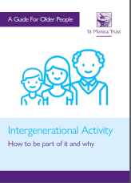
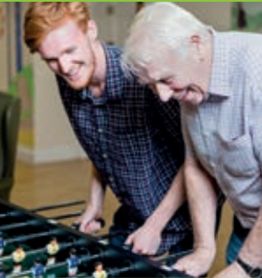
Intergenerational practice is
1-2-1 interaction/communication
Purposeful activities
Giving and receiving
Strengths-focused
promotes
Understanding/mutual respect
Sense of ownership & achievement
Challenge to ageism.
“Intergenerational practice is inclusive and builds on the positive resources that
younger and older people have to offer each other and those around them.”
Beth Johnson Foundation, 2009.
Notes:
Hamish

Slide 5
Mounting evidence that people want more IG opportunities
e.g. Large survey in USA
2/3 adults would like more time with different age groups
3/4 want opportunities in their community to meet & get to know people.
I Need You, You Need Me: The Young, The Old, and What We Can Achieve Together. Generations United/Eisner Foundation (2017) https://www.gu.org/app/uploads/2018/05/SignatureReport-Eisner-INeedYou-Background-Paper.pdf
Proactivity needed
Older people nowadays have much less opportunity to spend time with children than they used to.
Notes:
Hamish

Slide 6
Some of the Positive Effects for Young and Old
Boosts confidence, self-esteem and mood
Feeling useful and valued
Enjoyment of fun activities together
Richer everyday experiences
See the world from other perspectives
Make new friends
Sense of achievement
Challenge preconceptions
Counteract negative stereotypes / behaviour
Learn from each other
Share cultural experiences
Increased understanding and respect.
Notes:
Hamish

Slide 7
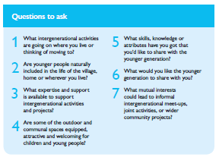
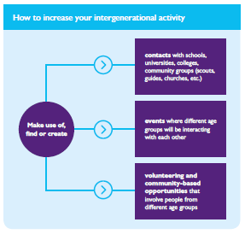
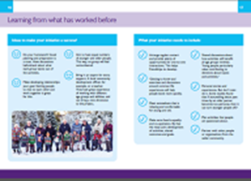
How to Create More IGA!
Questions for older people to ask
Who to contact in the community
Learning from what has worked before
Notes:
Hamish

Slide 8
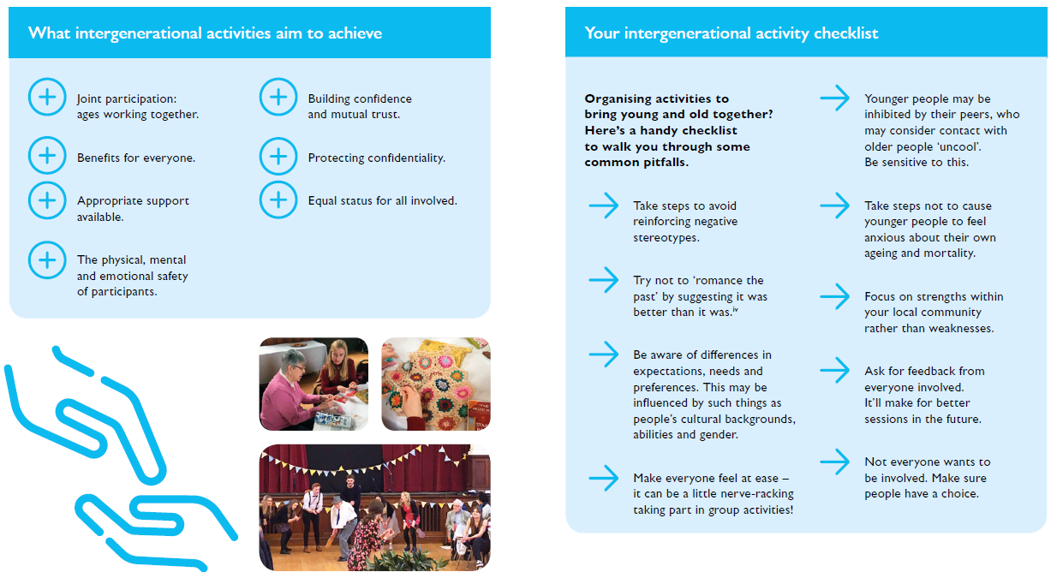
Essential Objectives
Notes:
Hamish

Slide 9
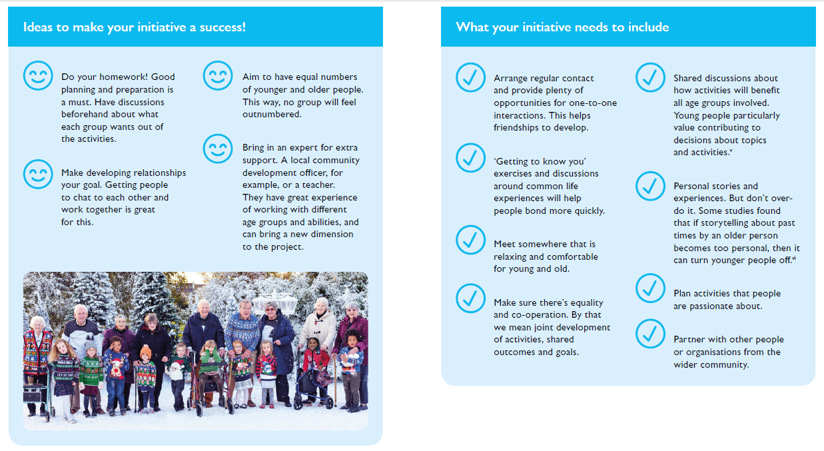
Learning from what has worked before
Notes:
Hamish

Slide 10
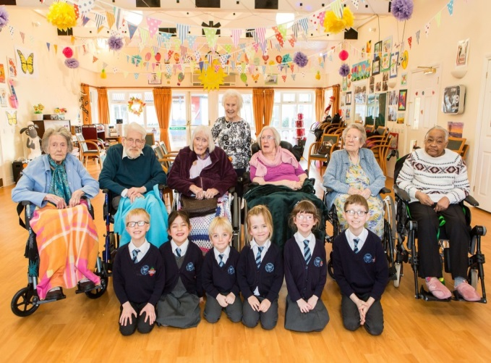
Evidence of Benefits of IGA at St Monica Trust
Examples
* OPHf4YOs
ST and LT outcomes
* TCQ
* Sound Track

Slide 11
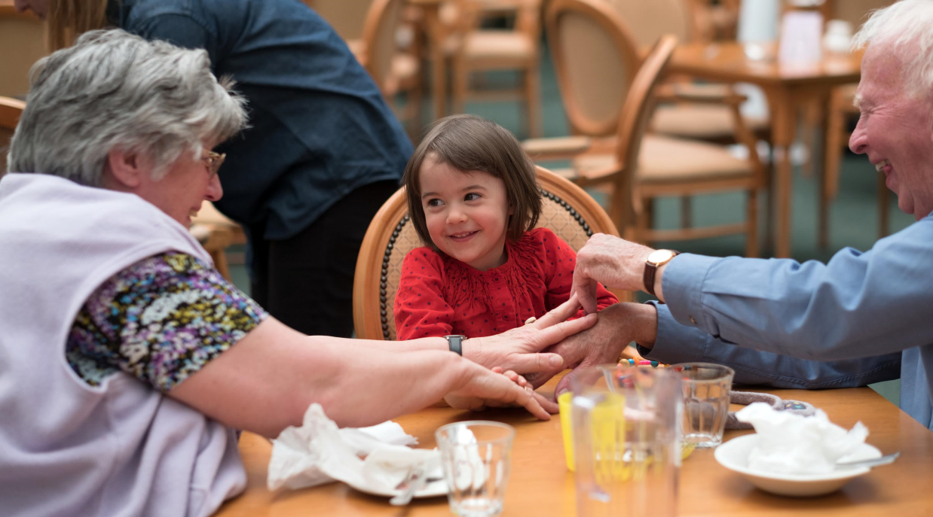
OPHf4YOs: Outcomes
Feeling loved Relief from boredom New lease of life | Learning Social skills Self-esteem Relationships Enjoyment Confidence Awareness Understanding
Notes:
Hamish

Slide 12
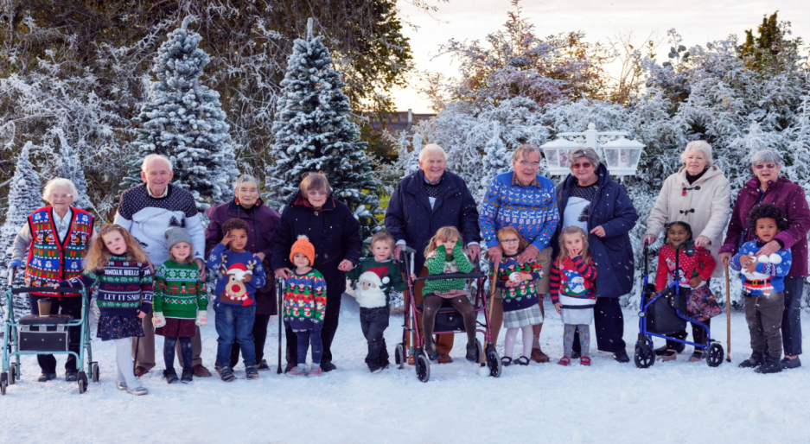
OPHf4YOs: Outcomes
●●●
“It has drawn me out of a semi-sleep”
●●●
●●●
“Being with these children has been like having a shot of adrenalin which
bucked us all up!”
●●●
OPHf4YOs Residents 2017
Notes:
Hamish

Slide 13
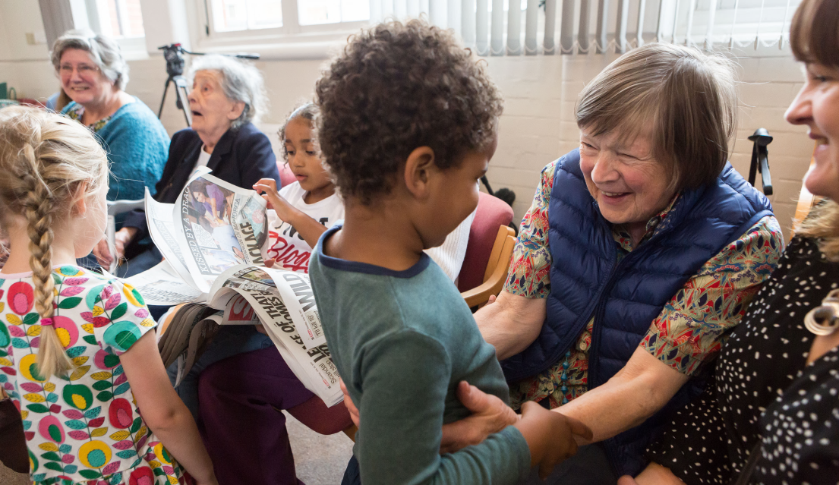
OPHf4YOs: Longer Term Outcomes
Pleased/proud
Changed perspectives & attitudes to life
Great memories
Strong friendships continue with children as well as parents
Notes:
Hamish

Slide 14
Sound Track: 2018 participant feedback survey
Resident respondents paired up with a young composer
All strongly agreed that
* they got a lot more out of being involved because the composers were youngsters rather than older adults;
* being involved had been enjoyable, stimulating, and important to them;
Notes:
Hamish

Slide 15
Sound Track: 2018 participant feedback survey
All agreed, or strongly agreed, that
it had a positive impact on
* their life
* emotional wellbeing
* how connected they feel to others
* how they view young people
* their appreciation of young people.
Notes:
Hamish

Slide 16
Sound Track: 2018 participant feedback survey
2018 residents:
“It was so refreshing to have young people around”
“It made me feel that life is good”
“It was the highlight of my life”
2018 young musician:
“I hadn’t realised that somebody in their eighties is just like me, but with more years of experience”
Notes:
Hamish

Slide 17
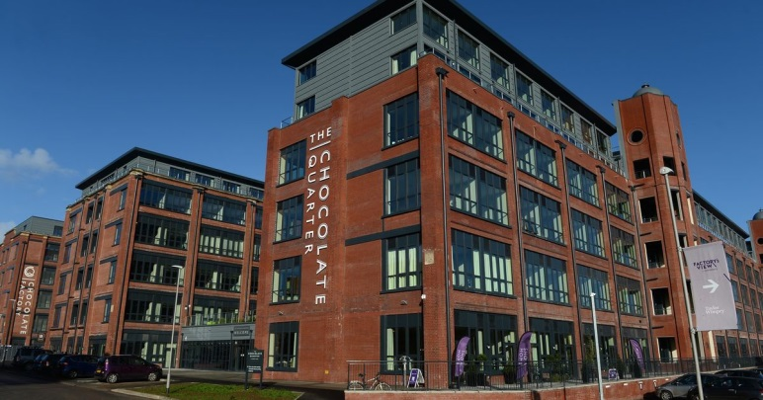
The Chocolate Quarter Keynsham
Our newest village designed around community integration
Innovative village in the heart of a community.
Businesses - work spaces - a retirement facility - care home - public community spaces for all to share.
Notes:
Hamish

Slide 18
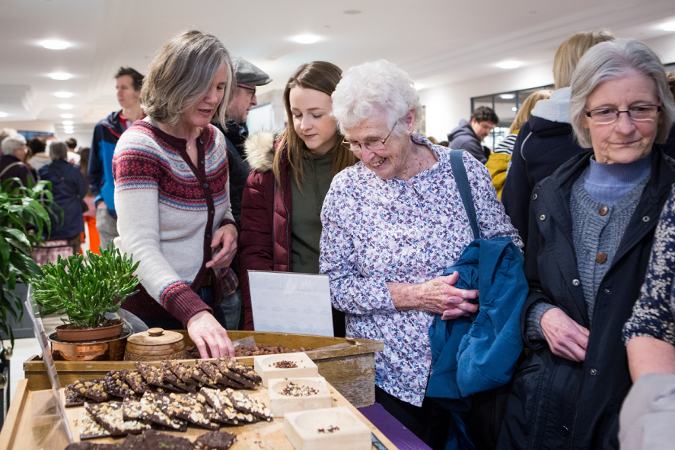
The Chocolate Quarter residents survey Dec 2018
70% return rate; 79 respondents
Residents pleased with
- the ambience of TCQ,
- the intergenerational atmosphere,
- the quality and range of facilities, and
- that they used by people of all ages from outside.
Notes:
Hamish

Slide 19
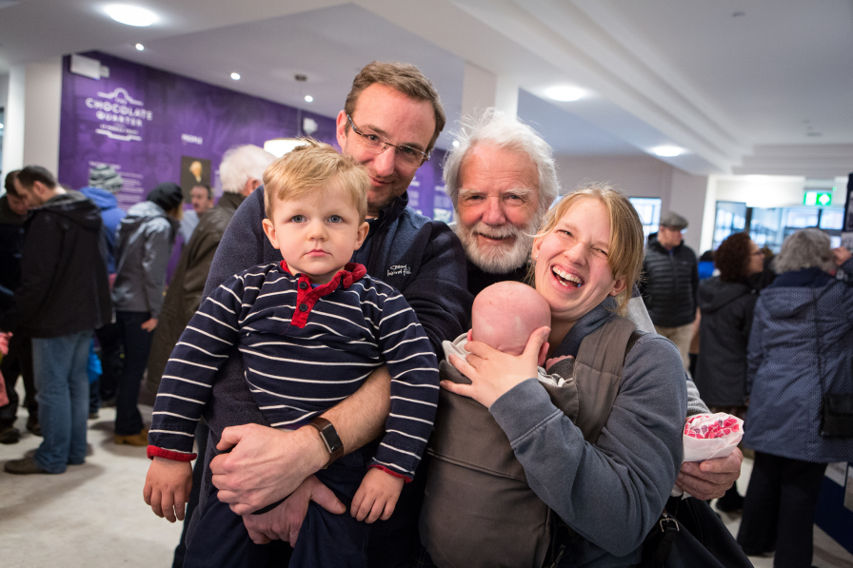
The Chocolate Quarter residents survey Dec 2018
Open comments - most common theme:
appreciation of the life brought to TCQ by seeing people of all ages
"It makes me feel part of a wider community, not just in an old peoples enclave"
Notes:
Hamish

Slide 20
The Chocolate Quarter residents survey Dec 2018
Most residents ‘strongly agreed’ or ‘agreed’ with:
I find having community spaces open to both the public and residents enhances living at TCQ (75%)
I would recommend living here to my friends (92%)
Notes:
Hamish

Slide 21
Things that make you glad you live at TCQ - most popular response: the public community spaces
“Mixture of ages. A residence rather than `old peoples home'. Life goes on around us.”
“Connections to the community”
“That we share facilities with the community.”
Notes:
Hamish

Slide 22
●●●
“Intergenerational Programs are a vaccination against ageism and a prescription for longevity”
(Bridges Together)
●●●
Rachael Dutton, Head of R&I
rachael.dutton@stmonicatrust.org.uk
Notes:
Hamish

Slide 23
Forthcoming book Intergenerational Learning in Practice: ‘Together Old and Young
will feature best practice across Europe
volume 1
overview of key concepts, theory and research from a range of disciplines informing intergenerational practice
volume 2
practice focused, will describe a range of IG initiatives in formal and non-formal settings, early childhood education, and school settings
our chapter
'Old Peoples Home for 4-Year-Olds’: A Social Experiment looking at the Impact of the Contact on Health and Wellbeing'
published by Routledge later this year.
Notes:
Hamish

