Slide 1
My Intelligent Home (Mii-Home) Project
Service Director - Business Development, Salix Homes, Salford, Manchester, UK.
jonathan.drake@salixhomes.co.uk

Slide 2
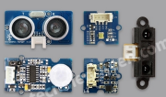
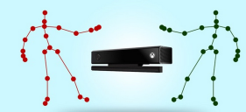
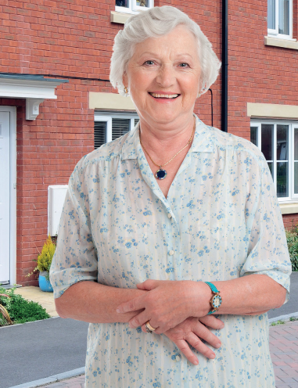

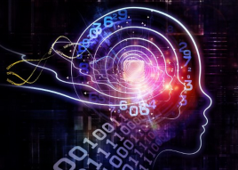
Mii-Home
1
Sensors in Houses
Measure motion activity
Detect deterioration
1
Promoting independence
for older people
Better health and social care outcomes
Improved experience for services users and carers
Reduced health and
social care costs
2
Artificial Intelligence
Software analyses patterns and predicts decline in health requiring action
3
Artificial intelligence
3
2
Alerts
Signals that an intervention is required
To carers or relatives
To Care on call
Triggers an intervention that restores health by usual care pathways

Slide 3



A Salford Initiative

Slide 4
Outline
Motivation and Background
  Why are we working on technology for assistive independent living?
  Aim
  Affordable solution
Problem Statement
Attributes Detected
System
  MiiHome Ecosystem
  MiiHome Information Flow
  Platform Model
  System Architecture
Conclusions
Mii-Home

Slide 5
Motivation and Background
  Why are we working on technology for assistive independent living?
    population ages,
    growing expenditure on managing the health of older people.
  Aim
    improve peoples quality of life,
    improve sustainability,
    reduce treatment costs.
  Affordable solution
    Off-the-shelf embedded technologies,
    Deploy in the home.
low-cost, tech-based
solutions, including ambient living and remote healthcare management systems
are under development

Slide 6
Motivation and Background
  Why are we working on technology for assistive independent living?
    population ages
    growing expenditure on managing the health of older people
elderly wish to live independently at home, but
are at risk of increased
frailty, social isolation, inactivity, low mood and falls.

Slide 7
Ageing Population, UK
Number and percentage of people receiving support with social care in England.
Source: Health and Social Care Information Centre & Office for National Statistics

Slide 8
Ageing Population, UK
Number of older people supported by social services department by type of social care support, England.
Source: Health and Social Care Information Centre

Slide 9



Slide 10
Motivation and Background
  Why are we working on technology for assistive independent living?
    population ages
    growing expenditure on managing the health of older people
  Aim
    improve peoples quality of life,
    improve safety
    reduce treatment costs
    Sustain people in their home
assisting people to live at home for as long
as possible

Slide 11
Problem Statement
  Focusing on frailty we have two objectives:
    to evaluate the effectiveness of using MS Kinect for remote monitoring of the elderly in the home
    to assist the clinicians with the assessment of performance of activities of daily living in the periods between hospital clinic visits based on the historical data collected with the MS Kinect and analysed by our proposed system.
person-centered integrated
care in the home

Slide 12
Attributes Detected
  Gait speed and gait disorder
  Furniture crawling
  Sit-to-stand
person-centered integrated
care in the home

Slide 13
Mii-Home Ecosystem
person-centered integrated
care in the home

Slide 14
Motivation and Background
  Why do we work on assistive healthcare technologies?
    population ages,
    growing expenditure on managing the health of older people.
  Aim
    improve peoples quality of life,
    improve safety,
    reduce treatment costs.
  Affordable solution
    Off-the-shelf embedded technologies,
    Deploy in the home.
low-cost, tech-based
solutions, including ambient living and remote healthcare management systems
are under development

Slide 15
Mii-Home Platform Model

Slide 16
Hardware Installed Participant Homes
2

Slide 17
MiiHome Information Flow

Slide 18
Conclusions
  Design and creation of the framework
    Enabling 24/7 monitoring system
    Data storage
    System integration
    Definition of the core modules
Future Work
  Health services testing
person-centered integrated
care in the home

