Slide 1
Intergenerational Living
A cohousing perspective
Jawahar De Sousa July 2019

Slide 2
What is cohousing?
“Cohousing communities are intentional communities, created and run by their residents. Each household has a self-contained, private home as well as shared community space. Residents come together to manage their community, share activities, and regularly eat together.”
UK CoHousing
“an intentional community as a living environment… where significant relationships with neighbours are the norm rather than the exception, where generations mix and everyone has a role, where people experiment with commitment to something beyond their individual interests.”
Mobilise - December 2018

Slide 3
Cohousing Principles
Participation – individuals are involved in all community processes
Co-operative structure - non-hierarchical structure and decision-making
Site design, layout & size – that encourage social interaction and create a sense of community – optimum size 15 to 30 households
Shared facilities – community kitchen and dining area, laundry, meeting space, gardens, car park, bicycle and tool stores, workshops
Community managed – residents share responsibility for running all aspects of the organisation, community and estate.
Sustainable – environmental and social

Slide 4
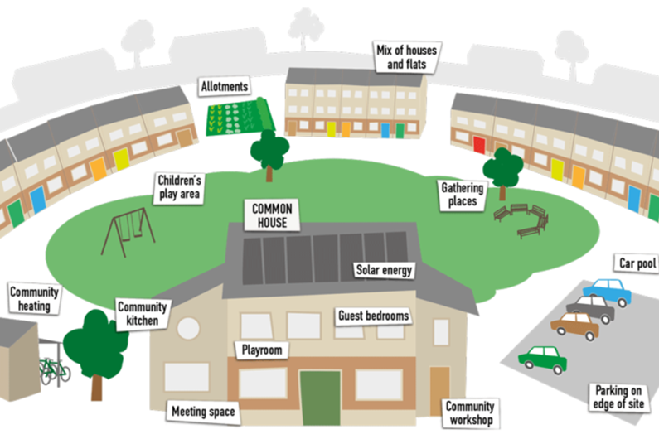
An ideal cohousing site layout
a

Slide 5
How does intergenerational housing differ from cohousing?
“an intentional community living environment… where significant relationships with neighbours are the norm rather than the exception, where generations mix and everyone has a role, where people experiment with commitment to something beyond their individual interests.”
“..key difference is that cohousing is usually owned and managed by residents, whereas models of intergenerational housing are usually initiated, owned and managed by not for profit organisations…”
Mobilise Dec 2018
Isn’t the difference in the nature and quality of community interaction?

Slide 6
Essential elements that provide the ‘glue’ for cohousing communities (1)
Community involvement - in all aspects of cohousing from initiating, designing, managing and maintaining the estate and community

Slide 7
Essential elements that provide the ‘glue’ for cohousing communities (2)
Organisation
Co-operative structure – equality and shared responsibility
Collaborative working and management
consensual decision making

Slide 8
Essential elements that provide the ‘glue’ for cohousing communities (3)
Community activities
cooking and eating together regularly
gardening and maintenance workdays
community and organisation management meetings
community events e.g. music and/or dance evenings; playing games – volley ball, softball, board games, etc.; film nights; parties.

Slide 9
Essential elements that provide the ‘glue’ for cohousing communities (4)
Sharing
shared communal facilities, communal spaces and gardens
school runs and after school child care
looking out for neighbours including elderly, infirm or ailing
collective shopping e.g. food co-ops
bicycle maintenance
car sharing

Slide 10
What makes cohousing good for intergenerational living?
Cohousing communities are usually intergenerational and this generation mix benefits individuals and the community. These benefits however, are the outcome of community processes: it is community interaction and the opportunity for it - the activities and the sharing, equality and responsibility - engender a sense of community and belonging; helps build trust, respect, friendships – it is this that makes for supportive and caring communities.

Slide 11
How can the cohousing experience of intergenerational communities contribute to developing other forms of intergenerational community living?

