Slide 1
ECH strategy and the issues beyond older people; ECH as a hub for communities.
^{Helen Charlesworth-May}
Strategic Director Adult Social Care and Health
Notes:
Introduce self

Slide 2
Council’s ambition for Extra Care
New wave of well designed Extra Care developments for older age living into the middle of this century
Extra Care has a pivotal role at the heart of the communities
Extra Care to become the default alternative to residential care provision across the Duchy
Roll out Extra Care housing schemes across all major towns in Cornwall and find solutions for less populated areas
To develop mixed tenure model that reflects the socio-demographics of the local catchment now and into the future.
Where the sites lend themselves to include the development of other priorities
For public and private investment to be well-spent and deliver value for money
Notes:
Emphasis on a programme approach to all the elements of development opportunities for extracare in Cornwall.
Extracare as “hubs” that support social capital and community integration of support to older people across health, housing and care
As default to resi care -extracare to include as appropriate NHS and other partners
Need to balance economic viability of extracare, with dispersed population and choice in a wider approach to housing for older people
Maximise choice and access for local people to these schemes with tenure mixes that enable that – through coproduction and codesign on a local basis

Slide 3
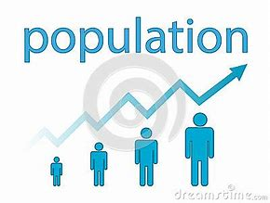

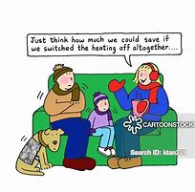

Rural Cornwall
20% Affordable housing in urban areas
Houses are 20% more expensive in urban areas
Less likely to be adapted for aging
Estimated that ½ rural households over 65
More 75 year olds living in
rural areas than urban areas
Rural population ageing faster than other parts of the Country
Cornwall 2050
49% of rural households
have a regular bus
service
12% higher incidence of fuel poverty in rural area compared with 10% in urban areas
In 2010 36% of rural homes did not have access to gas.
20% of GP services are in rural areas
Average journeys to GP are longer
Higher than national average for medical home visits
Notes:
NOTE; Information was provided by the Housing LIN at the provider event last August
The numbers of people across Cornwall aged 65+ is predicted to increase by 78% by 2030
Cornwall is largely a rural community and the rural population is aging faster here that in other parts of the Country.
Intergenerational living urban models won’t work well in Cornwall.
The Pydar Project is an exemplar regeneration programme and it is the only opportunity to do a town based scheme that closely fits the brief of creating an intergenerational community.

Slide 4
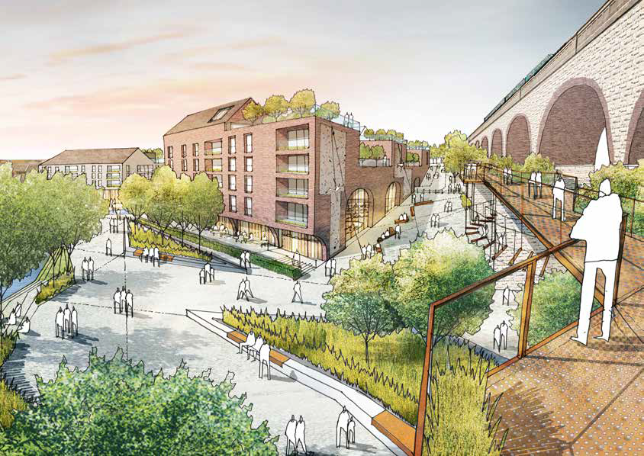
Our Ambition
Create strong communities
Social Capital
Affordable and appropriate housing options
Shared responsibility
Notes:
Brief - The Pydar Street Regeneration Project seeks to create a prosperous, inclusive and sustainable, urban neighbourhood for Truro, shaped by the views of the local community. Pydar will create new homes, innovative work and learning spaces and an exciting riverside park with leisure and community facilities.
Work of the principles of;
creating strong communities based on a culture of dignity, respect and compassion; and for older people to remain deeply rooted in our communities (A vision for ASC; Capable Communities and Active Citizens 16.11.2010) ; and create a sense of freedom by shifting power away from local authorities to people and their communities
Shared responsibility to create healthy communities that actively embraces and provides for the needs and aspirations of our citizens be they Older People, Young People, Families people who choose to live in Cornwall.
Social Capital – Building relationships , mutual understanding and shared actions that bring communities together - Frederick Seebohms’ 1968 report said that social care should enable the greatest number of individuals to act reciprocally, giving and receiving services for the well-being of the whole community. An example of this is the Southwark Circle initiative Timebank schemes and complementary currency schemes that allow people living far away from their relatives to partner with local people in the same position to provide reciprocal care. Cornwall has a high number of people who retire to the County this may something that could be successful here.

Slide 5

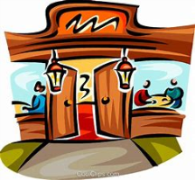





Community Infrastructure
Multi-use venue with storage
Riverside park
Plen-an-Gwarry
Improved public transport links
Shops and Restaurants
Riverside eateries
Artisan makers
Small independent shops
Workspace
Collaborative work space (provision for start-ups)
Modular office space (flexible workspace)
Traditional office offering
Learning
and
Innovation
The Hive - Digital Innovation Space by Falmouth University
Research and Development Clusters
High Tech Collaborations
Events and Activities
Leisure
Bowling Alley
Kids play zone
Food and beverage operators
Gym / Well-being
New Homes
Affordable homes
Townhouses and apartments
Inclusive homes for our elders
Accommodation for scholars and students
Hospitality
80-100 room hotel
Small ground floor shops and commercial units
Notes:
Cornish: Plen an Gwari), is a "playing-place" or round, a medieval amphitheater found in Cornwall. A circular outdoor space used for plays, sports, and public events, the plen-an-gwary was a Cornish variant of a construction style found across Great Britain.
Potential for Intergenerational learning by bringing individuals from different generations together for learning and sharing experiences. Judith Ish-Horowicz MBE set up the Apples and Honey Nursery the first social enterprise to join forces with a residential care home. Positive results include improved confidence in children, better communication skills
Digital innovation space – developing the next generation of entrepreneurs
Inclusive homes for our Elders – Cornwall is out to procure a strategic partner to help the Council deliver 750+ units of ExtraCare and due to the geography of the County and it’s rurality creates this opportunities for us to do something different.

Slide 6
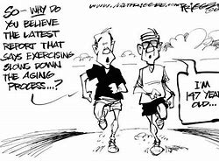
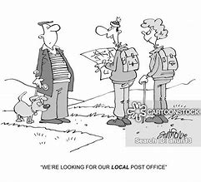
750+ Units of ExtraCare
Cornwall 2030
Notes:
Models for Cornwall around ExtraCare developments will need to be tailored to local community needs and developed out of community engagement and co-design e.g. schemes could include local post offices, digital based library resource, day services farm shops
Population change will have and is having a profound impact on services in Cornwall
1 in 4 people aged 65+ now
By 2025 increase in the 75 plus population will go up by 47%
To keep up we need to develop 3536 units of Extra Care by 2025 -750 units to support people with social care needs
We recognise that this capacity is just one element of a continuum of housing that will give us a healthy mix of options.

Slide 7
Thank you.
Helen Charlesworth-May
Strategic Director Adult Social Care and Health

