Slide 1
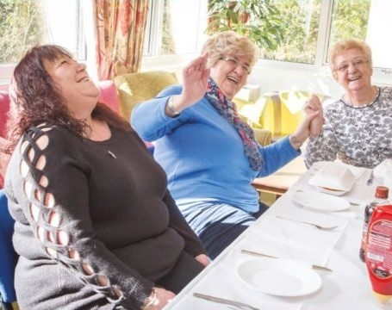
Our story
Retirement
Housing

Slide 2
Where we were
Retirement Housing Officers
Care call & access control system
SP funding
Lack of investment
Points based allocations

Slide 3
Person centred support
April 2010
  Floating support model (370 RH tenants)
  Care call & access control (all RH tenants)
  Extensive tenant & advocate involvement
  Stakeholder consultation
  SP funding + ‘paid for’ option
April 2012
  Exit from care call & access control (quality v cost)
  5 year SP contract
  Cross tenure model (80%+ BA tenants)
December 2016
  New 5 year contract award (down sizing)

Slide 4
4 Factors Impacting Performance
  1. Asset Performance including stock condition
  2. Demand within communities
  3. Popularity of community (localised)
  4. Accessibility of upper floor flats
Some important considerations:
  Local housing market & strategy
  WG policy (wellbeing of people & place)
  Local housing allowance

Slide 5
Trying some new things
Lowered the aged in three schemes to 50 in consultation with tenants.
Kennard Court- knocked down and six new bungalows in partnership with Aneurin Bevan and Torfaen Council.
‘The In One Place Project.’

Slide 7
Our new approach
The Retirement Housing project
Participatory approach
Communications and listening.
Transparent and fair- not afraid of difficult conservations
Co- production – Glanwern House

Slide 8
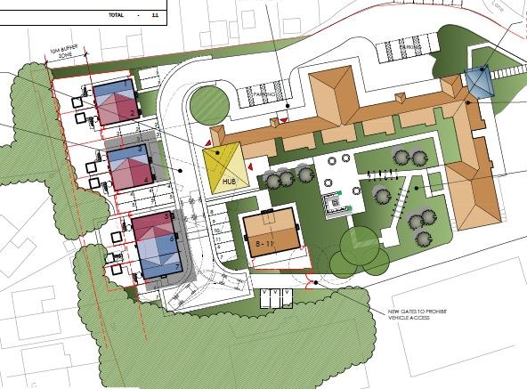
Working together-co-production

Slide 9
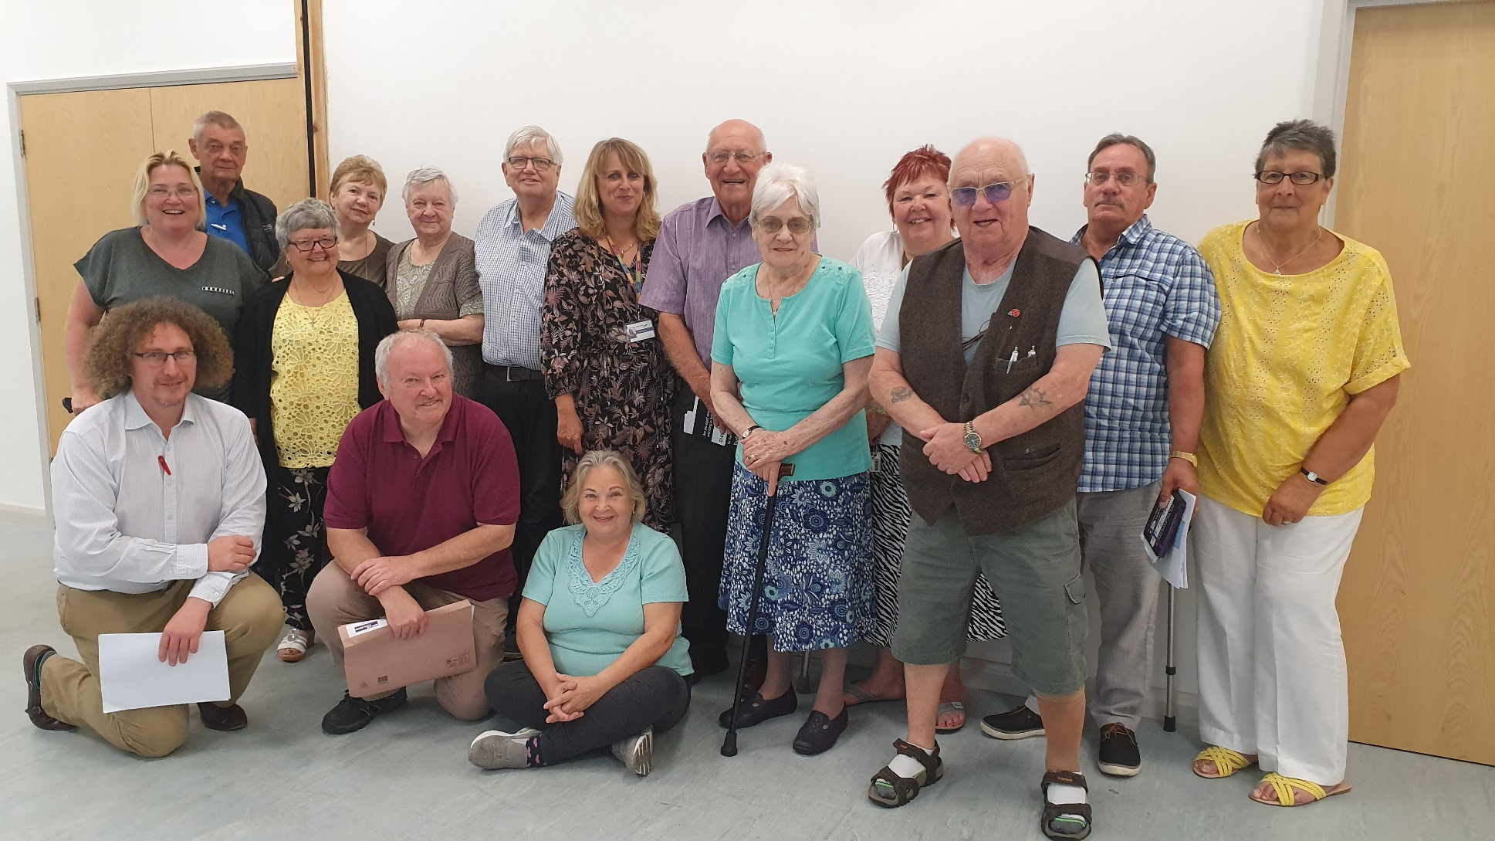
Mutuality- Our steering group

Slide 10

Criteria
Community
Cost
Accessibility
Demand

Slide 11
Reference Group
Partnership and Collaboration
Critical friend, how what we are doing fits around wider agenda, identify opportunities for collaboration and how strategically we deliver collective aims.

Slide 12
Timeline…key steps:
Undertake survey and assessment based on approved criteria
Wider consultation
Present final list of outcomes of schemes to Steering Group and Reference Group
Completion of project phase 1 March 2020.

