Slide 1
Worcestershire Dementia Dwelling Grants:
A needs-based scheme for providing aids and adaptations
Jennifer Bray
Association for Dementia Studies
University of Worcester

Slide 2
Background
‘Provision of aids and adaptations in the home designed to enable people with a diagnosis of dementia to manage their surroundings, retain their independence and reduce feelings of confusion and anxiety.’
County-wide pilot project (April 2017 – March 2018)
Led by Worcester City Council
Funded by The Better Care Fund
Six District Councils in Worcestershire
Supported by
Care & Repair Worcestershire
Dementia Advisors (Age UK Herefordshire & Worcestershire)

Slide 3
Dementia Dwelling Grants
Maximum grant equivalent of £750
Aids and adaptations NOT money
Eligibility criteria
Dementia diagnosis
No age restrictions
Not means-tested
Living in any type of community based housing
Referral routes
Community Mental Health Team
GP
Early Intervention Dementia Team
Self-referral

Slide 4
What it covers
Standard products from set list
Based on existing knowledge and experience
E.g. easy-to-use phone, day clock, whiteboard/notice board, toilet seat in contrasting colour
Bespoke products identified during assessment
E.g. bed settee to allow relative to stay and look after someone
NOT cover items from other sources
E.g. Facilities Grant, social care

Slide 5
The evaluation
Undertaken by Association for Dementia Studies, University of Worcester
Aims
Evidence of impact of aids and adaptations
Evidence to inform future delivery of the scheme
Methodology
Assessment form (wellbeing, loneliness, satisfaction with health and accommodation, mental wellbeing)
Evaluation form (at assessment, 3 months, 9 months)
Case studies

Slide 6
Participation
Ongoing process throughout pilot
510 assessments
382 (75%) received DDG grant
101 took part in evaluation
73 at 3 months
36 at 9 months

Slide 7
Demographics of recipients
Average age 80
Range 36 to 98
55% female
97% White British
62% married
30% widowed

Slide 8
Evaluation participants
95% had at least one carer
80% of those lived with carer
In most cases partner/spouse
86% of carers unpaid
84% diagnosed 2014 or later
40% Alzheimer’s disease
22% vascular dementia
21% mixed dementia
54% at least one other medical condition

Slide 9
Housing situation
Type of housing
64% lived in house (generally 3-4 bedrooms)
23% bungalow (generally 2-3 bedrooms)
Tenure
86% owner occupier
Living situation
68% live with partner/spouse
23% live alone

Slide 10
Items requested
Top 5 items
Free standing dementia clock
Notice board /whiteboard
Touch bedside light
Key locators
Memo minder
Not aware what is available

Slide 11
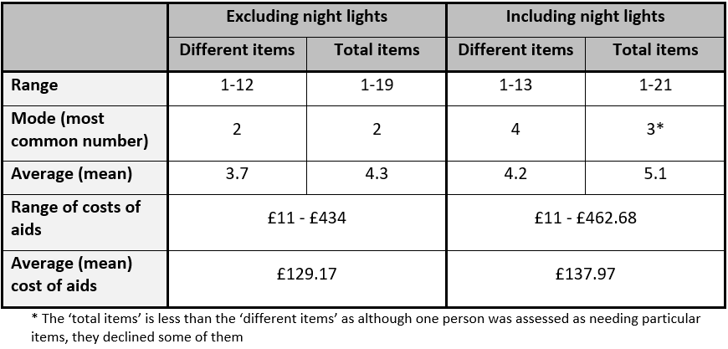
Costs
Costs of the items well within grant allowance
NOT include costs relating to assessment, fitting or a handyperson’s time
Notes:
People living alone need more than those living with someone else
Average (mean) number of different items requested Average (mean) number of total items requested Average (mean) total cost of items
Living alone 4.6 5.5 £150.16
Not living alone 4.0 4.9 £131.72

Slide 12
Impact of DDG – 3 months
Reduction in loneliness
No change in general health
High level of satisfaction with accommodation maintained
Improved ability to look after themselves
Felt safer
% people feeling lonely ‘often/always’ or ‘some of the time’
14.9%
10.6%
Loneliness
Baseline
3 months
Score out of 5
4.6
4.2
Ability to look after themselves
Baseline
3 months

Slide 13
Impact of DDG – 9 months
Continued reduction in loneliness
Little change in satisfaction with health
Increased satisfaction with accommodation
Decline in ability to look after themselves
No improvement in ‘feeling safe’
% people feeling lonely ‘often/always’ or ‘some of the time’
16.7%
11.1%
Loneliness
Baseline
9 months
Score out of 5
4.9
4.6
Ability to look after themselves
Baseline
9 months

Slide 14
Overall impact
DDG has made measurable difference for people affected by dementia in Worcestershire
Low-tech aids and adaptations
Provided scheme to help people remain independent in own homes
Funding is continuing across Worcestershire

Slide 15
General findings
Future proofing homes should be considered on diagnosis
Could also apply in other housing settings
Reinforced importance of personalised support
Able to pick and choose from list of items
Accessibility of the grant worked well
All ages, personal circumstances, not means-tested

