Slide 1
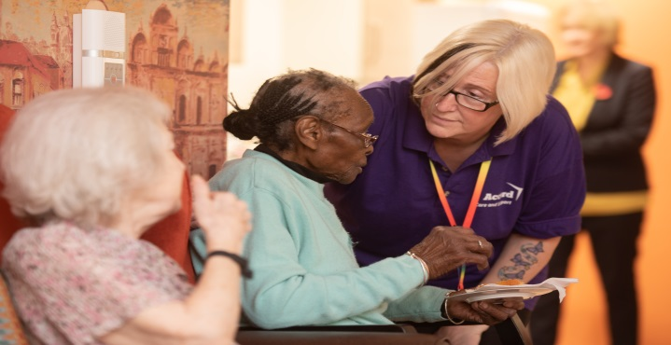
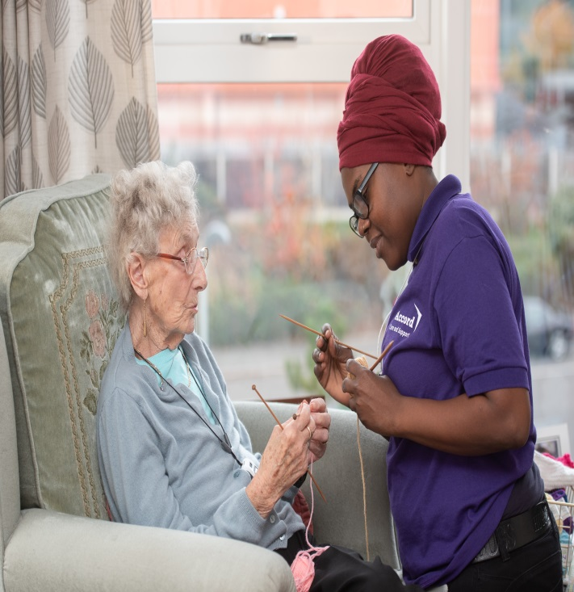
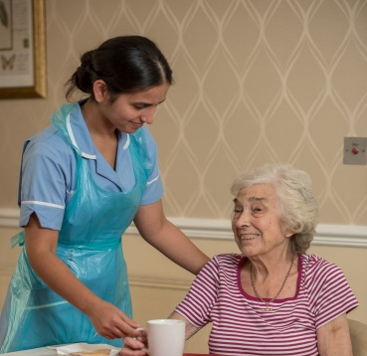
Action and innovation: delivering for diverse communities
Presented by Nicole Beeching - Assistant Director of Business Development

Slide 2
About Accord
Overview
Formed in 1965, Accord is one of the largest not-for-profit housing and social care organisations operating in the Midlands. We provide 13,000 affordable homes, deliver health and social care to 80,000 people and employ nearly 5,000 staff members. We operate predominantly across the Midlands but also have a presence in the North East as a provider of domiciliary care services.
Care & Support
Accord is a leading provider of health and social care services operating a turnover of £60 million across our community, residential, specialist, supported housing and domiciliary care services. We offer a comprehensive range of individually-tailored services throughout the Midlands and the North East. Over 92% of the Accord regulated care services have received a Good Rating from the CQC.

Slide 3
Accord’s provision
Meeting housing need for older BAME communities:
Kalyan - 20 bedsits/ flats
Ghulab - 36 flats/8 bungalows
7 of 14 sheltered housing schemes are for BAME elders providing 175 units across the West Midlands (Birmingham, Sandwell, Northampton, Walsall, Wolverhampton)
A number of services came to Accord when Ashram Housing Association and Gharana Housing Association joined the group. In addition to this the West Midlands-based services transferred from PA housing during 2018. This has enabled Accord to increase knowledge, experience and understanding of supporting our wider BAME communities.

Slide 4
Accord’s approach: inclusive not exclusive!
None of Accord’s services are exclusive to BAME communities, however, a number are aimed at supporting BAME communities. To optimise accessibility we:
Employ staff that represent our local communities with a range of language skills
Ensure that information is presented in an accessible format
Develop services in locations with a high BAME population and where communities cater for our customers e.g. access to shops and places of worship
Engage with community services, in-reaching and supporting our customers to access wider community services

Slide 5
Challenges to delivering services:
Building design and stock condition - many of our services are old, re-purposed stock, not specifically designed to meet the needs of the customer group
Marketing to meet diverse customer groups - balance between promoting access to all and specific benefits for BAME communities
Saturation of services in some areas
Lack of cross scheme working and sharing within organisation
Voids management - it often takes longer than average to fill voids

Slide 6
Going forward..
Developing a pilot project in Birmingham
Improving Links between services: care - extra care - sheltered housing - community
Extending our specialist knowledge by buddying service managers in geographical locations, enabling signposting, link working and engagement
Developing community networks and in-reach services
Stock condition reviews - Do our buildings meet the needs of our communities? How do we manage conflicting design principles? Can we do things better?
Greater understanding of needs driven by communities not just by Accord’s aspirations
Working in wider partnership to develop and deliver much needed services

Slide 7
Example of inclusive service offer:
Ribbon Court – Housing with Care in Coventry. Originally developed as a service for Asian elders however has evolved over time to reflect the surrounding community population. The staff team reflect the community make up which in turn makes the service more accessible and appeals to a wider customer group.
One of the simple approaches taken to integrate customers and to make services more inclusive is a project instigated by a group of customers. A group of Asian customers held cookery demonstrations for catering staff to ensure authentic food was cooked on site. Once they had ‘sorted out the chef’ this offer was extended to other customers living in the service. This resulted in a number of positive impacts including:
increased activity and engagement
increased customer interaction even where language barriers existed
New menus that reflected the new skills of catering team
increased take up of onsite catering services.

Slide 8
Making a difference….
Dementia Support Worker for Hard to Reach Communities
Commenced in 2012 with a view to improving access and engagement of hard to reach communities and ultimately improving diagnosis rates.
Direct correlation with increased diagnosis rates in BAME communities
Increased awareness raising through the 3Ds: Diabetes, Depressions and Dementia
Dementia Café attached to a housing block that support Asian Elders
Borough wide support groups and networks
https://www.youtube.com/watch?v=TF3tPw1I_fk

Slide 9
Contact us
Nicole Beeching
nicole.beeching@accordgroup.org.uk
0121 500 2319
Di Stirling-Chow
di.stirling-chow@accordgroup.org.uk
0121 500 2096

