Slide 1
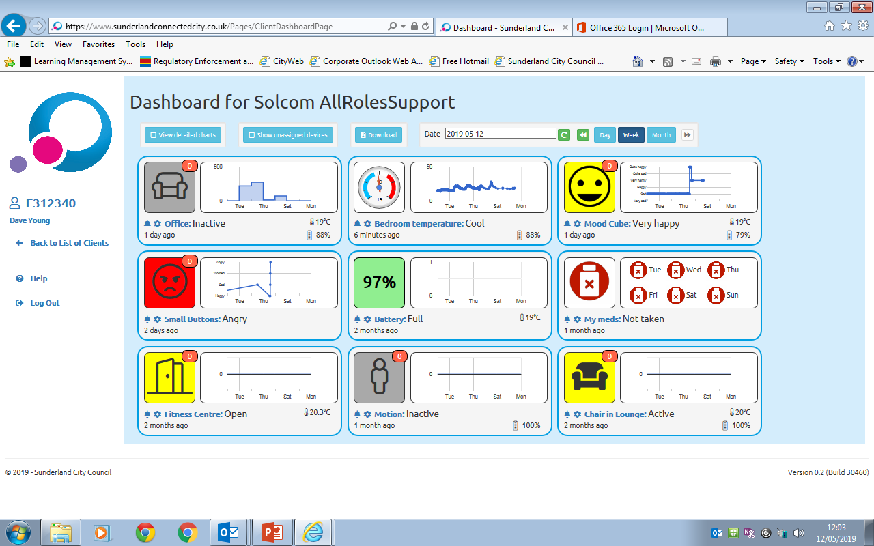
Sunderland Assistive Technology to Support Adult Health & Social Care Delivery
Dave young
Wayne Scott
Notes:
Introductions
Dave

Slide 2
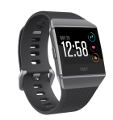
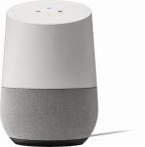
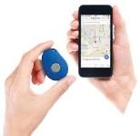
The internet of things
Technology items such as Smart Phones, Wearables and Home Automation are becoming common place in our society. This consumer tech is being harnessed for so many different purposes.
This led to the City’s Adult Social Care Department, to ask the question.
Can this Technology be harnessed for care proposes?
Notes:
Wayne
Technology items such as Smart Phones, Wearables and Home Automation are becoming common place in our society. This consumer tech is being harnessed for so many different purposes.
Discuss a little about products on screen and mention trial we did and we will go into more detail on this in slide 4.
This led to Sunderland City’s Adult Social Care Department, to ask the question.
Can this Technology be harnessed for care proposes?

Slide 3
The Answer = yes
Well how do people know how to do this?
What can the technology do?
How can the city help residents to do this?
It may work for an individual, but how might it work for the wider health & social care economy.
Is the technology robust to rely upon?
Notes:
Dave
The answer is Yes based upon our research and what we have learned.
But this raised further questions like
Well how do people know how to do this?
What can the technology do?
How can the city help residents to do this?
It may work for an individual, but how might it work for the wider health & social care economy.
Is the technology robust to rely upon?
Hopefully in this presentation we will explain how we have addressed those questions

Slide 4
What we have done
Performed R&D to understand the tech
Provided information on the Technology and demonstrated it on newly designed Sunderland information point web site
Created how to guides
https://www.sunderlandinformationpoint.co.uk/kb5/sunderland/directory/advice.page?id=OWWa5bKBGOg
Notes:
Wayne
To answer some of those questions we:
Performed R & D to understand the positives and negatives of technology on the market and tested how robust it was over a 16 week period, mainly using Samsung Smart Things hubs and various IOT devices.
We set up an IOT pilot in 12 homes of our existing customers, using Samsung SmartThings hub and the SmartThings APP and various IOT devices. We reviewed the pilot over 16 weeks. This proved quite successful and indicated that the technology could work to help people maintain living independently and indicated that there were benefits to families in helping them to keep their loved one at home for longer and their were financial benefits to the council as a commissioner in this approach.
We also wanted to test the reliability of the Samsung Gateway which links the IOT devices together and sends the information through the internet digitally. We found that this was operational 99.97% of the time.
What we also discovered as a bonus, was that the IOT Devices also provided remaining battery life % and room temperature information. This was functionality that we weren't expecting but this type of information is really useful to care providers to provide reassurance that a cared for persons environment is kept at an ambient temperature and that IOT devices can indicate when they need a battery replacement.
Due to the outcome of the Pilot and the Samsung hub operational figure, falling slightly short of 100%, we have been cautious, and we set ourselves working parameters, in that we would only use the IOT technology where safe to do so. This in essence has meant we use it as an alerting tool and not in situations which require an emergency response. We are not using it as an alarm system or using IOT red button call for help devices.
The small pilot made us think about our future strategy and how we might use IOT. It was a complete change from how we traditionally delivered TEC in the past. The emphasis now of our IOT system is that family and friends provide the front-line support, reducing the load on the local authority and extending the time that a person may live at home. This approach we call DIY Techcare and its very much user orientated. It invites carers in, as opposed to the traditional closed monitoring systems which centrally monitor, via a control room. It has the benefit that we encourage residents to purchase and or repurpose IOT technology that they may already have, such as smart home products.
Our approach benefits both the residents and the council. Saving the council in some cases the requirement to provide traditional closed monitoring systems, particularly for those people with no or low needs. DIY Techcare enables the council to avoid overheads such as provision, installation and monitoring of traditional TEC systems.
Following the small pilot we have Provided information on the this type of technology and demonstrated it on newly designed Sunderland information point web site in the digital assisted and supportive living pages. Links are on screen so please feel free after today to have a look.
We have created how to guides both paper and YouTube style to help residents benefit themselves from the technology they may already have. In these we demonstrate how to set up this smart technology and how to connect it all up using the Samsung Gateway. We also demonstrate how to download and configure the Samsung SmartThings App to enable family carer’s to set up their own DIY Techcare and receive information about how their loved one is managing living at home.
Here is an example of one of those video’s
Play Video

Slide 5
What we have done
National Test Bed Established
Discovery phase completed
Implementation phase begun
Establishment of Assistive Technology Prescribing Team in adult social care
Notes:
Dave
To understand more and to help answer all the questions related to the technology, which are first small pilot highlighted. The Council along with other partners in the city made a national bid to the 2018-19 Social Care Digital Innovation Programme. Ran by the Local Government Association and NHS digital. We were successful in that bid, which allowed us to move on.
The partners established a national test bed pilot using this consumer Internet of Things Technology, but on an increased scale.
Test bed partners completed the Social Care Digital Innovation Programme discovery phase July 18 to September 18, to understand the technology and how it may be used beyond an individual level.
Test bed partners began the implementation phase October 18 to present.
As part of that implementation phase we:
We identified several consumer technologies which could enable family carers to be at the heart of care monitoring. This included technologies in the market place like Samsung Smart Things, Cascade 3d and Care Team produced by Nquiringminds. In addition, we procured a software design company Solcom to design us an assessment platform which would capture the data from these technologies and display it in a meaningful way to carers and care staff. Which we will cover in more detail in further slides.
We established an small team to support and train adult social workers in the use of assistive technology.

Slide 6
Prescribing Team
About the Team
Notes:
Wayne
About the Team
The team is quite small and consists of
Prescribing Team Leader
Service Specialist
Technologist
Installation Assistant
The Technology Prescribing Team is established as a time limited team, which will:
Manage and facilitate the application of assistive technology within the adult social care assessment process so that after an amount of time its application is fully embedded in practice.
Work alongside social workers to identify where medically approved applications and other assistive technology are appropriate to support customers to manage health conditions and live independently.
Evaluate assistive technology solutions to further develop the Internal Technology Index and inform the test bed
Provide training, guidance and support in assistive technology for the adult social care workforce
The team works with social workers and match’s up residents which were contacting the councils adult social care with technology to meet some or all of their assessed needs. Where a needs assessment has been completed and a person has met the needs assessment criteria, Tech is provided following a cost benefits analysis and with the agreement of the resident and their family.
The team as we have said are also developing videos and how to guides, one of which we have just shown, which we signpost residents towards, and this enables residents to set up their own DIY Techcare.
The Tech Prescribing Team are support the integration of the test-bed assessment platform (which we will come on to further in the presentation) and link the application of Assistive Technology to frontline care assessments.

Slide 7
What we are doing
Produced a specification for both the IOT devices and the data core platform.
Discovery phase completed
Implementation phase begun
Establishment of Assistive Technology Prescribing Team in adult social care
Notes:
Dave
As a result of completing our discovery phase we knew we had to solve the problem of the technology being meant for individual use and not for the wider health & social care economy. In the test bed project we wanted to test if it were possible to collect the data produced by 120 of the internet of things devices and display that data in a meaningful way to help people to remain independent for longer in their own homes.
To test our solution, we installed four sets of IOT sensors, which addressed four key user concerns of moving around in the home, nutrition and hydration, monitoring mood and managing medication. In total we were able to collect the data produced by 120 of the internet of things devices and display that data in a meaningful way, to family carers and professional care staff. We also specified that from the data collected the platform should send by SMS notification updates. An example of this includes sending a notification to a family carer if the medication has not been accessed at the pre-determined times.
Key for us though was to be able to use that data as part of our care assessment process. We also recognised that unlike traditional TEC provided services, this type of technology is being driven. led and purchased by consumers. This creates a market place of choice but also produces challenges to our aims of collecting data to improve our care assessments.
In our test bed we produced a specification for both the IOT devices and the data core platform which would capture and display the data to carers and care staff. By splitting the specification this provided us with a good mix of suppliers for the devices and tested the skills of the core platform developer to link in to multiple providers in the market place. We looked at the IOT care market and recognised people may purchase themselves not only Samsung but, Cascade 3d or Care Team produced by Nquiringminds.
In both specifications we highlighted that open API’s were essential and that any devices and the platform must talk to each other and eventually the wider companies supplying the market. We the procured a company to supply the core platform and a number of companies to supply the basic IOT devices.
As part of our implementation phase, The Prescribing Team began assessing social care clients at the end of January who had agreed to participate in our project currently there have been 93 cases accepted so far For TEST BED and for wider assistive technology Techcare using just Samasung a 142 cases have been accepted. As a bonus we have managed to migrate some of AT clients using wider assistive technology Techcare on to the TEST BED Sunderland Core platform.
The core assessment platform also begun development in early February and is accessed via Sunderland Connected City. The platform is operational, all parts and API’s and alerting system are complete. We have provide access to both clients and staff to the core platform at the start of June.
We also established the Assistive Technology Prescribing Team described previously.
The preliminary feedback from clients and their carers has been positive for both the test bed project installations and prescribing team installations. Clients and carers are saying this equipment is life changing. In addition early indications seem to show that his approach may also have cost benefits to commissioners of care.
We are hoping this may be a win , win for all concerned but we need much more scrutiny over a greater client base and time to confirm the final evaluation findings. Indecently your chair has kindly offered us some support if we need it, in helping to visit a few clients and completing a user survey with them as part of the final evaluation.

Slide 8
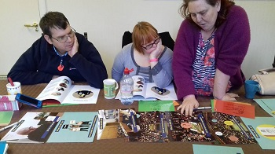
Case Studies
Notes:
Wayne
The preliminary feedback from clients and their carers has been positive for both the project installations and prescribing team installations. Clients and carers are saying this equipment is life changing. In addition early indications seem to show that his approach may also have cost benefits to commissioners of care.
We are hoping this may be a win , win for all concerned but we need much more scrutiny over a greater client base and time to confirm the final evaluation findings.
Although we still have to carry out our final evaluation, we do have some early case studies we can share with you to give you a flavour of our work.
CS1- gent in his mid 20’s with Huntington’s Disease, condition is progressing and he is losing the ability to use his limbs. He is no longer able to use his mobile phone and feels more isolated. The OT had considered prescribing the Possum system to assist him to more safely complete tasks such as turning on/off his lights.
The associated costs: Possum system £4000.
We are to install AT at a cost of £170, relating to a light bulb, a hub and an Alexa.
Not only does the Alexa turn on his light it also allows him to make phone calls and send text messages. His mother is an OT in another authority and it is encouraging that she too sees the value of this technology.
CS2-A gent in his late 40’s lives in a specialist 24 hour residential care home. His needs are mental health and alcohol related. He has a disturbed sleep pattern and it is reported he is often up during the night when he damages items/property in his room. On one occasion he has set fire to his curtains.
The care staff requested 1:1 care over night to prevent this reoccurring at a cost of £2k per week. This was in addition to the £500 per week residential fee.
We installed smart devices including a Nest protect and a Hub with a motion senor. The combined cost of this was £230 and we were to able to remove the 1:1 care as whenever he got up from his bed a text message was sent to a care who would then respond and check on him. (We have provided the internet connection as part of the Test Bed trial, should the need remain beyond the trial period then the Social Worker/Service manager will need to consider how this can continue without our internet connection).
CS3- An elderly lady with dementia has Telecare installed, she has a tendency to leave her home regularly and at times up late at night or early morning. Whenever her door is opened this sends an alert to the call centre which in turn usually results in a warden being dispatched to check on her. Often she is at home safe and well and the call out by the warden has been unnecessary. This lady has a long history of having around 200 alerts raised with the call centre each month. Telecare were monitoring her address 24/7 equating to 168 hours per week.
In discussions with the family we deployed AT equipment in the property that allowed the family to receive alerts as well as Telecare. Once the family were satisfied that they could have confidence in the AT system we reduced the level of monitoring by the call centre to cover those times the family were not available to respond. This equated to the call centre reducing their monitoring to 30 hours per week. The family report the initial results are good and they feel more relaxed knowing first hand what is happening with their mother. Because their mother is using a GPS system, this allows them to go straight to her when she has wandered from the home. Not having to call the Police is a support to them also.

Slide 9
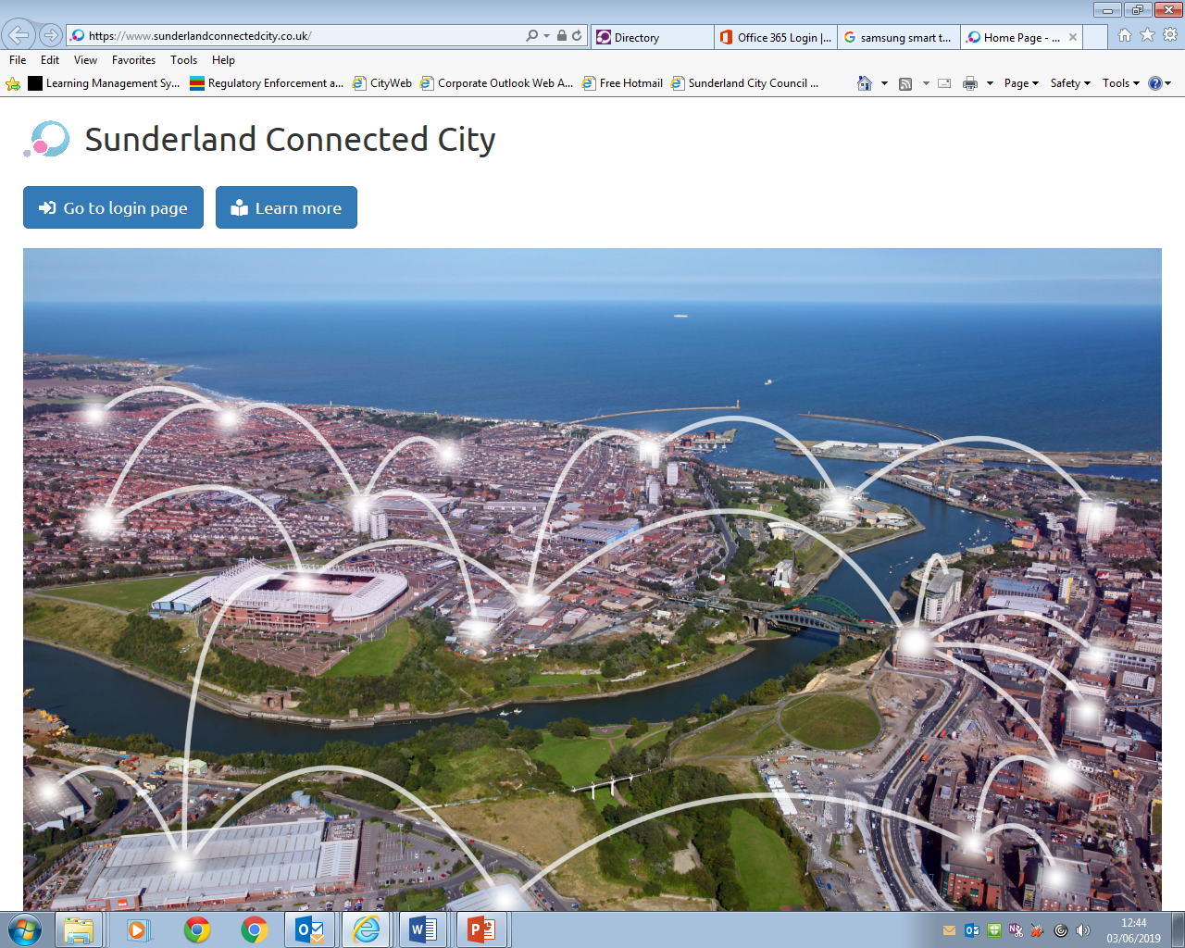
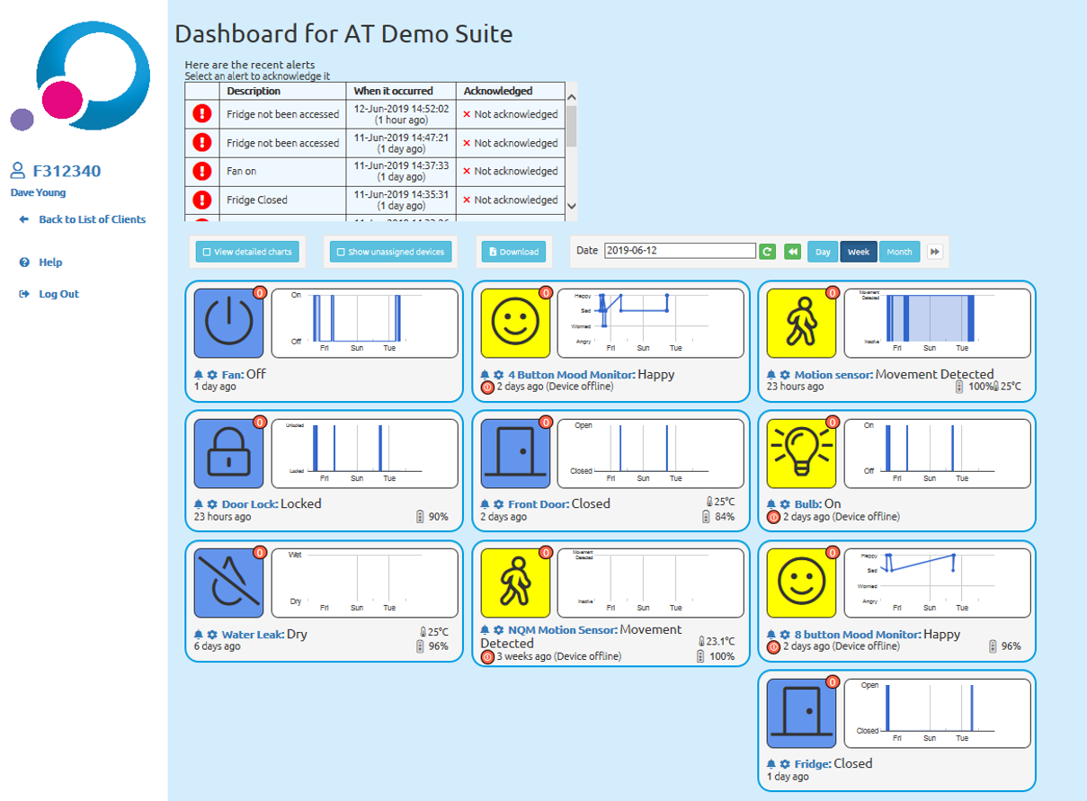
Sunderland Connected City core
https://www.sunderlandconnectedcity.co.uk/
Notes:
Dave
This slide provides a typical example of a participants view or what their family/informal carer may see on our assessment platform.
We have attempted to make the view as user friendly as possible and it was designed following feedback from a number of user workshops.
You can see there are a number of tiles which correspond with the devises installed in the participants home. In this example we have included power socket, Door lock, mood reporting, temperature, door ,battery life and movement around the home.
The number of internet of things devices that can be installed in a persons home is quite extensive and can include movement devices, fridge and cupboard sensors, light bulbs, basically any internet of things devices device which on the market can be connected. It is possible to connect cameras but for privacy and data protection reasons this project isn’t looking to do that.
If you notice some tiles in their right hand corner have a little red box with a number displayed in it. This denotes the amount of times that particular device has been activated that day. In addition to that if a devices hasn’t been activated during the 24 hr period, at the bottom of each tile it is shown when it was last activated.
The graphs on each tile also give an indication of when a device was activated and some change has occurred and if you put your mouse or finger on parts of the map it will pop up with more information. This include the date and time the device was triggered.
The user sessions feedback was that this was quite difficult to see and so we have also built in at the top right had of the screen the ability to look at a more detailed view and a user can choose to display the view for a day , week or month.
The very top chart also displays the alerts that will have been generated and if they have been responded to.
We recognise that this is just a prototype to prove the concept and it has some short comings. Particularly in terms of machine learning and not being able to learn a participants lifestyle patterns yet, which means it requires a lot more human eye scrutiny over the tiles to spot anomalies to patterns of behaviour.
To address this we have some future plans.

Slide 10
What are the future plans
Apply for additional grant via Pathfinder fund, supported by NHS digital
Perform a design stage and develop an improvement plan to scale the pilot up.
Implement improvements to the Core and Devices
Implement a sustainable business model, which can support regional and national upscale
Notes:
Wayne
Our future plans include:
Being able in the future to migrate those residents setting up DIY Techcare and give them the opportunity of using the Sunderland Core.
For those people with DIY Techcare, we hope in the future if their needs change and they do require our traditional Telecare, then we can build upon the tech they have and blend it with Telecare equipment.
We have applied for additional grant via Pathfinder fund, supported by NHS digital, if successful we would receive 50k to:
Perform a design stage and develop an improvement plan to scale the test bed pilot up. The plan developed at this design stage would incorporate the improvements we would make to the core, the devices and the resources/business model we would need to deliver these improvements.
If our design plan is successful in being chosen by the pathfinder funders, then we would progress to receive a sum of additional funding of up to 325k to implement the proposals contained in our design plan.

Slide 11
Questions & answers

