Slide 1
Housing LIN eastern region 11 June 2019
Key steps to successful planning applications
by
Iain Warner
Director, Tetlow King Planning

Slide 3
Seven P’s of Planning
roper
lanning and
reparation
revents
articularly
oor
erformance
P

Slide 4
Plan Making – Stages of Preparation
Evidence gathering (including Call for Sites, etc)
Issues and Options
Preferred Options (Regulation 18 stage)
Pre-submission Consultation (Regulation 19 stage)
Matter statements
Examination in public

Slide 5
Policy Examples – SHMA Supporting Evidence
6.5 The Objectively Assessed Need projections supplied by Edge Analytics indicate that the population aged 65 or over is going to increase dramatically over the plan period from 134,682 in 2015 to 205,906 in 2037, a rise of 52.9%
6.11 If it is presumed that occupation patterns remain at current levels then there is a requirement for 7,746 additional specialist units of which 7,157 should be sheltered housing and 319 extra care housing.
The requirement for 7,746 additional specialist units for older people represents 10.4% of the total Objectively Assessed Need for the period 2014 to 2037

Slide 6
Policy LP 10 Care, Independent Assisted Living
To meet the care needs of our future generations and generate growth in the care, independent and assisted living sector in line with the Economic Development Strategy, the Council will support the construction of high quality care homes and extra-care housing in sustainable locations. The Council will also work with the NHS, Essex County Council, care providers, educational establishments and businesses to promote technological advancements in the provision of care, improvements in training and qualifications for care professionals and support growth in the ‘supply chain’ industries related to care and assisted living.
The Council will support the provision of care homes and extra care housing within settlement development boundaries and, in particular, within the mix of accommodation for the residential and mixed-use developments across the District.
The Council will also consider, on their merits, proposals for the development of new (including change of use to) care homes (Use Class C2) on land outside of settlement development boundaries where they will still support a sustainable pattern of growth in the District. Such developments must either:
be located on a site safely accessible on foot within 800 metres of the edge of the settlement development boundary of one of the District’s ‘strategic urban settlements’, ‘smaller urban settlements’ or ‘strategic rural service centres’; or
be located on a site safely accessible on foot within 400 metres of the edge of the settlement development boundary of one of the District’s ‘rural service centres’.

Slide 7
Community Consultation
Who do we mean?
Local planning authority
Local interest groups
Local residents / residents association
Who else?
Adult Social Care
Clinical Commissioning Group

Slide 8
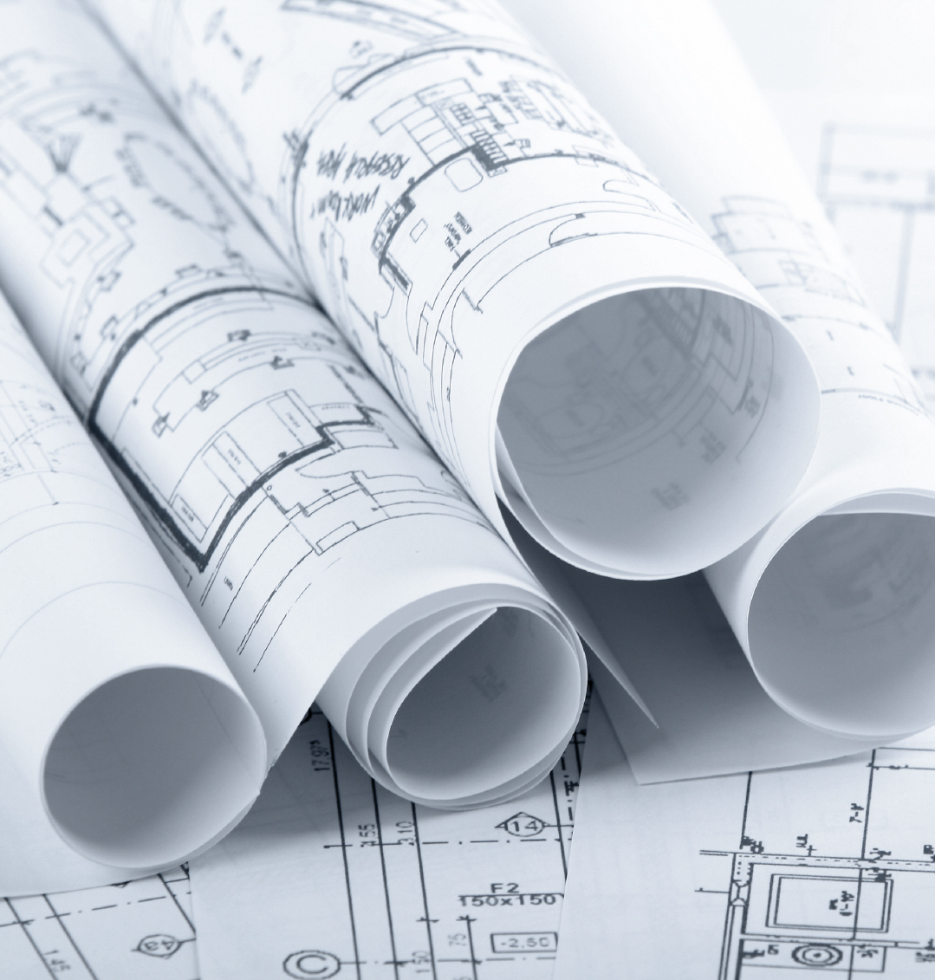
Planning Applications
Technical Jargon or Laymen terms
Teaching or Preaching
Evidenced based approach
Needs vs Benefits
Balancing arguments

Slide 9
Needs vs Benefits: West Malling Appeal Extra Care Proposal in the Green Belt (December 2018)
63… Substantial weight is accorded to the overall harm to the Green Belt albeit that the harm to openness and encroachment is mitigated by the site’s visual containment and limited public visibility. Nevertheless there are a number of other considerations to weigh against that harm.
64. I accord significant weight to the contribution that the development would make to general housing supply given the lack of a 5 year housing supply in the Borough, including through the likely consequential release on to the market of family housing as older residents move to the proposed development.
65. I accord substantial weight to the contribution that the development would make towards the need for specialist extra care housing for sale to older people which was not accurately estimated in the SHMA and for which the current and emerging development plan does not make adequate provision.
66. I accord significant weight to the health and well-being benefits for the future occupiers of the development…
68. My overall conclusion is that these other considerations cumulatively clearly outweigh the harm to the Green Belt and as such qualify as very special circumstances. As the demonstration of very special circumstances accords with national policy the proposed development does accord with CS Policy CP3 and the other identified conflicts with the development plan are outweighed by other material considerations. The appeal should therefore be allowed.
[Ref: APP/H2265/W/18/3202040]
Notes:
It is all too easy to get bogged down with these schemes with the matter of ‘need’ as we all secretly love being able to make a numbers case. It is accepted at all levels of government that we are an ageing society and that the growth rate of the older population is much greater than that of any other existing age cohort now and for the next 20 years. If I take one example of this, within South Oxfordshire the council’s own evidence base to support its emerging local plan suggests that the overwhelming majority of the household growth over the plan period is within the over 65s age cohort. However, the needs argument is only part of the case that is required to justify a development.
The perfect recent example of this would be the appeal decision from December 2018 for an extra care proposal within Tonbridge and Malling district (an appeal that I was involved with as the lead planning consultant). This was a site within the Green Belt and refused locally for a series of reasons. As part of the evidence we provided a detailed needs case to justify the development in pure numbers, however alongside that we also set out a detailed case to demonstrate that such developments are capable of delivering considerable benefits through the freeing up of housing as well as social and well-being benefits for older people who would move into the development. These were all factors that weighed together amounted to the required Very Special Circumstances that justified the development.
Contrary to much of what was alluded to in subsequent write-ups of the appeal decision, the Inspector was very mindful of the WMS that set out need alone is unlikely to amount to very special circumstances, indeed he addressed it clearly within his decision stating:
25. I conclude that the overall shortfall in housing supply is one significant factor to be weighed in the balance but is unlikely on its own to clearly outweigh the harm to the Green Belt.

Slide 10
Virginia Water – extra care proposal in the Green Belt (February 2019)
33. It is not necessary for me to reach a conclusion on the need and supply of this type of housing because even if I were to accept the appellant’s position on these matters, together with the other considerations in favour of development identified, these would attract no more than significant weight cumulatively. This would not be sufficient to outweigh the GB harm alone, let alone the cumulative harm that I have identified…
I have concluded that the development would harm the GB and this harm attracts substantial weight. In addition, I have attached significant weight to the harm that would result to the character and appearance of the area. I have had regard to the considerations in favour of the development which I have attached significant weight but these are not sufficient, even cumulatively, to outweigh the harm. Consequently, the very special circumstances necessary to justify the proposed development have not been demonstrated.
[Ref: APP/Q3630/W/18/3195463]
Notes:
It is important to recognise this when considering sites as even when an applicant believes that the needs case is very strong, in the context of a green belt proposal that is not enough to provide certainty of success. A perfect demonstration of this was a similar case put forward to justify another Green Belt development for the same client in Runnymede where the decision was issued post West Malling. In that appeal, despite running similar overall arguments over need, the Inspector concluded:
33. It is not necessary for me to reach a conclusion on the need and supply of this type of housing because even if I were to accept the appellant’s position on these matters, together with the other considerations in favour of development identified, these would attract no more than significant weight cumulatively. This would not be sufficient to outweigh the GB harm alone, let alone the cumulative harm that I have identified…
38. I have concluded that the development would harm the GB and this harm attracts substantial weight. In addition, I have attached significant weight to the harm that would result to the character and appearance of the area. I have had regard to the considerations in favour of the development which I have attached significant weight but these are not sufficient, even cumulatively, to outweigh the harm. Consequently, the very special circumstances necessary to justify the proposed development have not been demonstrated. [Ref: APP/Q3630/W/18/3195463]
This is a perfect example of similar weight being given to wider benefits of such specialist schemes but the degree of harm differing. It is also worth noting that the approach to determining need in the two appeals differed despite in both cases the council’s moving towards new local plans. In the West Malling scenario the Inspector accepted that the emerging plan failed to properly plan for the needs of older people and therefore felt able to make a judgement on the matter for himself, whereas in Runnymede despite significant objections to the council’s proposed approach of identifying the level of need and planning for delivery the Inspector felt unable to make a judgement for himself at the appeal. If nothing else it justifies the need to fully engage at local plan level for applicants, whilst for council’s it shows the need to consider properly what the likely need is for such specialist housing and how to plan to deliver it (although I would advocate not adopting the approach of Runnymede as a means of doing this).

Slide 11
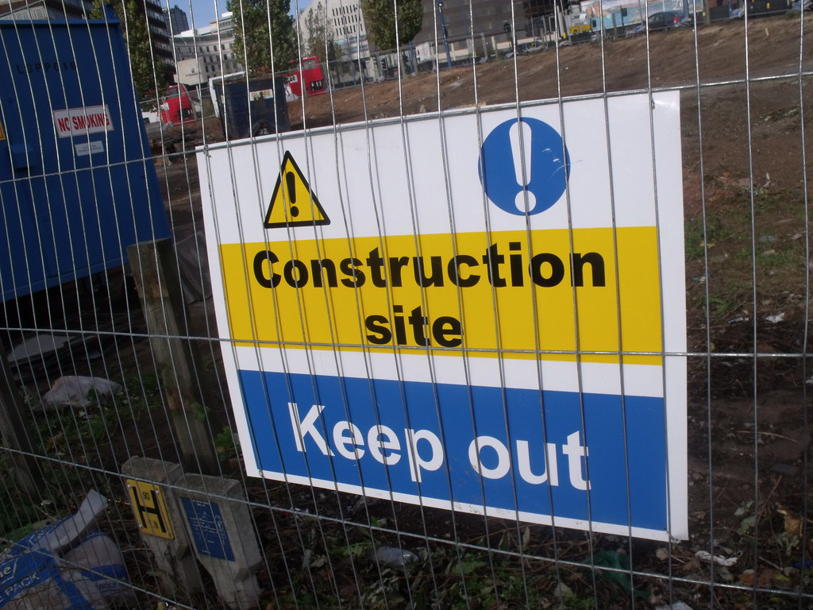
Delivery
Compliance
Conditions
s106
Site visits
During construction
Post completion
Why?

Slide 12
Conclusion
vs

