Slide 1
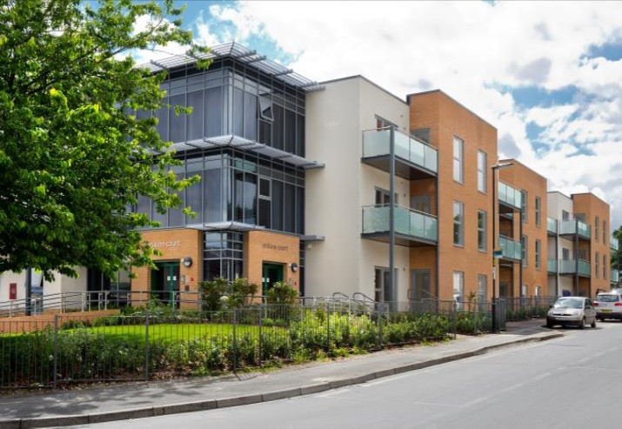
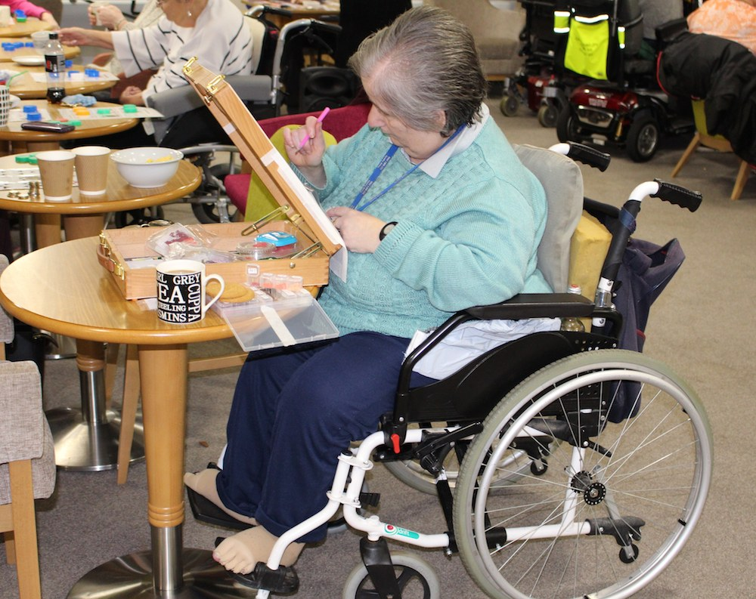
Demonstrating the Health and Social Care Benefits of Housing with Care
Dorota Strzelecka – Commissioner - Market Development Lead

Slide 2
About today
Need to better understand the impacts on HwC on the health system
Joint-working with Housing LIN
Findings of the report

Slide 3
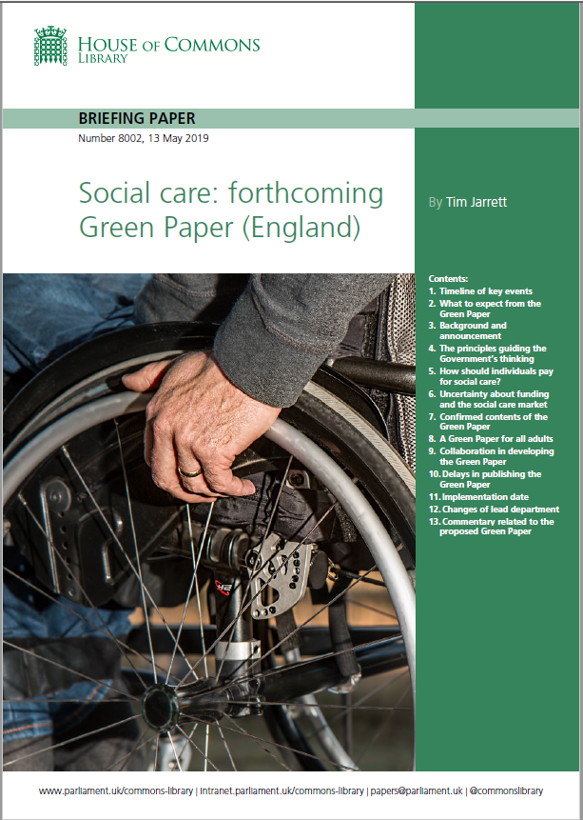
National Context
Stress on independence, and person-centred approaches to care and support
Community-based support and building community resilience
Further integration of services – health/ social care/ VCSs
Place-based commissioning
Housing with Care seen as one of the fundamentals of social care going forward

Slide 4
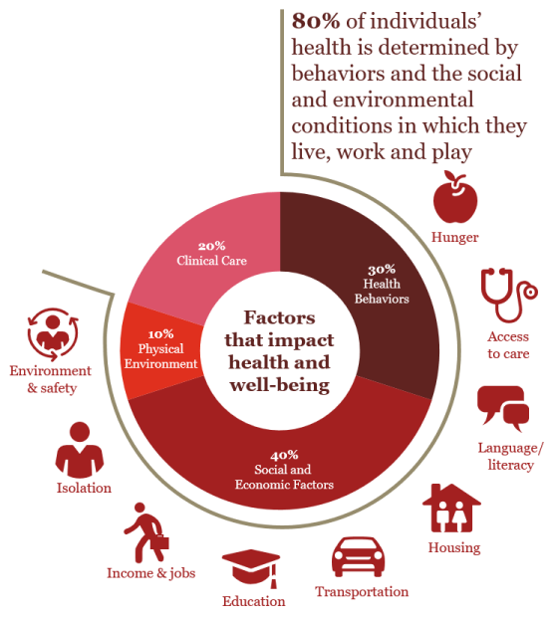
Local response to national policy
Holistic view of the person
Broader understanding of health - seen in the context of wellbeing
Significant focus on deprivation and health inequalities
Focus on communities
Regeneration and re-development to promote growth and community development
https://www.pwc.com/us/en/industries/health-services/case-for-intervening-upstream.html

Slide 5
Response to local need
54th most deprived city in England (out of 326 LAs)
Significant health inequalities within the city
35th out of 201 CCGs in terms of inequalities in the rates of emergency admissions for some urgent care sensitive conditions
46% of city residents with at least one LTC
DToC – benchmarking with other areas suggest improvement needed
Ageing population – to increase by 12% by 2023

Slide 6
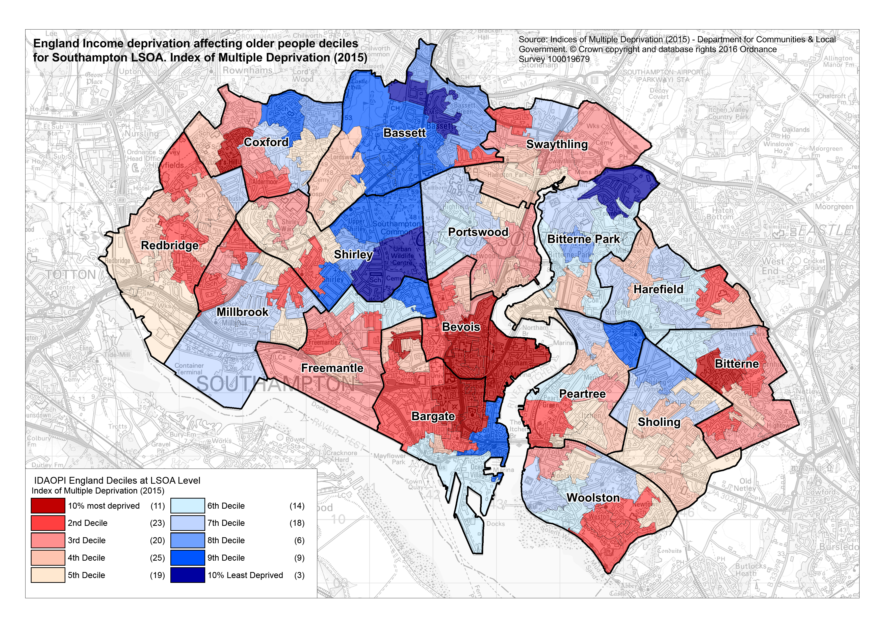

Slide 7
Housing with Care as enabler for change
‘Home First is as much a system mind-set as a service. It means always prioritising and, if at all possible, trying to get someone back to their usual place of residence before considering other options, because
home is best.’
Alternative to residential care
Improved social/care outcomes for residents
Developing Community Hubs to support area engagement
Links with health – appropriate assessment and ongoing care needs
Part of place-shaping strategies

Slide 8
Additional Considerations
New scheme to open in 2020 – vision for holistic care
GP services – opportunities for improved collaboration
Community Nursing – to support higher needs
Promoting the model
Opportunities for joint developments with NHS partners
Land optimisation project
Financial and benefit modelling
Ultimately – planning and policy development to improve outcomes and customers’ experience of care

Slide 9
About the research
Literature review of available materials and data used to estimate system wide benefits
Impacts on the following service areas:
GP services
Community nursing services
Non-elective admissions to hospital
Length of stay and discharges from hospital
Ambulance call outs
Financial cost-benefits
Investment potential and return in the context of SCC’s HwC growth strategy

Slide 10
Findings
Limited evidence available
Cost benefits identified for all impact areas
Robust assumptions used
All research points to improved quality of life and satisfaction for residents
Evidence of savings in addition to benefits to ASC

Slide 11
GP surgeries:
46% usage reduction after a year
£144.78 pp/per year
Community nursing:
Increase in proportion of residents visited (32% vs 73%)
Mean number decreased from 12 to 6 visits
£326.55 pp/per year
Non-elective Hospital Admissions:
More appropriate care, shorter time in hospital
£624.11 pp/per year
Length of hospital stay and discharges:
Reduction for unplanned stays from median 5-7 days to 1-2 days
£465.30 pp/per year
Ambulance call-outs:
Mostly related to improved falls management
1.5 to 2.8 x reduction in falls
£380 pp/per year
TOTAL COST-BENEFIT TO HEALTH
£1,976.74 pp/per year

Slide 12
What does it mean for Southampton?
Strategy to deliver 450 units over the next ten years
Health savings: £2,000 pp per year
Social care savings: £6,000 pp per year
Total: £8,000 pp per year
Strategic system benefit: up to £3,600,000 per year
Other benefits – regeneration of areas, downsizing, improved individual and community outcomes

Slide 13
What’s next?
Publication due very shortly
One City Approach to HwC – development and service delivery
Long term communications strategy to engage with health and VCSs
Community Hubs and colocation of services (e.g. libraries)
Highlighted need for longitudinal research into HwC
Broader public debate about options for later life

Slide 14
Any questions/ thoughts?
Dorota.Strzelecka@southampton.gov.uk

